Slide 1
Computer Graphics
Lecture 4
Geometry & Transformations

Slide 2
Some Basics
Basic geometric types.
  Scalars s
  Vectors v
  Points p = O + s * v
Transformations
  Types of transformation: rotation, translation, scale.
  Matrix representation
  Order ？
Geometric modelling
  Hierarchical modelling
  Polyhedral shapes.

Slide 3
Transformations
What is a transformation?
P′=T(P)
Why use them?
Modelling
  - Create objects in natural/convenient coordinates
  - Multiple instances of a prototype shape
  - Kinematics of linkages/skeletons - robot animation
Viewing
  Windows and device independence
  Virtual camera: parallel and perspective projections
Notes:
Transformations are very important.

Slide 4
Types of Transformations
Continuous (preserves neighbourhoods)
One to one, invertible
Classify by invariants or symmetries
   Isometry (distance preserved)
  Reflections (interchanges left-handed and right-handed)
  Rigid body motion: Rotations + Translations
   Similarity (preserves angles)
  Uniform scale
   Affine (preserves parallel lines)
  Non-uniform scales, shears or skews
   Collineation (lines remain lines)
  Perspective
   Non-linear (lines become curves)
  Twists, bends, warps, morphs, ...

Slide 5
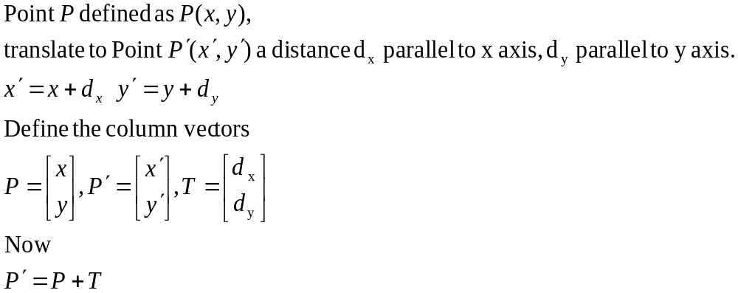
2D Translations
P’
P

Slide 6
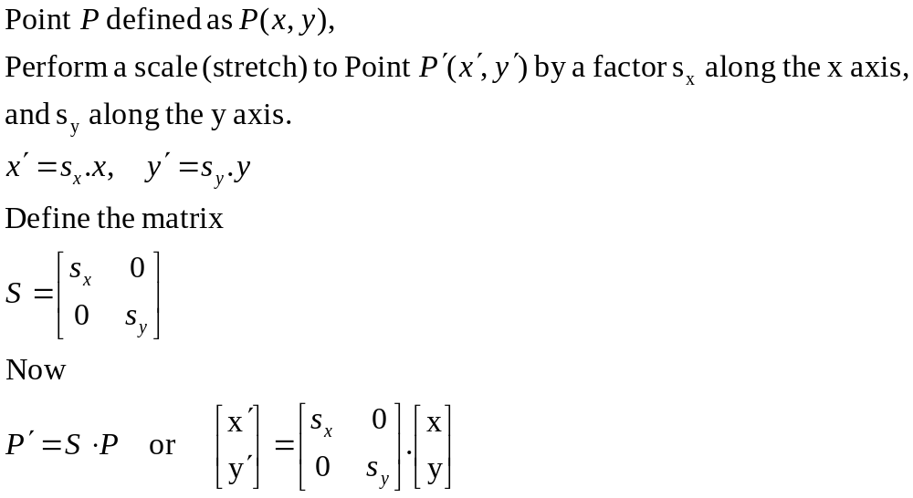
2D Scaling from the origin
P’
P

Slide 7
2D Rotation about the origin
y
θ
P’(x’,y’)
P(x,y)
r
r
x

Slide 8
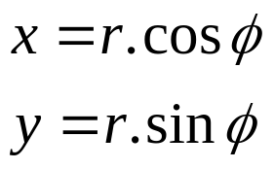
2D Rotation about the origin.
y
P’(x’,y’)
P(x,y)
r
θ
y
φ
r
x
x

Slide 9
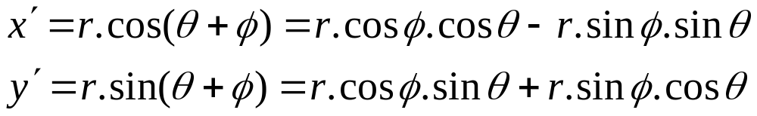
2D Rotation about the origin.
y
P’(x’,y’)
P(x,y)
r
θ
y
φ
r
x
x

Slide 10
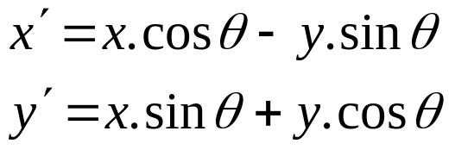
2D Rotation about the origin.
Substituting for r :
Gives us :

Slide 11
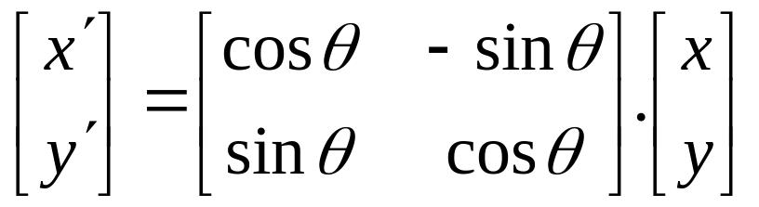
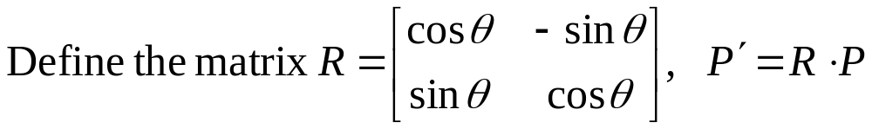
2D Rotation about the origin.
Rewriting in matrix form gives us :

Slide 12
Transformations.
Translation.
  P′=T + P
Scale
  P′=S ⋅ P
Rotation
  P′=R ⋅ P
We would like all transformations to be multiplications so we can concatenate them ⇒ express points in homogenous coordinates.

Slide 13
Homogeneous coordinates
Add an extra coordinate, W, to a point.
  P(x,y,W).
Two sets of homogeneous coordinates represent the same point if they are a multiple of each other.
  (2,5,3) and (4,10,6) represent the same point.
At least one component must be non-zero ⇒ (0,0,0) is not defined.
If W≠ 0 , divide by it to get Cartesian coordinates of point (x/W,y/W,1).
If W=0, point is said to be at infinity.
Notes:
V. important

Slide 14
Homogeneous coordinates
If we represent (x,y,W) in 3-space, all triples representing the same point describe a line passing through the origin.
If we homogenize the point, we get a point of form (x,y,1)
  homogenised points form a plane at W=1.
W
P
W=1 plane
X
Y

Slide 15
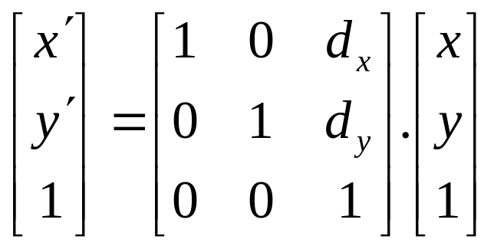
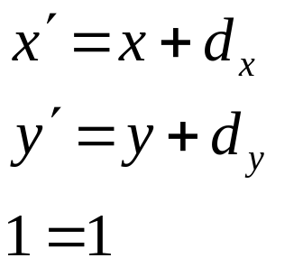
Translations in homogenised coordinates
Transformation matrices for 2D translation are now 3x3.

Slide 16
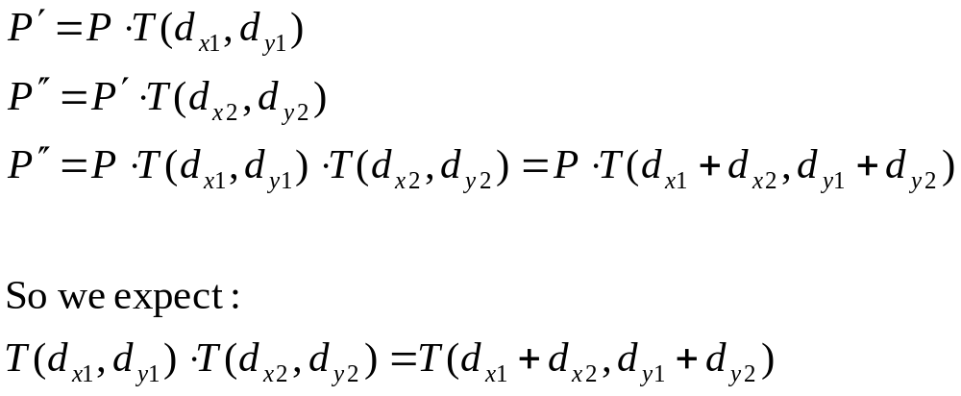
Concatenation
We perform 2 translations on the same point:

Slide 17
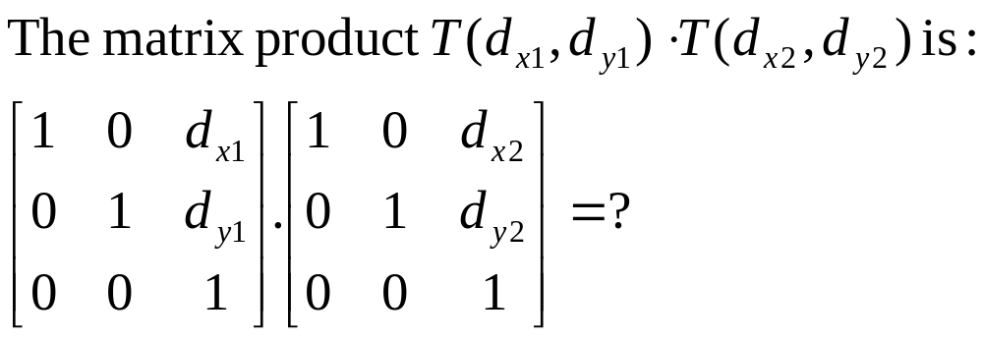
Concatenation.
Matrix product is variously referred to as compounding, concatenation, or composition

Slide 18
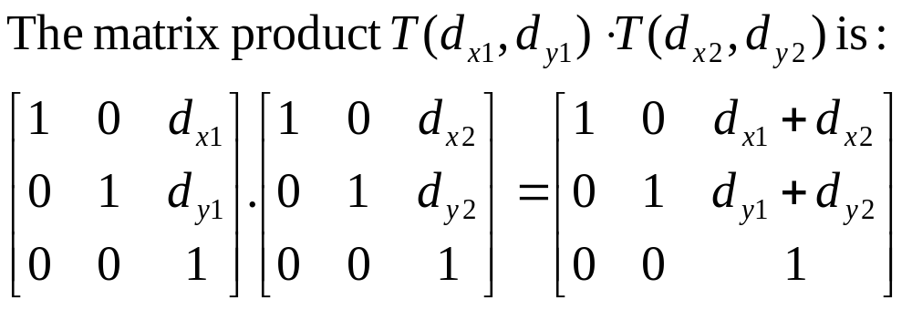
Concatenation.
Matrix product is variously referred to as compounding, concatenation, or composition.
This single matrix is called the Coordinate Transformation Matrix or CTM.

Slide 19
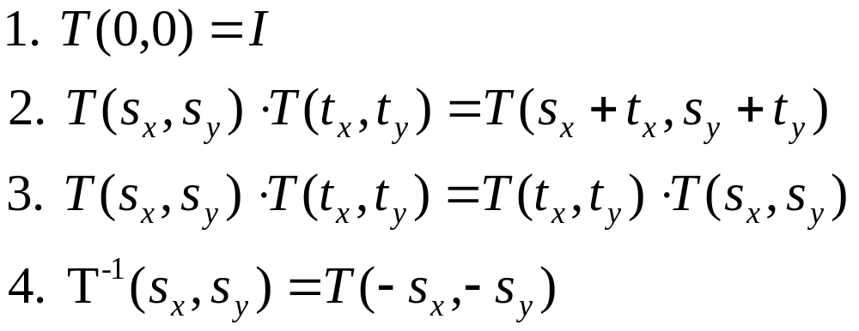
Properties of translations.
Note : 3. translation matrices are commutative.

Slide 20
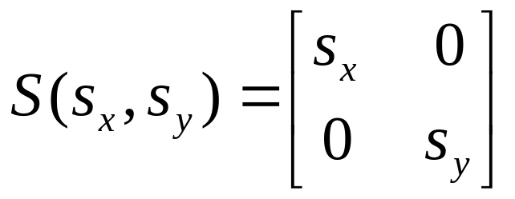
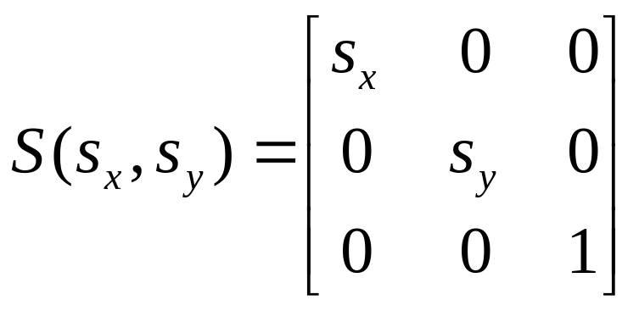
Homogeneous form of scale.
Recall the (x,y) form of Scale :
In homogeneous coordinates :

Slide 21
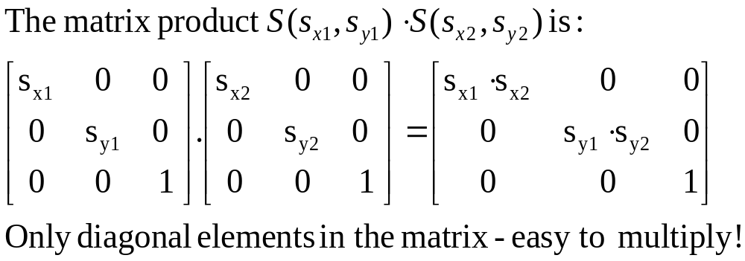
Concatenation of scales.

Slide 22
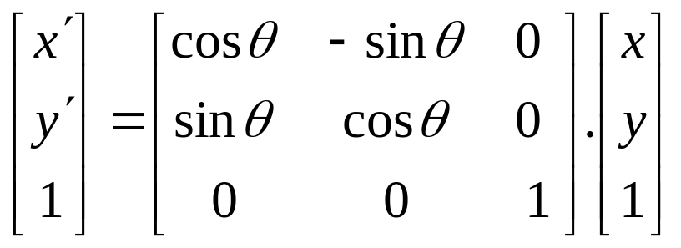
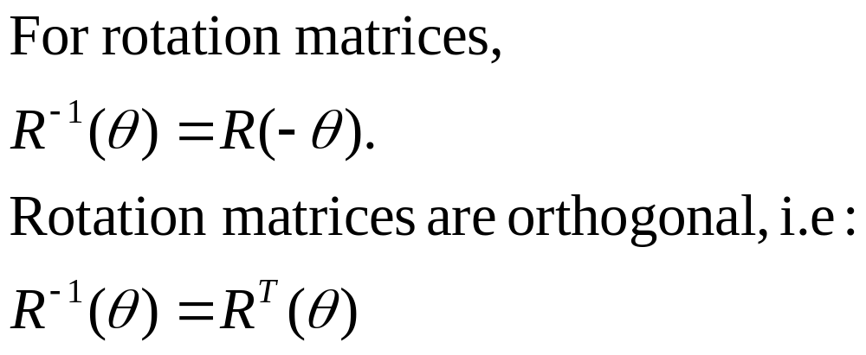
Homogeneous form of rotation.

Slide 23
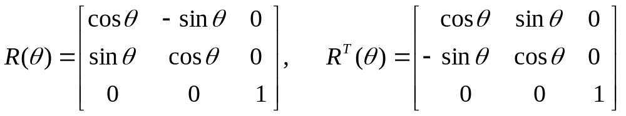
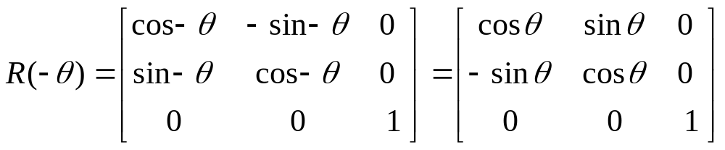
Orthogonality of rotation matrices.

Slide 24
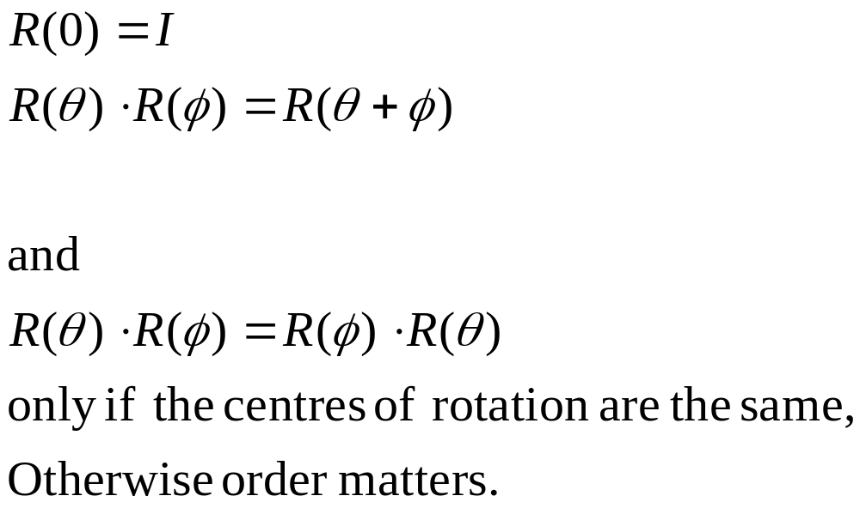
Other properties of rotation.

Slide 25
Types of transformations.
Rotation and translation
  Angles and distances are preserved
  Unit cube is always unit cube
  Rigid-Body transformations.
Rotation, translation and scale.
  Angles & distances not preserved.
  But parallel lines are.
  Affine transformations.

Slide 26
3D Transformations.
Use homogeneous coordinates, just as in 2D case.
Transformations are now 4x4 matrices.
We will use a right-handed (world) coordinate system - ( z out of page ).
y
Note:
Convenient to think of display as
Being left-handed !!
( z into the screen )
x
z (out of page)

Slide 27
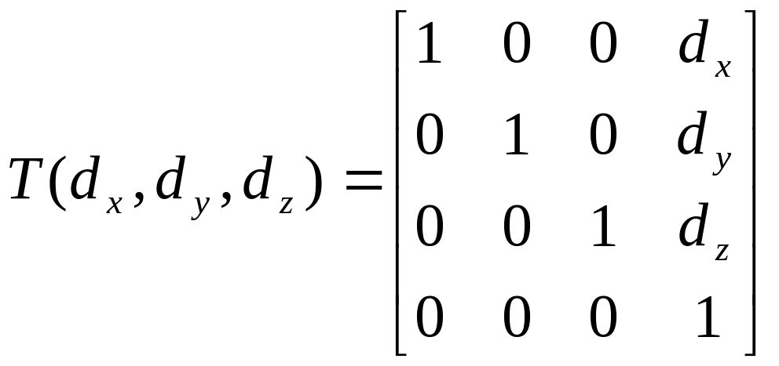
Translation in 3D.
Simple extension to the 3D case:

Slide 28
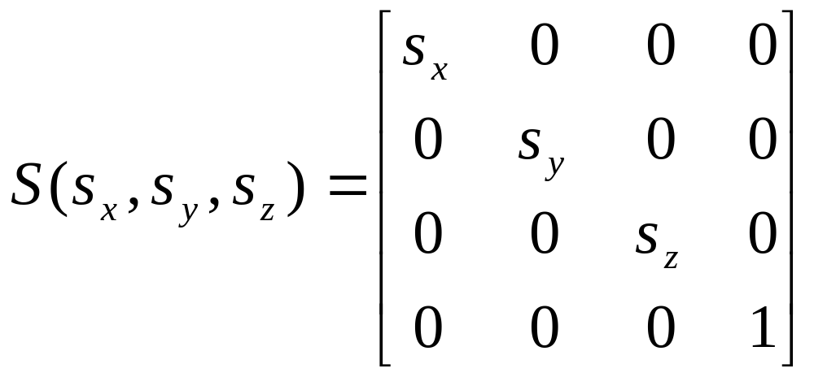
Scale in 3D.
Simple extension to the 3D case:

Slide 29
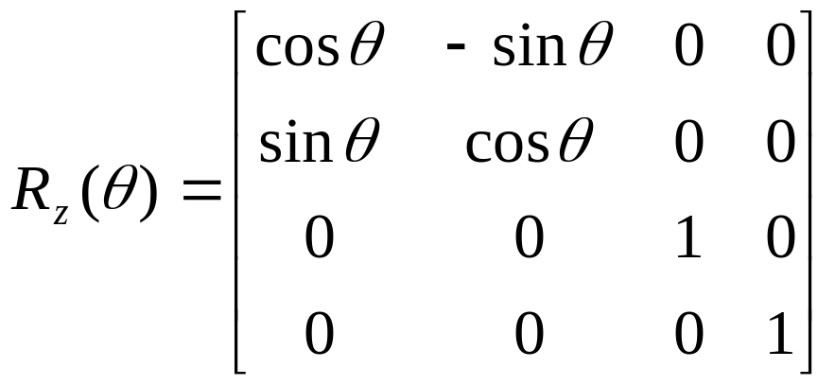
Rotation in 3D
Need to specify which axis the rotation is about.
z-axis rotation is the same as the 2D case.

Slide 30
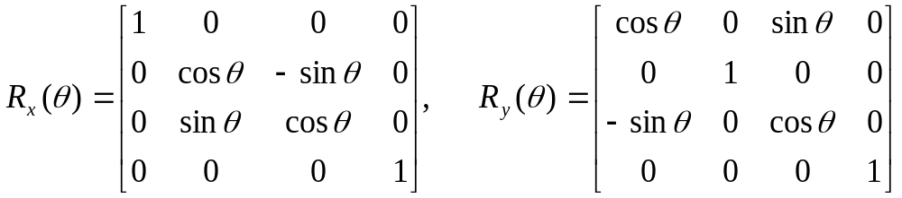
Rotation in 3D
For rotation about the x and y axes:

Slide 31
Rotation about an arbitrary axis?
Hard!
But we know how to rotate about the major axes.
So turn required rotation into one about major axis.
We need to translate arbitrary axis a to pass through origin, rotate to align with major axis, perform rotation, and rotate and translate back to original position.
Say M_{z} is the compound transformation to translate and rotate a to align with z-axis, then M_{z}⁻¹ is the reverse transformation required to restore a to its original position.
Ignore translation for present, a passes through origin…..

Slide 32
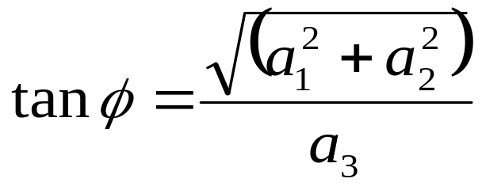
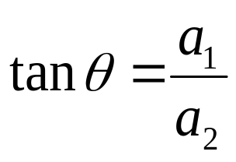
How do we define M?
M transforms a into a vector along the z-axis, ie. Ma = k
Construct the rotation matrix R(α) as follows:
R_{a} (α) = M⁻¹R_{z}(α)M
A suitable M⁻¹can be found with a little effort, ie. M⁻¹k = a
First define axis direction a as a unit vector as:
a = (a₁,a₂,a₃) = R_{z}(-θ)R_{x}(-φ)k = (sinφsinθ, sinφcosθ, cosφ)
Thus:
and:

Slide 33
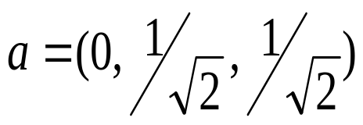
Rotation about arbitrary axis
So: M⁻¹ = R_{z}(−θ)R_{x}(−φ) and therefore: M = R_{x}(φ)R_{z}(θ)
And the full expression for a rotation about an arbitrary axis is:
R_{a}(α) = T⁻¹R_{z}(−θ)R_{x}(−φ)R_{z}(α)R_{x}(φ)R_{z}(θ)T
Example: consider axis through origin,
Thus φ = 45º and θ = 0º and
R_{a}(α) = R_{x}(-45º)R_{z}(α)R_{x}(45º)

Slide 34
Computer Graphics
Projection, Clipping and Mathematics of 3D Viewing

Slide 35
Parallel projections.
Specified by a direction to the centre of projection, rather than a point.
  Centre of projection at infinity.
Orthographic
  The normal to the projection plane is the same as the direction to the centre of projection.
Oblique
  Directions are different.

Slide 36
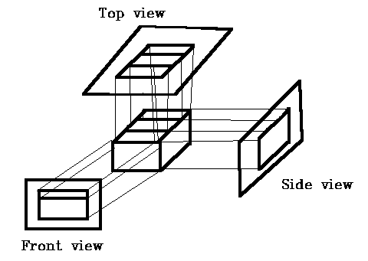
Orthographic projections.
Most common orthographic
Projection :
Front-elevation,
Side-elevation,
Plan-elevation.
Angle of projection parallel to principal axis; projection plane is perpendicular to axis.

Slide 37
Axonometric orthographic projections.
Projection plane not normal to principal axis.
Show several faces of the object at once.
Foreshortening is uniform rather than being related to distance.
Parallelism of lines is preserved.
Angles are not.
Distances can be measured along each principal axis ( with scale factors ).

Slide 38
Isometric projection.
Most common axonometric projection.
Projection plane normal makes equal angles with each axis.
i.e normal is (d_{x},d_{y},d_{z}), |d_{x}| = |d_{y}|=|d_{z}|
Only 8 directions that satisfy this condition.

Slide 39
Isometric projection.
y
y
Normal
120º
120º
120º
x
z
x
Projection
Plane
All 3 axes equally foreshortened
measurements can be made
Hence the name iso-metric
z

Slide 40
Oblique projections.
Projection plane normal differs from the direction of projection.
Usually the projection plane is normal to a principal axis.
  Projection of a face parallel to this plane allows measurement of angles and distance.
  Other faces can measure distance, but not angles.
  Frequently used in textbooks : easy to draw !

Slide 41
Oblique projection
Normal
Parallel to x axis
y
x
Projection
Plane
z

Slide 42
Geometry of oblique projections.
y
Projection plane is x,y plane
L=1/tan(β)
- angle between normal and projection
direction
- Determines the type of projection
α is choice of horizontal angle.
Given a desired L and α,
Direction of projection is
(L.cosα, L.sinα,-1)
L.sinα
P´
β
L
z
α
P=(0,0,1)
L.cosα
x
Notes:
Don’t worry too much about this diagram – the properties of the projections are important.

Slide 43
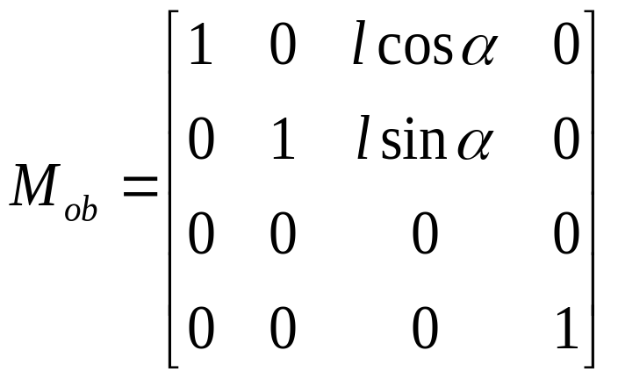
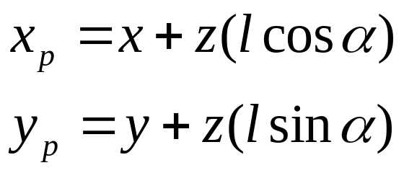
Geometry of oblique projections
Point P=(0,0,1) maps to:
P’=(l.cosα, l.sinα, 0) on xy plane,
and P(x,y,z) onto P’(x_{p},y_{p},0)
and

Slide 44
Mathematics of Viewing
We need to generate the transformation matrices for perspective and parallel projections.
They should be 4x4 matrices to allow general concatenation.
And there’s still 3D clipping and more viewing stuff to look at.

Slide 45
Perspective projection – simplest case.
Centre of projection at the origin,
Projection plane at z=d.
Projection
Plane.
y
P(x,y,z)
x
P_{p}(x_{p},y_{p},d)
d
z

Slide 46
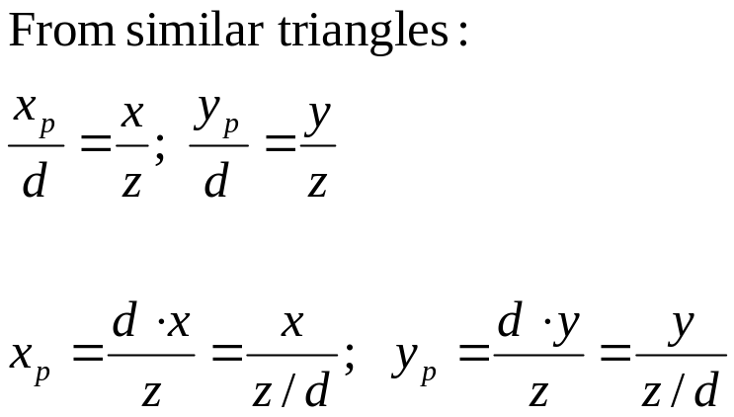
Perspective projection – simplest case.
x
x_{p}
P(x,y,z)
z
d
y
P(x,y,z)
d
x
z
P_{p}(x_{p},y_{p},d)
y_{p}
P(x,y,z)
d
z
y

Slide 47
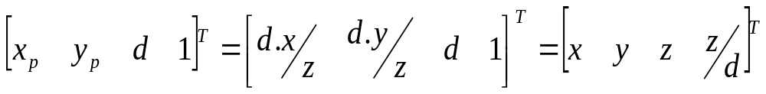
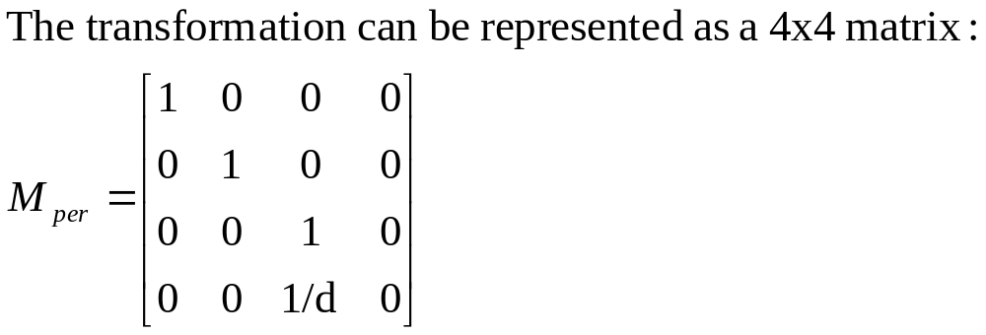
Perspective projection.
Notes:
Important to understand the assumptions we made to derive this.

Slide 48
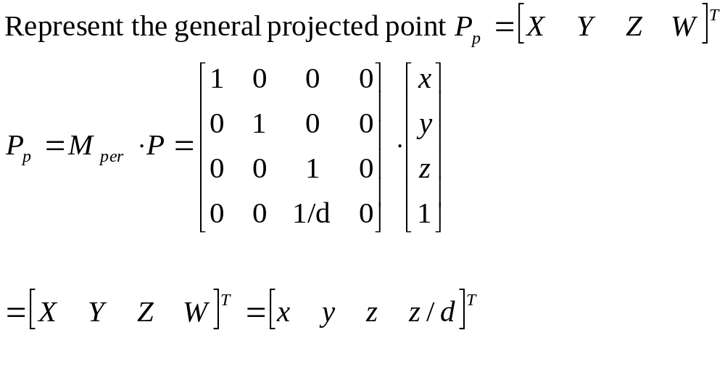
Perspective projection.

Slide 49
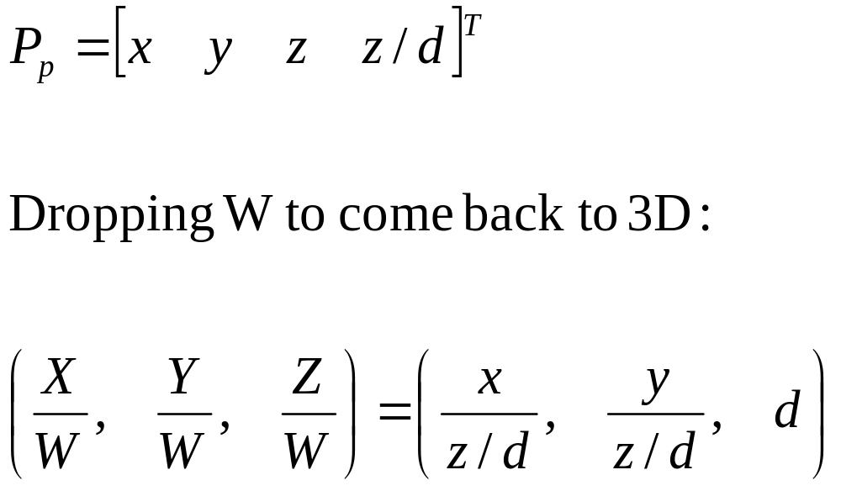
Perspective projection.
Trouble with this formulation :
Centre of projection fixed at the origin.

Slide 50
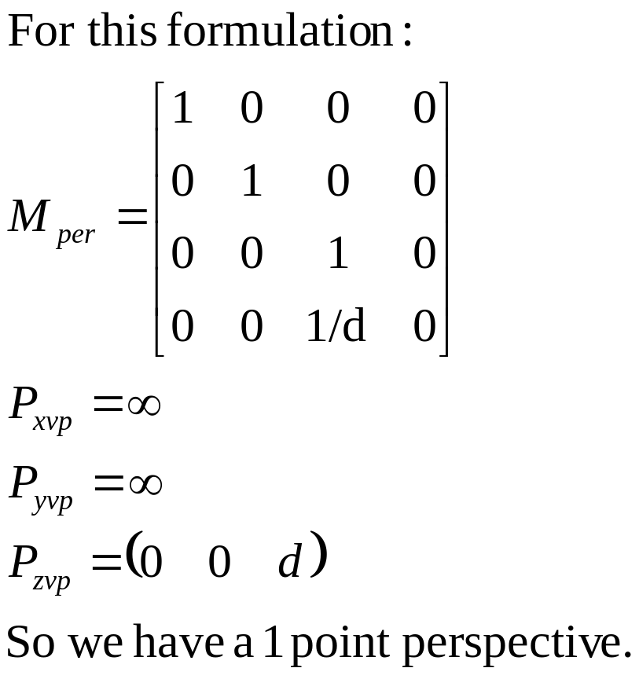
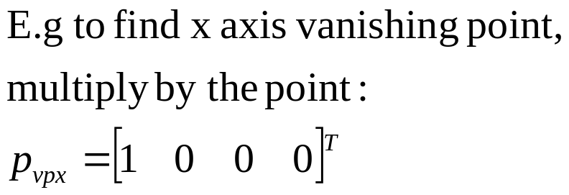
Finding vanishing points.
Recall : An axis vanishing point is the point where the axis intercepts the projection plane → point at infinity.
Notes:
Important principle of finding vanishing points.

Slide 51
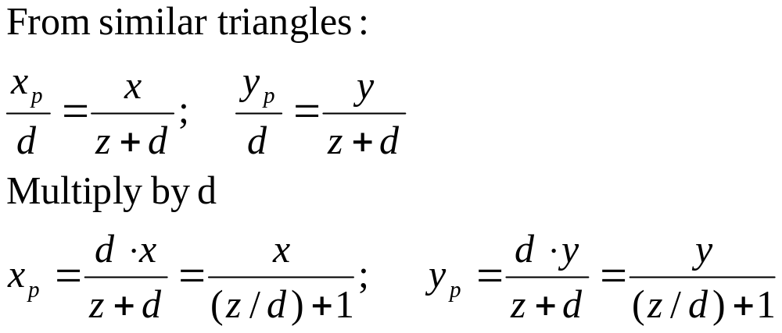
Alternative formulation.
x
d
z
x_{p}
P(x,y,z)
y_{p}
P(x,y,z)
z
y
d
Projection plane at z = 0
Centre of projection at
z = -d

Slide 52
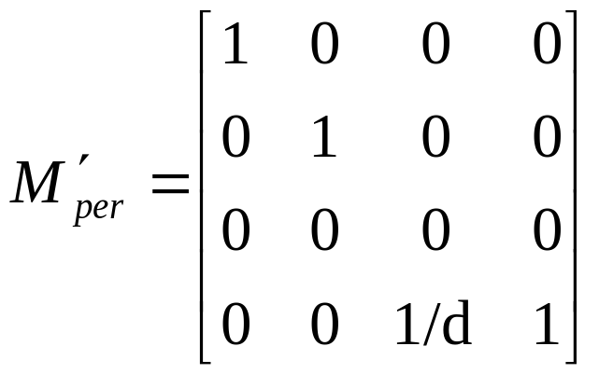
Alternative formulation.
x
d
z
x_{p}
P(x,y,z)
y_{p}
P(x,y,z)
z
y
d
Projection plane at z = 0,
Centre of projection at
z = -d
Now we can allow d→∞

Slide 53
Stereo Projection
Stereo projection is just two perspective projections :
l
Left eye
x
E
r
z
object
E
l
Right eye
r
Max effect at 50cm
display screen

Slide 54
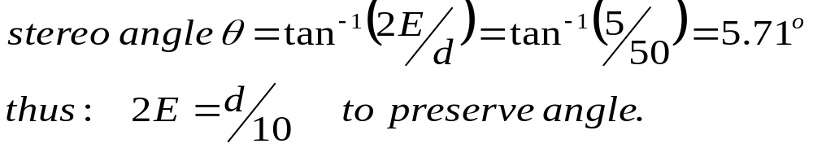
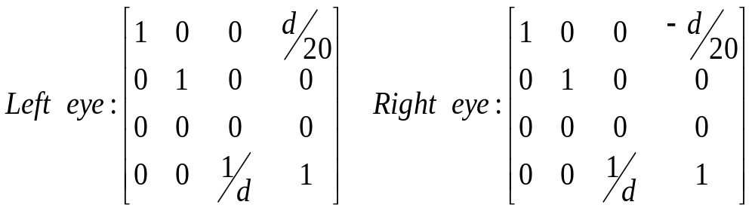
Stereo Projection
E is the interocular separation, typically 2.5cm to 3cm.
d is the distance of viewer from display, typically 50cm.
Let 2E = 5cm:

Slide 55
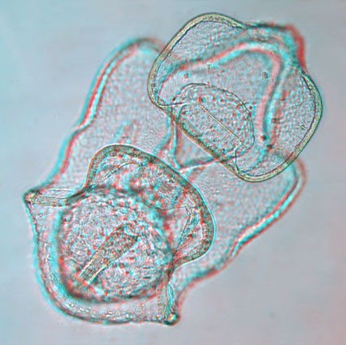
View as an anaglyph

Slide 56
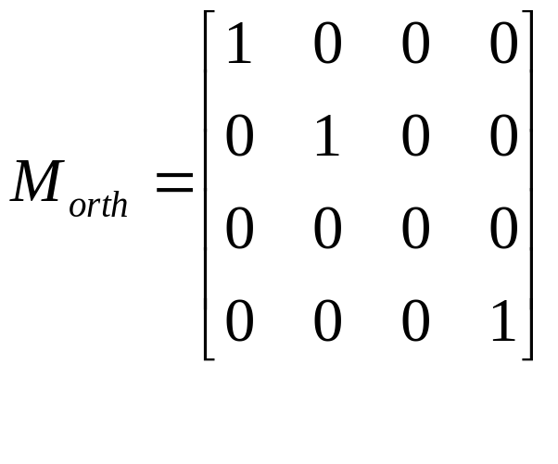
Orthographic projection.
Orthographic Projection onto a plane at z = 0.
x_{p} = x , y_{p} = y , z = 0.

Slide 57
Implementation of viewing.
Transform into world coordinates.
Perform projection into view volume or eye coordinates.
Clip geometry outside the view volume.
Perform projection into screen coordinates.
Remove hidden lines.

Slide 58
3D clipping.
For orthographic projection, view volume is a box.
For perspective projection, view volume is a frustrum.
left
Far clipping plane.
Near clipping plane
Need to calculate intersection
With 6 planes.
right

Slide 59
Speeding up projection.
Can always place camera at origin !
  OpenGL , Renderman.
Much easier to clip lines to unit cube
  Define canonical view volumes.
  Define normalising transformations that project view volume into canonical view volume.
  Clip, transform to screen coordinates.

Slide 60
3D clipping.
Can use Cohen-Sutherland algorithm.
  Now 6-bit outcode.
  Trivial acceptance where both endpoint outcodes are all zero.
  Perform logical AND, reject if non-zero.
  Find intersect with a bounding plane and add the two new lines to the line queue.
  Line-primitive algorithm.

Slide 61
3D polygon clipping.
Sutherland-Hodgman extends easily to 3D.
Call ‘CLIP’ 6 times rather than 4.
Polygon-primitive algorithm.

Slide 62
Sutherland-Hodgman algorithm.
Four cases of polygon clipping :
Inside
Outside
Inside
Outside
Inside
Outside
Inside
Outside
Output
Vertex
Output
Intersection
Second
Output
First
Output
Case 3
No output.
Case 1
Case 2.
Case 4

Slide 63
Clipping and homogeneous coordinates.
Efficient to transform frustrum into perspective canonical view volume – unit slope planes.
Even better to transform to parallel canonical view volume
  Clipping must be done in homogeneous coordinates.
Points can appear with –ve W and cannot be clipped properly in 3D.

Slide 64
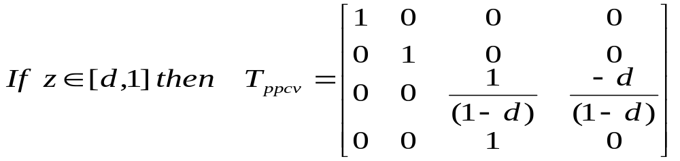
Transforming between canonical view-volumes
The perspective canonical view-volume can be transformed to the parallel canonical view-volume with the following matrix:
Derivation left as an exercise.

Slide 65
Clipping in 3D.
3D parallel projection volume is defined by:
-1≤x ≤1, -1 ≤y ≤1 , -1 ≤z ≤0
Replace by X/W,Y/W,Z/W:
-1≤X/W ≤1, -1 ≤Y/W ≤1 , -1 ≤Z/W ≤0
Corresponding plane equations are :
X= -W, X=W, Y=-W, Y=W, Z=-W, Z=0

Slide 66
Clipping in W
If W>0 , multiplication by W doesn’t change sign.
W>0: -W ≤X ≤W, -W ≤Y ≤W, -W ≤Z ≤0
However if W<0, need to change sign :
W<0: -W≥X ≥W,-W ≥Y ≥W, -W ≥Z ≥0
Notes:
Important to realize why clipping with W is a problem, but methods are not important.

Slide 67
Points in Homogeneous coordinates.
W
P₁=[1 2 3 4]^{T}
W=1
Projection of P1 and P2 onto W=1 plane
X or Y
P₂=[-1 –2 –3 –4]^{T}

Slide 68
Points in Homogeneous coordinates.
W
P₁=[1 2 3 4]^{T}
Region A
W=1
Projection of P1 and P2 onto W=1 plane
X or Y
Region B
P₂=[-1 –2 –3 –4]^{T}
Need to consider both regions when
Performing clipping.

Slide 69
Clipping in Homogeneous coordinates
Could clip twice – once for region B, once for region A.
  Expensive.
Check for negative W values and negate points before clipping.
What about lines with endpoints in each region ?

Slide 70
Lines in Homogeneous coordinates.
P1
W
Projection of points.
W=1
X
P2

Slide 71
Lines in Homogeneous coordinates.
P1
W
Clipped lines
W=X
W=1
X
Solution : Clip line segments, negate both endpoints, clip again.
W=-X
P2

Slide 72
Final step.
Divide by W to get back to 3-D
  Divide by z.
  Where the perspective projection actually gets done – perspective foreshortening.
Now we have a ‘view volume’.
  Don’t flatten z due to hidden line calculations.

Slide 73
Summary.
Orthographic matrix - replace (z) axis with point.
Perspective matrix – multiply w by z.
  Clip in homogeneous coordinates.
  Preserve z for hidden surface calculations.
  Can find number of vanishing points.

