Slide 1
Computer Graphics
Animation Techniques
Introduction
Keyframe interpolation

Slide 2
Types of Animation
Scripted Animation
Procedural Animation
Motion capture

Slide 3
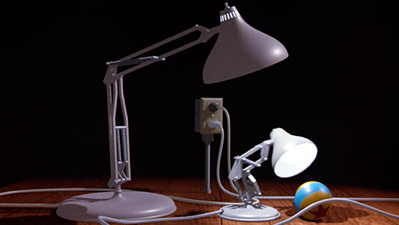
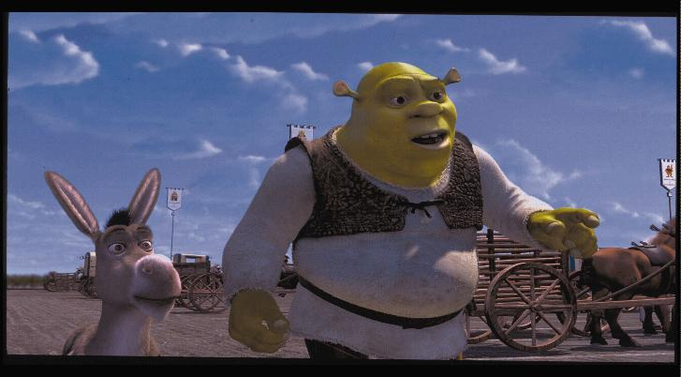
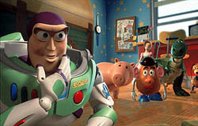
Scripted Animation

Slide 4
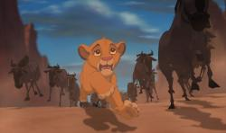
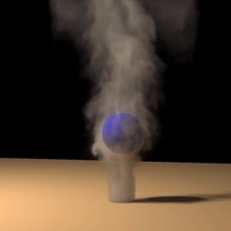
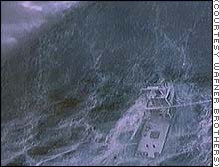
Procedural animation

Slide 5
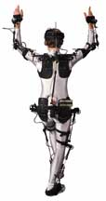
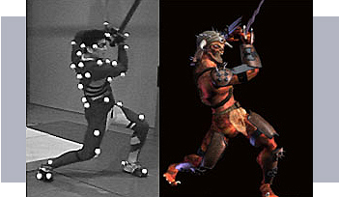
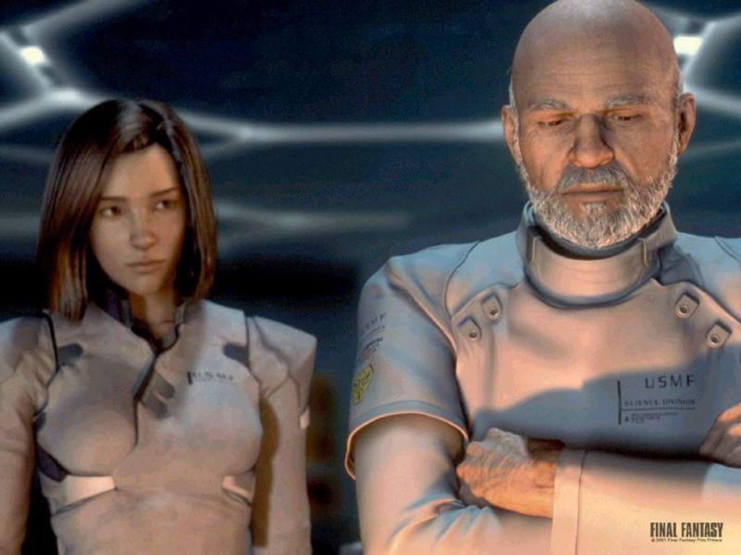
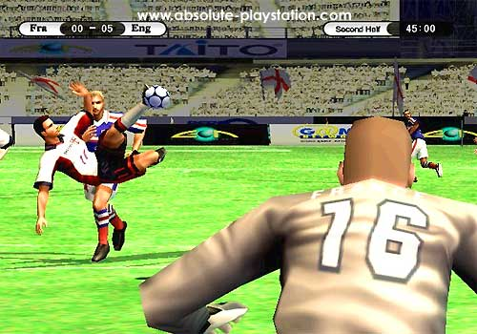
Motion capture

Slide 6
Topics in Animation
Scripted Animation
  Keyframe interpolation, articulated models, inverse kinematics, deformations, …
Procedural Animation
  Particle Systems, Flocks, Crowds, Cloth, Fire, Smoke, Water, …
Motion capture
  Filtering, editing, retargeting, stitching,…

Slide 7
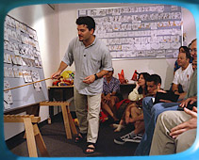
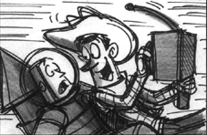
Overview of CG animation
Story

Slide 8
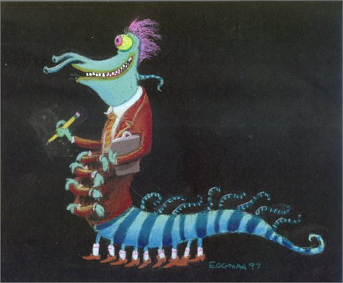

Overview of CG animation
Art

Slide 9
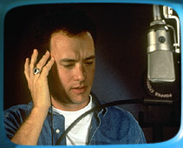
Overview of CG animation
Recording

Slide 10
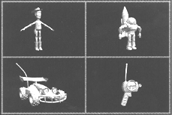
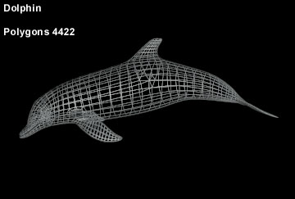
Overview of CG animation
Modeling

Slide 11
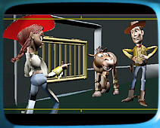
Overview of CG animation
Layout

Slide 12
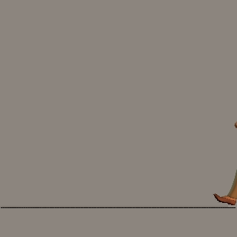
Overview of CG animation
Animation

Slide 13
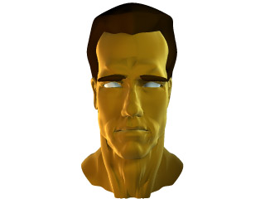
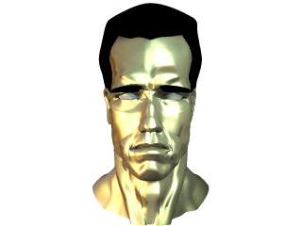
Overview of CG animation
Shading

Slide 14
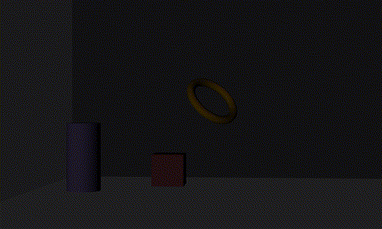
Overview of CG animation
Lighting

Slide 15
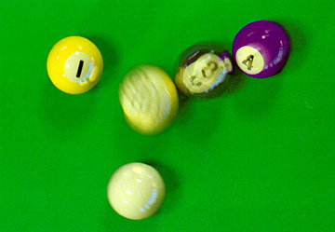
Overview of CG animation
Rendering

Slide 16
Why CG animation?
One medium of many:
  live action, classical animation, clay, puppets, …
3D has aspects of live film
  Camera, cinematography
CG has aspects of classical animation:
  Stylization, fantasy, scripted motion, …
Accessible
  Computer editing.
  Don’t need to act, don’t need to draw.
  Need to understand acting, need to understand images

Slide 17
Story, Animation most important
Modeling, rendering can’t save bad story
Modeling, rendering can’t save bad acting
Great story, acting are all you need:
  Simpsons, South Park
  “Europe and Italy”
  “Yes and No”

Slide 18

Keyframe animation: classical
Animator draws character at “extreme” poses
Fill in in-betweens
Textbook “Illusion
of Life”

Slide 19
Keyframe animation: CG
Model parameters
  Position (x,y,z), joint angles, deformations, …
Key frames = data points
In-between = interpolation
Many ways to interpolate:
  linear
  splines (polynomial curves)

Slide 20
Simple Animation
Use Bézier curve C(t) for character position.
Map frame (24 frames per second) to t:
  Position(f) = C((f-f_{start})/(f_{end}-f_{start}))
0<= t <=1

Slide 21
Speed along the spline
Uniform parameterization: speed varies
Arc-length parameterization: constant speed
User-specified speed

Slide 22
Arc-length parameterization
Really, reparameterization
Define S(t), length along curve until t
  ds² = dx² +dy²
  S(t) = ₀∫^{t} ((dx/dt)²+(dy/dt)²)^{½} dt
  S(t) = ₀∫^{t} || dC(t)/dt|| dt
Reparameterize:
  C_{arc}(s) = C(t(s)) where t(s) = S⁻¹(s)
Need inverse function

Slide 23
Arc-length reparameterization
Exact computation is too expensive & hard
Simple approximation: chord length
  Sample M times (sufficiently large, e.g. M=10N)
  S_{i} = S_{i-1} + || C(i/M) – C((i-1)/M) ||
To invert:
  Given s in [0,S_{M}]
  find i such that S_{i} < s < S_{i+1}
  t = (i + (s-S_{i})/(S_{i+1}-S_{i})) / M
For normalized arc length, use s S_{M}, s in [0,1]

Slide 24
User-specified speed
Assign times to knots
Ease-in, ease-out
Interesting questions re editing, UI…
Not going to get into this now…

Slide 25
Animating Arbitrary Parameters
Previous discussion created a 2D (3D) curve as a function of t, used for position
We want to create 1D function of frame, used for any parameter (“avar”)
Want to interpolate key values
Want to control shape between values
Many possible splines…
We will use 2D Bezier curves!

Slide 26
2D curve for avar values
Curve is C(t) => (C_{x}(t), C_{y}(t))
To get value at frame f, reparameterize:
  Avar(f) = C_{y}(t(f)) where t(f) = C_{x}⁻¹(f)
To find inverse:
  Given f find t: C_{x}(t)=f
  Standard form: C_{x}(t)-f=0: root finding
  We’ll use binary search to find t

Slide 27
Root finding by binary search
Given function F(t) for t in [0,1],
  want t such that F(t)=0
  assume t=0, t=1 bracket a root
Algorithm:
  start with t_{l}=0, t_{r} = 1
  compute t_{m}= (t_{l} + t_{r})/2 and F(t_{m})
  if t_{l} , t_{m} bracket a root t_{r}t_{m} else t_{l}t_{m}
  repeat until t_{l}≈ t_{r}

Slide 28
Hierarchical modeling
General model concepts
Individual parts
Transformations that link the parts
Parameters for:
  part shape (e.g. squash, wink)
  relationship between parts (e.g., squash, tilt)
Hierarchical relationship between parts
  when base moves, everything moves
  head and buttons move with torso
  eyes move with head

Slide 29
Hierarchy of “nodes”
Each node…
  defines a transformation
  draws its shape in local coordinates
  has children that inherit its local coordinates

Slide 30
Snowman
Base
Torso
Button1
Button2
Button3
Head
Nose
Eye1
Eye2

Slide 31
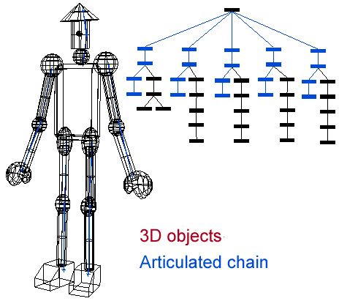
Robot

Slide 32
Draw by traversing the tree
Base class for Node has generic routine
  draw(Gfx g)
  {
  g.push();
  g.transform(getTransform());
  drawGeometry(g);
  for (i=0; i<children.length; ++i)
  children[i].draw(g);
  g.pop();
  }
Subclasses for different shapes, parameters

Slide 33
Variation
  draw(Gfx g, AffineTransform xf)
  {
  xf = getTransform(xf);
  g.push();
  g.transform(xf);
  drawGeometry(g);
  g.pop();
  for (i=0; i<children.length; ++i)
  children[i].draw(g, xf);
  }
other variations possible…

Slide 34
Other things to do with a tree
names
parameters
picking
bounding box
collision/contact calculation
Edit: build interactive modeling systems

Slide 35
What is the basic tree good for?
Modeling robots
  separate parts
  fixed relationships between them
Extend in two different directions:
  scene graph
  skeleton.

Slide 36
Scene Graph
Multiple types of nodes
  grouping, transformation, materials, surfaces
  cameras and lights
Generic surface nodes
  Data specific to each use
Multiple instantiation
  a DAG (directed acyclic graph), not a tree

Slide 37
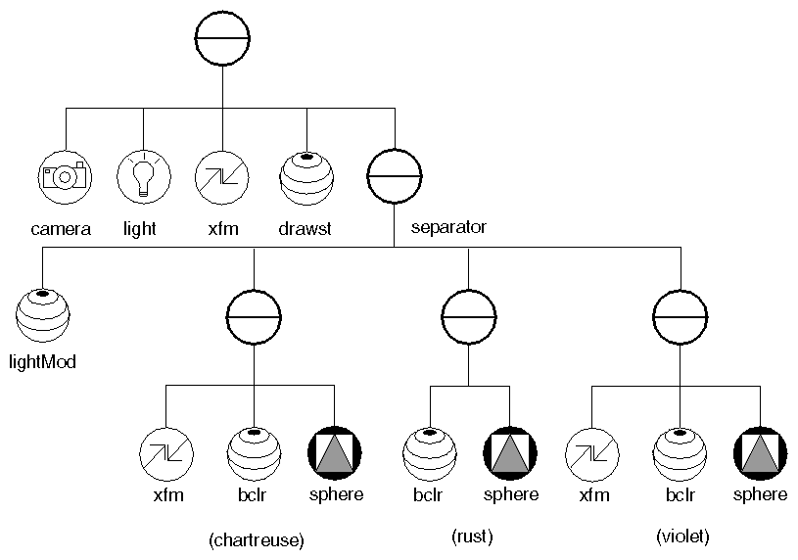
OpenInventor Scene Graph

Slide 38
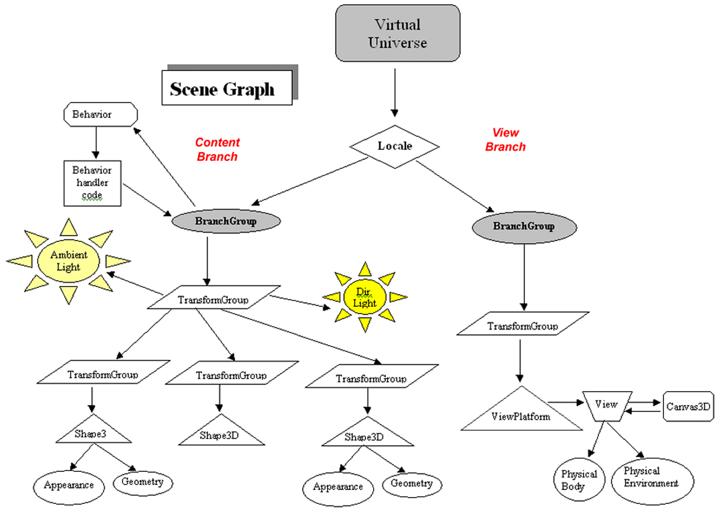
Java3D Scene Graph

Slide 39
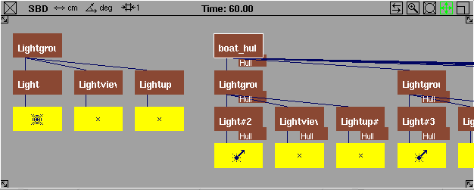
Alias|Wavefront “SBD” Window

Slide 40
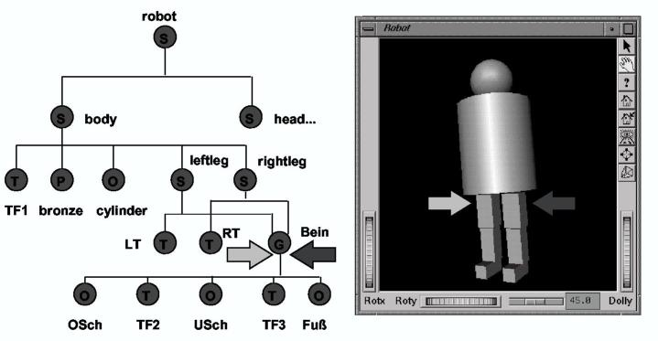
Instantiation

Slide 41
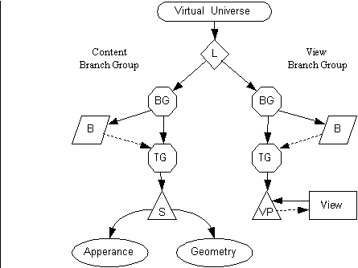
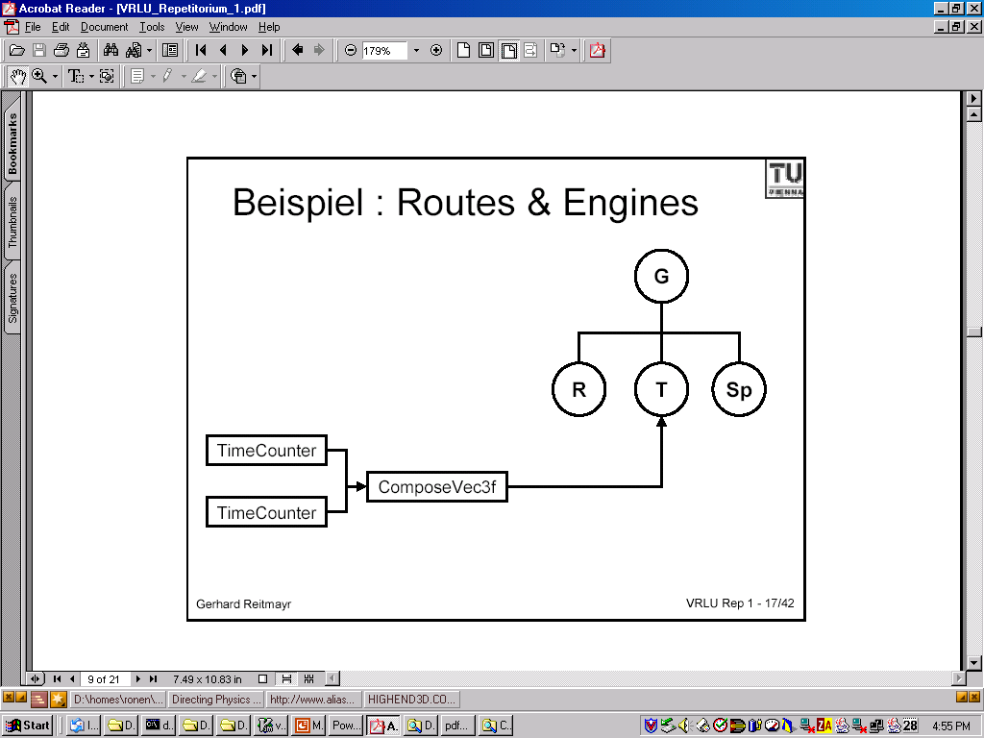
Computation in a scene graph
linked/computed parameters
animation

Slide 42
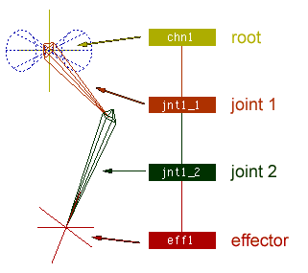
Skeleton
restricted transformations
no drawn geometry, just “bones”

Slide 43
Use of skeleton
support for direct manipulation
support for inverse kinematics
skinning to build models

Slide 44
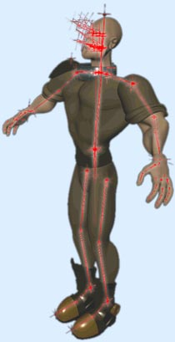
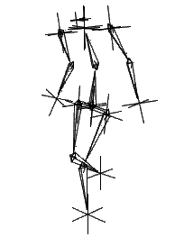
Skinning characters

Slide 45
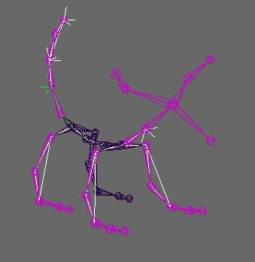
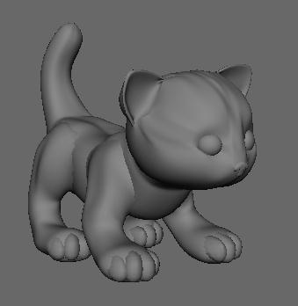
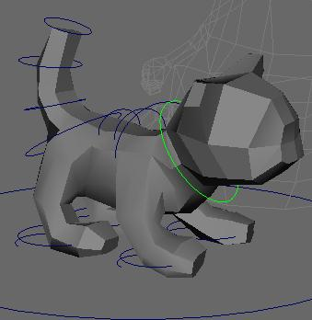
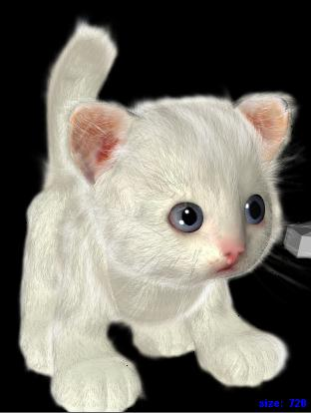
Even for non-humans
www.sharktacos.com

