Slide 1
Computer Graphics
Animation Techniques
Inverse Kinematics

Slide 2
Inverse kinematics
Goals
  Keep end of limb fixed while body moves
  Position end of limb by direct manipulation
  (More general: arbitrary constraints)

Slide 3
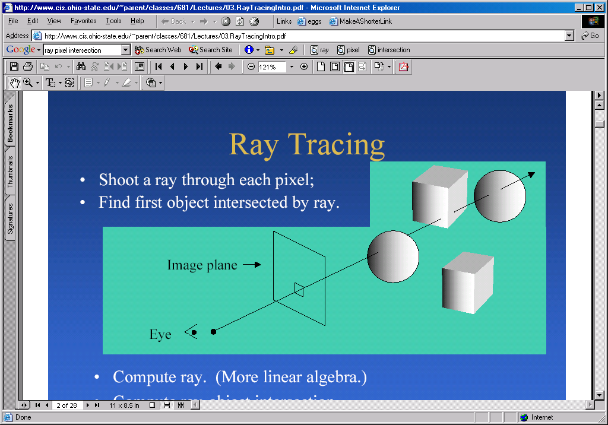
Direct manipulation: Picking
Mouse clicks on pixel:
  2D: convert pixel coords to world coords
  3D: ray from eye through pixel into world

Slide 4
Direct manipulation: Picking
Hierarchical model
  traverse hierarchy, test intersection at each node
  convert to common coordinates (world or local)
  can optimize with bounding box info
  (3D) find the closest hit
Base
Torso
Button1
Button2
Button3
Head
Nose
Eye1
Eye2

Slide 5
Finding the transform at a node
compute recursively:
  AffineTransform getFullTransform()
  {
  return getTransform(parent.getTransform())
  }
in practice cache transforms
  when transform changes,
  mark descendents dirty
may want transform
going out or in to node.
  getFullTransform(true)
  getFullTransform(false)
Base
Torso
Button1
Button2
Button3
Head
Nose
Eye1
Eye2

Slide 6
Dragging
convert pixel vector to world vector
  in 3D, typically move parallel to image plane
update position of picked object

Slide 7
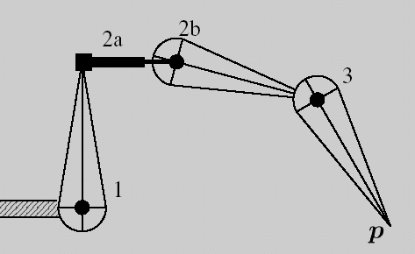
Inverse Kinematics (IK)
Make limb from “Link” objects
Define “Target” object

Slide 8
IK in model hierarchy
Compute links’ parameters based on target’s position
Target is a type of node
  Parameters: x, y
  Pointers to controlled links
Model calls compute()
before calling draw()
Link0
Link1
Link2
Link3
Target

Slide 9
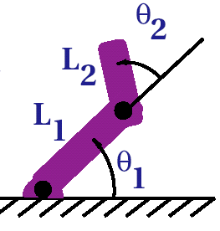
Two-link IK
Can solve by trigonometry
  d² = L₁² + L₂² – 2 L₁ L₂ cos(θ₂)
  L₂² = L₁² + d² – 2 L₁ d cos(α)
  tan(θ₁+α) = (X_{y}-base_{y})/(X_{x}-base_{x})
Remember…
  Two solutions in the plane
  Check bounds
  Convert to common coordinates (world)
  Take into account rotation of base coordinates
  Radians vs. degrees

Slide 10
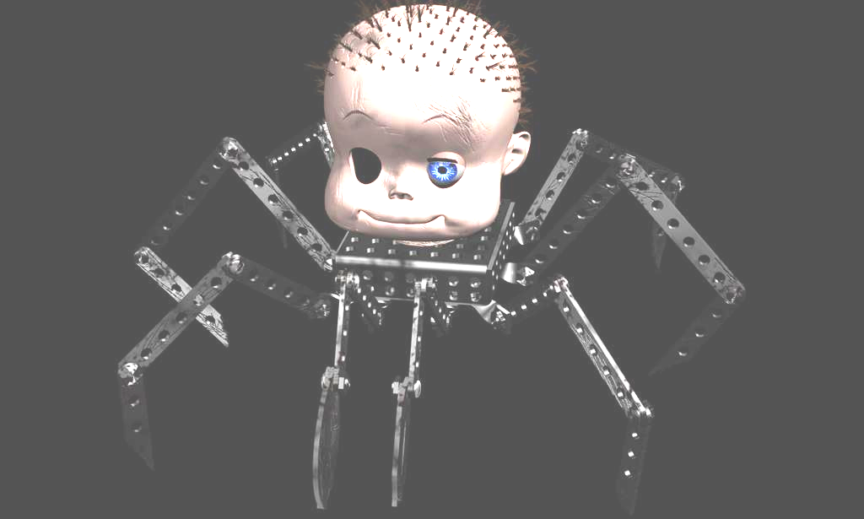
Three-link IK
Can also solve with trigonometry
  Extra parameter for choice of solution
  Joint limits

Slide 11
General N-link IK
want f(θ) = X
  θ is a vector of N link parameters (angles, extensions)
  f(θ) is the position of the endpoint (2D coordinates)
  X is the position of the target (2D coords)
Given X, find θ
X

Slide 12
What makes this hard?
Not always a unique solution
Not always well-behaved
Nonlinear problem
Joint limits

Slide 13
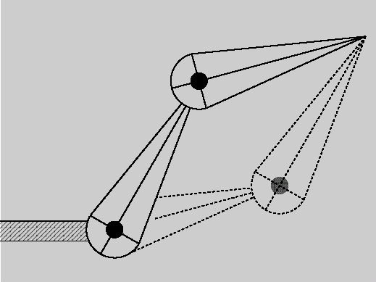
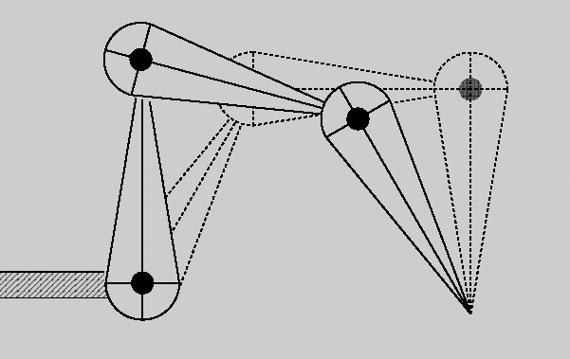
Not always a unique solution
Disjoint solutions:
Continuum of
solutions:
No solution:

Slide 14
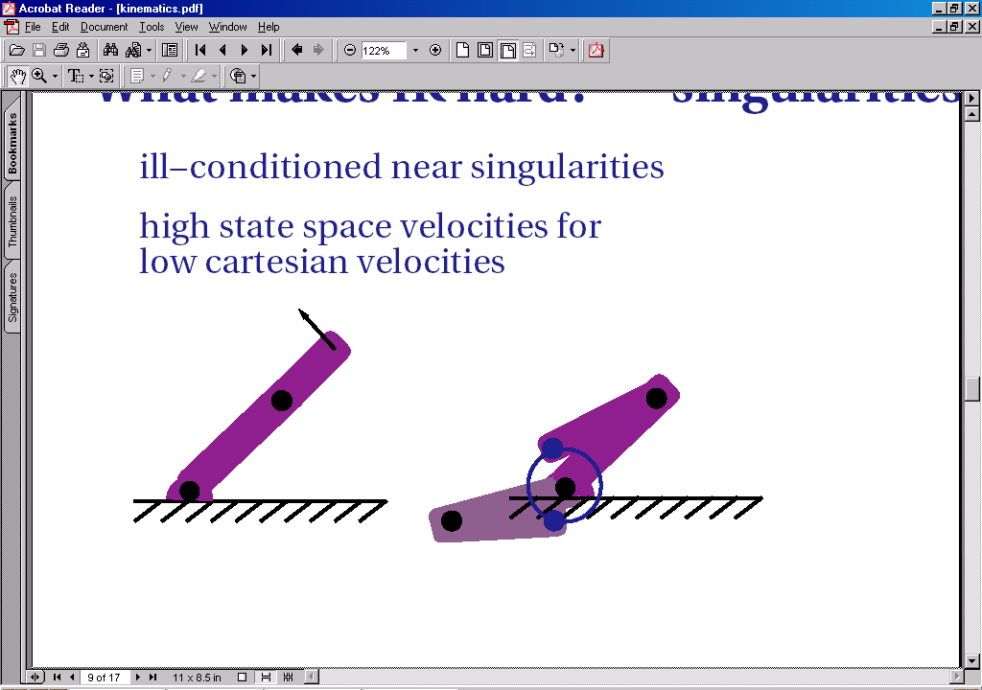
Not always well-behaved
Small change in X can cause big change in θ
Changing θ might not move end towards X

Slide 15
Multivariate nonlinear root finding
Want to solve f(θ) – X = 0
Taylor series expansion:
  f(θ+Δ) = f(θ) + f’(θ)Δ + f’’(θ) Δ Δ/2 + …
Given:we have a value of θ and f(θ)
  don’t know how to find Δ such that f(θ+Δ) = X
  can find Δ that gets closer
  then θ ← θ+Δ and repeat

Slide 16
Local Linearization
Taylor series expansion:
  X = f(θ+Δ) = f(θ) + f’(θ)Δ + f’’(θ) Δ Δ/2 + …
Use first term of Taylor series:
  X = f(θ) + J(θ) Δ
Jacobian matrix:
  J(θ) = vf_{i}/vθ_{j} =
  Change in f(θ) for an infinitesimal change in θ
vf_{x}
vθ₀
vf_{x}
vθ₁
vf_{x}
vθ₂
…
vf_{y}
vθ₀
vf_{y}
vθ₁
vf_{y}
vθ₂
…
vf_{z}
vθ₀
vf_{z}
vθ₁
vf_{z}
vθ₂
…

Slide 17
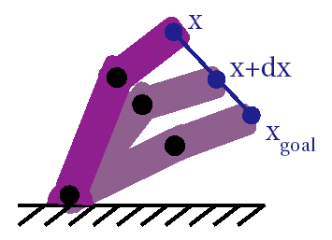
Local linearization
Let E(θ) = X – f(θ), error in the current pose:
J Δ = E
solve for Δ
Δ moves end towards X
  Only valid for small Δ
  Take series of small steps
  Recompute J(θ) and E(θ) at each step

Slide 18
Solving by taking small steps
Start with current pose
  Finds solution closest to current
  least movement
Must take small steps: how small?
  Could try to find optimum size
  know we’re doing rotations:
    keep less than ~2 degrees, sin(x)z x, cos(x)z1

Slide 19
Algorithm
  solve()
  {
  start with previous θ;
  E = target - computeEndPoint();
  for(k=0; k<max && |E| > eps; k++){
  J = computeJacobian();
  solve J Δ = E;
  if (max(Δ)>2) Δ = 2Δ/max(Δ);
  θ = θ + Δ;
  E = target - computeEndPoint();
  }
  }

Slide 20
Problem: solving J Δ = E
Can’t do Δ = J⁻¹ E
J isn’t invertible – not even square
  in our case, 2 x N
D₀
vf_{x}
vθ₀
vf_{x}
vθ₁
…
vf_{x}
vθ_{N}
D₁
E_{x}
=
vf_{y}
vθ₀
…
vf_{y}
vθ₁
vf_{y}
vθ_{N}
.
.
.
E_{y}
D_{N}

Slide 21
Solving J Δ = E: pseudo inverse
Trick: J^{T}J is square. So:
  J Δ = E
  J^{T}J Δ = J^{T} E
  Δ = (J^{T}J)⁻¹J^{T} E
  Δ = J⁺E
J⁺=(J^{T}J)⁻¹J^{T} is the pseudoinverse of J
  Properties: JJ⁺J=J, J⁺JJ⁺=J⁺
  same as J⁻¹ when J is square and invertible
  J is mxn => J⁺ is nxm
How to compute pseudoinverse?
  What if (J^{T}J)⁻¹ is singular?

Slide 22

Singular Value Decomposition
Any mxn matrix A can be expressed by SVD
  A = U S V^{T}
    U is mxmin(m,n), columns are orthogonal
    V is nxmin(m,n), columns are orthogonal
    S is min(m,n)xmin(m,n), diagonal: singular values
  unique up to sign and order of s_{i} values
    canonical: positive, sorted largest to smallest
    other properties: rank is # of non-zero values; determinant is product of all values, …

Slide 23

Pseudoinverse using SVD
Given SVD, A = U S V^{T}
pseudoinverse is easy: A⁺ = VS⁻¹U^{T}
singular: some s_{i} = 0,
ill-conditioned: some s_{i} << s₀
  use 0 instead of 1/s_{i} for those (“truncated”)
  choose small threshold ε, test s_{i} < ε s₀
1

Slide 24
Solving A X = B using SVD
Using truncated A⁺ B gives least-squares solution:
  If no solution, gives X that minimizes ||AX-B||²
  If many solutions, minimizes ||X||² such that AX=B
  Numerically stable for ill-conditioned matrices
SVD has many other properties.
  rank of A is # non-zero singular values, determinant is product of all singular values, …
  known algorithm to compute it
SVD is a powerful hammer!
  slow O(n³); there are faster algorithms.
  but SVD always works, is fast enough for us
  hard to implement. some libraries have bugs (Java3D)

Slide 25
Back to IK
Reminder: solve X = f(θ)+J(θ)Δ
  f(θ) is position of end point
  i^{th} column of J comes from link i
X
vf_{x}
vθ₀
vf_{x}
vθ₁
…
vf_{x}
vθ_{N}
vf_{y}
vθ₀
vf_{y}
vθ₁
…
vf_{y}
vθ_{N}

Slide 26
Computing the Jacobian columns
Jacobian of a rotation:
  Assume rest of limb is rigid
  Let r = f(θ)-pivot_{i} = (r_{x}, r_{y})
  Then vf(θ)/vθ_{j} = (-r_{y}, r_{x}) p /180
Jacobian of a translation link:
  vf(θ)/vθ_{j} = vector in direction of link
Notes:
  Remember to compute in world space!
  I’ve assumed one degree of freedom per link

Slide 27
IK Algorithm
  solve()
  {
  Vector θ = getLinkParameters();
  Vector E = target - computeEndPoint();
  for(k=0; k<max && E.norm() > eps; k++){
  Matrix J = computeJacobian();
  Matrix J⁺ = J.pseudoinverse();
  Vector Δ = J⁺ E;
  if (max(Δ)>2) Δ *= 2/max(Δ);
  θ = θ + Δ;
  putLinkParameters(θ);
  E = target - computeEndPoint();
  }
  }

Slide 28
What’s left for IK?
Joint limits
Choosing desired configuration

Slide 29
Joint limits
Each joint may have limited range.
Modify algorithm:
  After finding Δ, test each joint:
    θmin_{i} < (θ+Δ)_{i} < θmax_{i}
  If it would go out of range
    set column i of J to 0
    claims “this parameter has no effect”
  Recompute J⁺
    Least-squares solution will make Δ_{i} z 0
    For robustness, you may want to force Δ_{i} =0
  Find Δ, repeat

Slide 30
Choosing configuration
Suppose you have a homogeneous solution δ:
  J δ = 0
  If Δ solves J Δ = E, then (Δ+ δ) does also:
  J (Δ+ δ) = J Δ+ J δ = E + 0 = E
Given a desired change C to θ,
  project into null space of J using (J⁺J-I) C:
    J [(J⁺J-I) C] =[J (J⁺J-I)] C = (JJ⁺J-J)C = (J-J)C = 0

Slide 31
Choosing configuration
Given preferred values θ_{pref}
  construct desired change C:
  C_{i}=α_{i}(θ- θ_{pref})_{i}
  weights α_{i} give relative strengths
Modify algorithm:
  Construct C
  Use Δ = JE + (J⁺J-I)C
Null-space projection of C won’t harm solution
Solution will bias towards θ_{pref}

Slide 32
Note on numerical algorithms
Various algorithms for non-linear multidimensional root-finding…this one works for us
Root-finding is related to optimization:
  F(θ)=X ⬄ minimize ||F(θ)-X||²
Many computer animation problems are optimization problems
Many algorithms have solving AX = B at their core.

