Slide 1
Computer Graphics
Animation Techniques
Deformation

Slide 2
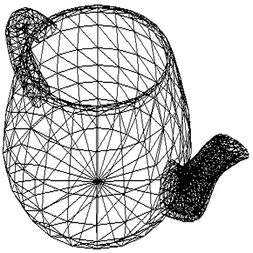
Point-based models
Almost all models in CG are based on points.
Polygonal meshes.

Slide 3
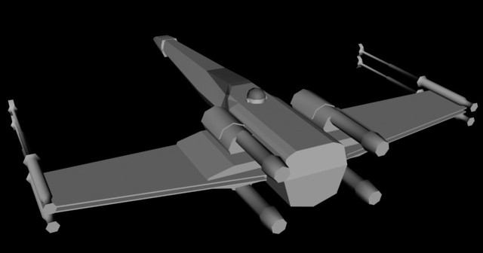
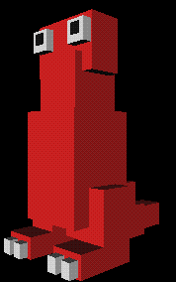
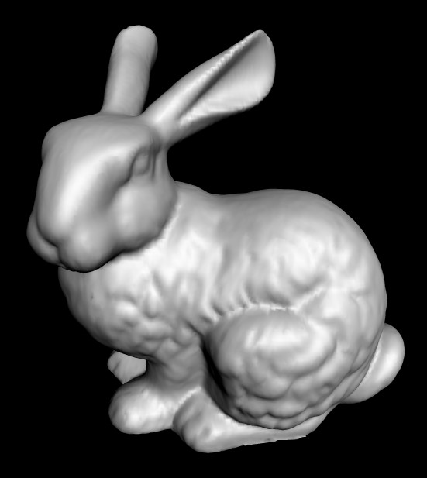
Polygonal models

Slide 4
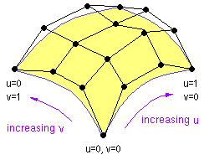
Smooth models
Control mesh
Parametric patches:
  Bézier
  NURBS

Slide 5
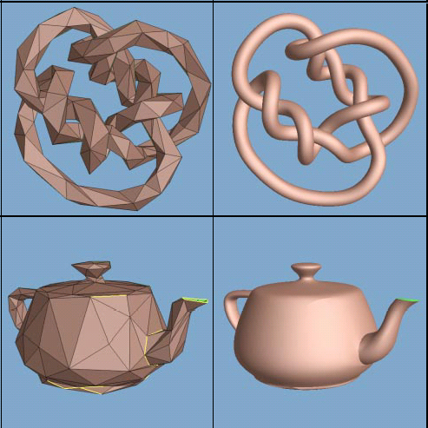
Smooth models
Control mesh
Subdivion surface

Slide 6
Deformation
To deform a model, move its control points.
  The rest is details…
Types of deformation:
  Function-based deformation
  Free-form deformation
  Skeleton deformation
  Point cluster deformers
  Shape interpolation, morphing

Slide 7
Function-based deformation
Define a function over all space
  M: R³ → Transformation (matrix)
To transform a point P:
  evaluate function M at P
  transform P by the result:
  P’ = M(P) P

Slide 8
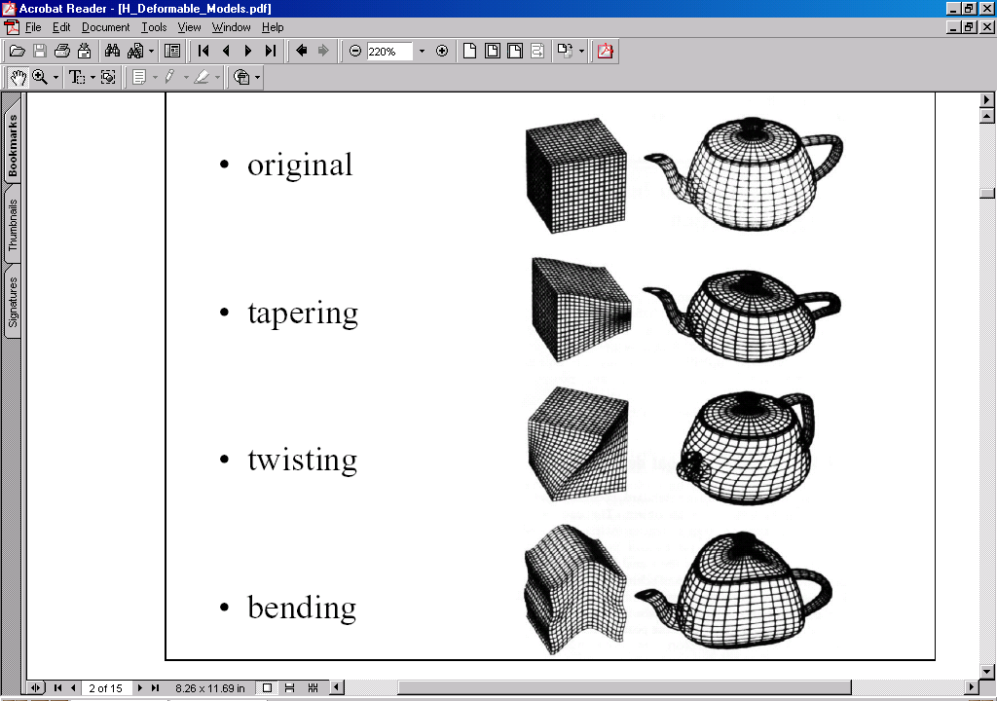
Undeformed model

Slide 9
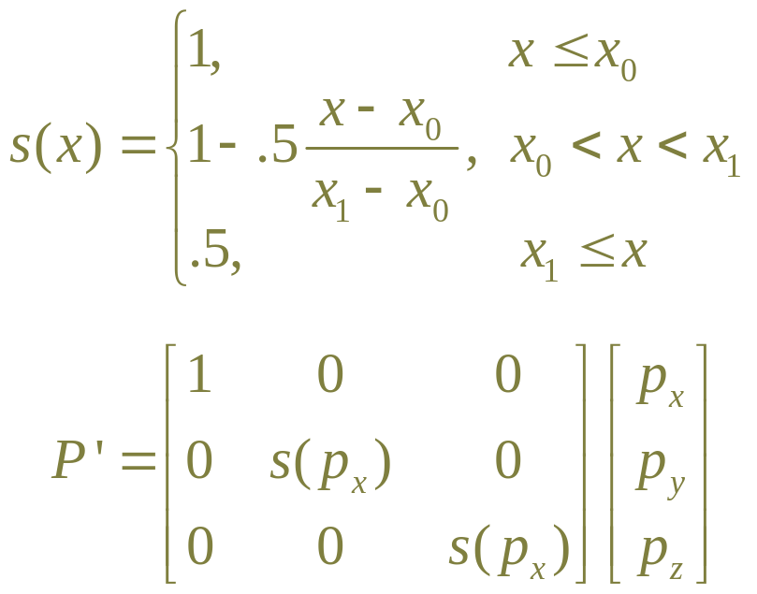
Taper

Slide 10
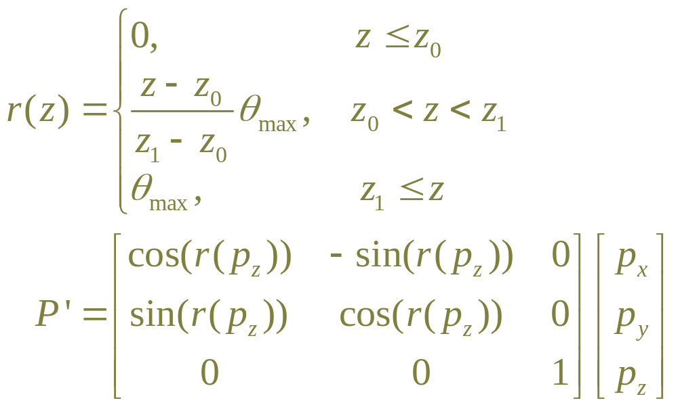
Twist

Slide 11
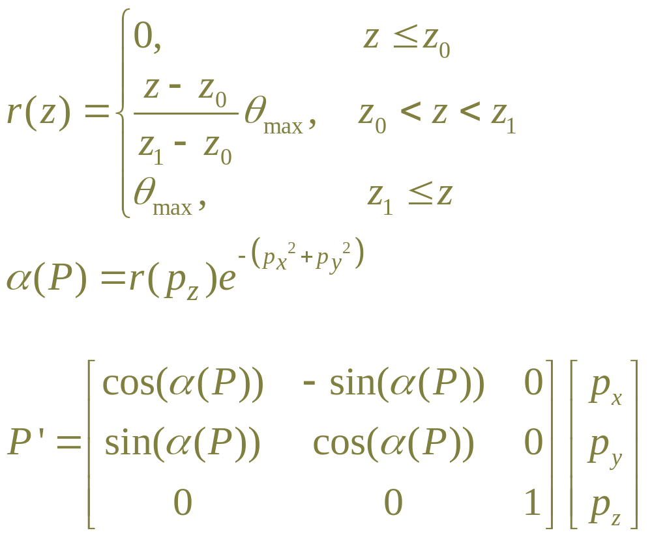
“Vortex”

Slide 12

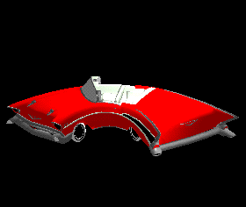
Bend

Slide 13
Bend
Given x₀, y₀, h, q, r=h/q
Three regions:
  Below y₀: unaffected
  Above y₀+h
    translate down by h
    rotate by -q about (x₀+r, y₀)
  Between y₀ and y₀+h:
    interpolate translation
    interpolate rotation angle
h
q
(x₀,y₀)
(x₀+r,y₀)

Slide 14
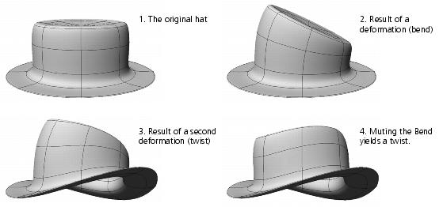
Combinations of deformations
Original
Bend
Bend+Twist
Twist

Slide 15
Potential problem
If there aren’t enough points, model collapses
Solutions:
  adaptively create new points
  build models with enough points where needed

Slide 16
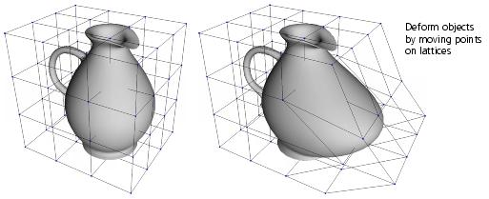
Free-form deformation (FFD)
Define a lattice around the model
Move the points of the lattice
The model deforms with it

Slide 17
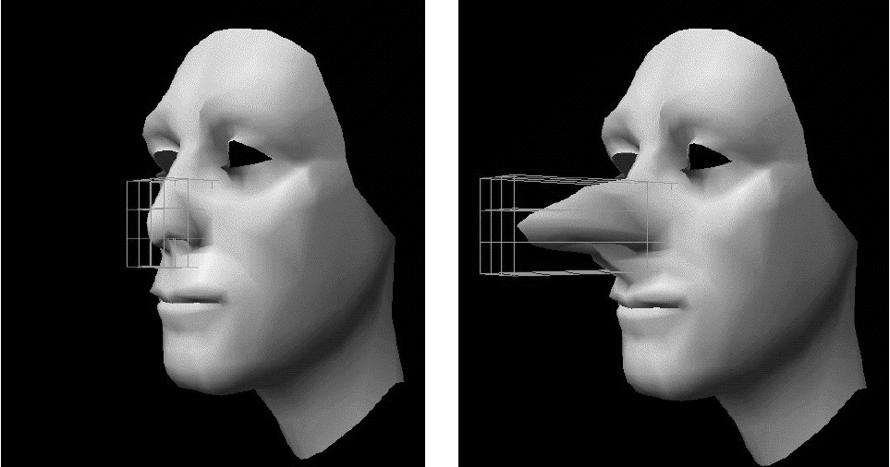
FFD example

Slide 18
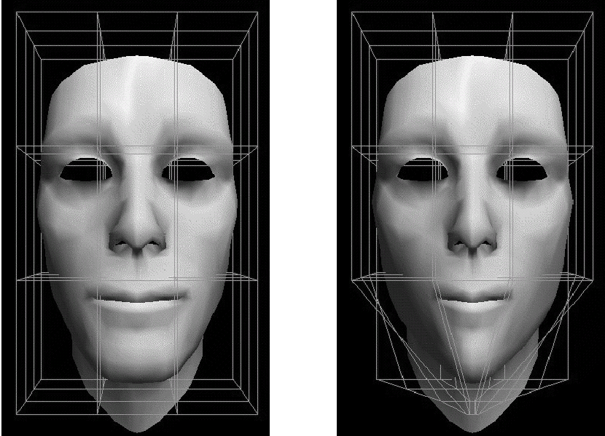
FFD example

Slide 19
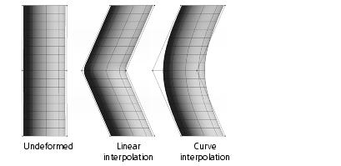
FFD: interpolation
Different ways to interpolate:

Slide 20
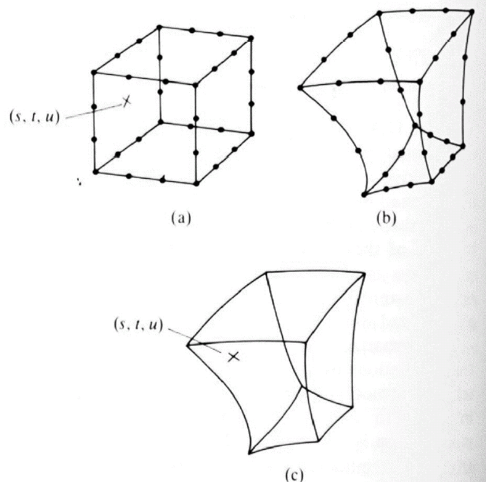
Computing FFD
find (s,t,u) coordinates
of P in original grid
interpolate deformed
grid points at (s,t,u)

Slide 21
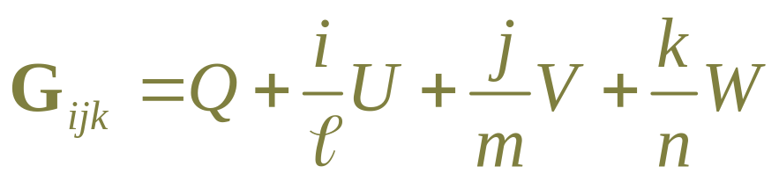
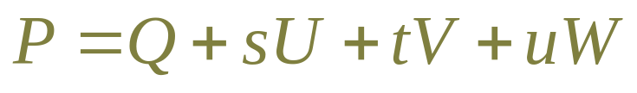
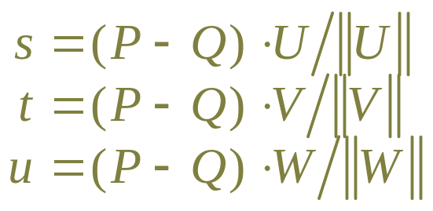
Computing FFD: coordinates
Grid:
  origin=Q, orthogonal axes=U,V,W, # cells=l,m,n
  Grid points:
Point to deform:

Slide 22
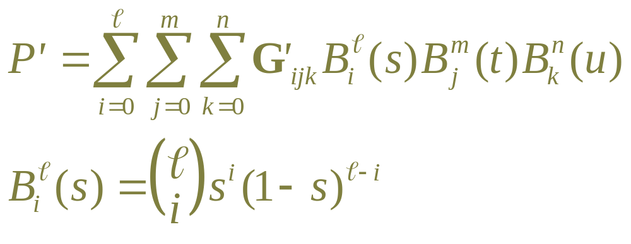
Computing FFD: interpolation
Grid points moved to G’_{ijk}
Interpolate using multidimensional Bézier :
Or use piecewise lower-order Bézier segments

Slide 23
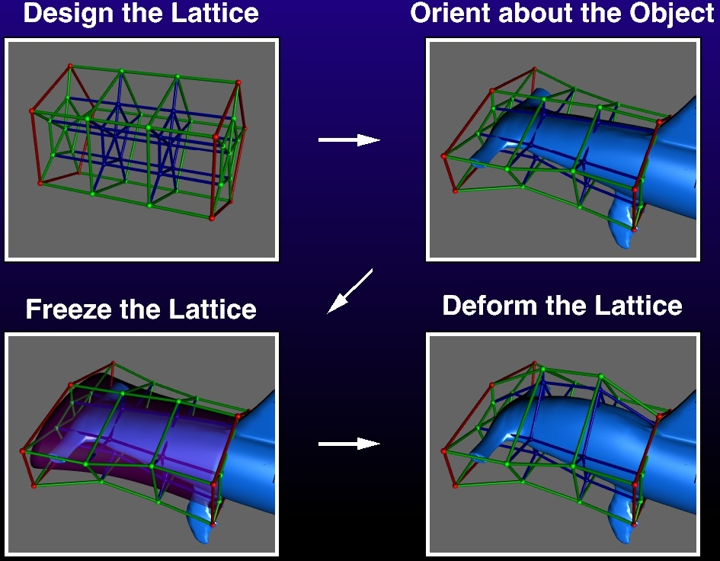
FFD with arbitrary topology

Slide 24
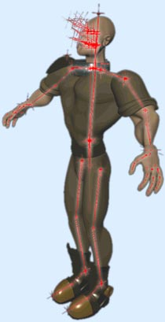
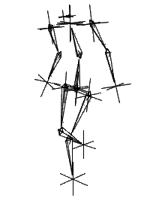
Skeleton deformation
Skeleton (IK) inside the “skin”

Slide 25
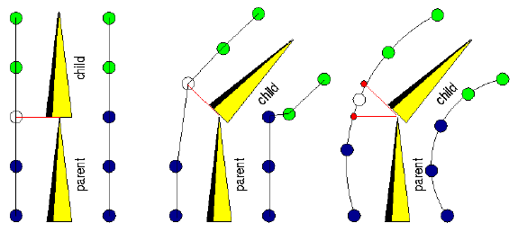
Skeleton deformation
Associate each point with nearest link
When link moves, transform its points.

Slide 26
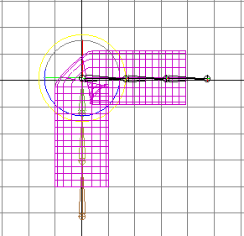
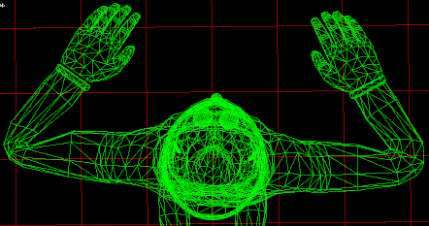
Problem: collapsing, kinking

Slide 27
Point weights
Each point gets affected by several links
Take weighted average
Adjust the weights until it looks good

Slide 28
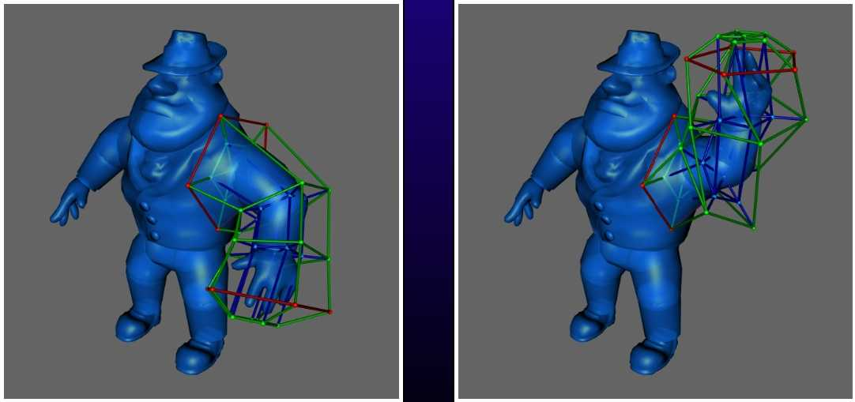
Skeleton with FFD
Skeleton moves FFD grid
FFD moves points

Slide 29
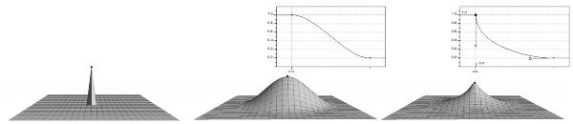
Point cluster deformers
Select “cluster” of points
Apply an operation directly to some points
Weights often set by spatial fields

Slide 30
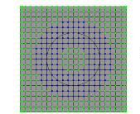
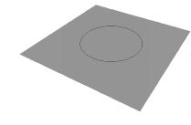
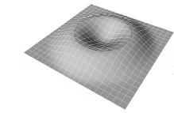
Point cluster deformers

Slide 31
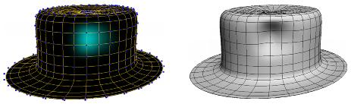
Point cluster deformers
Weights painted on by hand
    (there are more points than shown in the wireframe)

Slide 32
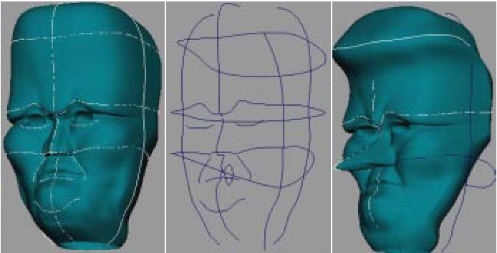
Wires
Reference curves on model
Draw target curves

Slide 33
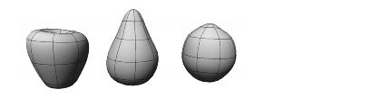

Shape interpolation
sculpt several target shapes
use weighted average
  meshes must have same topology

Slide 34
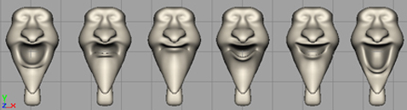
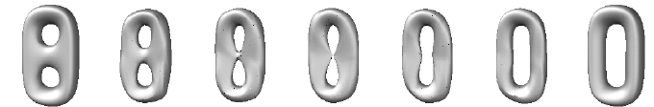
Shape interpolation
used often for mouth shapes:
research for shapes with different topology

Slide 35
Deformer in Model Hierarchy
Skin node has
  original “rest position” points
  deformed current points
Deformer node
  (Examines control nodes)
  Examines skin rest points
  Updates skin current points
Link0
Skin
Deformer
Link1
Link2
Link3

Slide 36
Note on coordinate systems
Easiest to work in deformer’s local coords
  Transform from one node’s coords to another
WORLD
(W-to-B)=(B-to-W)⁻¹
(A-to-W)
(B-to-W)
A
B
(A-to-B) = (W-to-B) (A-to-W)
= (B-to-W)⁻¹(A-to-W)

Slide 37
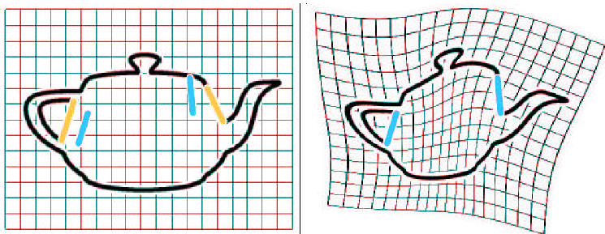
Deforming images
Like objects, but deform every pixel
    (s’, t’)=deform(s,t) => newimage[s’][t’]=image[s][t]
Map source features to target features

Slide 38
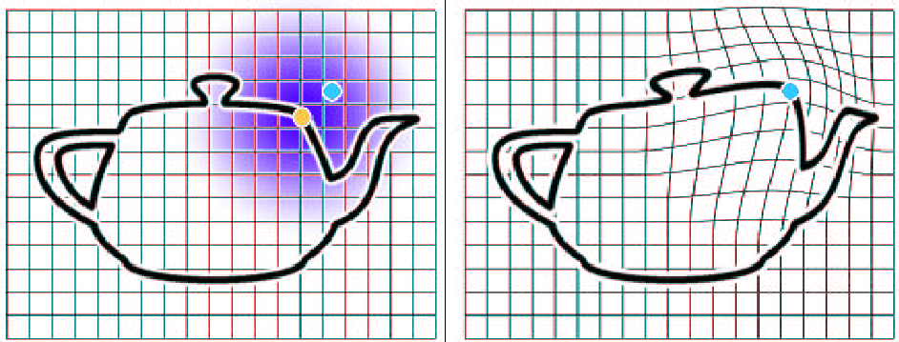
Deforming images
can use weight fields, etc.
Issues
  map backwards to avoid holes
  ghosting if backwrads map isn’t one-to-one
  must do proper image filtering

Slide 39
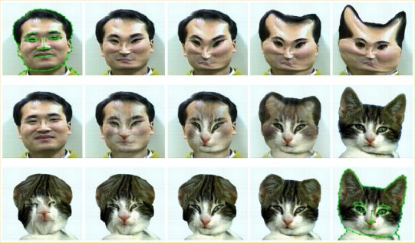
Animated image morph

