Slide 1
WEEK – 6 STATINOMICS
C R DEEPAK KUMAR
DEEPAK RAMESH

Slide 2
BINOMIAL DISTRIBUTION
MONDAY
[0.82,0.18]
TUESDAY
[0.82,0.18]
WEDNESDAY
[0.82,0.18]
THURSDAY
[0.78,0.22]
FRIDAY
[0.82,0.18]

Slide 3
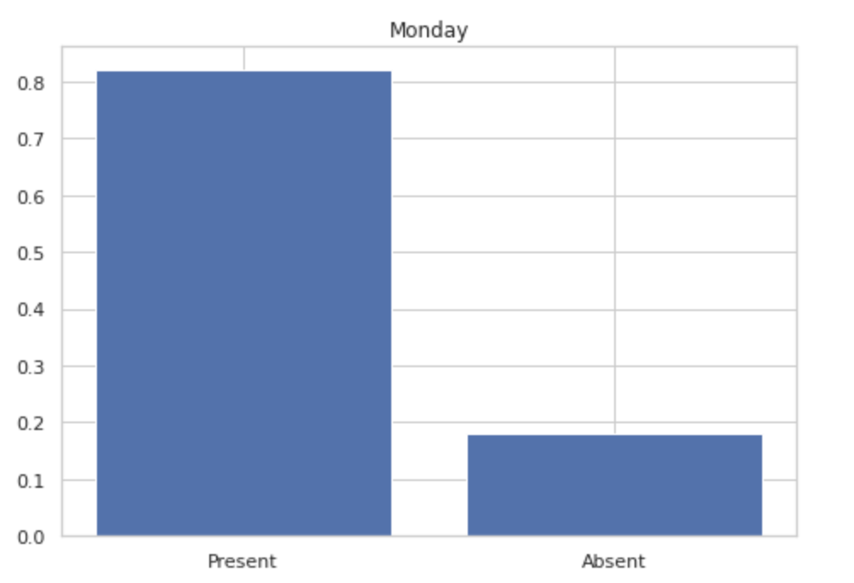
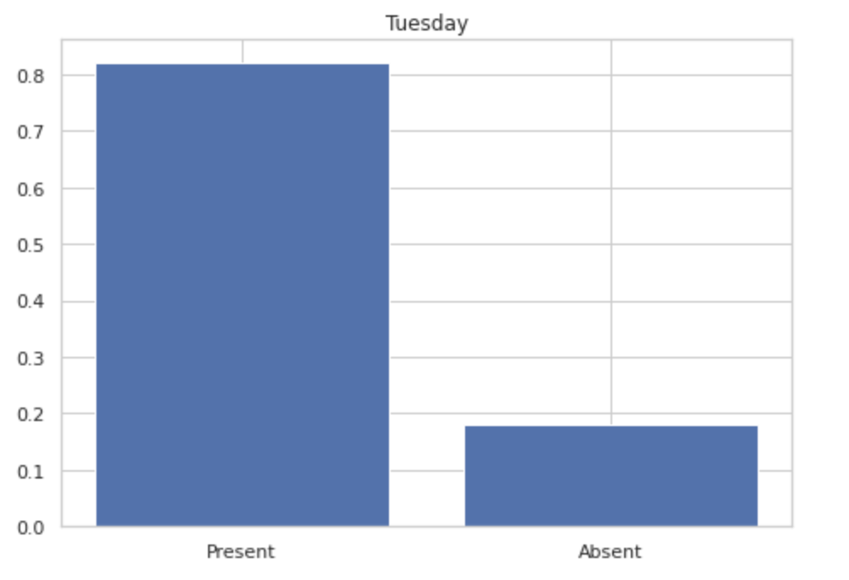
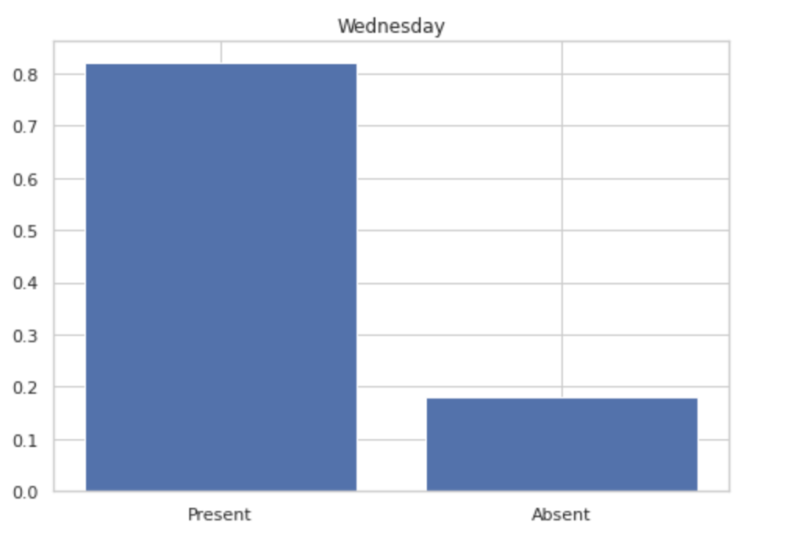
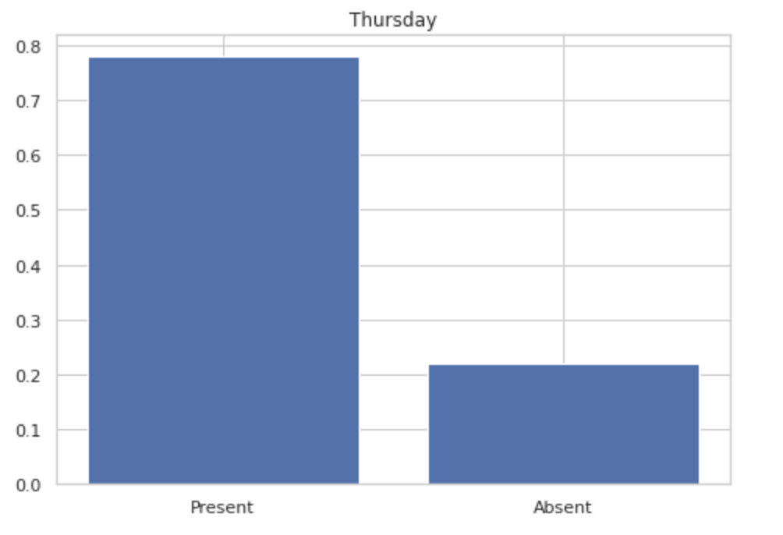
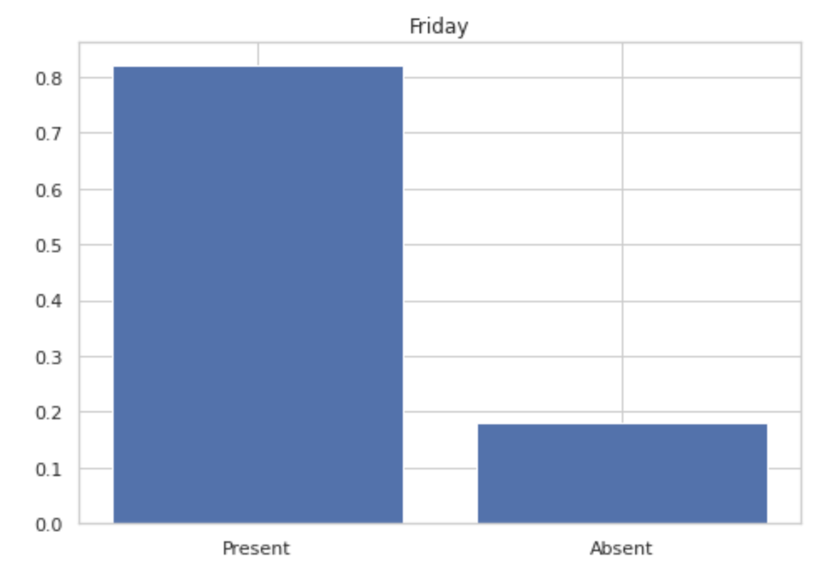
BINOMIAL DISTRIBUTION

Slide 4
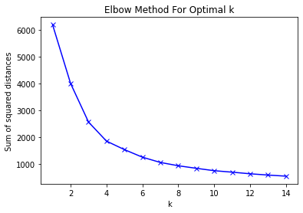
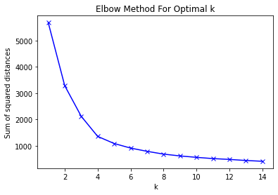
For n_clusters = 2, silhouette score is 0.32761960021319964)
For n_clusters = 3, silhouette score is 0.3606736737936344)
For n_clusters = 4, silhouette score is 0.35780067995291)
For n_clusters = 5, silhouette score is 0.34277974691483687)
For n_clusters = 6, silhouette score is 0.3637536927960447)
For n_clusters = 7, silhouette score is 0.3622605888705192)
For n_clusters = 8, silhouette score is 0.3577252271686808)
For n_clusters = 9, silhouette score is 0.35249946100226304)
MONDAY
For n_clusters = 2, silhouette score is 0.38566369826783214)
For n_clusters = 3, silhouette score is 0.4022869065382034)
For n_clusters = 4, silhouette score is 0.43275900882135315)
For n_clusters = 5, silhouette score is 0.41684966354534025)
For n_clusters = 6, silhouette score is 0.40006472299069074)
For n_clusters = 7, silhouette score is 0.3867595034896286)
For n_clusters = 8, silhouette score is 0.3934541612149311)
For n_clusters = 9, silhouette score is 0.38110899320126884)
TUESDAY

Slide 5
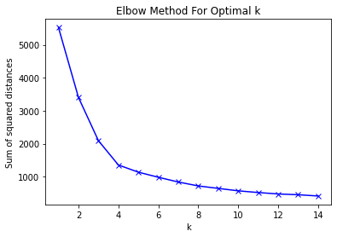
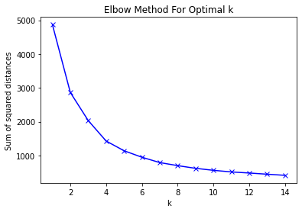
For n_clusters = 2, silhouette score is 0.3726794782112048)
For n_clusters = 3, silhouette score is 0.40518939545587024)
For n_clusters = 4, silhouette score is 0.4380658965175449)
For n_clusters = 5, silhouette score is 0.4052089569988323)
For n_clusters = 6, silhouette score is 0.3800210971671763)
For n_clusters = 7, silhouette score is 0.3741568272039008)
For n_clusters = 8, silhouette score is 0.3880249208397771)
For n_clusters = 9, silhouette score is 0.3856760815733098)
WEDNESDAY
For n_clusters = 2, silhouette score is 0.41315613583546473)
For n_clusters = 3, silhouette score is 0.3799091330017175)
For n_clusters = 4, silhouette score is 0.40252492989691596)
For n_clusters = 5, silhouette score is 0.4010365256583583)
For n_clusters = 6, silhouette score is 0.392423449082482)
For n_clusters = 7, silhouette score is 0.37827386515755496)
For n_clusters = 8, silhouette score is 0.3720053683043028)
For n_clusters = 9, silhouette score is 0.3646382148136735)
THURSDAY

Slide 6
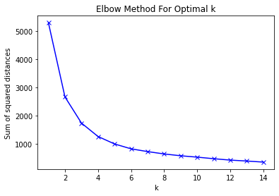
For n_clusters = 2, silhouette score is 0.5319579981048834)
For n_clusters = 3, silhouette score is 0.46863261681987944)
For n_clusters = 4, silhouette score is 0.4804255405435305)
For n_clusters = 5, silhouette score is 0.4446579230839993)
For n_clusters = 6, silhouette score is 0.4269674032985802)
For n_clusters = 7, silhouette score is 0.4184119642337698)
For n_clusters = 8, silhouette score is 0.41539859019214664)
For n_clusters = 9, silhouette score is 0.4126341713815101)
FRIDAY

Slide 7
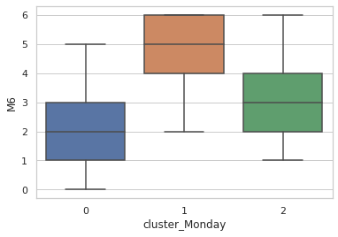
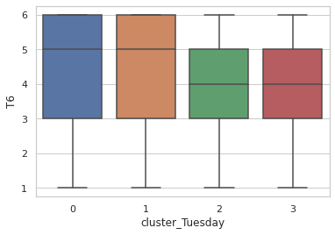
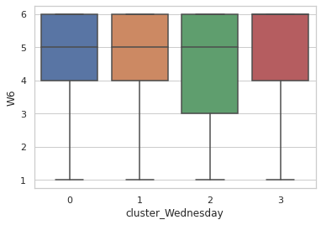
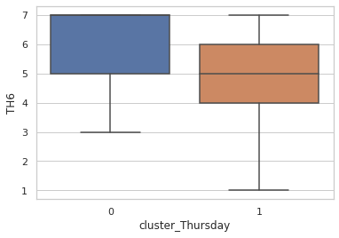
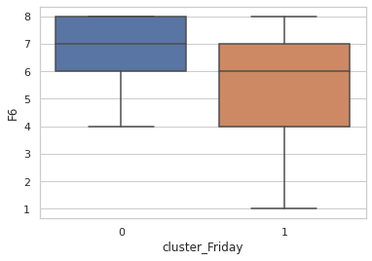
DISTRIBUTION OF CLUSTERS

Slide 8
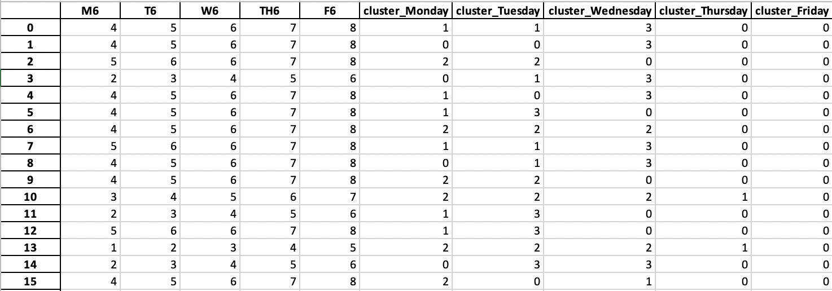

Slide 9
IMPORATANT FEATURES FOR PREDICTION
USING RANDOM FOREST REGRESSOR:
For Monday : Tuesday
For Tuesday : Monday and Wednesday
For Wednesday : Tuesday and Thursday
For Thursday : Wednesday and Friday
For Friday : Thursday

Slide 10
SCORES OF PREDICTION
Scores of Each Prediction:
Monday: 96%
Tuesday: 99%
Wednesday: 99%
Thursday: 99%
Friday: 96%
ADDED THE RESPECTIVE WEEK DAY CLUSTER AS ‘X’ TO PREDICT THE FUTURE
THE NEW CLUSTER FEATURE IS A ACCURACY BOOSTER FOR THE MODEL

Slide 11
BERNOULLI DISTRIBUTION
STUDENTS WHO GET ABOVE 5 PASS ,OTHERS FAIL

Slide 12
CENTRAL TENDENCIES
Missing
Mice
Predicted
Mean
STD
Mean
STD
Mean
STD
M 3.570208
T 4.263480
W 4.870257
TH 5.720663
F 6.573691
M 1.728063
T 1.536609
W 1.298683
TH 1.377536
F 1.488489
M 3.556
T 4.229
W 4.842
TH 5.725
F 6.630
M 1.726222
T 1.513555
W 1.295652
TH 1.373048
F 1.484353
M 3.490
T 4.252
W 4.831
TH 5.742
F 6.672
M 1.786363
T 1.530633
W 1.300819
TH 1.355461
F 1.504220
Median
Mode
Median
Mode
Median
Mode
M 4
T 4
W 5
TH 6
F 7
M 6
T 6
W 6
TH 7
F 8
M 4
T 4
W 5
TH 6
F 7
M 6
T 6
W 6
TH 7
F 8
M 3
T 4
W 5
TH 6
F 7
M 4
T 4
W 5
TH 6
F 7

Slide 13
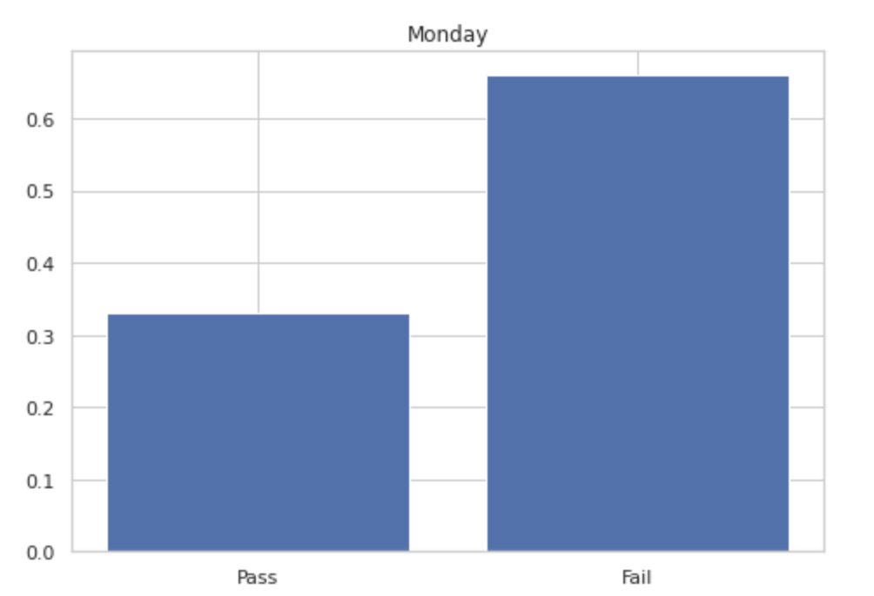
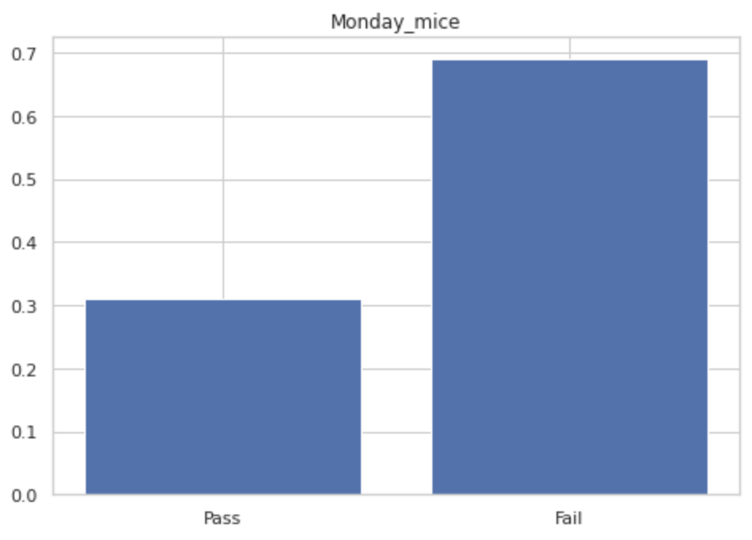
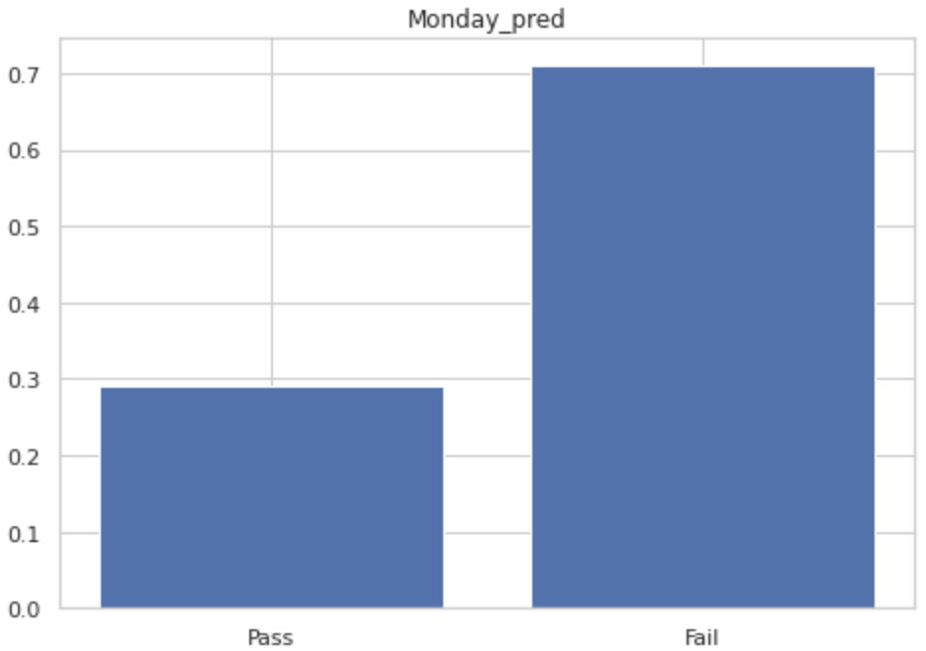
0.33,0.66
0.31,0.69
0.29,0.71

Slide 14
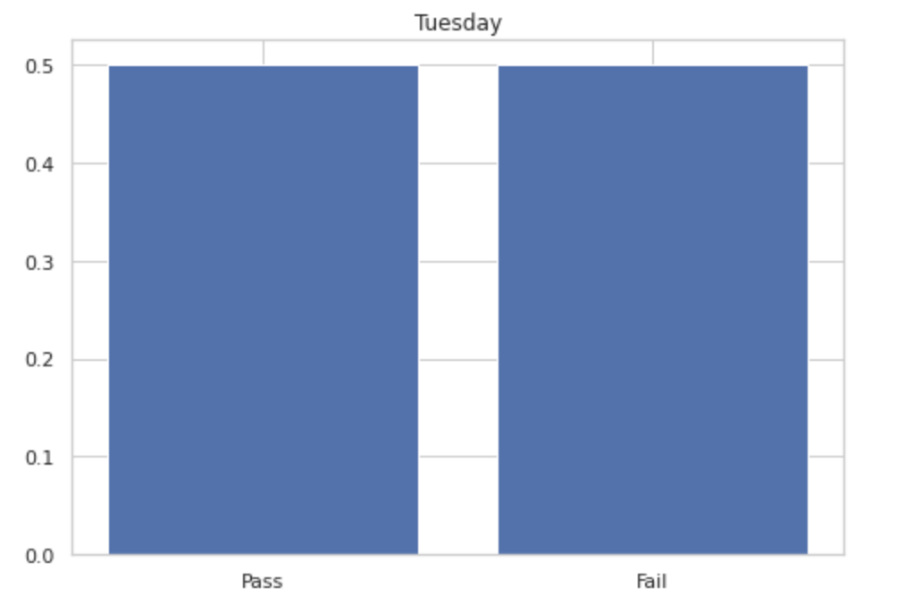
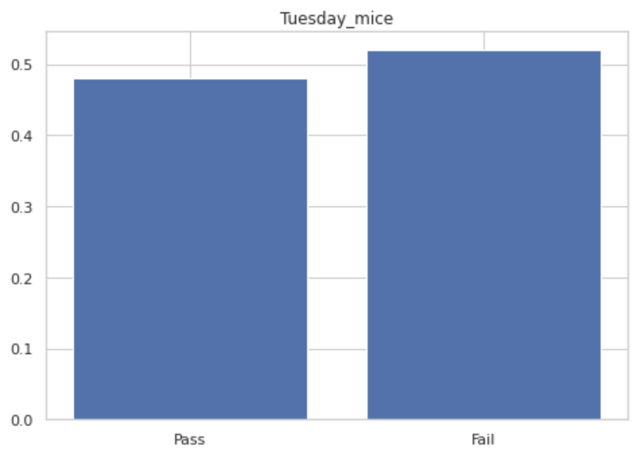

0.48,0.52
0.5,0.5
0.48,0.52

Slide 15
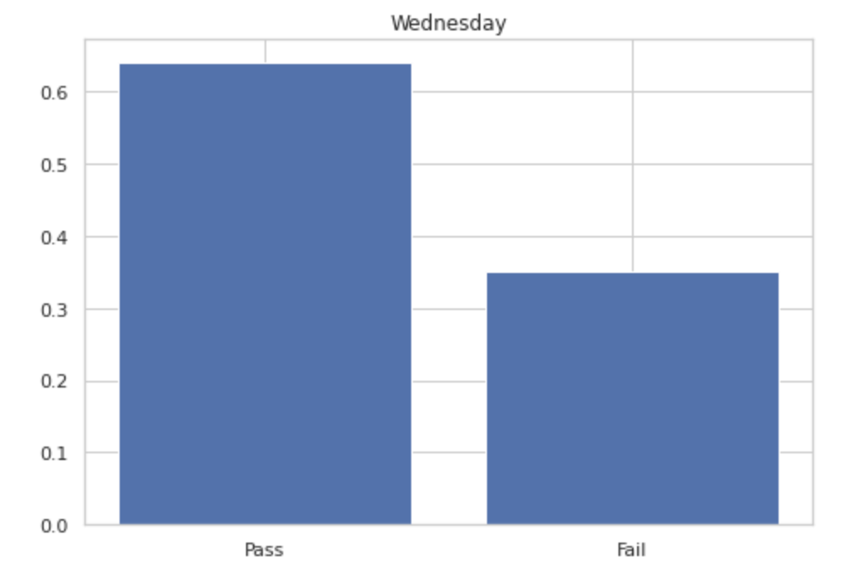
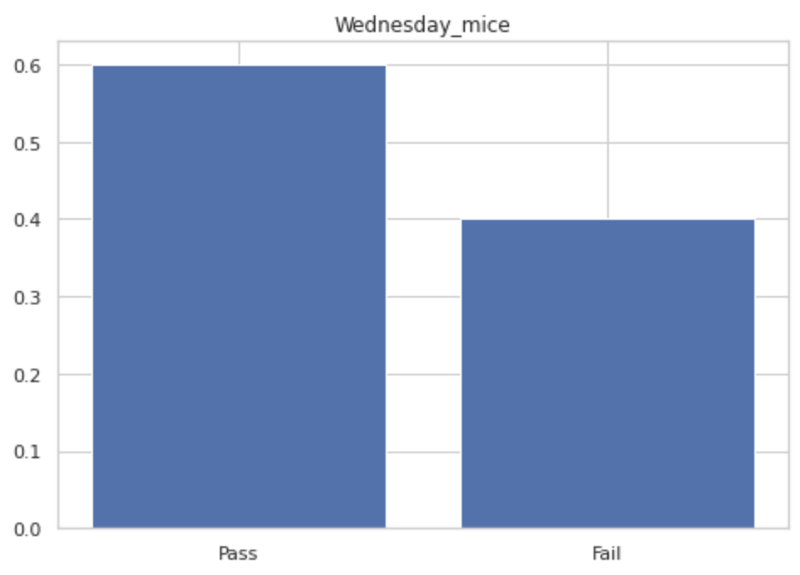
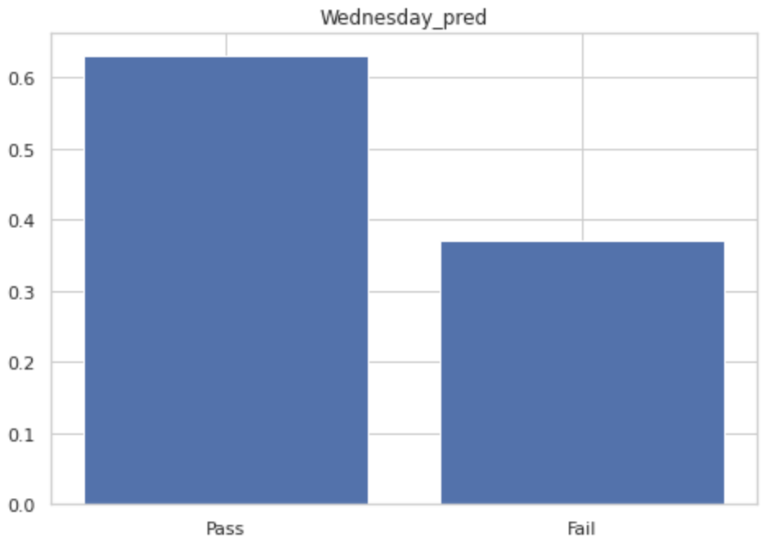
0.64,0.35
0.6,0.4
0.63,0.37

Slide 16
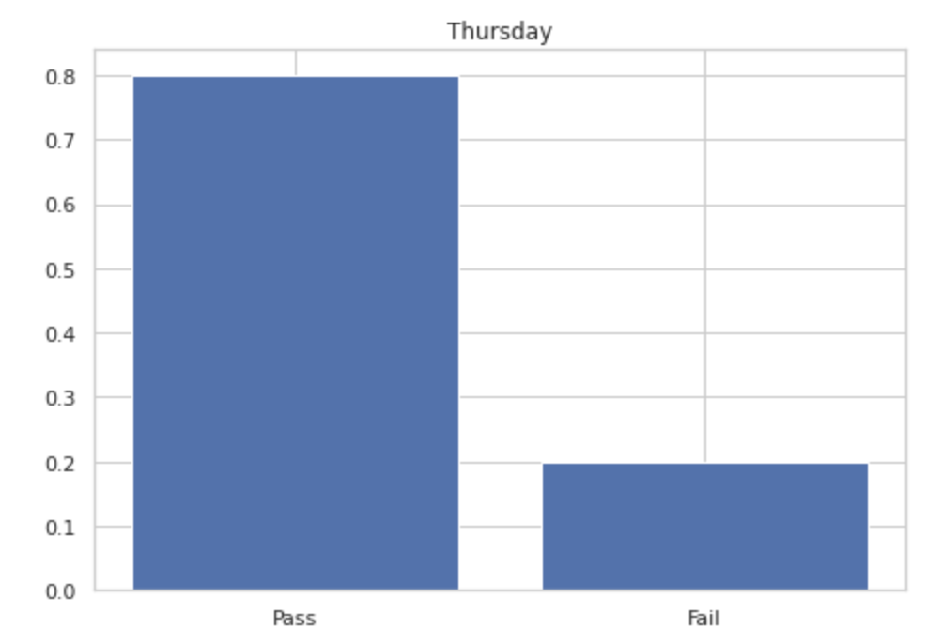
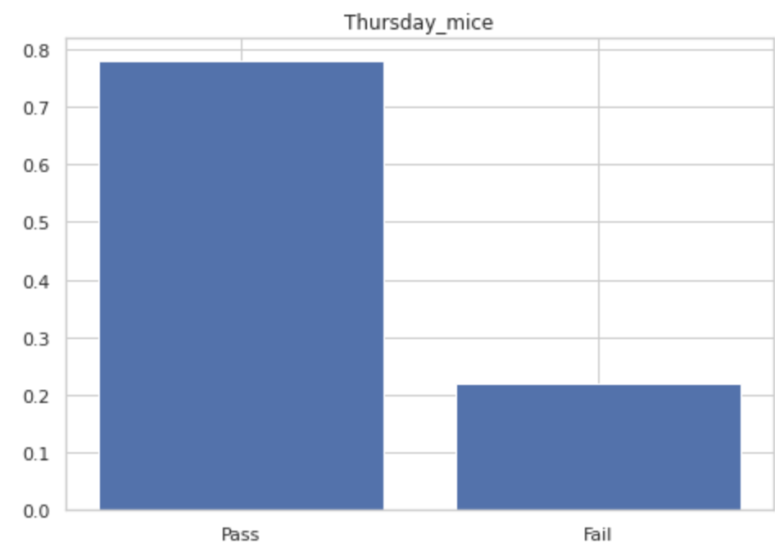
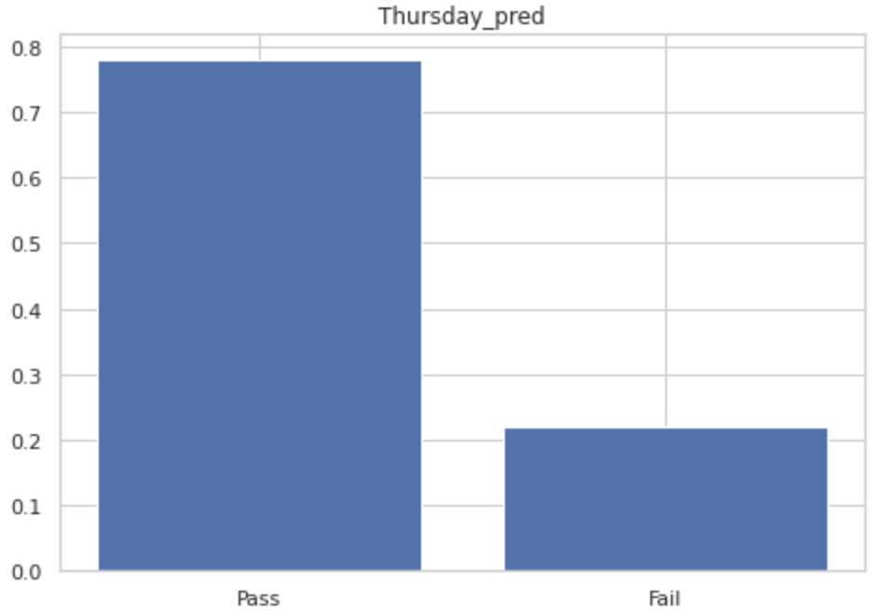
0.8,0.2
0.78,0.22
0.78,0.22

Slide 17
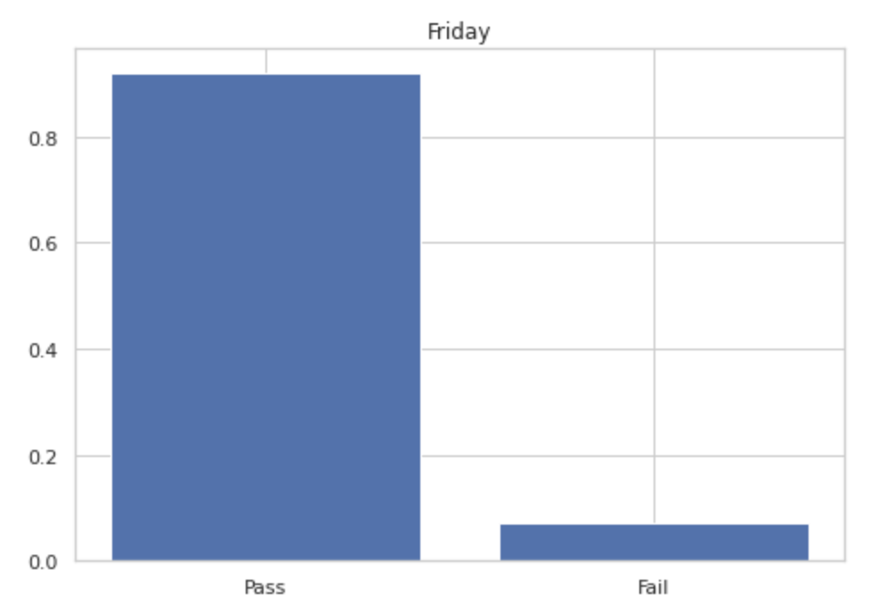
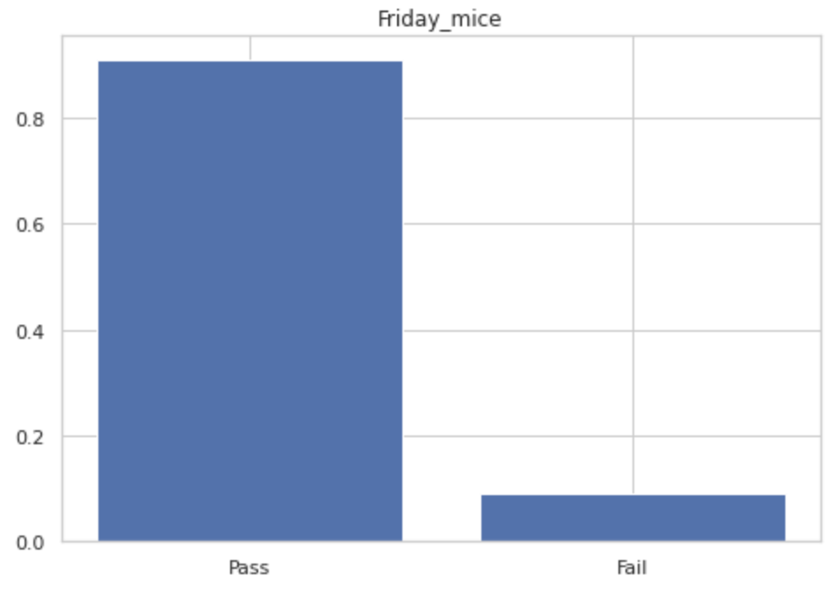
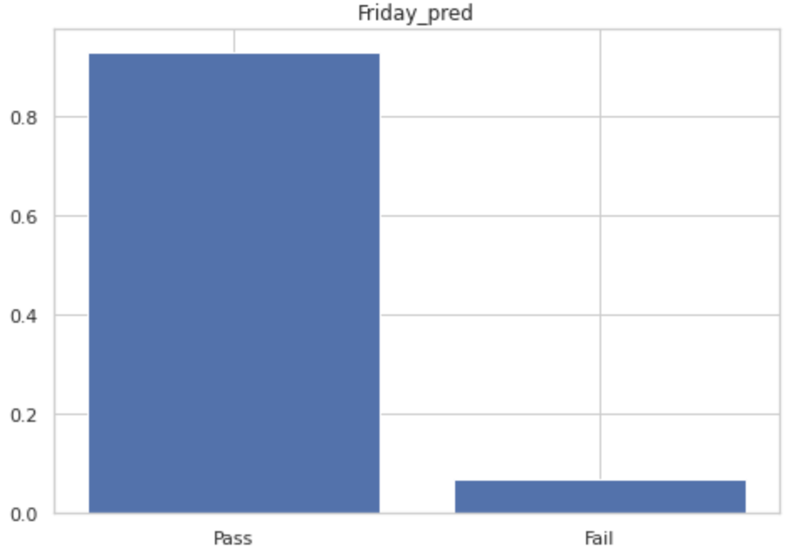
0.93,0.07
0.92,0.07
0.91,0.09

Slide 18
MOMENTS OF THE DATA
x | M | xM | x-mean | (x-mean)^2*M | (x-mean)^3*M | (x-mean)^4*M
0 | 2 | 0 | -3.556 | 25.290272 | -89.93220723 | 319.7989289
1 | 154 | 154 | -2.556 | 1006.102944 | -2571.599125 | 6573.007363
2 | 172 | 344 | -1.556 | 416.435392 | -647.97347 | 1008.246719
3 | 157 | 471 | -0.556 | 48.534352 | -26.98509971 | 15.00371544
4 | 180 | 720 | 0.444 | 35.48448 | 15.75510912 | 6.995268449
5 | 143 | 715 | 1.444 | 298.174448 | 430.5639029 | 621.7342758
6 | 192 | 1152 | 2.444 | 1146.842112 | 2802.882122 | 6850.243906
7 | 0 | 0 | 3.444 | 0 | 0 | 0
Sum | 1000 | 3556 |  | 2976.864 | -87.288768 | 15395.03018
 |  | 3.556 |  | 2.976864 | -0.087288768 | 15.39503018

Slide 19
MONDAY
MONDAY_MICE
Test Statistic | -7.47392
 |  | 95% confidence Interval | -0.21063
 |  |  | 0.131118
Test Statistic | -8.17334
 |  | 95% confidence Interval | -0.17171
 |  |  | 0.137667
MONDAY_PRED
Test Statistic | -8.65742
 |  | 95% confidence Interval | -0.03141
 |  |  | 0.277962
TUESDAY
TUESDAY_MICE
Test Statistic | -6.93304
 |  | 95% confidence Interval | -0.52342
 |  |  | -0.18106
Test Statistic | -7.7252
 |  | 95% confidence Interval | -0.46341
 |  |  | -0.15404
TUESDAY_PRED
Test Statistic | -7.98872
 |  | 95% confidence Interval | -0.44439
 |  |  | -0.13501

Slide 20
WEDNESDAY
WEDNESDAY_MICE
Test Statistic | -1.93737
 |  | 95% confidence Interval | -1.00933
 |  |  | -0.66717
Test Statistic | -3.17445
 |  | 95% confidence Interval | -0.92994
 |  |  | -0.62056
WEDNESDAY_PRED
Test Statistic | -2.82216
 |  | 95% confidence Interval | -0.94999
 |  |  | -0.64062
THURSDAY
THURSDAY_MICE
Test Statistic | 0.786569
 |  | 95% confidence Interval | -1.09196
 |  |  | -0.7427
Test Statistic | 0.878595
 |  | 95% confidence Interval | -1.05767
 |  |  | -0.7483
THURSDAY_PRED
Test Statistic | -0.35544
 |  | 95% confidence Interval | -1.05521
 |  |  | -0.74583

Slide 21
FRIDAY
FRIDAY_MICE
Test Statistic | 1.502153
 |  | 95% confidence Interval | -1.07471
 |  |  | -0.73339
Test Statistic | 3.325734
 |  | 95% confidence Interval | -1.15023
 |  |  | -0.84085
FRIDAY_PRED
Test Statistic | 6.854922
 |  | 95% confidence Interval | -1.35187
 |  |  | -1.04249

Slide 22
POISSON DISTRIBUTION
SAMPLE TAKEN FROM POPULATION HAS TO FOLLOW POISSON DISTRIBUTION, SAMPLE IS BEING WITH STUDENTS WHO HAVE THE SAME PERSONA
THE DISTRIBUTION OF STUDENTS ACCORDING TO SCORES OF THE SAMPLE MUST REPRESENT THE POPULATION

Slide 23
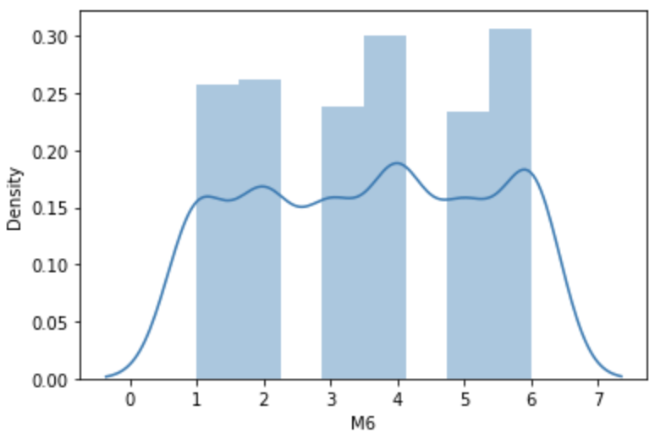
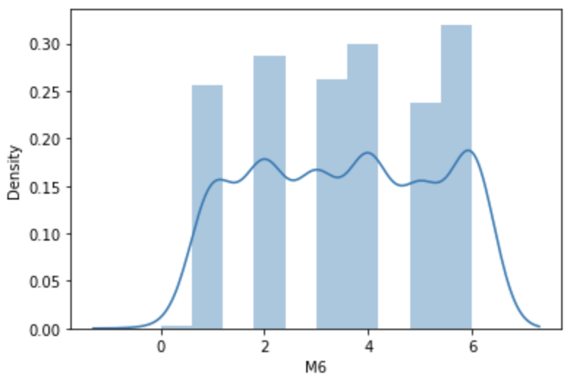
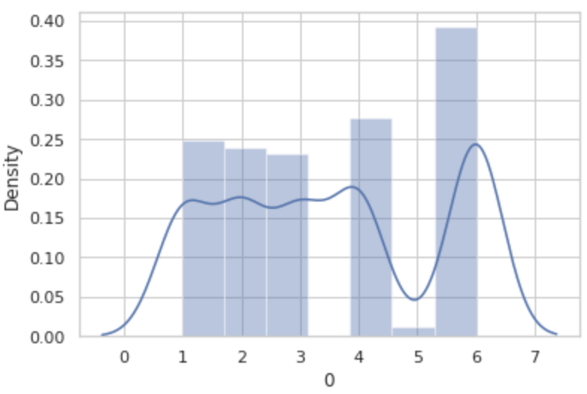
x | M
0 | 0
1 | 132
2 | 134
3 | 122
4 | 154
5 | 120
6 | 157
7 | 0
x | M
0 | 2
1 | 154
2 | 172
3 | 157
4 | 180
5 | 143
6 | 192
7 | 0
x | M
0 | 0
1 | 177
2 | 171
3 | 165
4 | 198
5 | 9
6 | 280
7 | 0

Slide 24
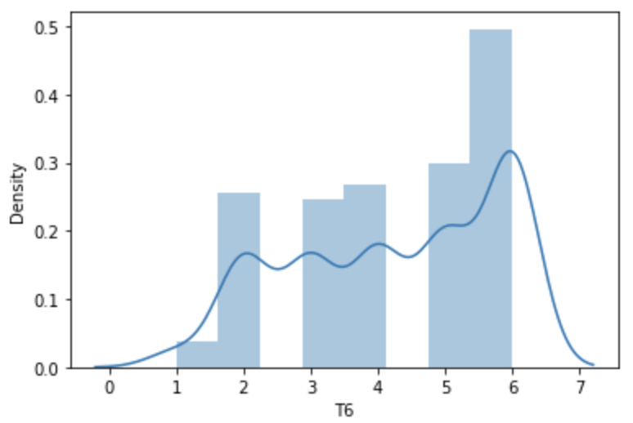
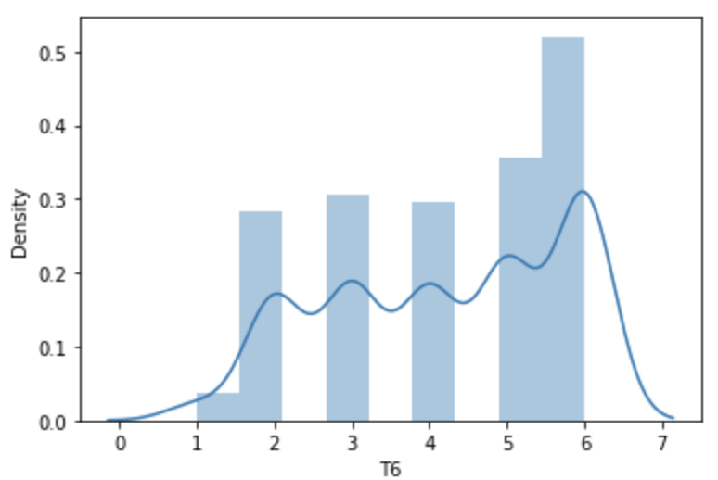
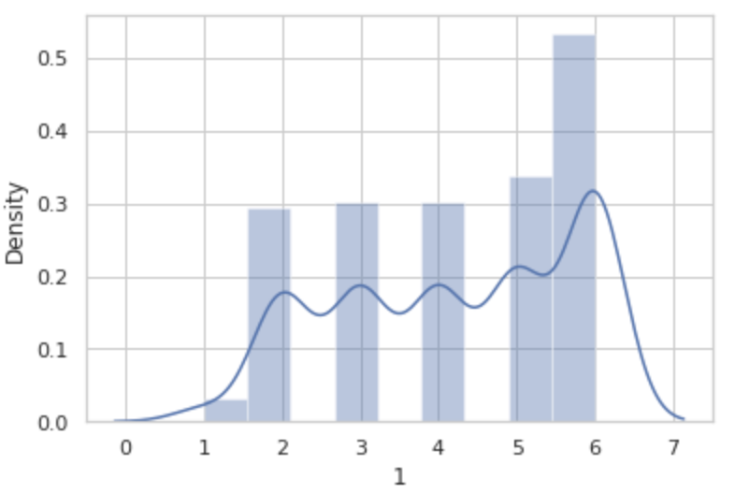
x | T
0 | 0
1 | 19
2 | 130
3 | 126
4 | 136
5 | 152
6 | 253
7 | 0
x | T
0 | 0
1 | 21
2 | 157
3 | 170
4 | 165
5 | 198
6 | 289
7 | 0
x | T
0 | 0
1 | 17
2 | 163
3 | 168
4 | 168
5 | 188
6 | 296
7 | 0

Slide 25
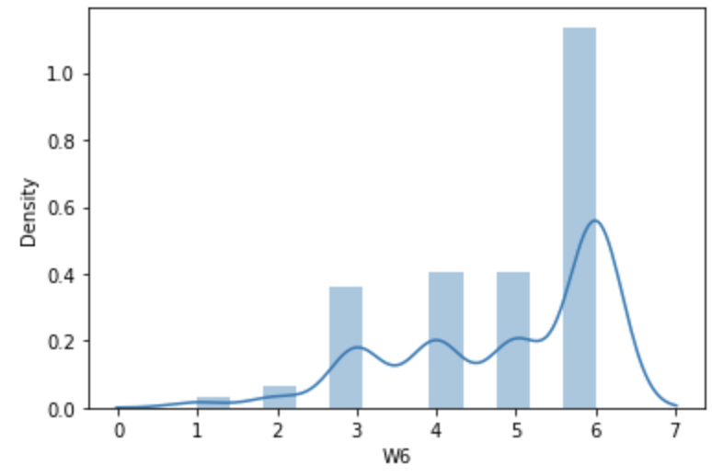
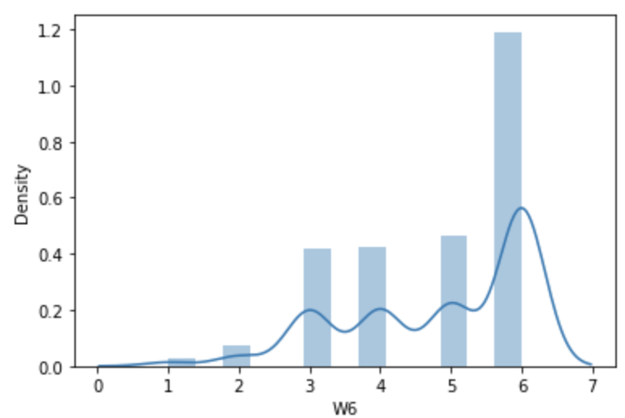
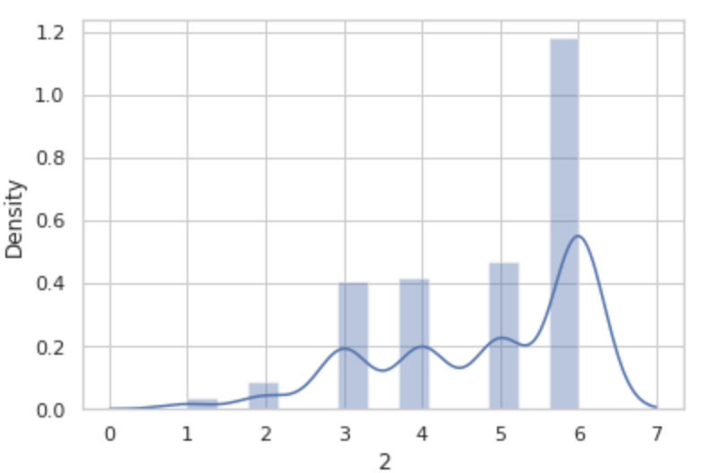
x | W
0 | 0
1 | 11
2 | 22
3 | 123
4 | 137
5 | 137
6 | 387
7 | 0
x | W
0 | 0
1 | 11
2 | 29
3 | 161
4 | 163
5 | 178
6 | 458
7 | 0
x | W
0 | 0
1 | 13
2 | 34
3 | 157
4 | 161
5 | 181
6 | 454
7 | 0

Slide 26
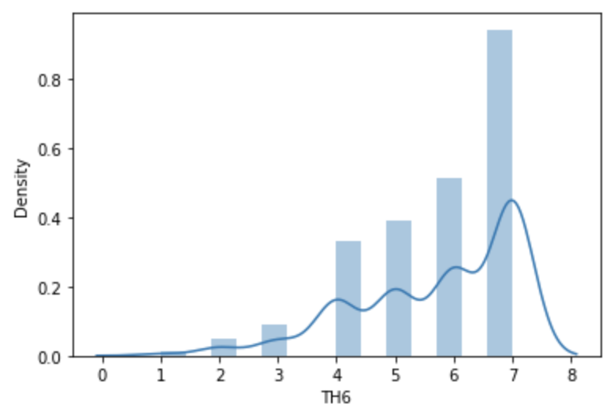
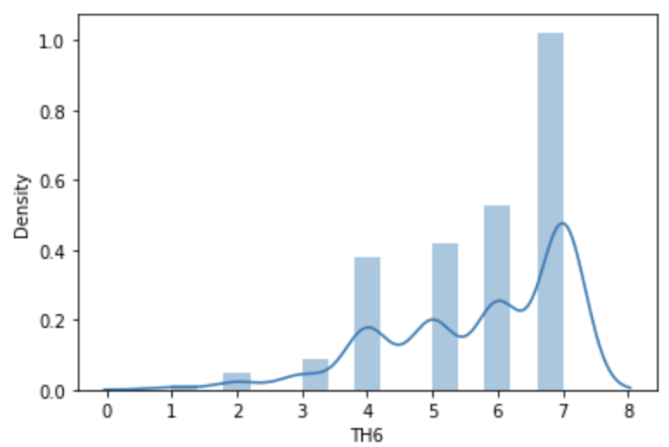
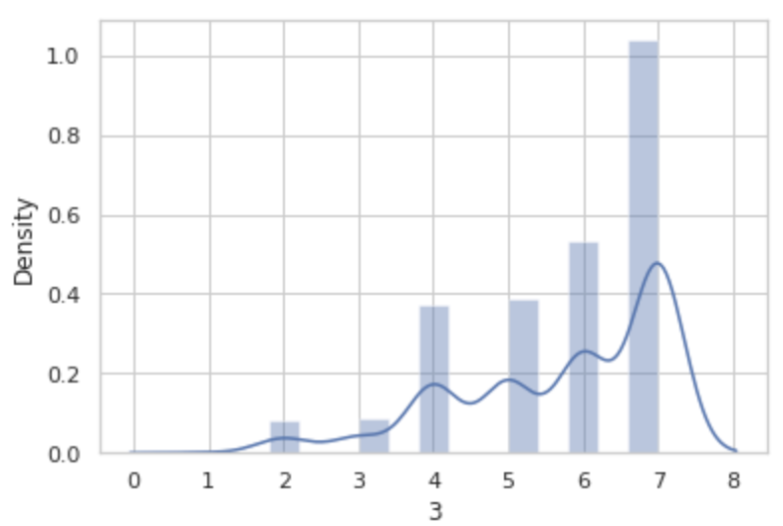
x | TH
0 | 0
1 | 4
2 | 17
3 | 31
4 | 112
5 | 131
6 | 172
7 | 317
x | TH
0 | 0
1 | 6
2 | 19
3 | 36
4 | 151
5 | 168
6 | 211
7 | 409
x | TH
0 | 0
1 | 1
2 | 32
3 | 35
4 | 148
5 | 155
6 | 214
7 | 415

Slide 27
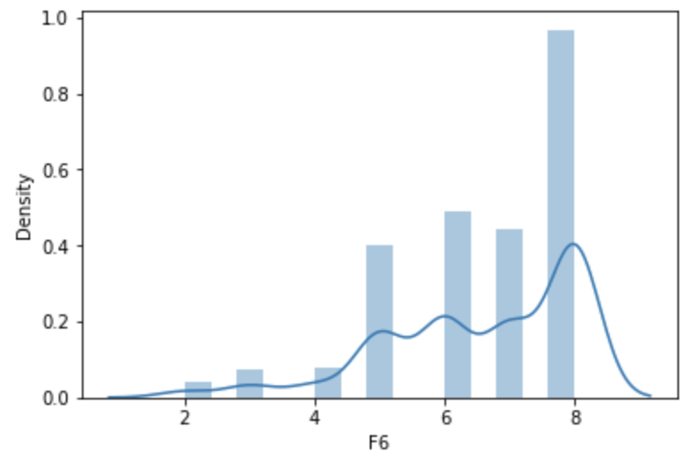
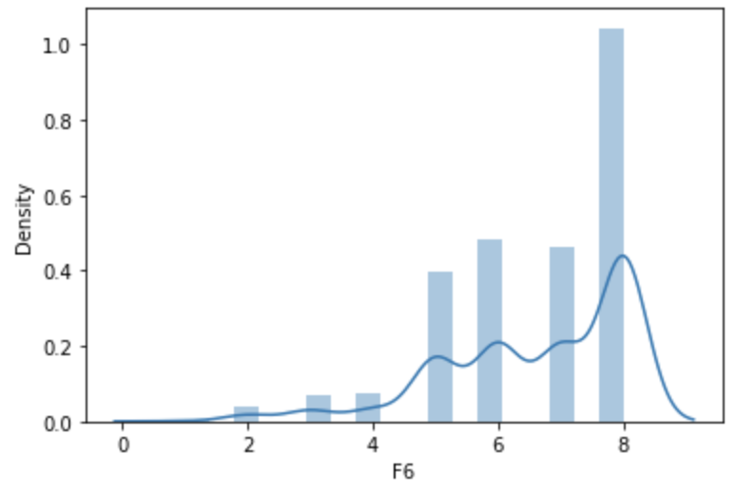
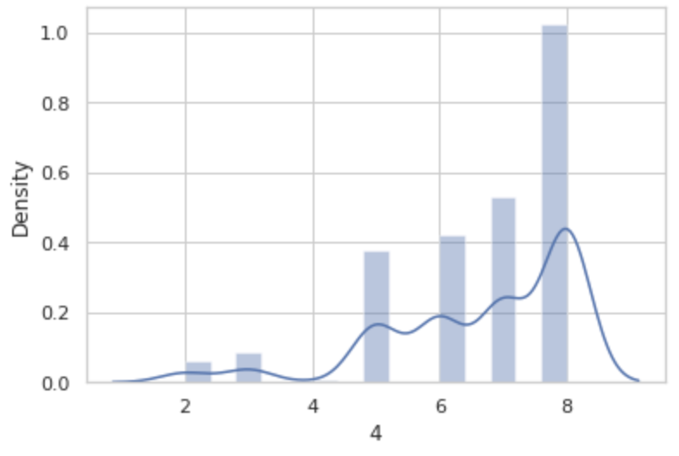
x | F
0 | 0
1 | 0
2 | 13
3 | 25
4 | 26
5 | 132
6 | 161
7 | 146
8 | 318
x | F
0 | 0
1 | 1
2 | 16
3 | 27
4 | 29
5 | 154
6 | 187
7 | 180
8 | 406
x | F
0 | 0
1 | 0
2 | 25
3 | 34
4 | 2
5 | 151
6 | 168
7 | 211
8 | 409

Slide 28
NORMAL DISTRIBUTION
CALCULATED MEAN AND STANDARD DEVIATION FOR EACH WEEK DAY FROM WEEK-1 TO WEEK-6
EX: M1, M2, M3, M4, M5
EX: M1, M2, M3, M4, M5, M6
EX: M1, M2, M3, M4, M5, M6, PREDICTED WEEK-7

Slide 29
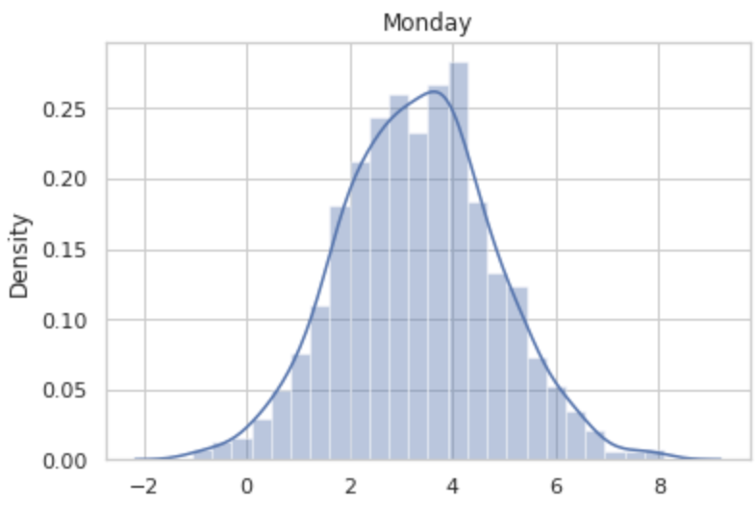
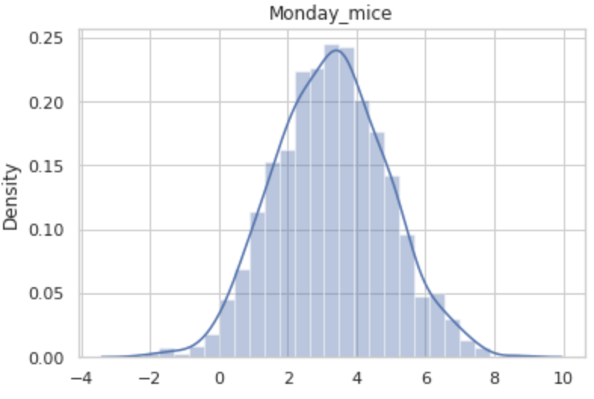
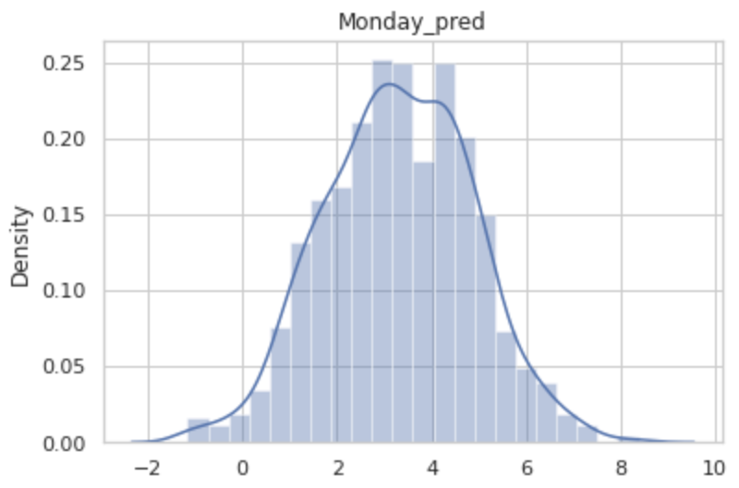
(3.27, 1.6)
(3.3, 1.6)
(3.2, 1.56)

Slide 30
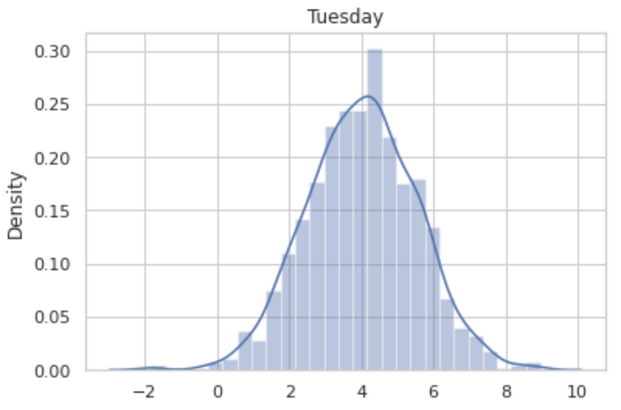
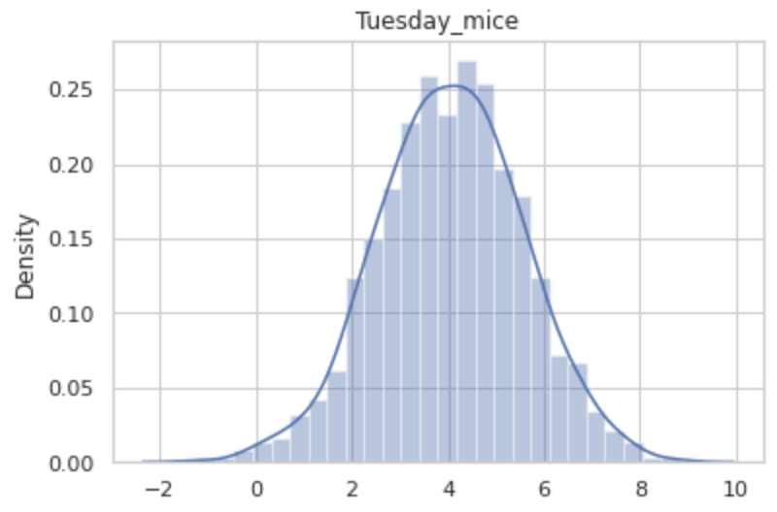

(4, 1.5)
(4, 1.5)
(4.05, 1.5)

Slide 31



(4.7, 1.4)
(4.7, 1.4)
4.75, 1.38

Slide 32



(5.4, 1.3)
(5.48, 1.32)
(5.5, 1.3)

Slide 33



(6.07, 1.2)
(6.16, 1.28)
(6.2, 1.32)

Slide 34
THANK YOU

