Slide 1
ELK
Elastic Search Logstash Kibana

Slide 2
The Evolution of the Elastic Stack
The acronym ELK stands for Elasticsearch, Logstash, and Kibana, three open-source projects that form a powerful stack for log ingestion and visualization, log search, event analysis, and helpful visual metrics for monitoring applications.
E lasticsearch is the heart of the stack: a JSON-based search and analytics engine, distributed and scalable. It was built on top of Apache Lucene and provides a JSON REST API, cluster management, high availability, and fault tolerance.
L ogstash is an ETL (extract, transform, load) tool to enrich documents, run data processing pipelines. These pipelines ingest data from multiple sources, transform and send it to Elasticsearch.
K ibana provides the visualization front-end, a window into the Elastic Stack. With dashboards and visualization elements, the data stored in Elasticsearch can be explored, aggregated and analyzed.

Slide 3
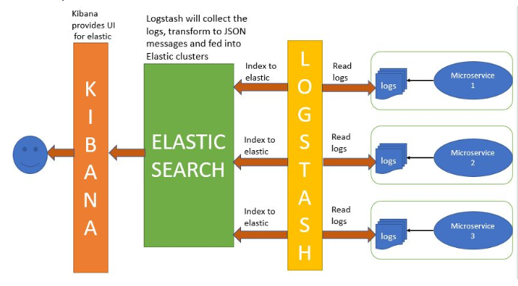
Use cases…

Slide 4
Cond…
Consider you have a single application running and it produces logs. Now suppose you want analyze the logs generated. One option is to manually analyze them. But suppose these logs are large, then manually analyzing them is not feasible.
Suppose we have multiple Application running and all these applications produce logs. If we have to analyze the logs manually we will need to go through all the log files. These may run into hundreds.
We can use ELK here to analyze the logs more efficiently and also using more complex search criterias. It provides log aggregation and efficient searching.

Slide 5
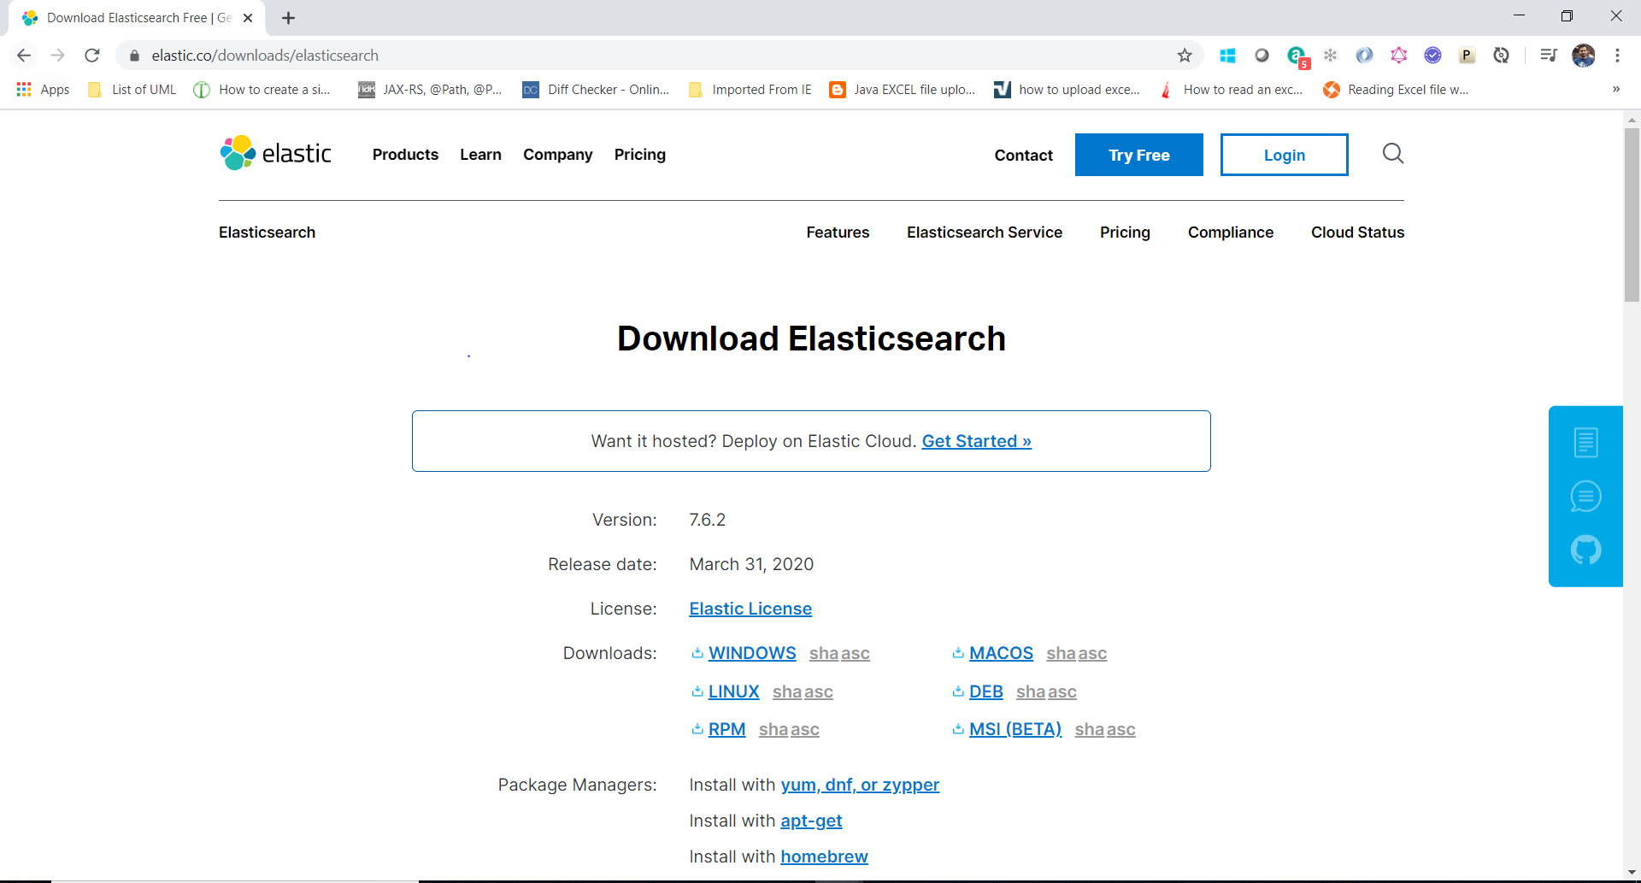
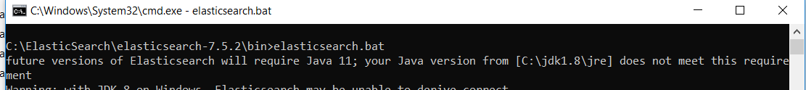
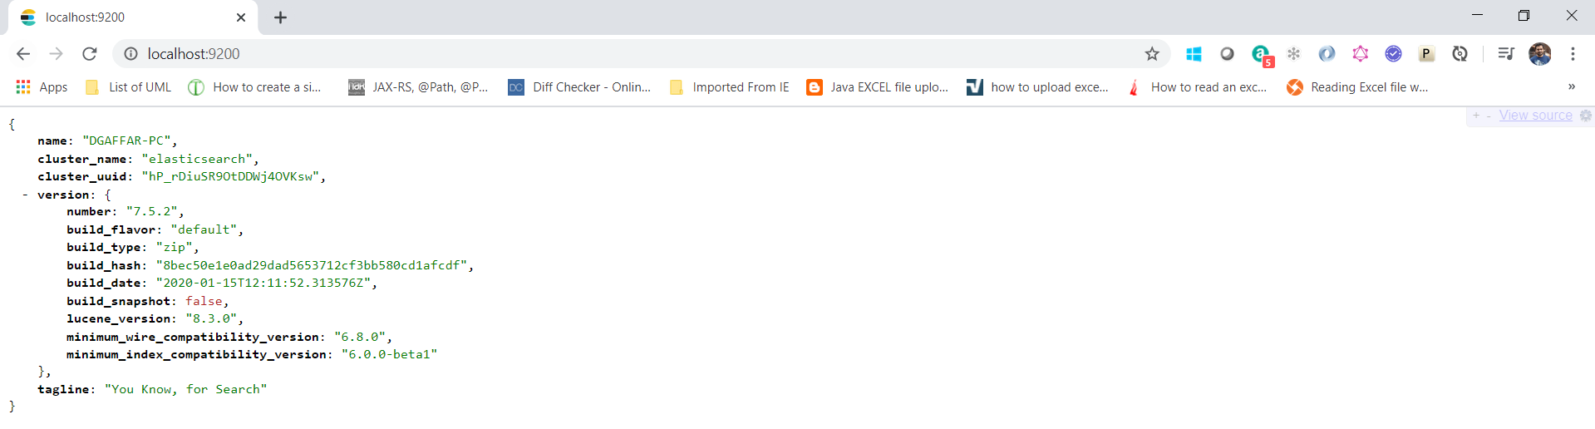
Download - ELK
Elasticsearch : https://www.elastic.co/downloads/elasticsearch
Unzip & Start Elasticsearch
localhost:9200/

Slide 6
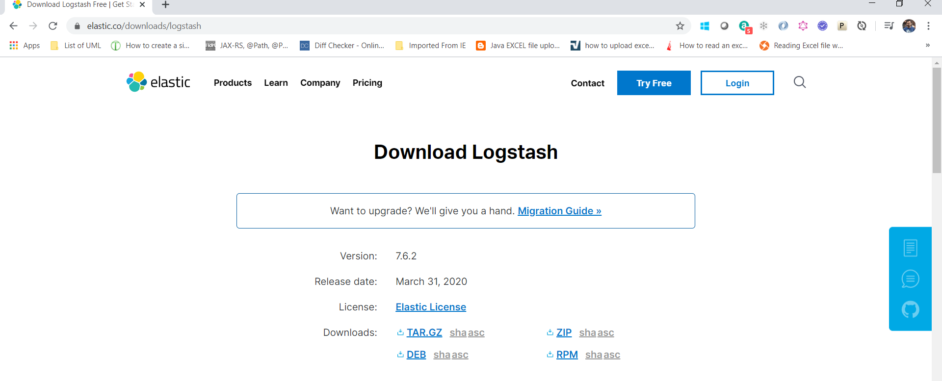
Contd…
Logstash : https://www.elastic.co/downloads/logstash
Note : Create the configuration file logstash.conf . Making the changes for this file and starting logstash. need to make some changes. []

Slide 7
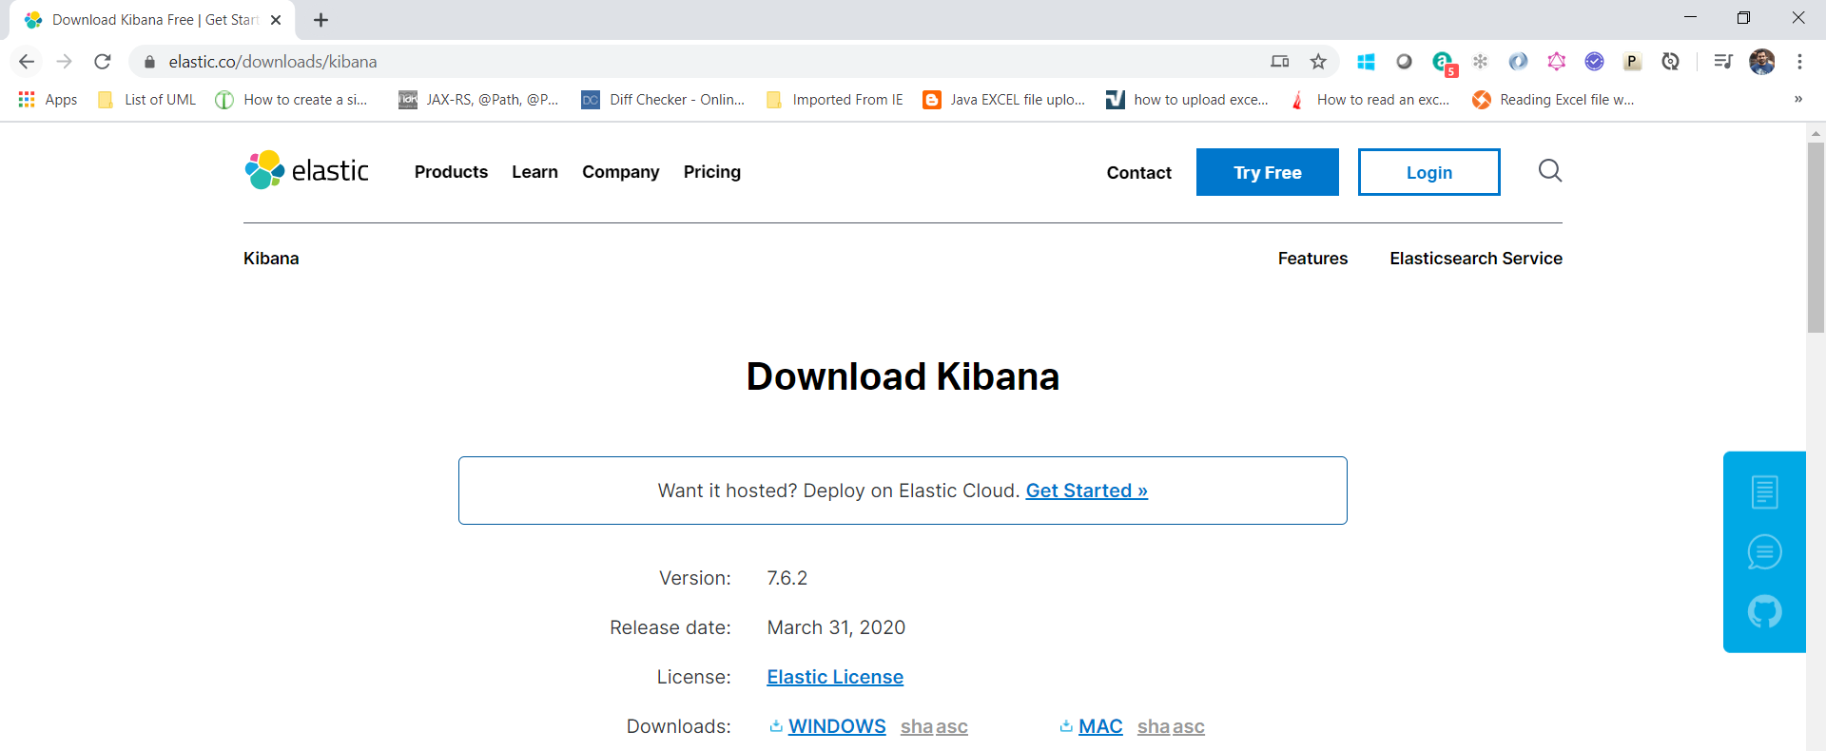

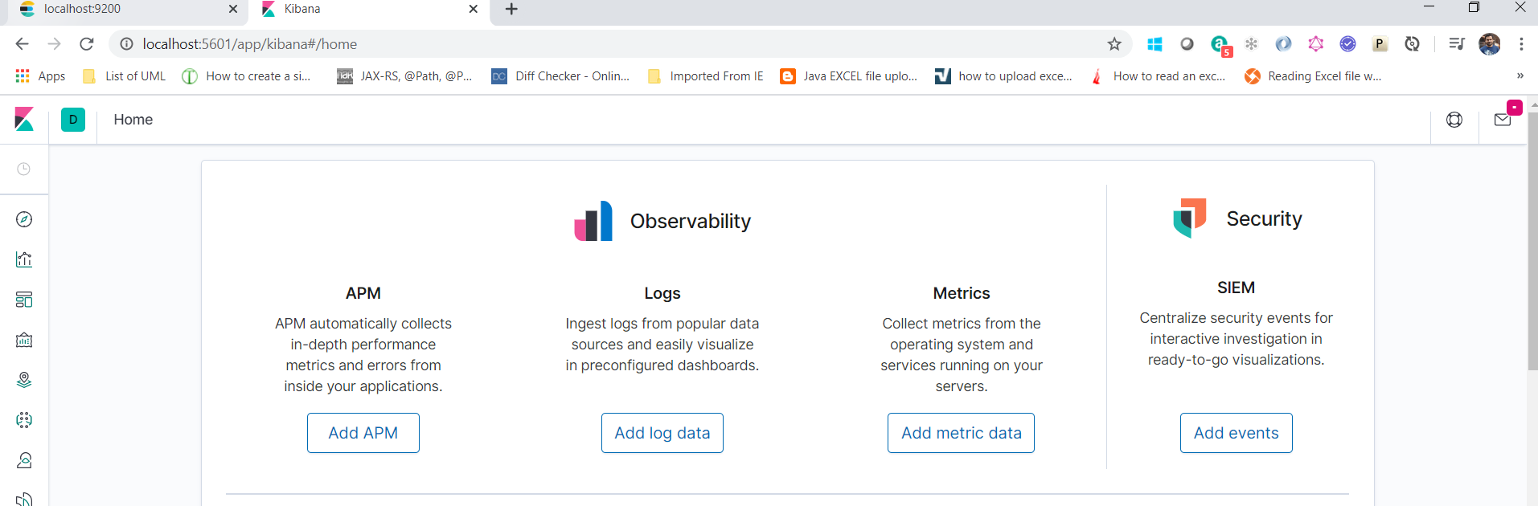
Contd…
Kibana : https://www.elastic.co/downloads/kibana
Unzip, inside config folder make some configuration. Kibana.yml file uncomment elasticsearch url.
Start kibana.bat and localhost: http://localhost:5601/

Slide 8
Application-LogsMonitoring
@RequestMapping(value = "/logsmonitoring")
public String helloWorld() {
String response = "Welcome to Extreme Networks.....!!!!" + new Date();
LOGGER.info(Level.INFO + ", "+ response);
return response;
}
@RequestMapping(value = "/exception")
public String exception() {
String response = "";
try {
throw new Exception("Exception has occured....");
} catch (Exception e) {
LOGGER.error("Error....: ", e);
StringWriter sw = new StringWriter();
PrintWriter pw = new PrintWriter(sw);
e.printStackTrace(pw);
String stackTrace = sw.toString();
LOGGER.error("Exception - " + stackTrace);
response = stackTrace;
}

Slide 9
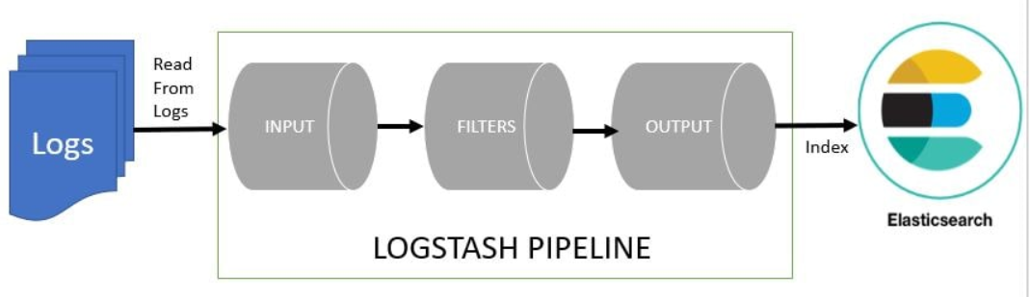
Logstash pipeline
logging.file = C:/elk/log-monitoring-elk.log
Create logstash.conf file under bin folder. In this file contains 3 segments.
Input :
C:\ELK\log-monitoring-elk
Filter:
if [message] =~ "\tat" {
Output:
elasticsearch {
hosts => ["localhost:9200"]

Slide 10
Test….
0. Run ElasticSearch , Logstash , Kibana
Run springboot application
http://localhost:9001/logsmonitoring
http://localhost:9001/exception
4. Postman :
http://localhost:9200/_cat/indices/?v
http://localhost:9200/logstash-2020.04.09-000001/_search

Slide 11
Kibana
http://localhost:5601/app/kibana#/home
kibana UI console- localhost and create an index pattern logstash-*
to see the indexed data.
Management –> create index pattern.[ logstash-*]
Discover -> choose logstash-* and give the timestamp see the logs.
Download the source code from GitLab Dowlath Basha G / Logs-Monitoring-ELK-SpringBoot

