Slide 1
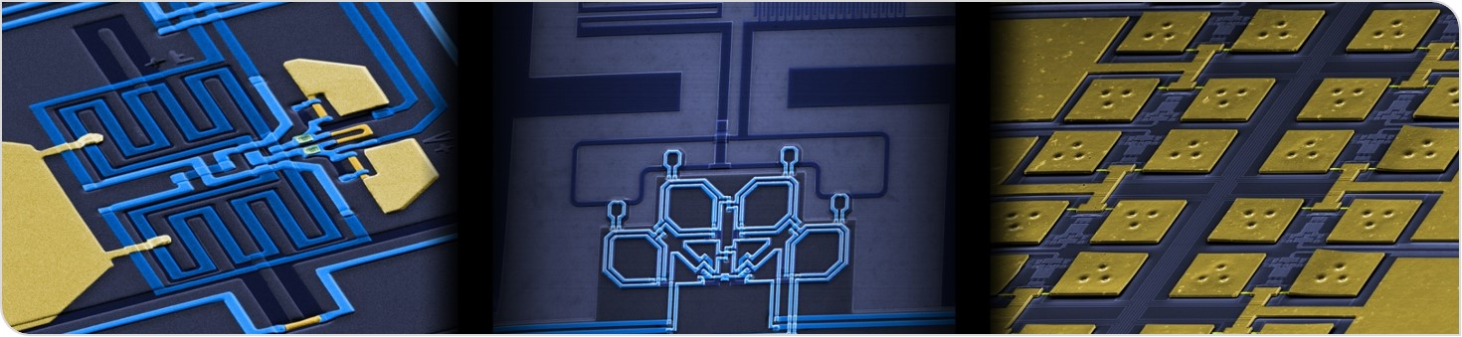
Heat flow simulations
DELight Meeting 19.11.23
Lena Hauswald

Slide 2
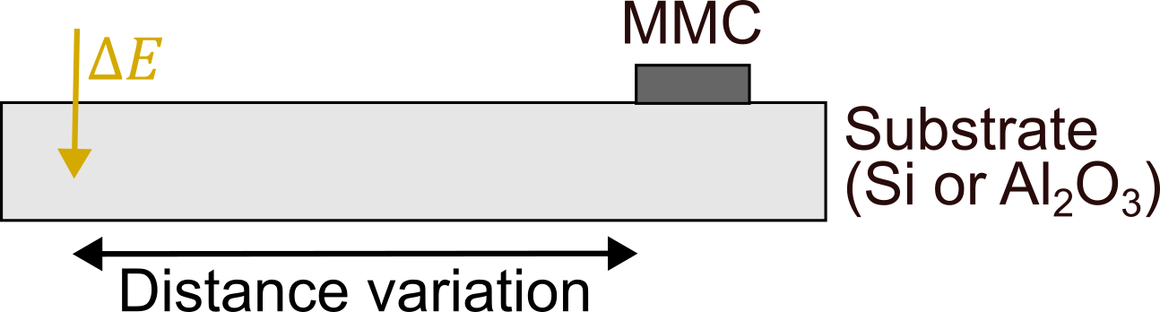
Heat flow simulation
Rise time determination
Radially symmetrical → 2D-problem

Slide 3
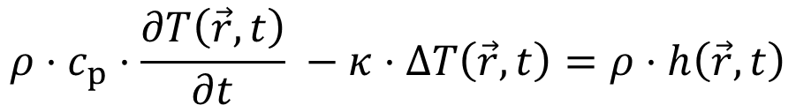
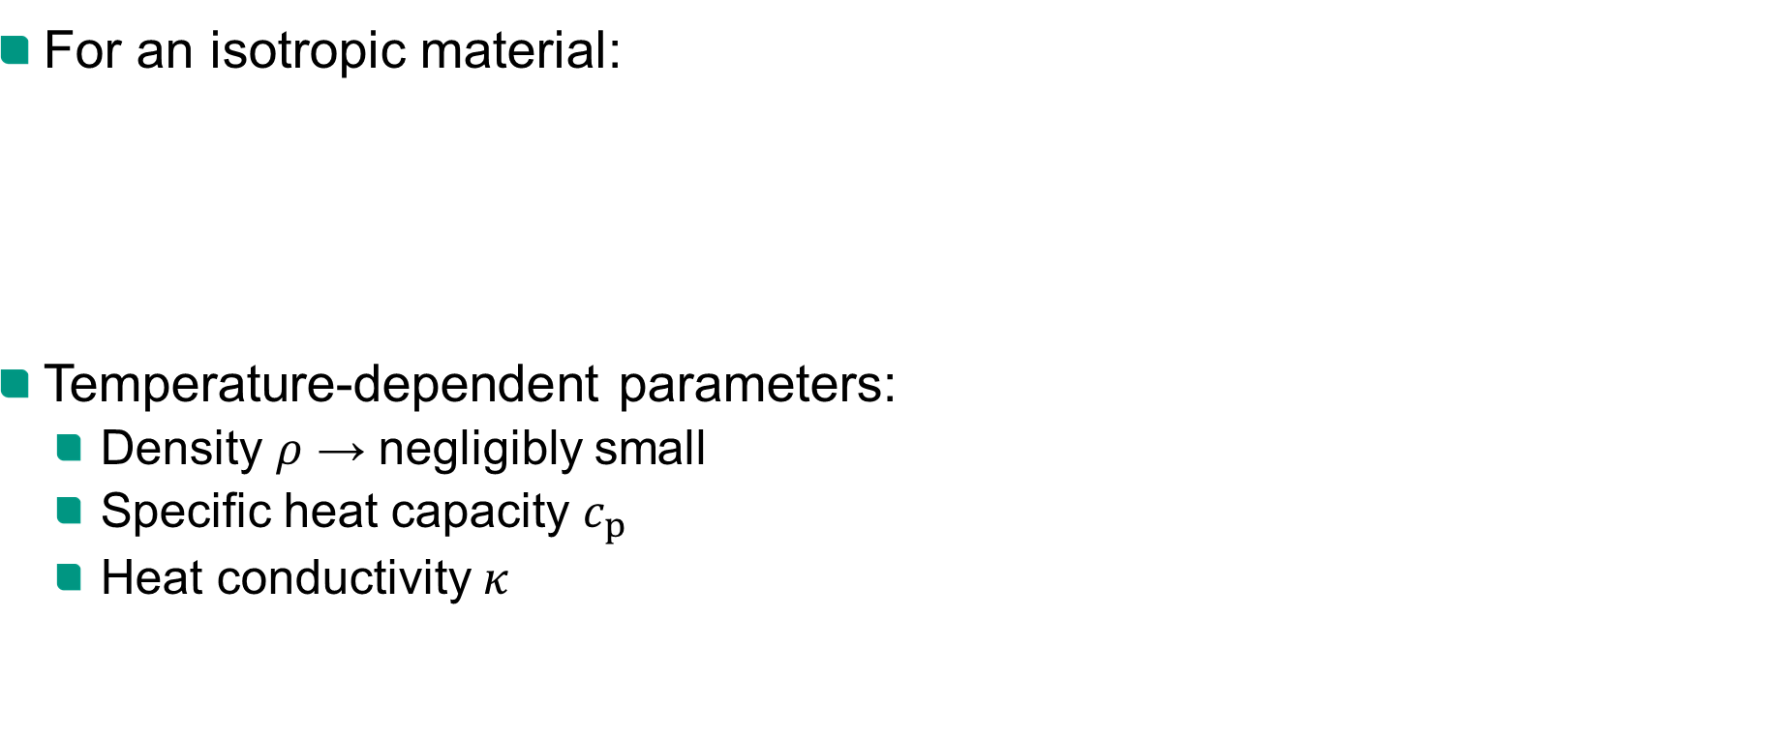
Diffusion equation
For an isotropic material:
Temperature-dependent parameters:
Density $ρ$ → negligibly small
Specific heat capacity $c_{p}$
Heat conductivity $κ$
$$ρ⋅c_{p}⋅\frac{∂T\left(\vec{r},t\right)}{∂t} −κ⋅ΔT\left(\vec{r},t\right)=ρ⋅h\left(\vec{r},t\right)$$
specific heat capacity $c_{p}$, heat conductivity $κ$, heat source $h$

Slide 4
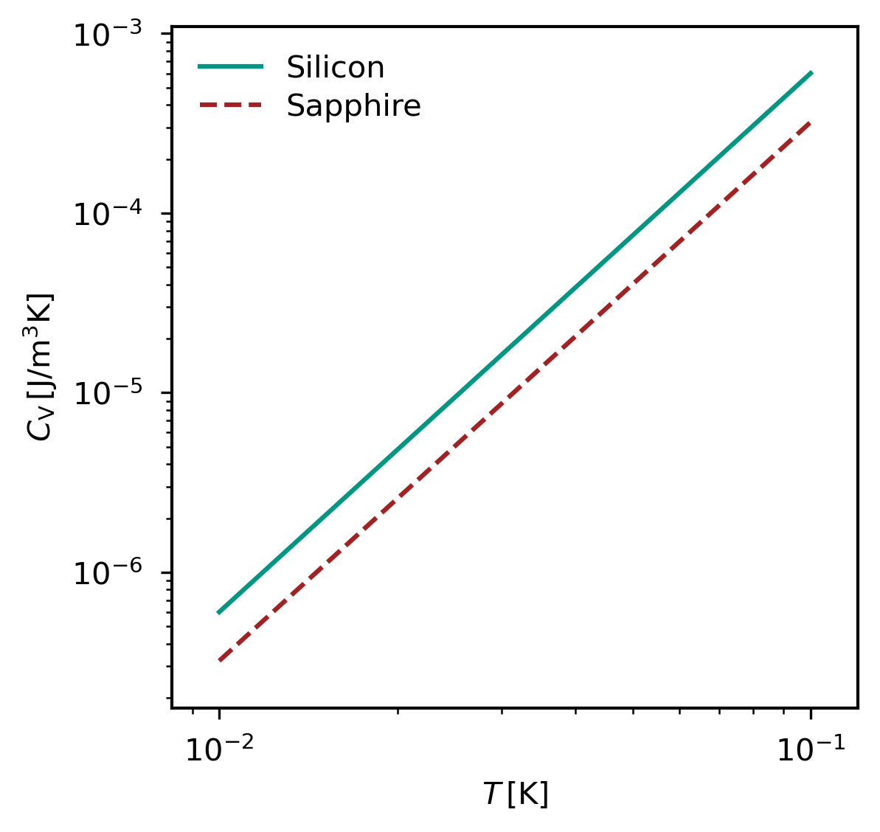
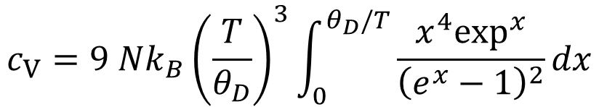
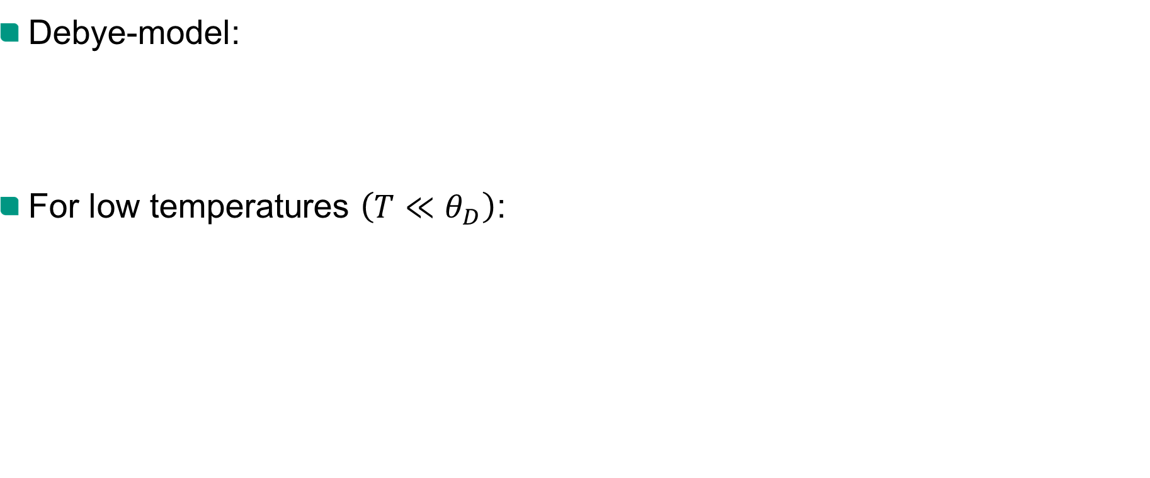

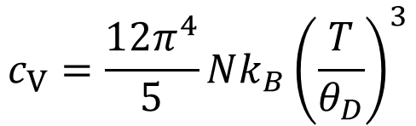
Specific heat capacity
Debye-model:
For low temperatures $\left(T≪θ_{D}\right)$:
$$c_{V}=9 Nk_{B}{\left(\frac{T}{θ_{D}}\right)}^{3}\int_{0}^{θ_{D}/T}{\frac{x^{4}\exp^{x}}{{\left(e^{x}−1\right)}^{2}}{dx}}$$
debye-temperature $θ_{D}$
$$c_{V}=\frac{12π^{4}}{5}Nk_{B}{\left(\frac{T}{θ_{D}}\right)}^{3}$$

Slide 5

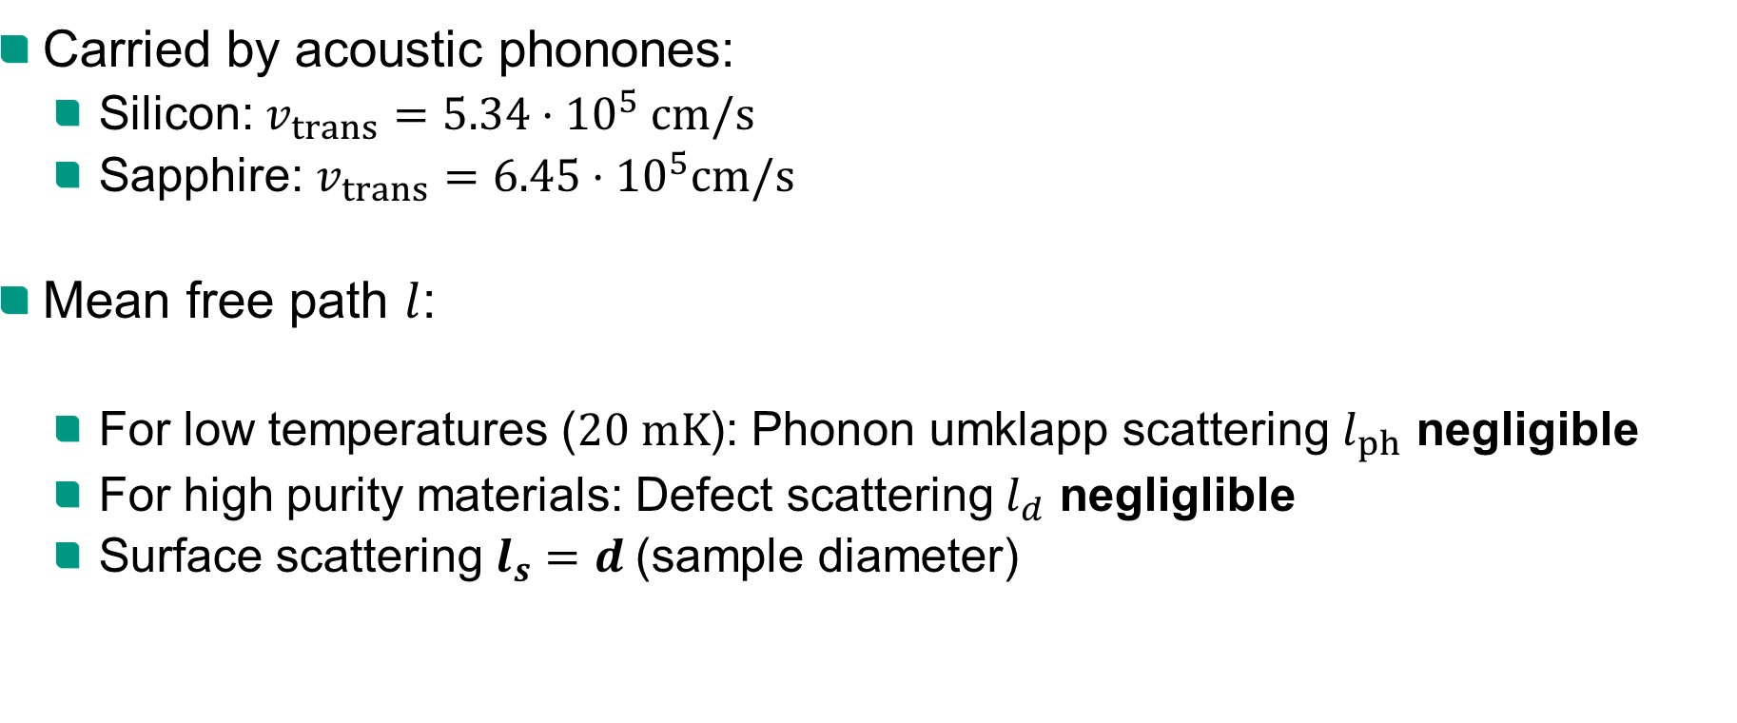

Heat conductivity
Carried by acoustic phonones:
Silicon: $v_{trans}=5.34⋅{10}^{5} cm/s$
Sapphire: $v_{trans}=6.45⋅{10}^{5}cm/s$
Mean free path $l$:
For low temperatures ($20 mK$): Phonon umklapp scattering $l_{ph}$ negligible
For high purity materials: Defect scattering $l_{d}$ negliglible
Surface scattering $l_{s}=d$(sample diameter)
$$κ=\frac{1}{3}c_{V}⋅v⋅l$$
$$\frac{1}{l}=\frac{1}{l_{ph}}+\frac{1}{l_{s}}+\frac{1}{l_{d}}$$

Slide 6
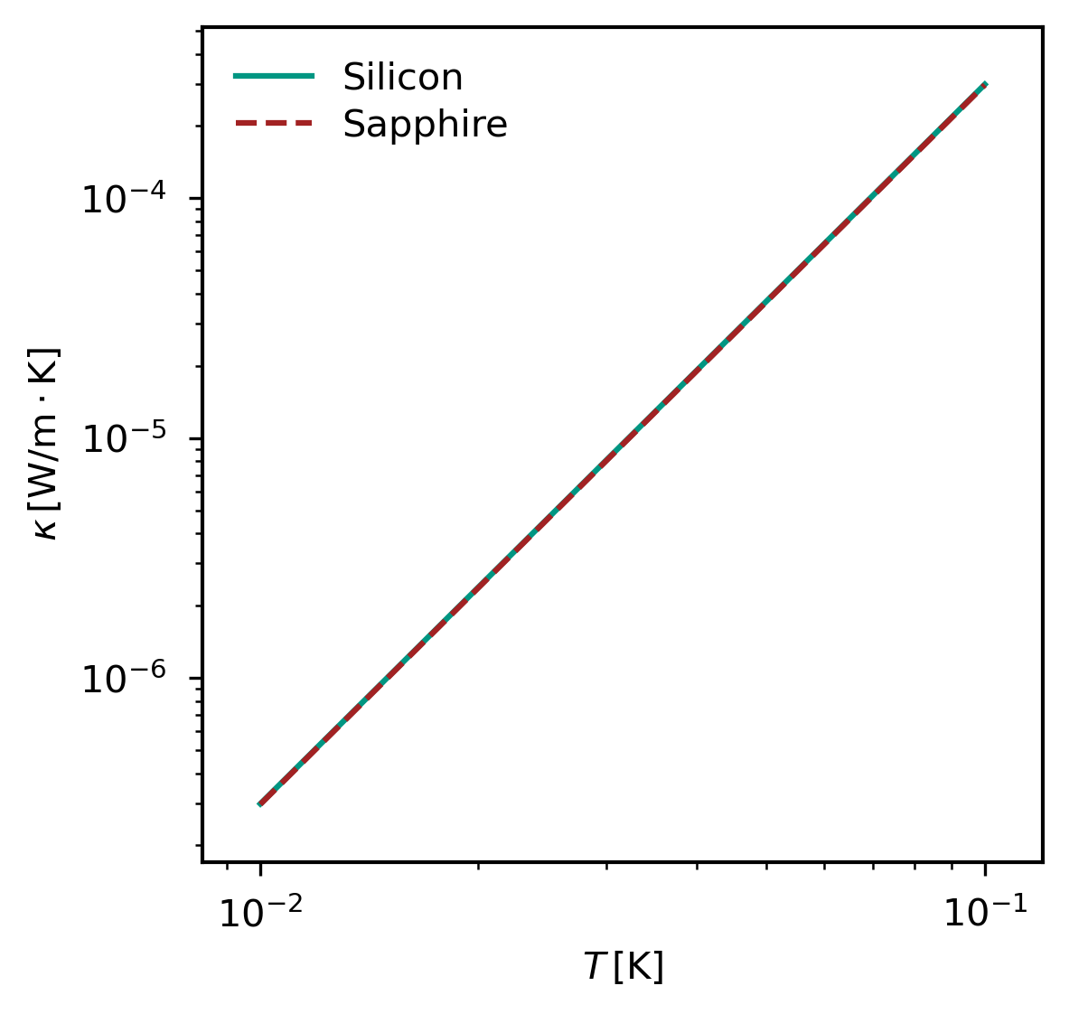
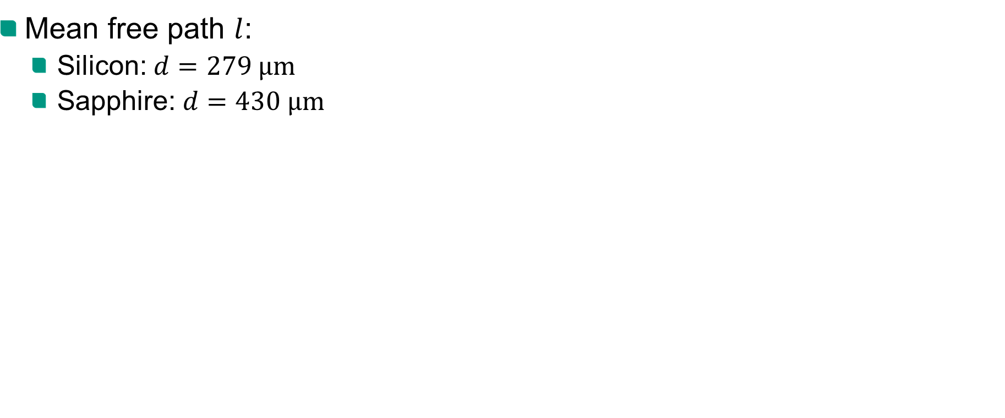
Heat conductivity
Mean free path $l$:
Silicon: $d=279 µm$
Sapphire: $d=430 µm$

Slide 7
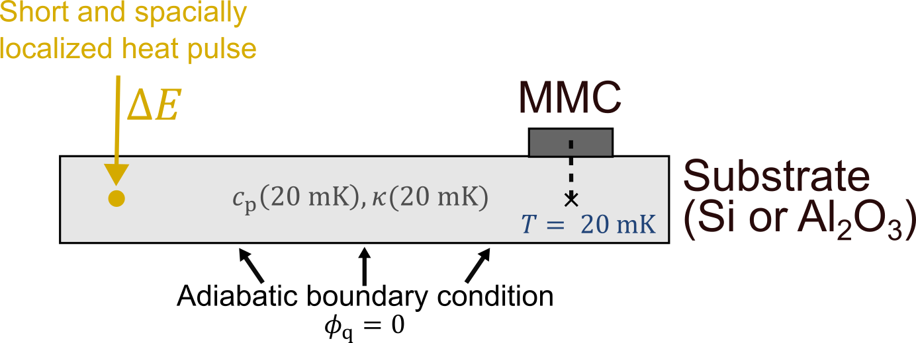
Simulation of heat flow
Finite-Elemente-Methode (FEM) simulation with Elmer
Subdivision of the area into small triagonals

Slide 8
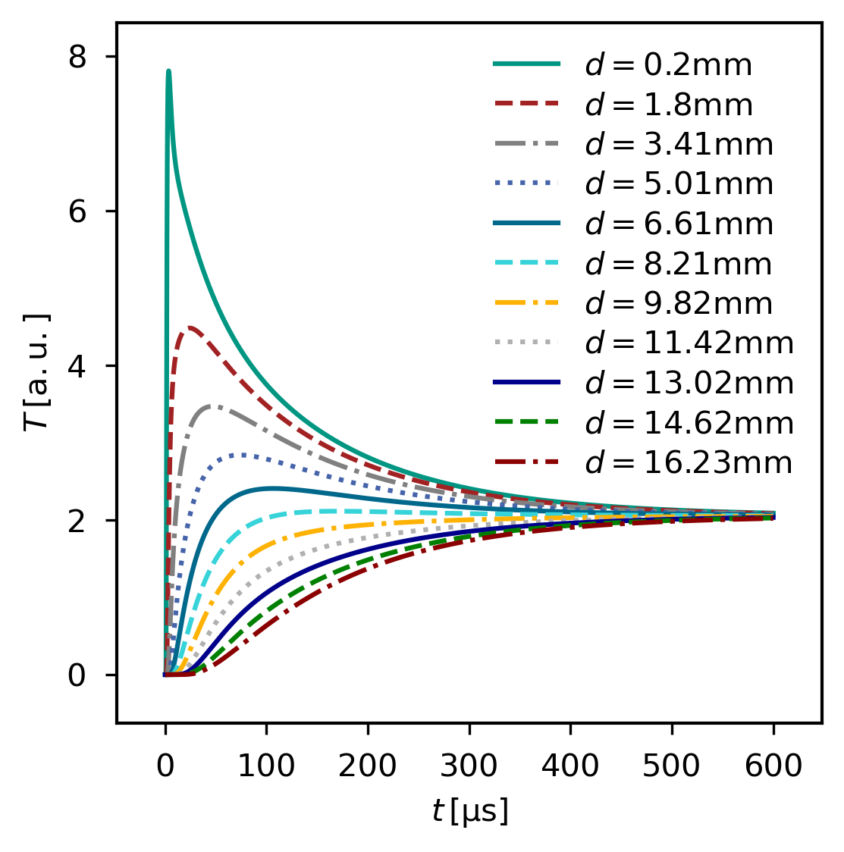
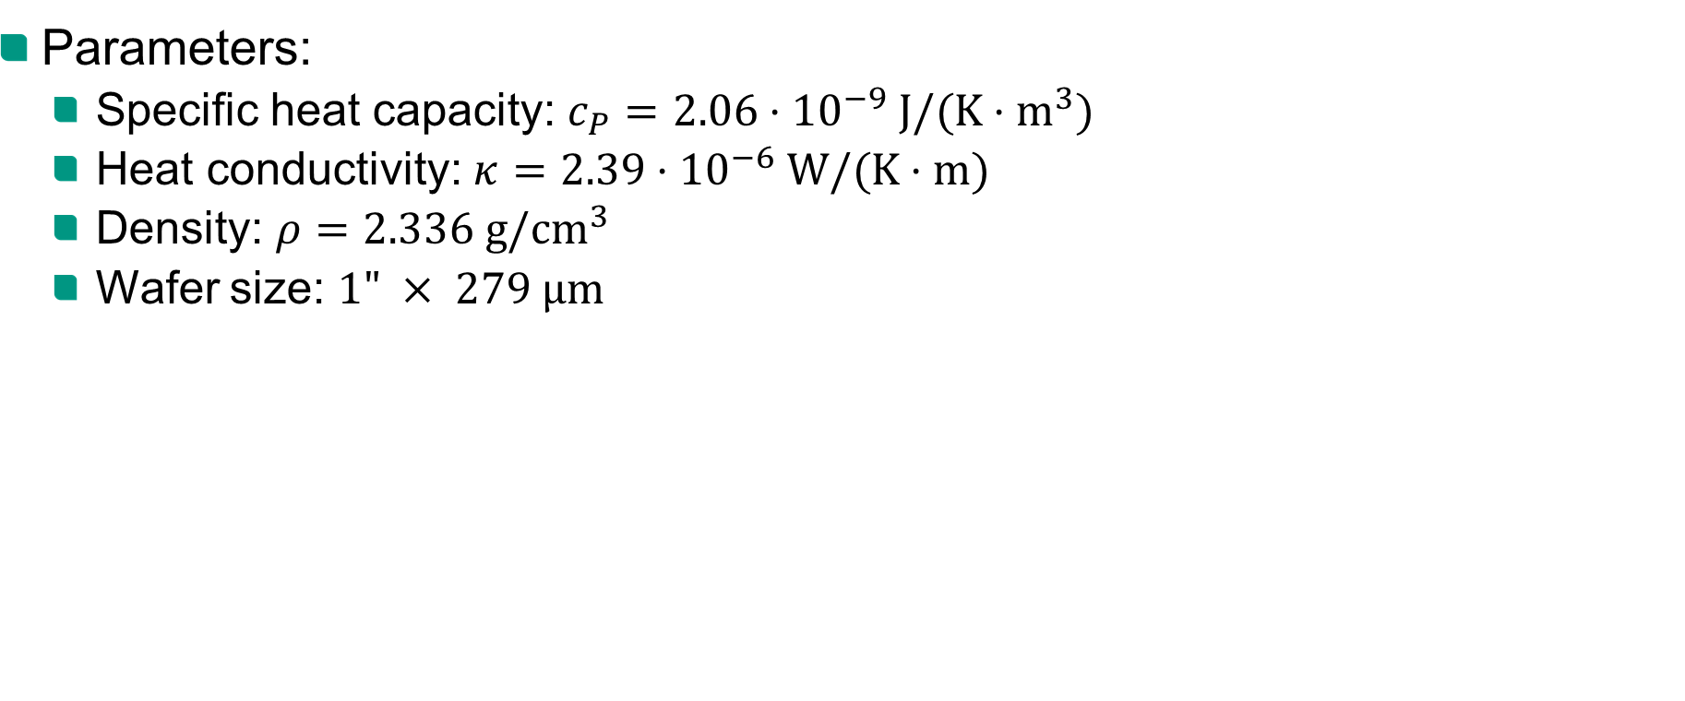
Silicon
Parameters:
Specific heat capacity: $c_{P}=2.06⋅{10}^{−9} J/(K⋅m^{3})$
Heat conductivity: $κ=2.39⋅{10}^{−6} W/(K⋅m)$
Density: $ρ=2.336 g/cm^{3}$
Wafer size: $1" × 279 µm$

Slide 9
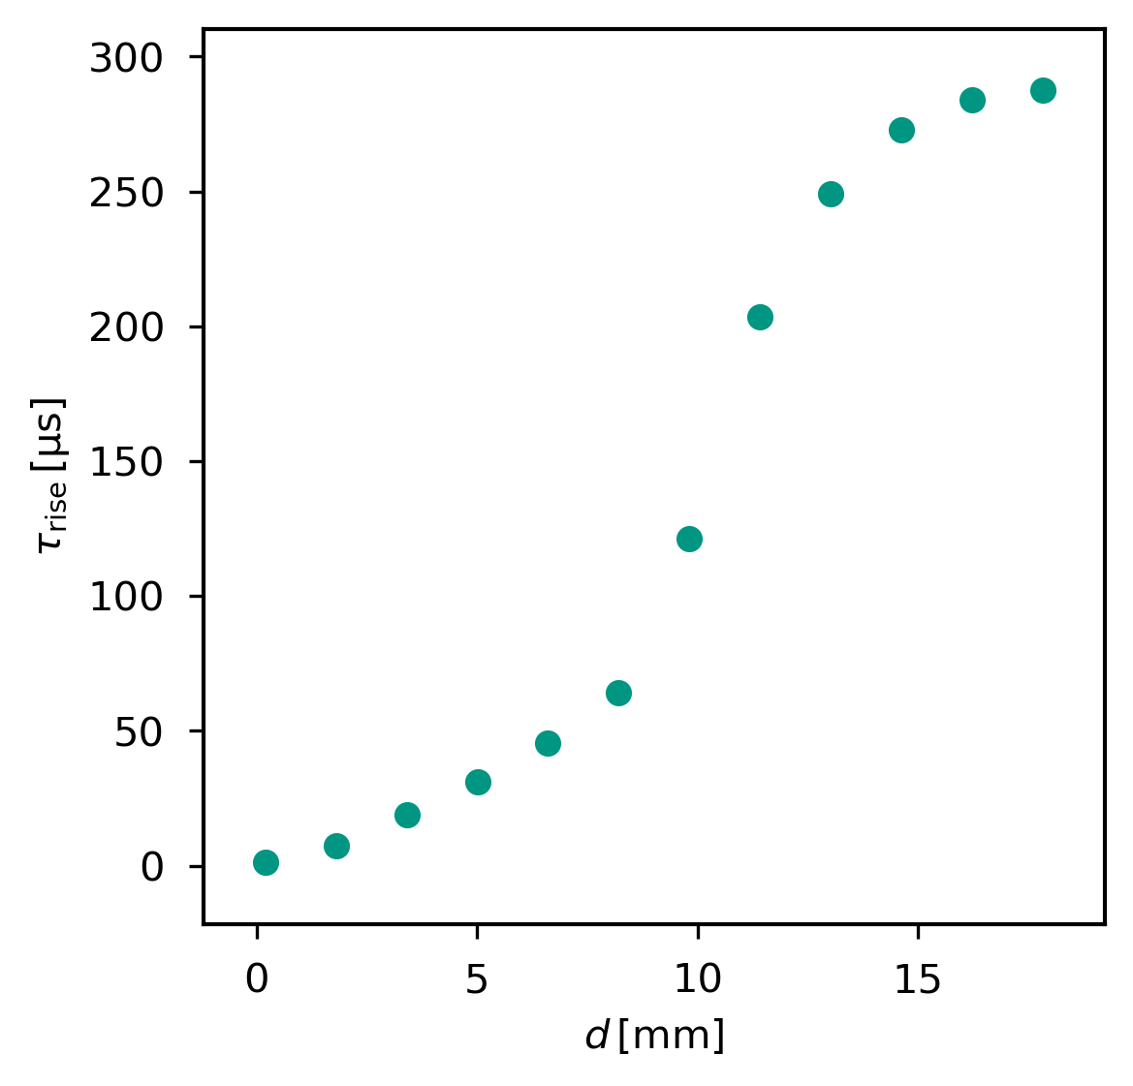
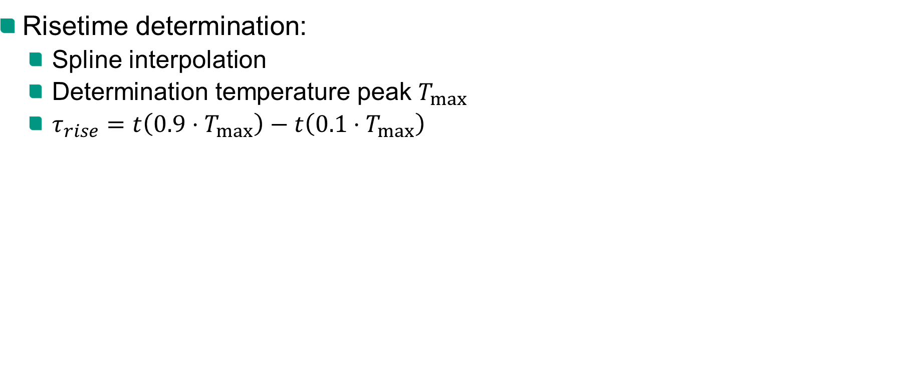
Silicon
Risetime determination:
Spline interpolation
Determination temperature peak $T_{max}$
$τ_{rise}=t\left(0.9⋅T_{max}\right)−t\left(0.1⋅T_{max}\right)$

Slide 10
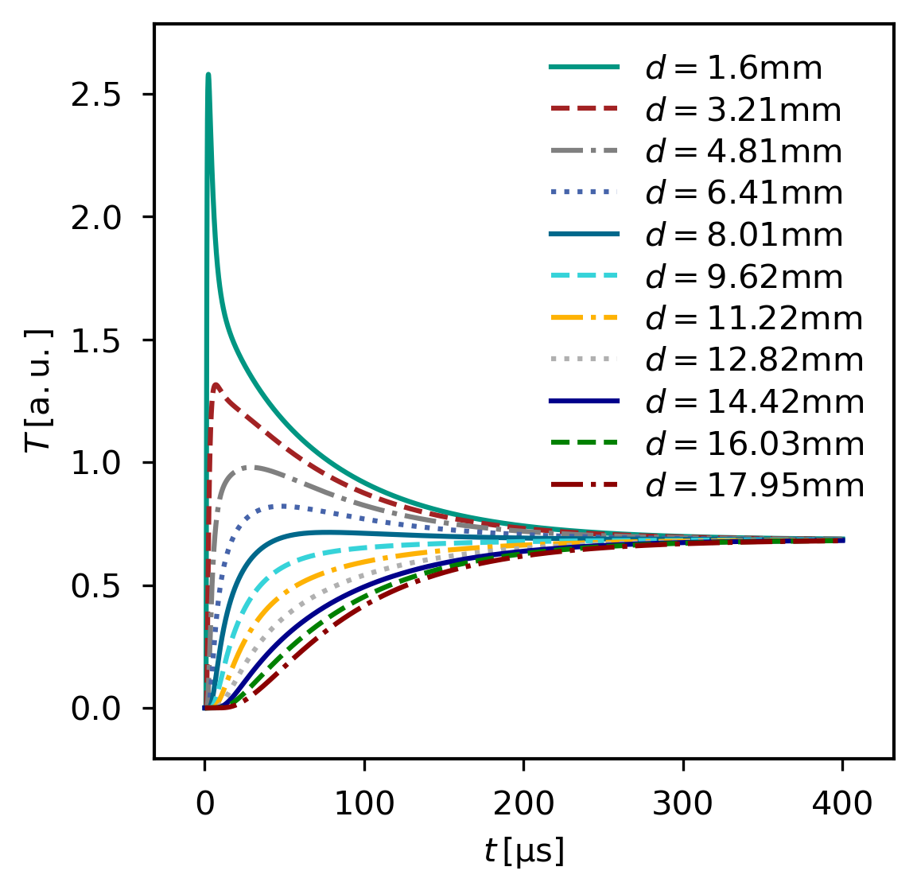
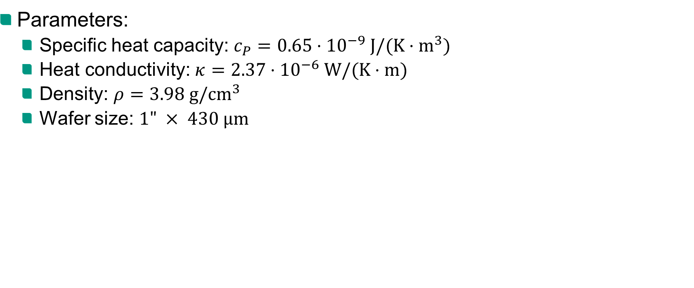
Sapphire
Parameters:
Specific heat capacity: $c_{P}=0.65⋅{10}^{−9} J/(K⋅m^{3})$
Heat conductivity: $κ=2.37⋅{10}^{−6} W/(K⋅m)$
Density: $ρ=3.98 g/cm^{3}$
Wafer size: $1" × 430 µm$

Slide 11
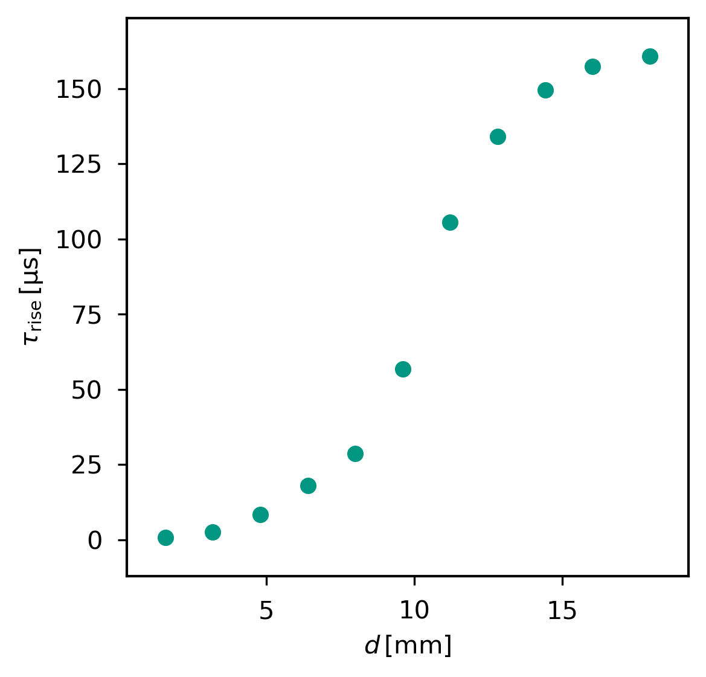
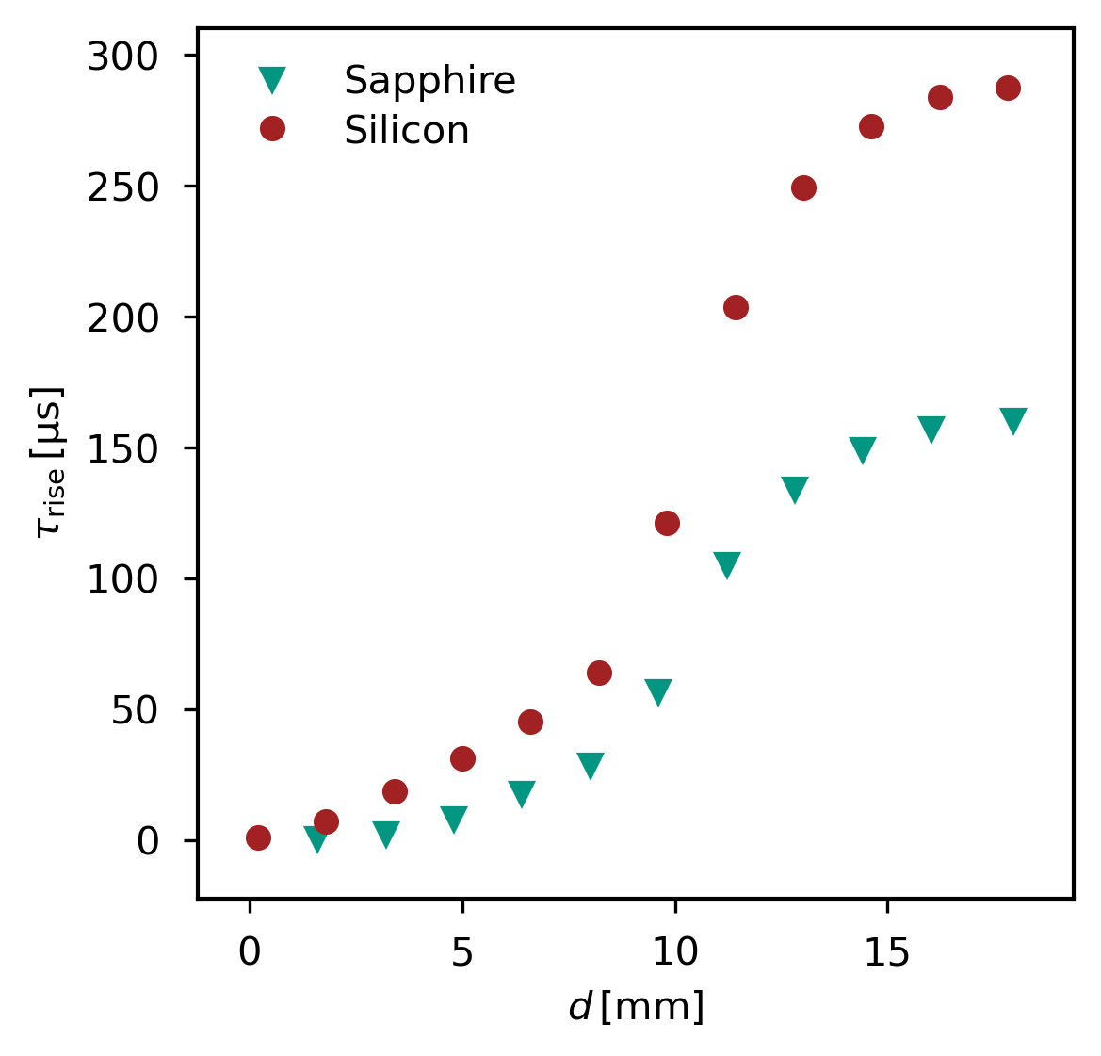

Sapphire
Risetime determination:
Comparison with silicon
Conclusion:
Sufficient rise time even in thermal mode
Validation of substrate choice → smaller rise time for sapphire

