Slide 1
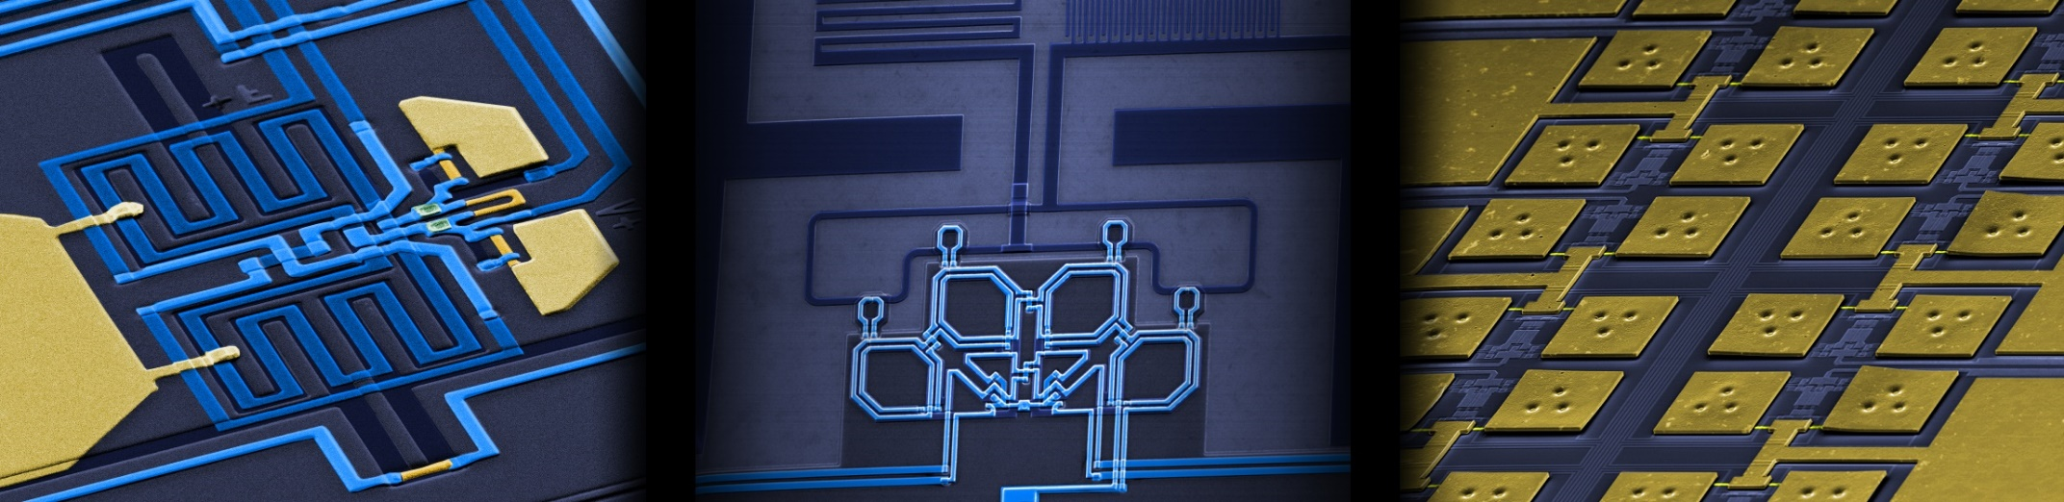
DELight Heat Capacity Simulations
DELight Meeting 19.11.24
Friedrich Wagner

Slide 2
Meander MMC with Dielectric Absorber

Slide 3
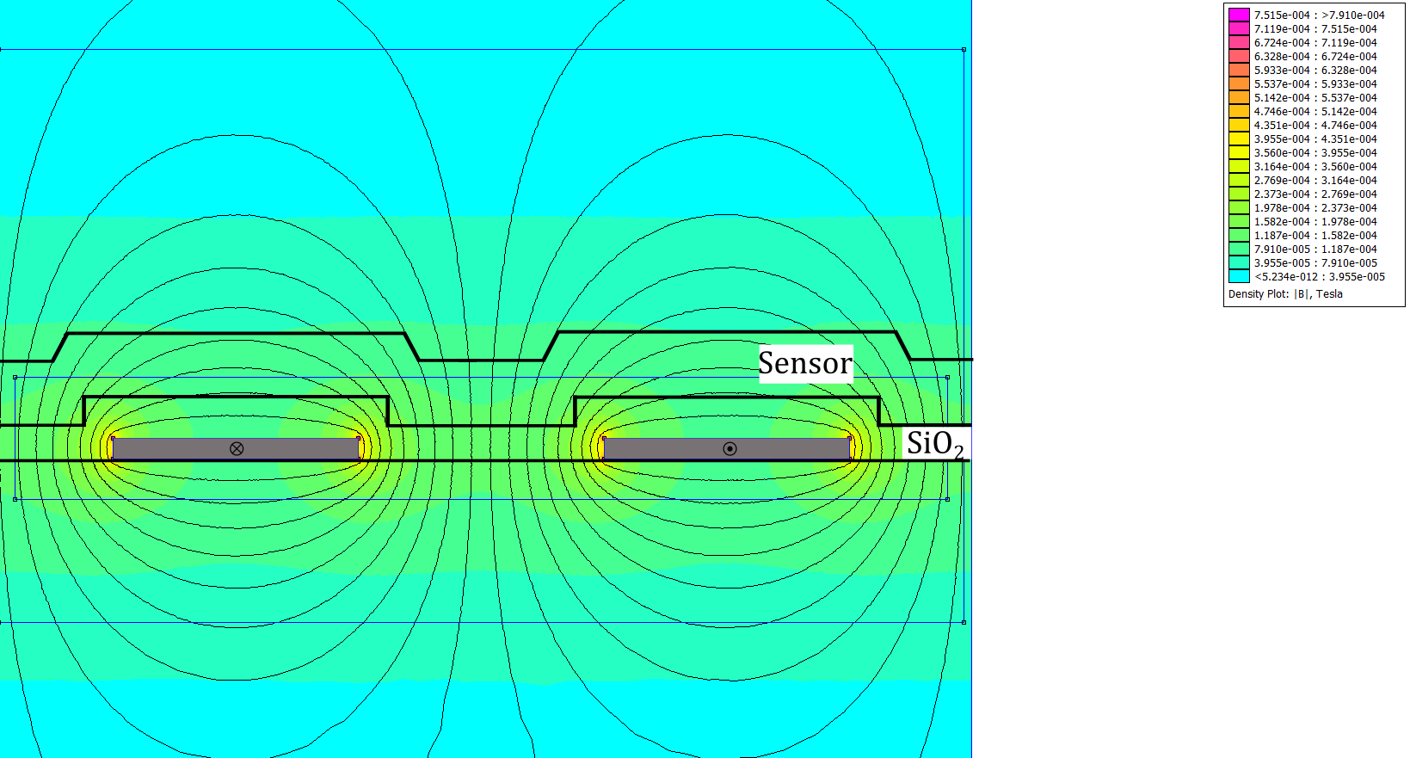

FEMM Simulation
Meander pick-up coil
w = 3 µm, p = 6 µm, d = 250 nm
SiO2 thickness: 300 nm

Slide 4
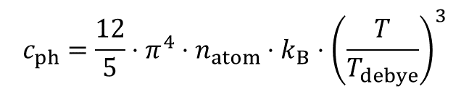
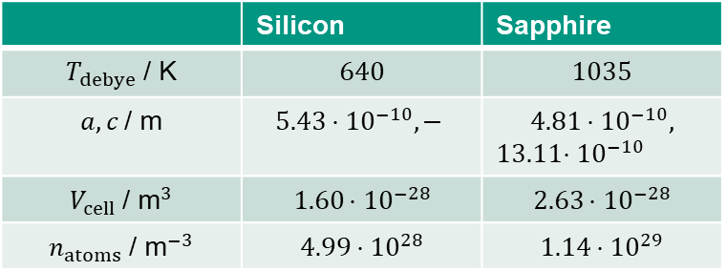

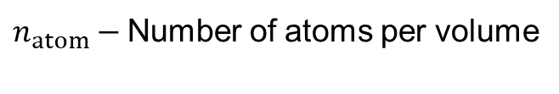
Crystal Heat Capacity Calculation
Specific heat crystal absorber:
Further contributions from insulator and superconductor materials
 | Silicon | Sapphire
$$T_{debye} \text{/} \text{K}$$ | $$640$$ | $$1035$$
$$a, c \text{/ }\text{m}$$ | $$5.43⋅{10}^{−10}, −$$ | $$4.81⋅{10}^{−10},$$ 13.11$⋅{10}^{−10}$
$$V_{cell}{ \text{/} \text{m}}^{3}$$ | $$1.60⋅{10}^{−28}$$ | $$2.63⋅{10}^{−28}$$
$$n_{atoms}{ \text{/} \text{m}}^{−3}$$ | $$4.99⋅{10}^{28}$$ | $$1.14⋅{10}^{29}$$
$$c_{ph}=\frac{12}{5}⋅π^{4}⋅n_{atom}⋅k_{B}⋅{\left(\frac{T}{T_{debye}}\right)}^{3}$$
$n_{atom}−$Number of atoms per volume
$T_{debye}−$Debye temperature

Slide 5
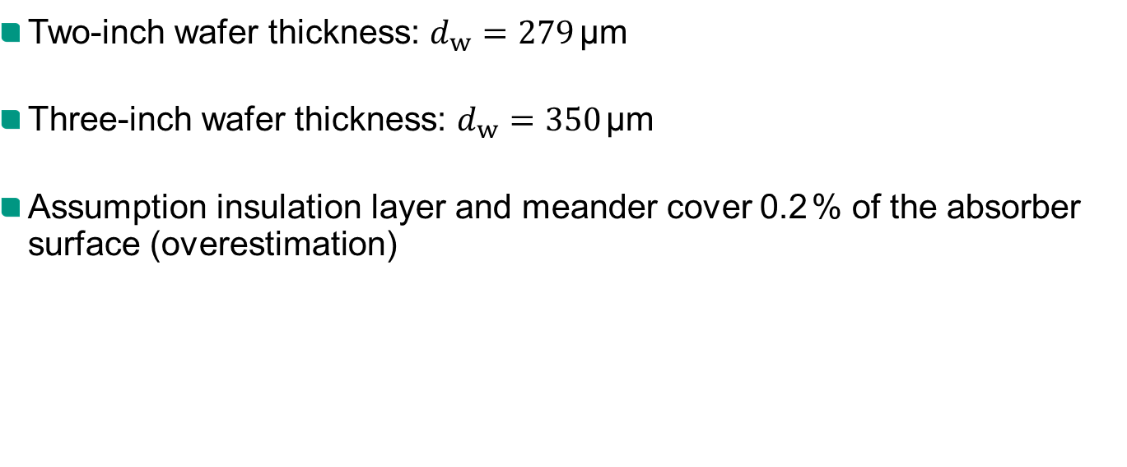
Simulation Geometry
Two-inch wafer thickness: $d_{w}=279$ µm
Three-inch wafer thickness: $d_{w}=350$ µm
Assumption insulation layer and meander cover 0.2 % of the absorber surface (overestimation)
Optimization script: Uses heat capacity calculations to find optimal sensor geometry and energy resolution

Slide 6
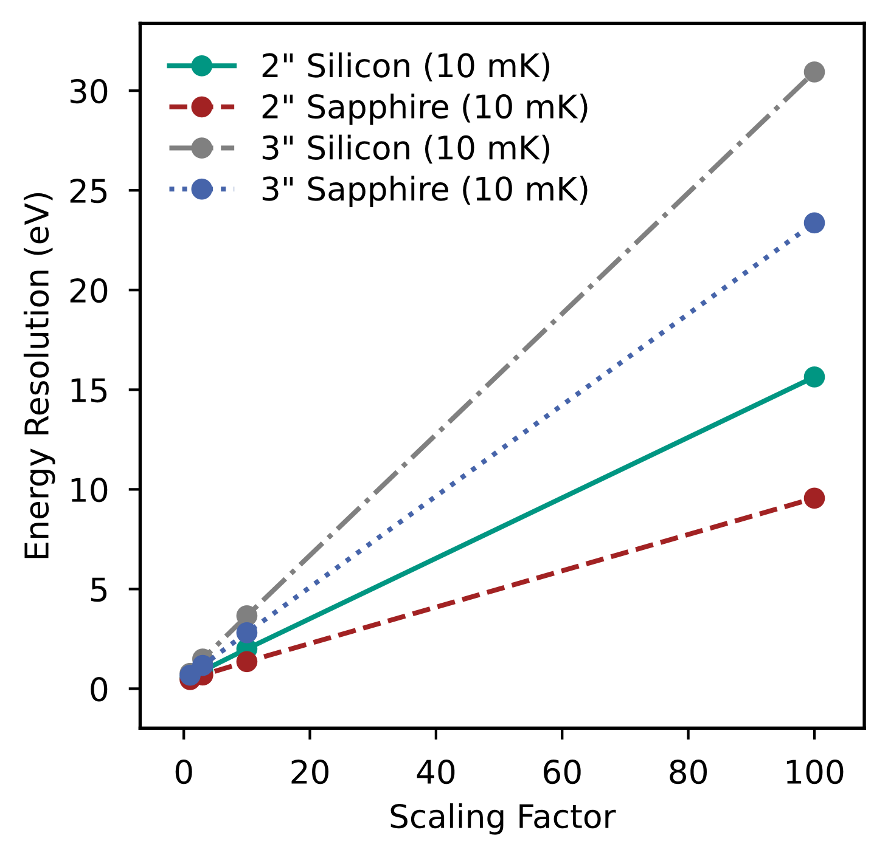
Scaling Factor
Simulation of increased heat capacity for crystal absorber (x3, x10, x100)
Sensor geometries optimized for base heat capacity
Height and length then assumed to be fixed

Slide 7
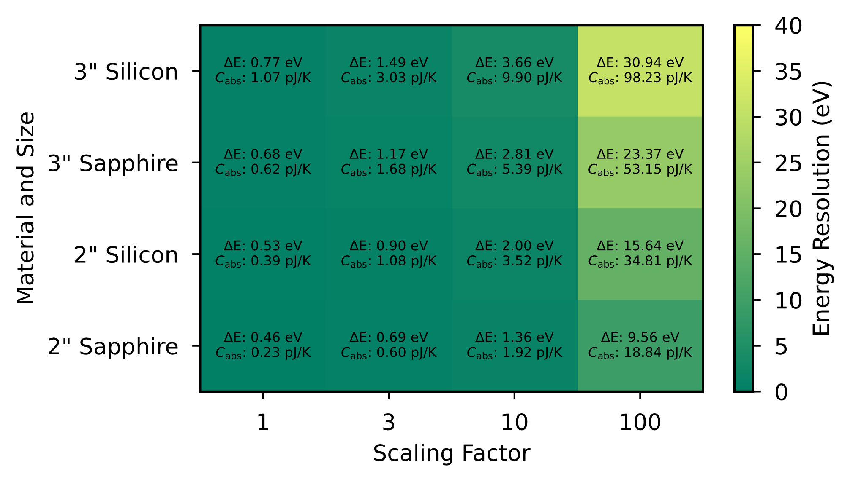
Simulation Results : Energy Resolutions @ 10 mK

Slide 8
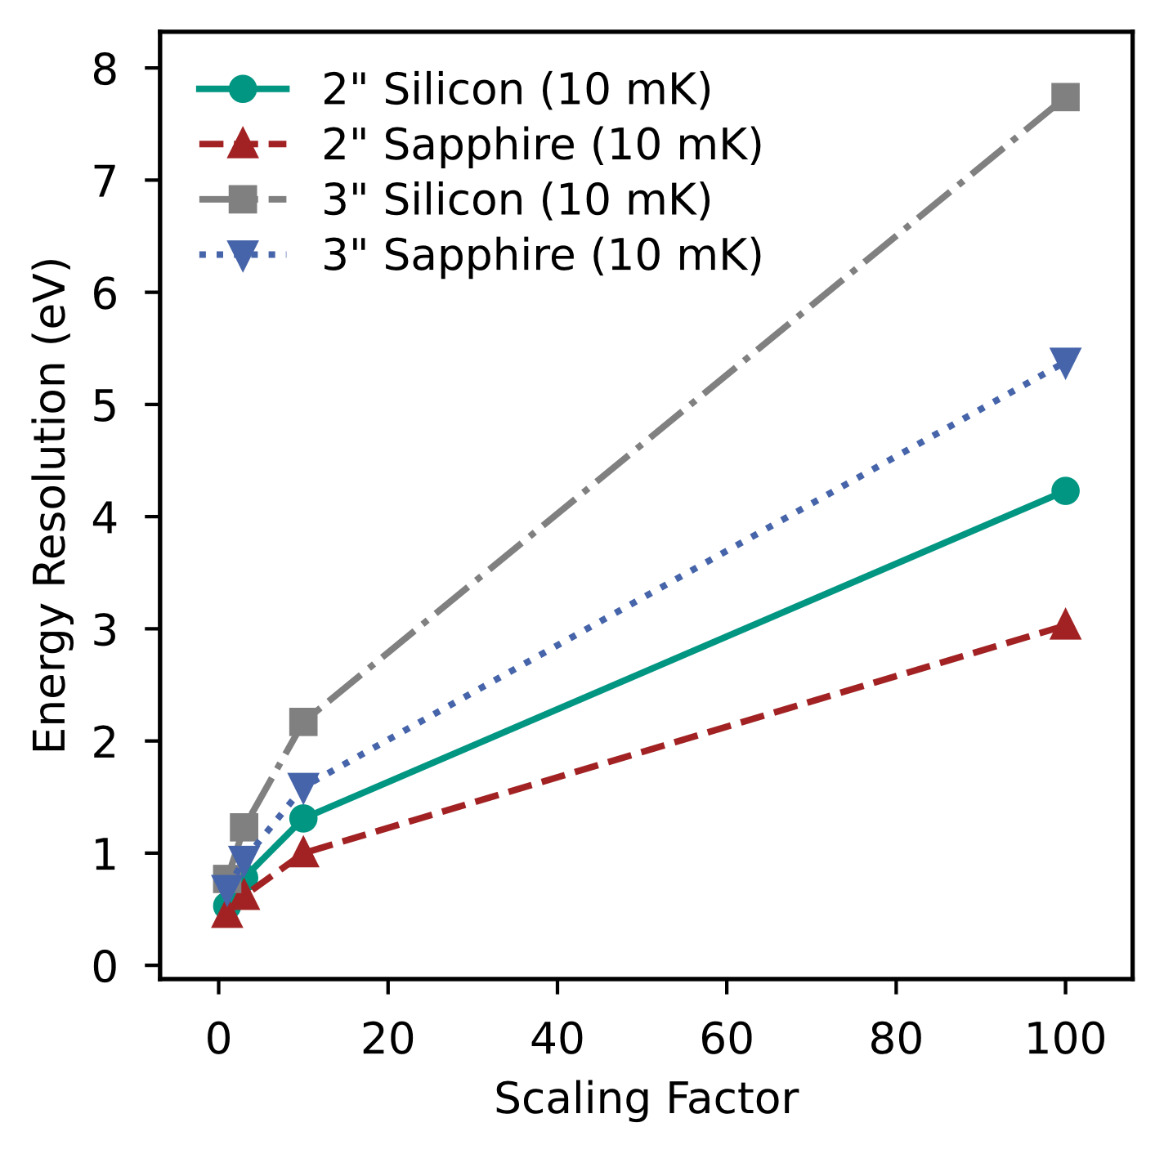
Simulation: Geometry Not Fixed

Slide 9
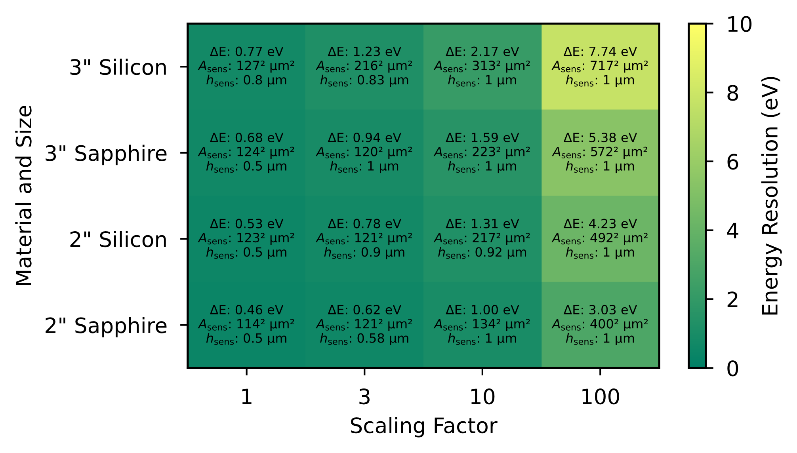
Simulation Results: Geometry Not Fixed @ 10 mK

Slide 10
Athermal Detector Simulations

Slide 11
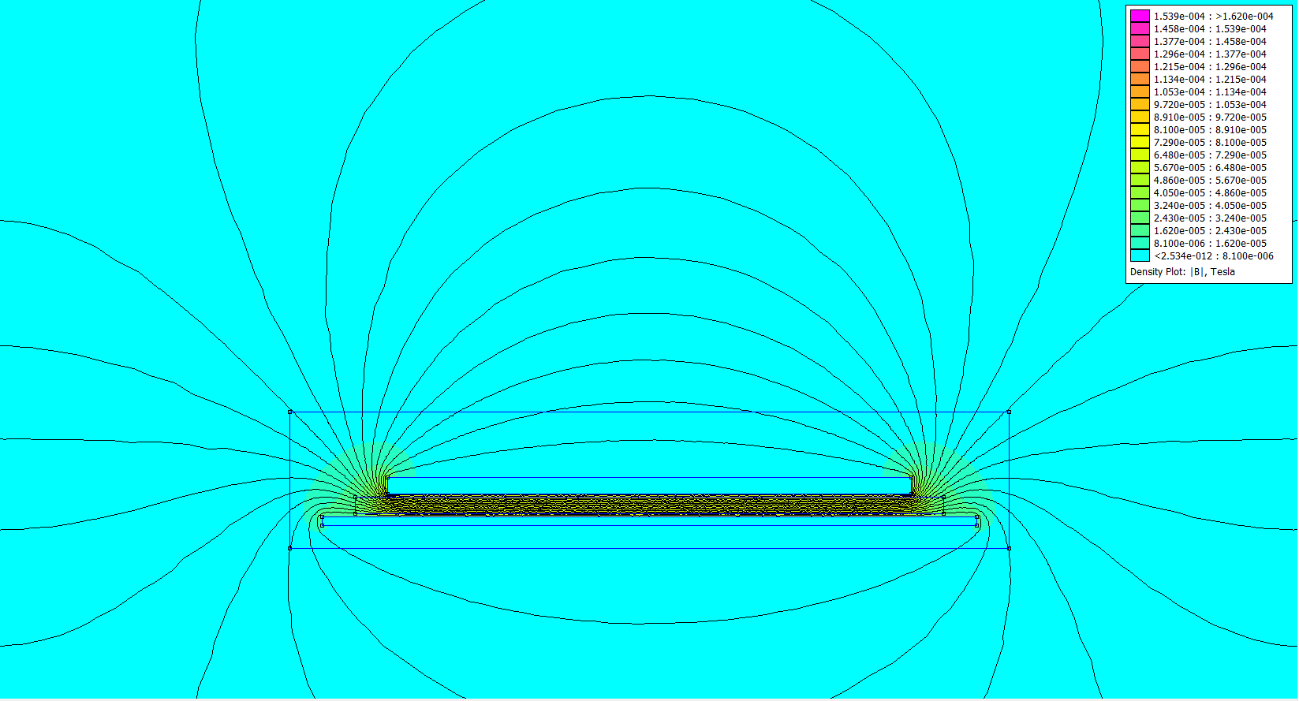
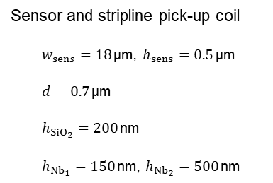
FEMM Simulation
Sensor and stripline pick-up coil
$w_{sens}=18$ µm, $h_{sens}=0.5$ µm
$d=0.7$ µm
$h_{SiO_{2}}=200$ nm
$h_{Nb_{1}}=150$ nm, $h_{Nb_{2}}=500$ nm

Slide 12
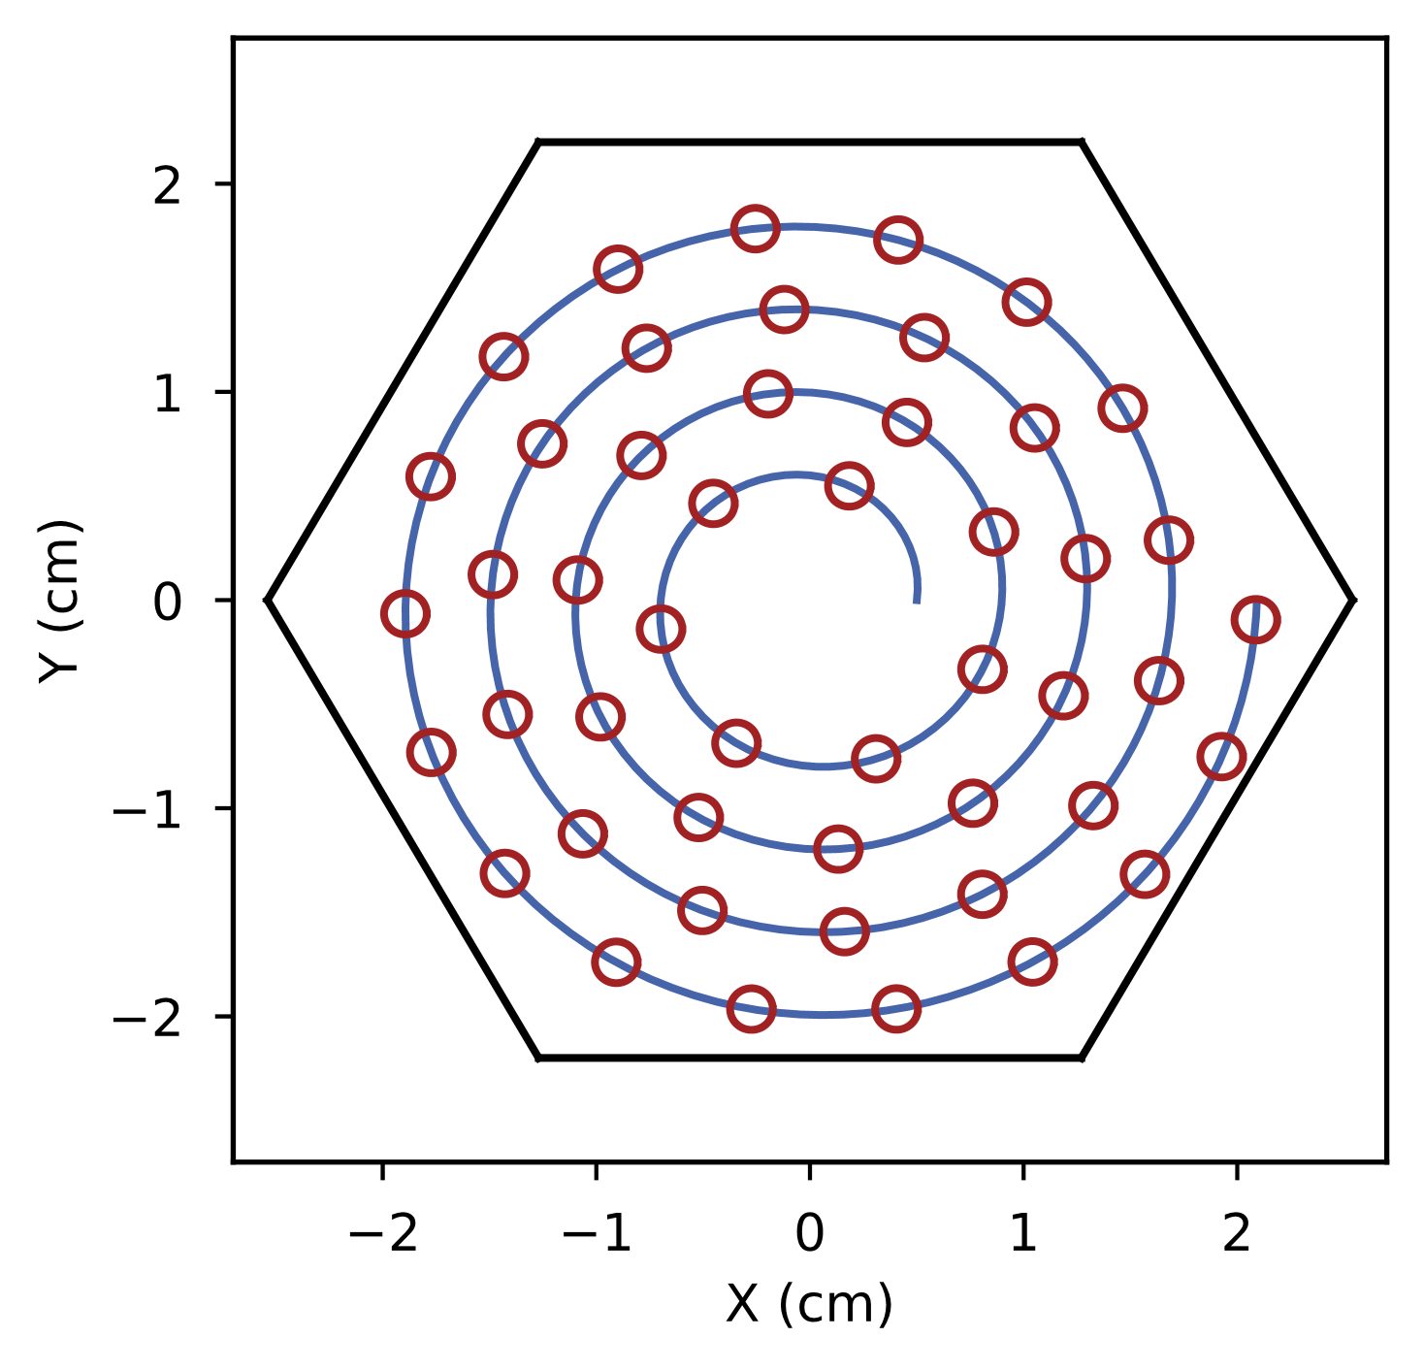
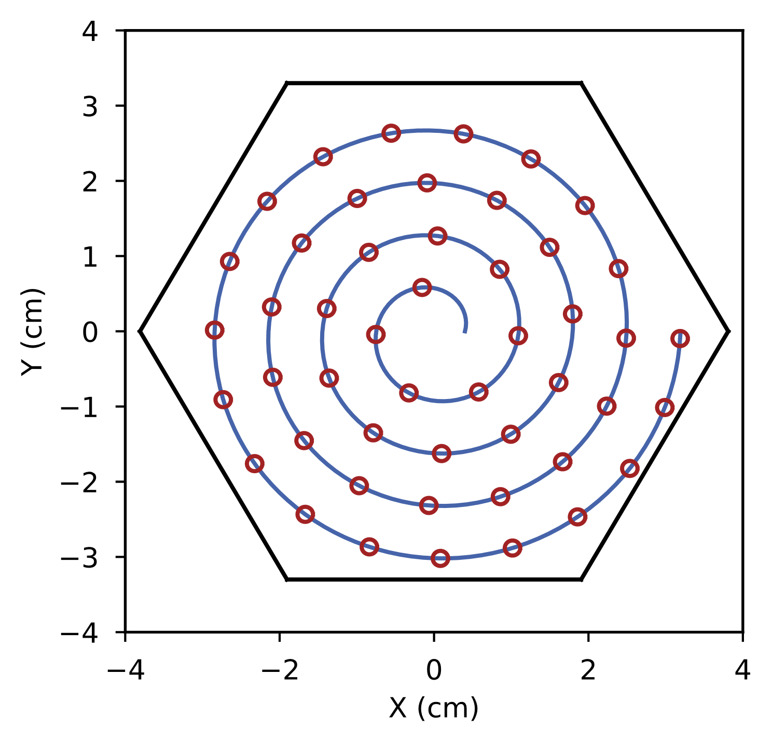
Pick-Up Coil – Collector Arrangement
Two-inch
Three-inch
Spiral Inductance: 15.94 nH
Spiral Inductance: 22.12 nH

Slide 13
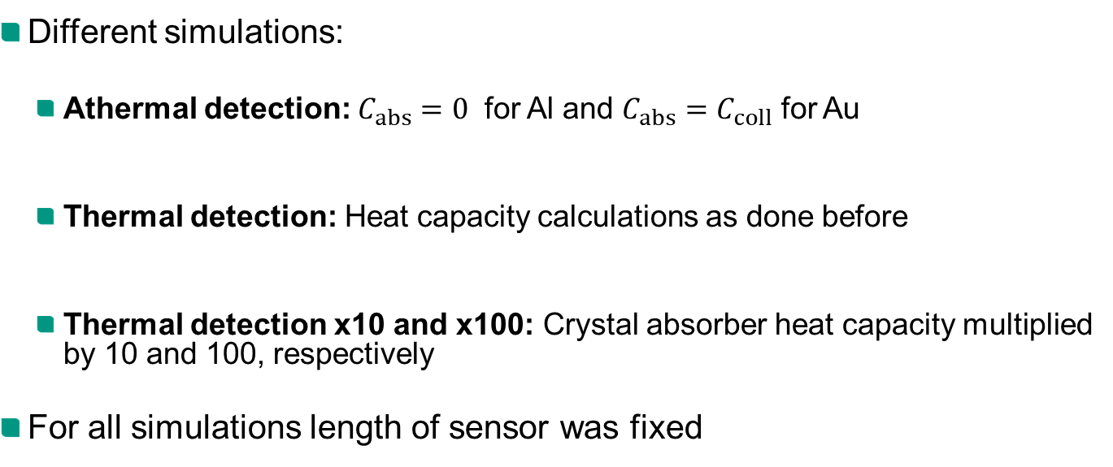
Optimization Simulations
Different simulations:
Athermal detection: $C_{abs}=0$ for Al and $C_{abs}=C_{coll}$ for Au
Thermal detection: Heat capacity calculations as done before
Thermal detection x10 and x100: Crystal absorber heat capacity multiplied by 10 and 100, respectively
For all simulations length of sensor was fixed

Slide 14
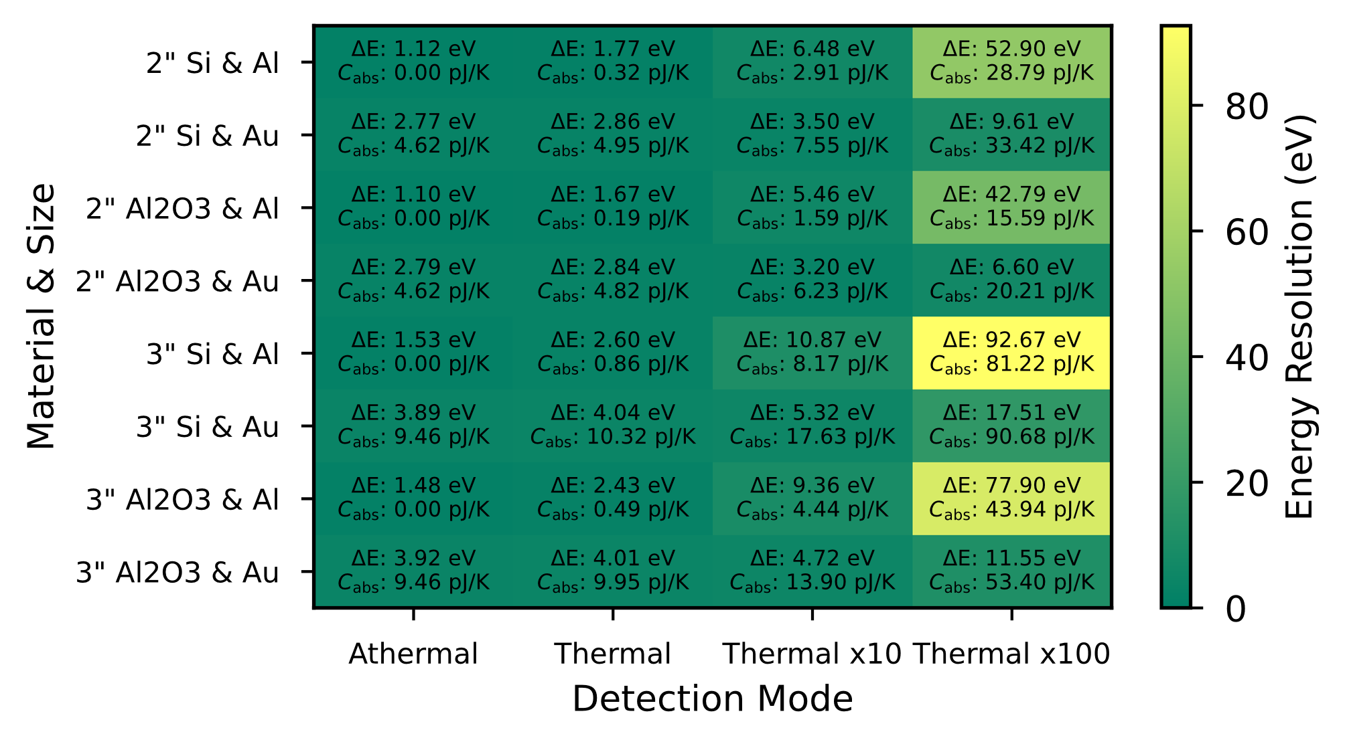
Simulation Results: Comparison Si and Al2O3

Slide 15
Simulation Results: Comparison Si and Al2O3
Conclusion:
Even for larger heat capacities of the crystals, the energy resolution is good enough

