Slide 1


Update on Particle ID
Dowling Wong, A.Apyan, (Brandeis)
W.P.McCormack, P.C.Harris (MIT)
Oct. 2023

Slide 2

INDEX
Introduction about particle ID
Current version of ID
New Clustering algorithm
Optimized analysis package
Total # of page: 27
Estimate time: 20mins

Slide 3
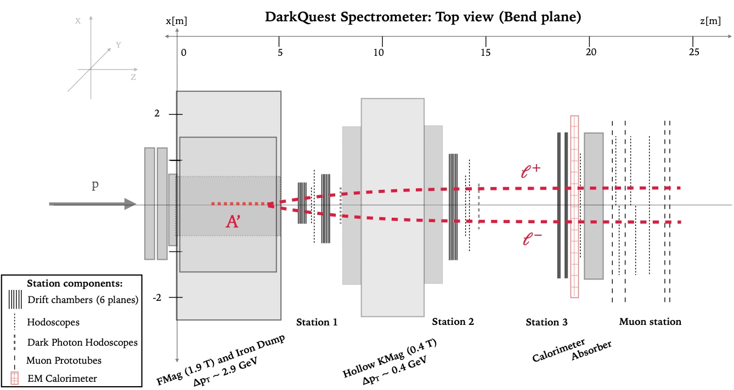
Introduction to ID
Short introduction & goal
Data pattern for different particles
Historical versions

Slide 4
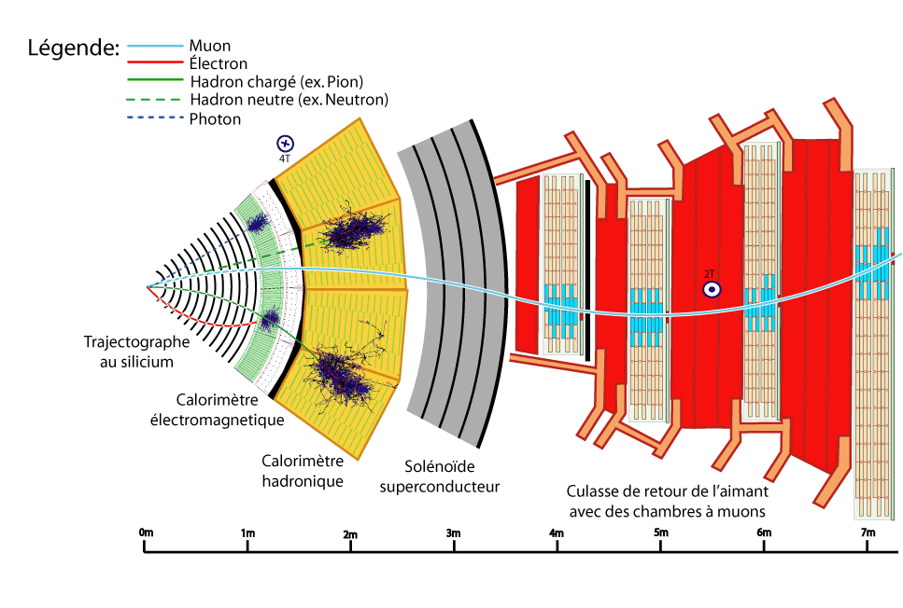
Particle ID aims to classify different particles in each event, where a particle is reconstructed using multiple detector components. This information helps us to form a complete picture of what happened in events.
The ultimate goal for our work is to build a particle ID like tagging system of particle flows at CMS. That we use tracking chambers, calorimeter, and hodoscope information to reconstruct trajectories and tag particles in each single event.
A considerable part of our work is exploratory, and highly customized for DarkQuest experiment setup.

Slide 5
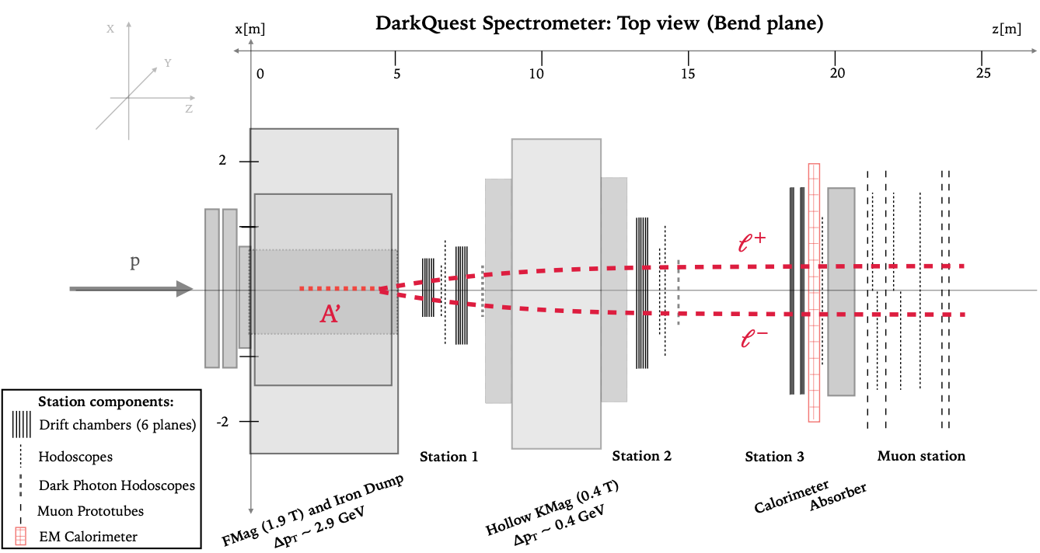
Full track(st1+st2+st3) [E/p]
st3_stracklet [x, y, z, px, py, pz]
EMCal [widthx, widthy, Wew_x, Wew_y, seed_x, seed_y]
Hodoscope [det41_y, det42_y, det43_y, det44_y, det45_x, det46_x]

Slide 6
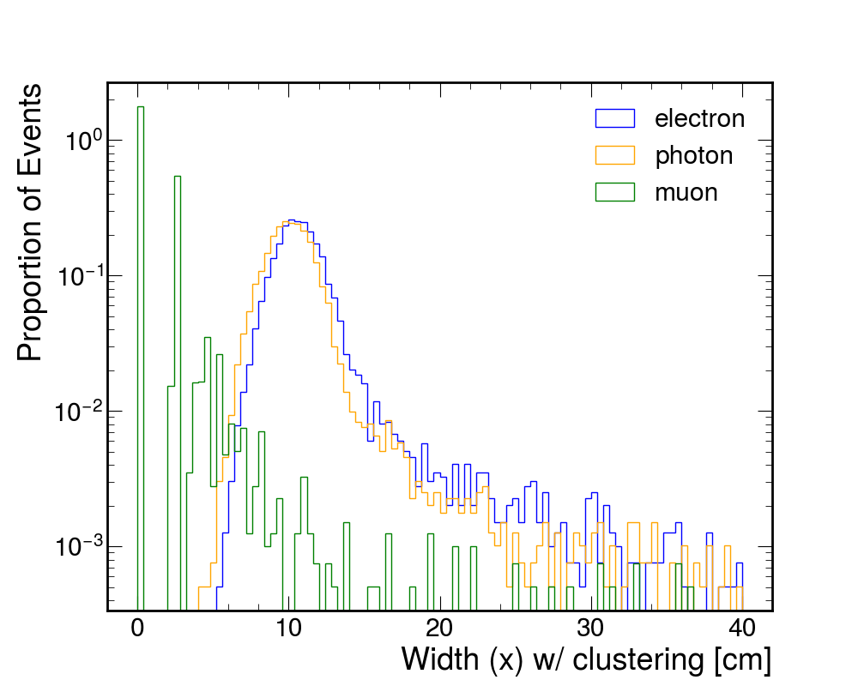
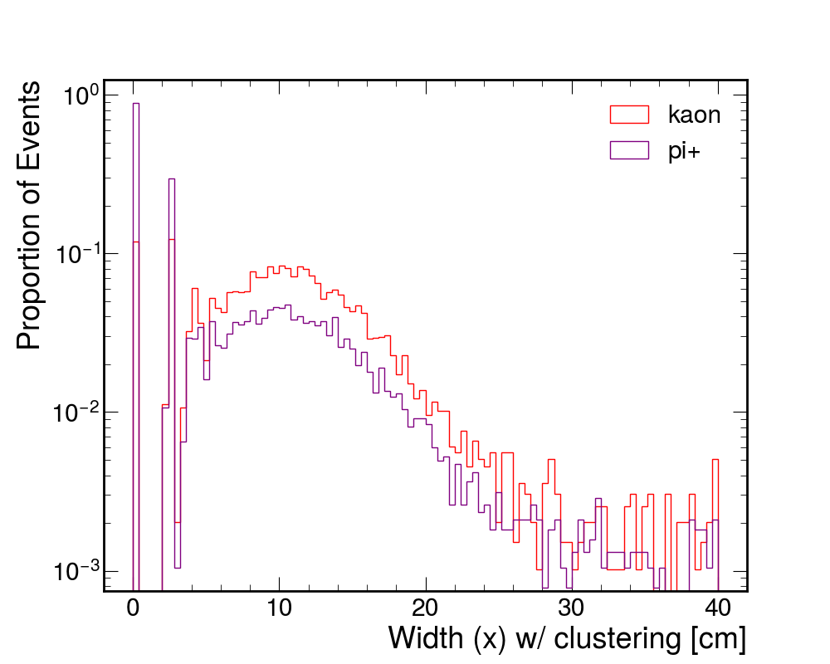
Quantifying cluster shapes
Full track(st1+st2+st3) , st3_stracklet, Hodoscope. Only has a single value for each particle.
To quantitatively study the shape of cluster on Emcal, we plot the distribution of width(x and y), Energy Weighted width of particles on EMCal. As in DQ
Along with track extrapolation points on EMCal, Energy over momentum, we implemented the first version of ParticleID.

Slide 7
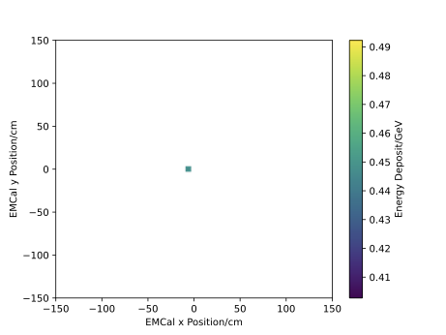
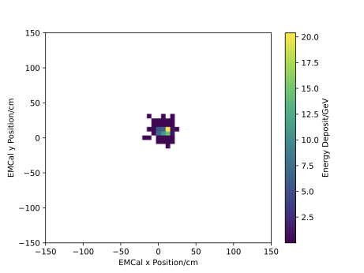
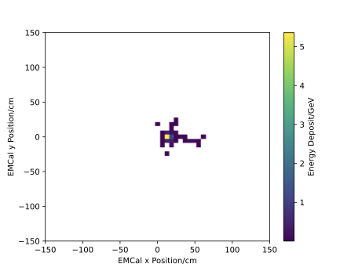
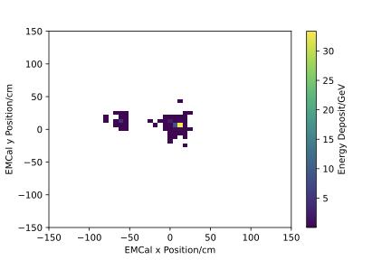
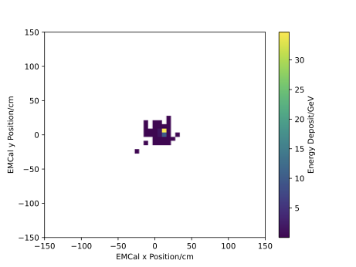
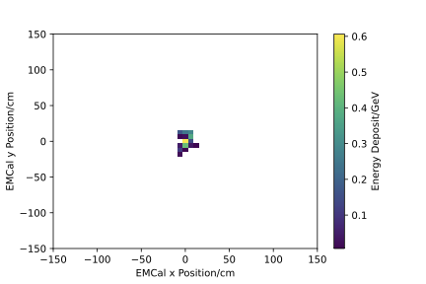
Spreadsheet for particle characteristics
Types | Full track (E/P) | st3_tracklet | EMCal Cluster size | Hodoscope
Muon | Yes, ~0 | Yes | Few Points | Yes, through absorber
Electron/Positron | Yes, ~1 | Yes | Large | No
Pi+/Pi- | Yes, (0,1) | Yes | Middle | Some
Pi0 | No | No | XLarge | No
Photon | No | No | Large | No
Klong | No | No | Middle | No

Slide 8
Cut-Based ID for Electron
Inputs:
[widx, widy, Wew_x, Wew_y, Dist_x, Dist_y, E/P]
 | Pass Rate
muon | 0
electron | 59.50%
positron | 55.70%
photon | 0.40%
pi+ | 3.40%
pi- | 3.80%
klong | 0
pi0 | 0.20%
🧐
Well, can we do a DNN based particle ID to improve the efficiency?

Slide 9
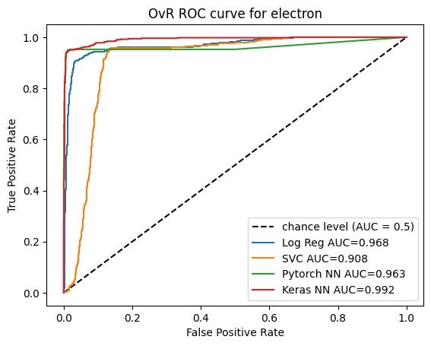

This NN-based ID has the same input as cut-based one, looks good?
The analysis is only on leading cluster of each single particle guns evts.
But we are looking for dark photon into
dimuon and dielectron, right?

Slide 10
Review
Full track(st1+st2+st3) [E/p], effectively distinguish between muon and electron
St3_stracklet Position and direction to extrapolate trajectory
EMCal *Currently use # of seeds to determine how to reconstruct Finally will depends on #of trkls and EMCal energy seeds
Hodoscope Efficiently get muon and pi+- separated.
Notes:
Using # of seeds to determine how many particles to reconstruct is not very accurate, just in general, for charged particles, # of tacks should definitely be the key to determine how many clusters to reco. So mention post-analysis in the later page.

Slide 11
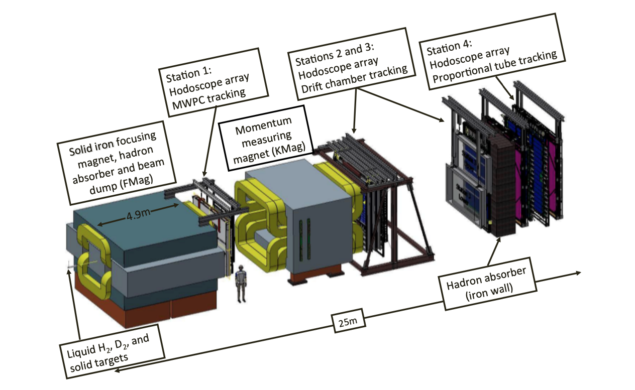
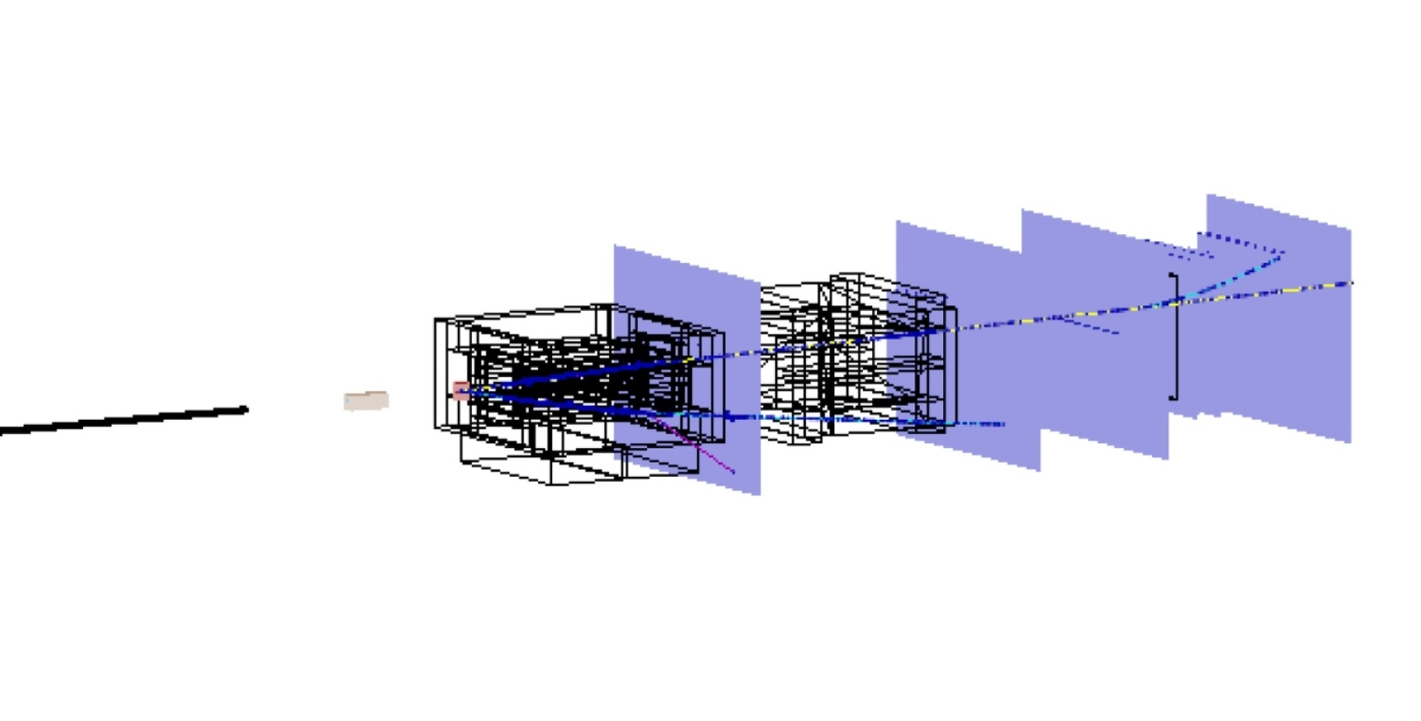
Reconstruction Logic
Track finding & EMCal clustering
Clusters match track & hodoscope hits
1
2
μ+-
𝛄
*Post ana for “missing muon”
Run tagger on “particles”
3
4

Slide 12
New Clustering & Efficiency
A’ -> mm
A’ -> ee
Single particle guns
Diphoton samples

Slide 13
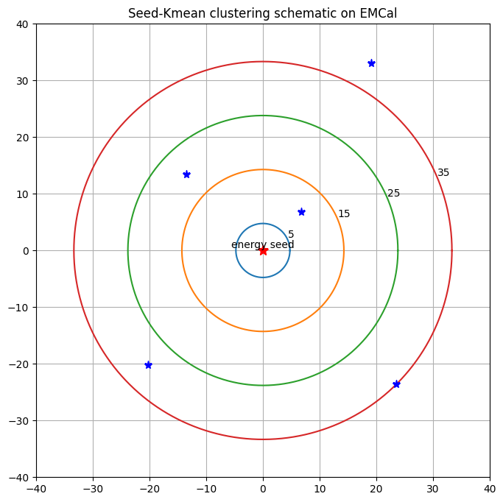
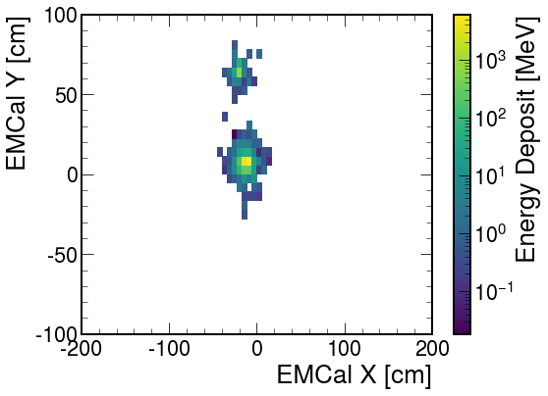
Step1. Set a energy threshold, emin. Collect all hits with eng above this level.
[x_i, y_i, eng_i]
Step2. Loop through the hits,within distance threshold, no hits have higher energy.
*currently set emin=0.2GeV, radius=50cm. Low energy threshold make sure hard to miss a particle.
Step3. Run Kmean once, find if some cluster has been missed(mainly for muon). *exceed tolerance.& (post-ana)
Step4. Once get seeds all set, tagging each hits to clusters.

Slide 14
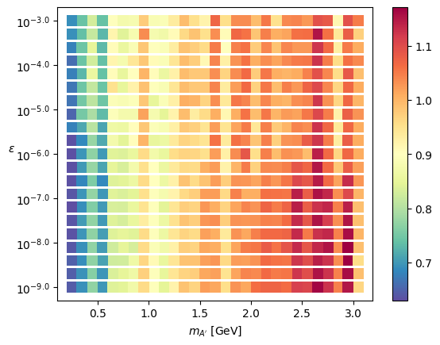
A’->mm
Seed tagging efficiency
All 609 possible mass and coupling
combination.
eff_st=(𝝨 # seeds /𝝨 # trkls)

Slide 15
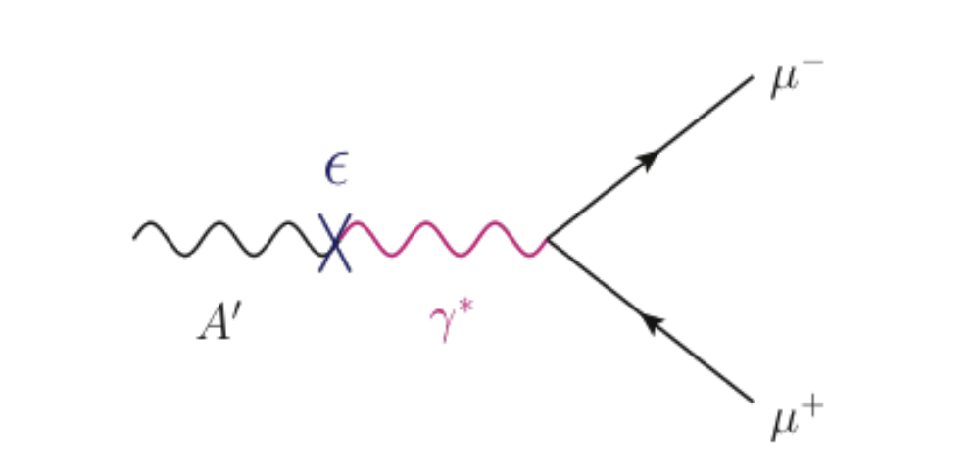
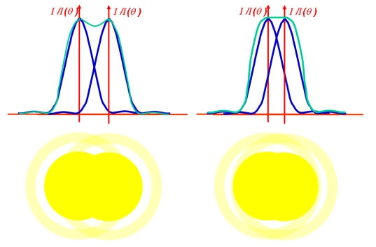
What happened to low mass A’?
Like Angular
resolution
EMCal cell
*From Ming
*Diphoton has the same problem

Slide 16
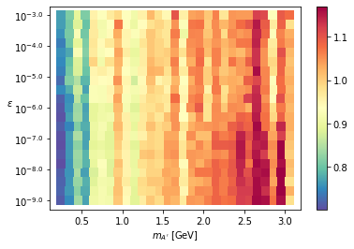
Verification of Guess
Even lower the energy threshold and radius to 0.1, 10. Still doesn’t give visible difference.
Conclusion after manually checking dark blue samples: there are higher density of events has only one hit on EMCAL

Slide 17
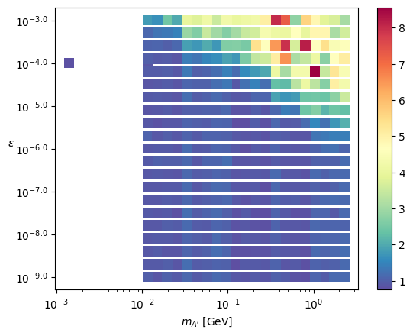
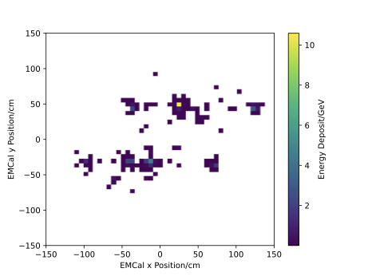
A’->ee
Seed tagging efficiency
All 443 possible mass and coupling
combination.
Dark red

Slide 18
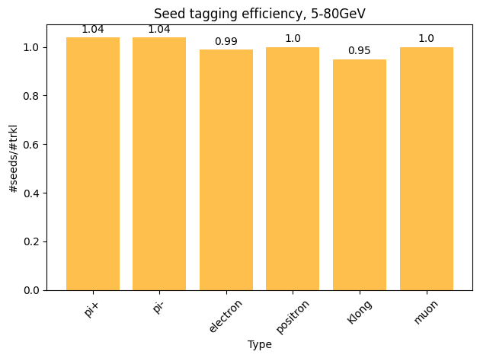
Seed tagging efficiency of single particle gun
1=100%
eff_st=(𝝨 # seeds /𝝨 # trkls)
*For Klong, ratio is #evts w/ seed / evts w/ valid EMCal record

Slide 19
New Particle ID
2 versions w/ and w/o track
For both muon and electron
Tagging efficiency vs Pz

Slide 20
Data preparation
With the reconstruction logic mentioned above, we can connect hits on each station to a consistent particle trajectory.
With information array for each particle as NN input. Save into CSV
[wid_x, wid_y, wew_x, wew_y, seed_x, seed_y, trkl_x, trkl_y, trkl_z, trkl_px, trkl_py, trkl_pz, E/p, h4_41, h4_42, h4_43, h4_44, h4_45, h4_46]
Preparing with my package dwong, mention later.

Slide 21
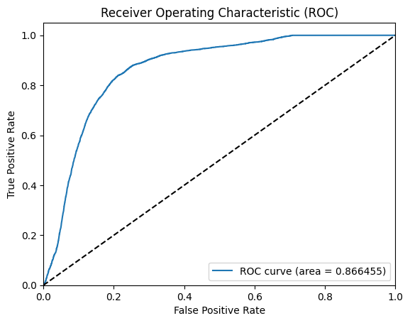
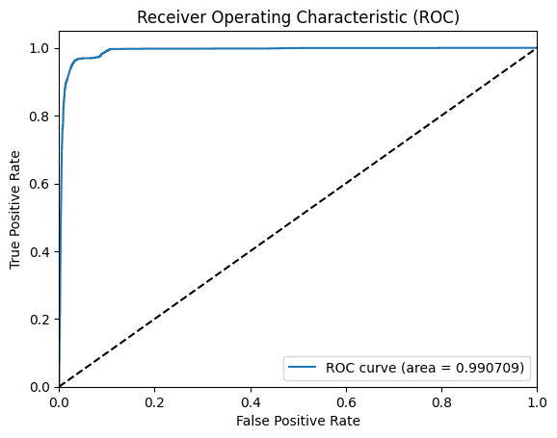
Result: ROC curve for ID w/o full track(E/p)
Electron ID
Muon ID
Input: [wid_x, wid_y, wew_x, wew_y, seed_x, seed_y, trkl_x, trkl_y, trkl_z, trkl_px, trkl_py, trkl_pz, h4_41, h4_42, h4_43, h4_44, h4_45, h4_46]

Slide 22
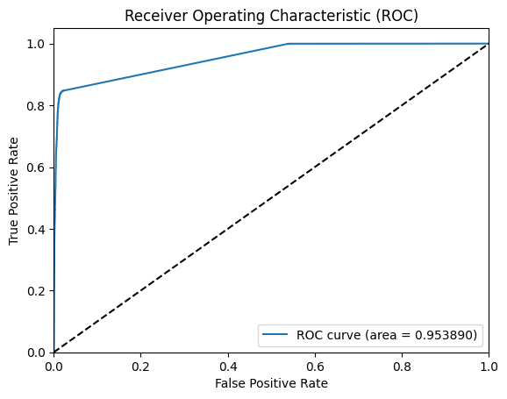

Result: ROC curve for ID w/ full track(E/p)
Electron ID
Muon ID
Input: [wid_x, wid_y, wew_x, wew_y, seed_x, seed_y, trkl_x, trkl_y, trkl_z, trkl_px, trkl_py, trkl_pz, E/p, h4_41, h4_42, h4_43, h4_44, h4_45, h4_46]

Slide 23
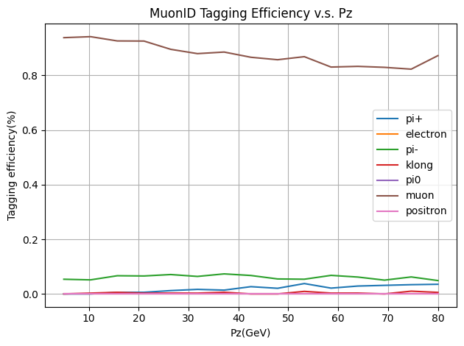
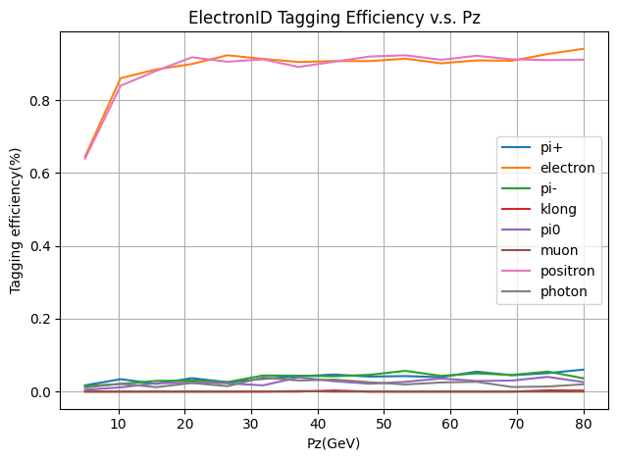

Result: Tagging efficiency vs Pz
Why range 5-80GeV?

Slide 24
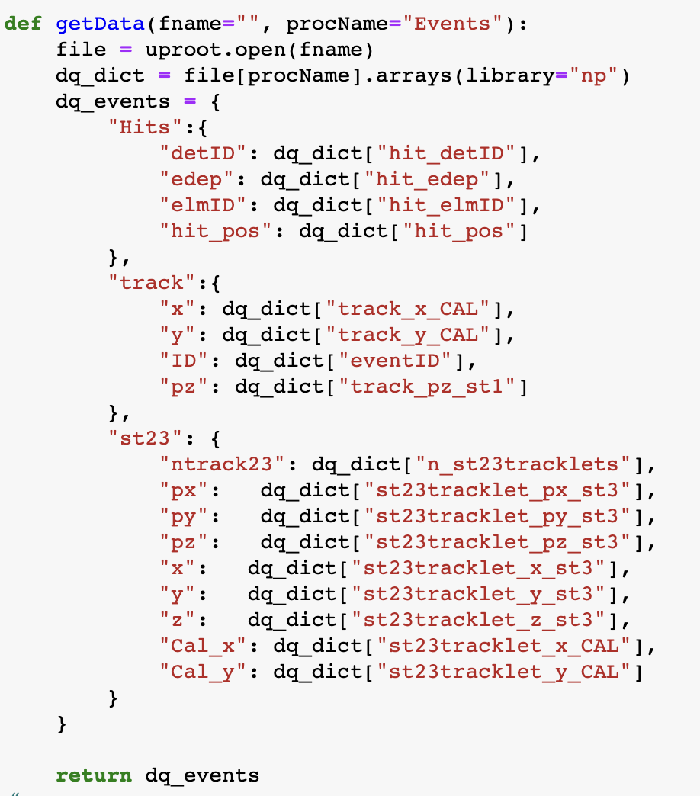
Package dwong!!!
DQ analysis package dwong released on pip. People could play around.
Include analysis functions, NN-ID model, training frame, csv saving tools, samples and EMCal plot tools.
Optimized with numpy and cython.

Slide 25
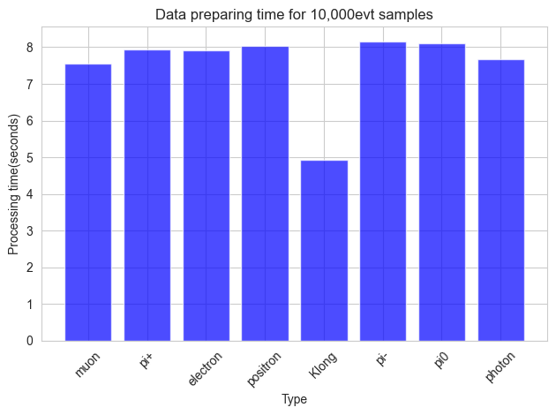



Repo for analysis code:
Repo for dwong package:
Pypi page of dwong

Slide 26
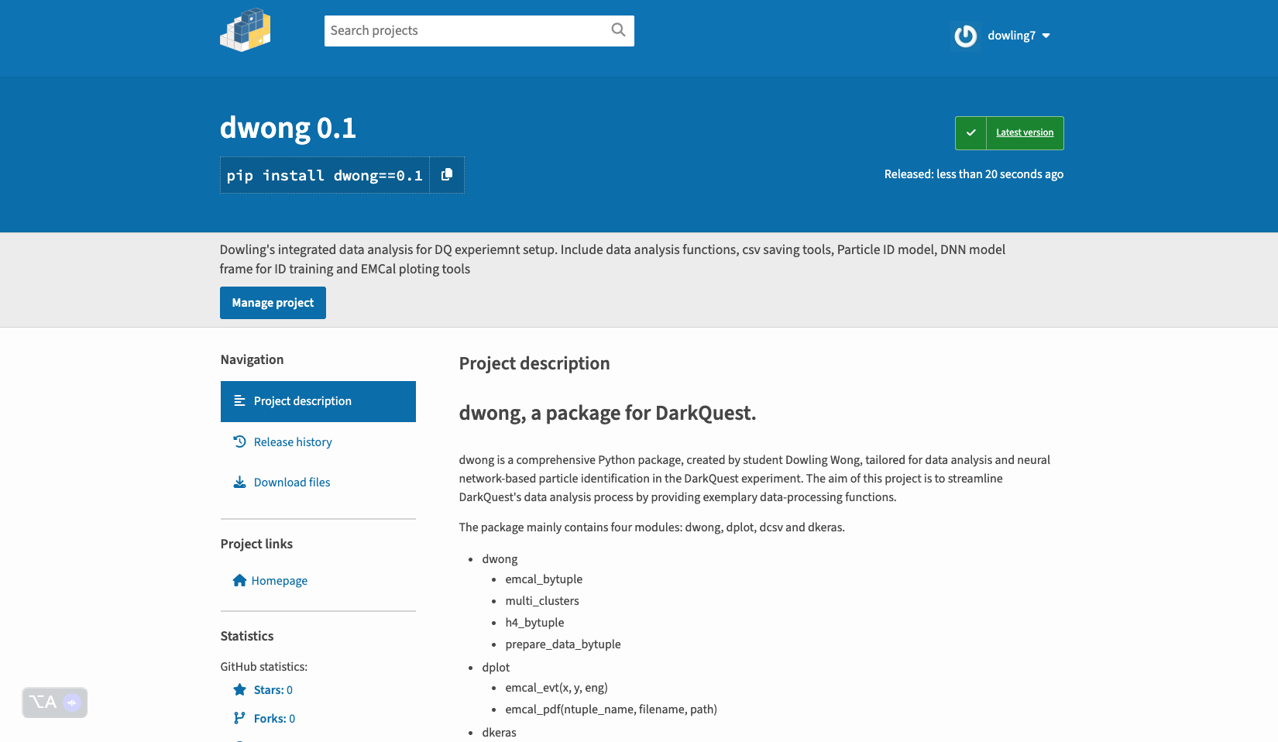

Slide 27
Thank You!
Questions?

