Slide 1
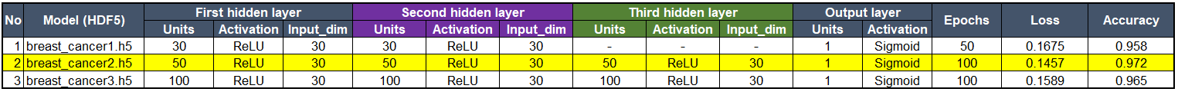
1. Neural Network Model Compiling, Training, and Evaluating the Model
Number of neurons, layers, and activation function selected for the neural networks were as follows:
<Summary>
Trial and error to add more neurons and layers, and different configurations of activation functions were attempted in order to increase the model performance.
<Result>
The accuracy rate of the best model (Model #2) was 97.2%. Better than the Model#1 by adding more units, the third hidden layer, and doubling the number of epochs. It turned out Model#3 was slightly less accurate even though it added even more units possibly due to overfitting the model.

Slide 2
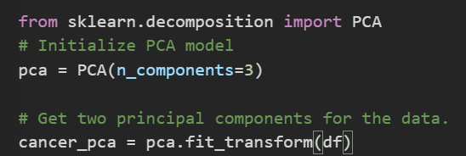
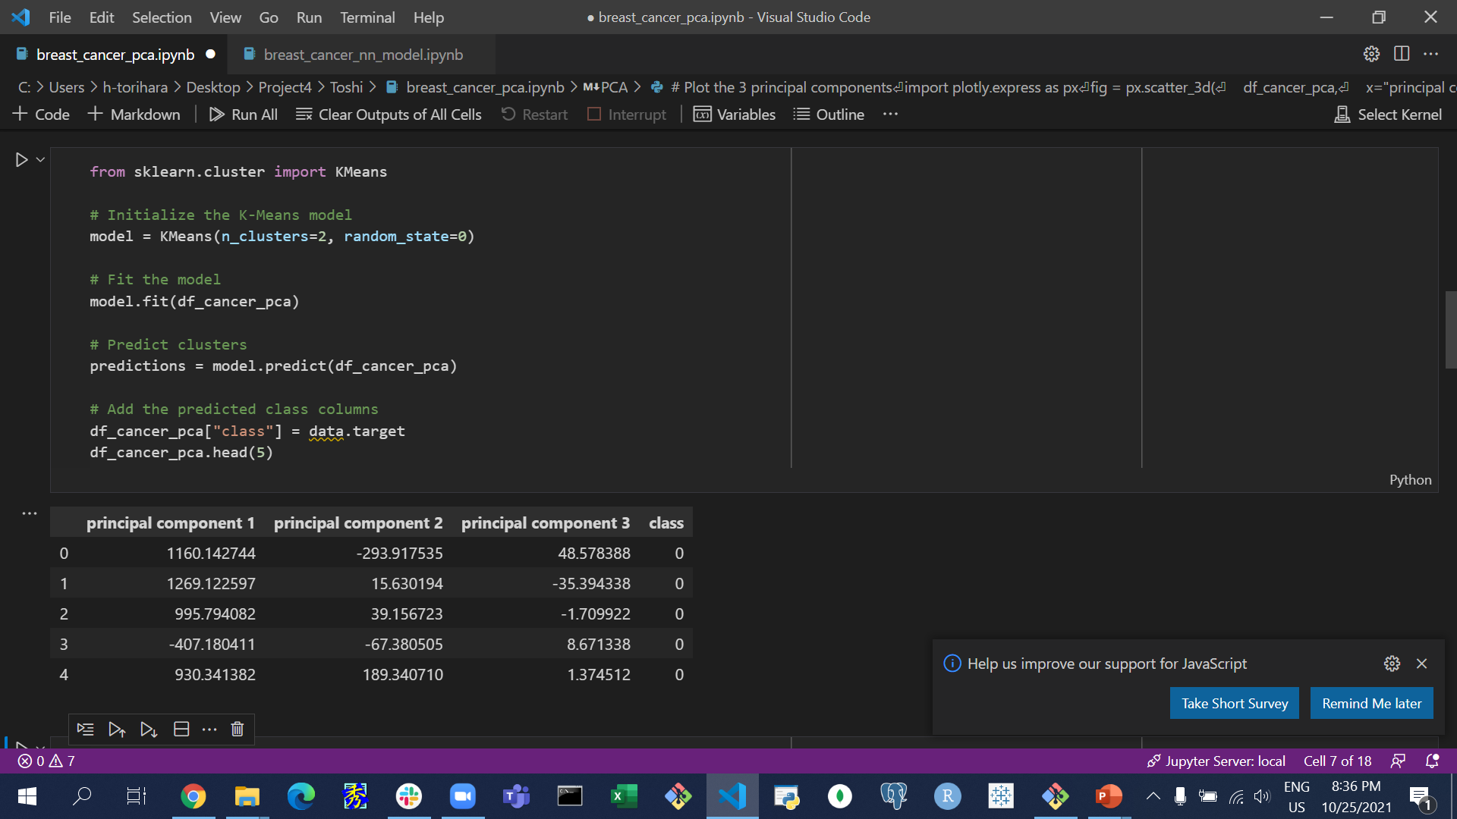
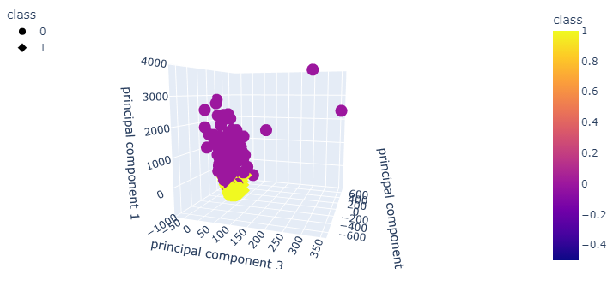
2. Principal Component Visualization of clusters with KMeans

