Slide 1

Project 4 – Breast Cancer Identifier Is there a feature or set of features that best predicts whether the patient is Malignant or Benign?
Scikit-learn -- Python-Pandas -- SQL Database

Slide 2
Why?
1 in 8 Women in the United States will develop Breast Cancer in her lifetime.
63% of breast cancer cases are diagnosed at a localized stage (no sign that the cancer has spread outside of the breast), for which the 5-year survival rate is 99%.
There are over 3.8 million breast cancer survivors in the United States.

Slide 3
How?
Using Scikit-learn – Python Pandas – SQL Database.
Data Processing
Compiling, Training, and Evaluating the Model
Neural Network Model
Principal Component Analysis - Visualization of clusters with KMeans
Random Forest Classifier and Feature Importance
Results

Slide 4
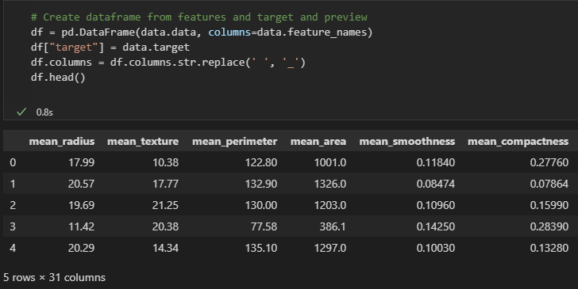
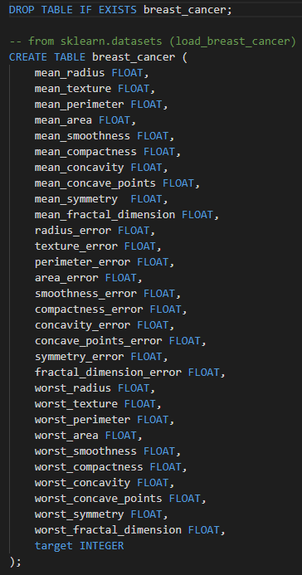
Data Processing
The target variable of the model was the column ‘Target’; [0]: Malignant, [1]: Benign.
3 (Mean, Error, Worst) sets of 10 features were used in the models.
The features were renamed to replace the space for an underscore to easily translate into a SQL Database.
Python Pandas → SQL Database

Slide 5
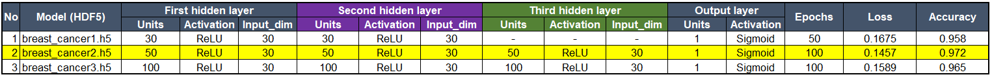
Compiling, Training, and Evaluating the Model
Neural Network Model
Number of neurons, layers, and activation function selected for the neural networks were as follows:
<Summary> Trial and error to add more neurons and layers, and different configurations of activation functions were attempted in order to increase the model performance. <Result> The accuracy rate of the best model, Model #2, was 97.2%. Better than the Model #1 by adding more units, the third hidden layer, and doubling the number of epochs. It turned out Model #3 was slightly less accurate even though it added even more units possibly due to overfitting the model.

Slide 6
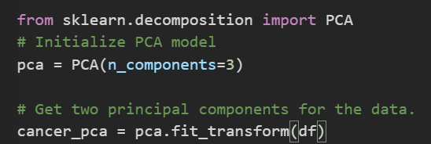
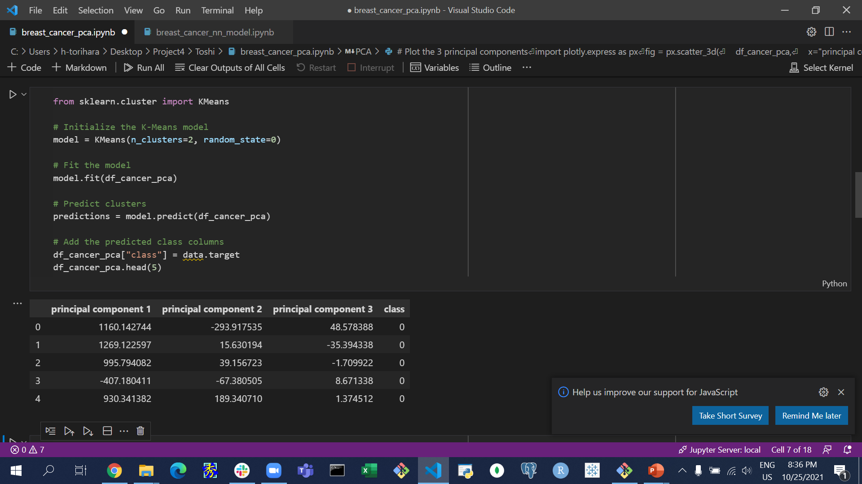
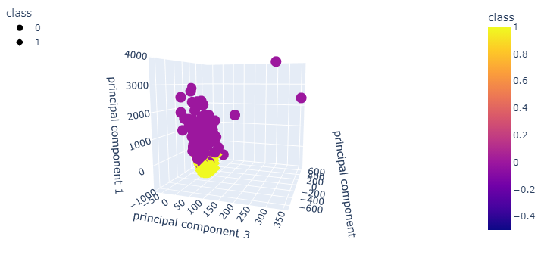
Compiling, Training, and Evaluating the Model
Principal Component Analysis - Visualization of clusters with KMeans

Slide 7
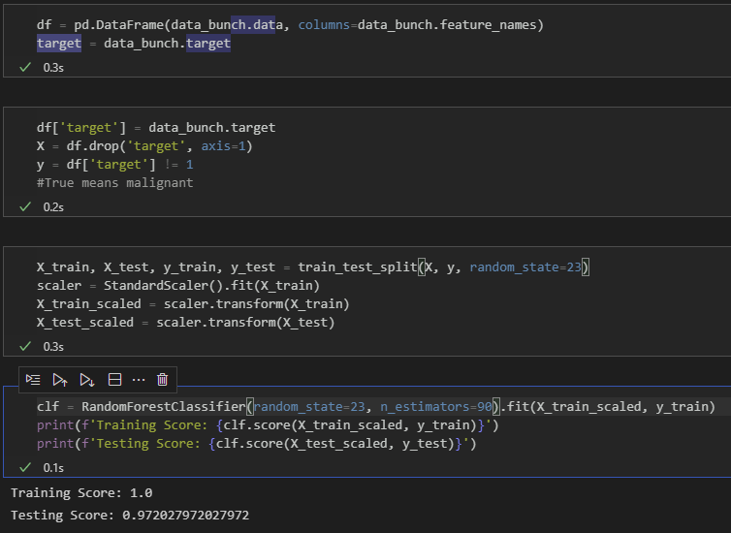
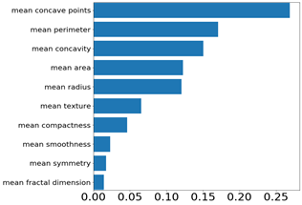
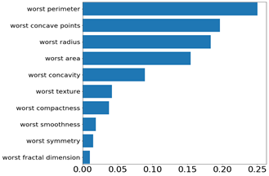
Compiling, Training, and Evaluating the Model
Random Forest Classifier and Feature Importance

Slide 8
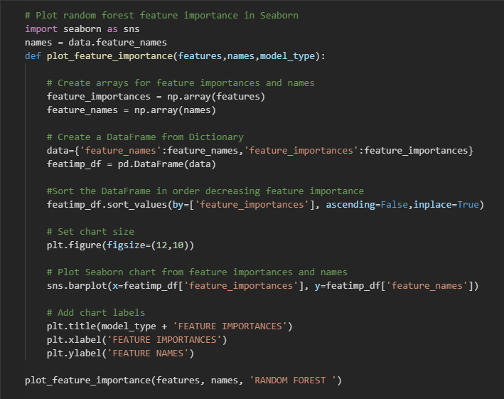
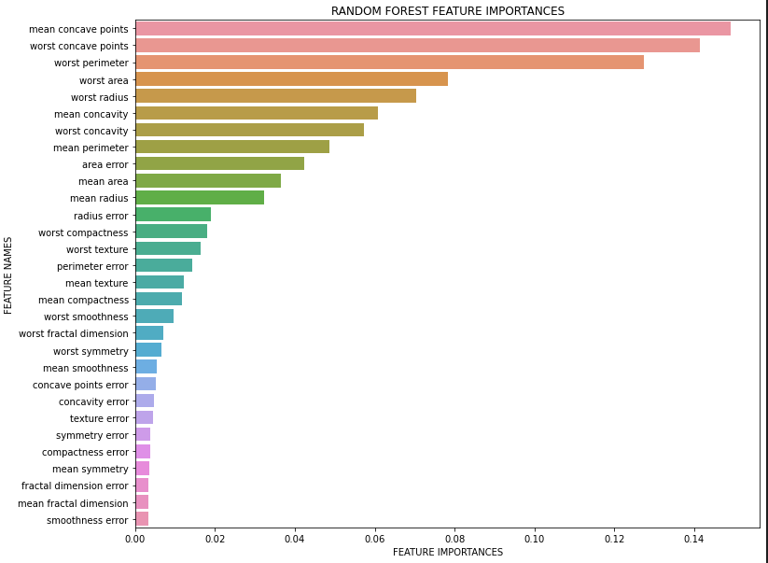
Compiling, Training, and Evaluating the Model
Random Forest Classifier and Feature Importance

Slide 9
Results
Data played heavily into the accuracy of our models;
Neural Network: 95-97%
PCA: Successfully clustered based on diagnosis.
Random Forest: 95-97%
The next plausible direction would be to use the Dataset to determine survival rate based on the 30 features. Is there a solid line that can be drawn based on the features that can help medical professionals determine survival.

