Slide 1
AUTOMATED AIR QUALITY DATA PREDICTION USING DENSITY BASED SPATIAL CLUSTERING OF APPLICATIONS WITH NOISE AND GRADIENT BOOSTING REGRESSOR ALGORITHM

Slide 2
Introduction:-
The project's specific goal is to forecast the concentration levels of the missing values of the air pollutants like PM2.5, PM10, CO, SO2, and NO2 in a specific area.

Slide 3
Density Based Spatial Clustering of Applications with Noise(DBSCAN):-
DBSCAN is a popular unsupervised machine learning approach for clustering data
It works by identifying dense areas of data points in a dataset and assembling them into clusters
DBSCAN is particularly useful for datasets with complex forms and changing densities
It does not require the user to predetermine the number of clusters, making it a great tool for exploratory data analysis
DBSCAN can handle datasets with non-uniform density and is robust to noise and outliers

Slide 4
DBSCAN Algorithm :-
Step - 1::First we check that we have correctly split the dataset for sake of our convenience.
Step - 2::Then we checked the values if there any null value, if Null (NaN) value occurred we replaced it with 0.
Step - 3::Then again check for the NaN (if any) present.
Step - 4::Then we make a elbow graph to check the epsilon value using K- nearest neighbor algorithm
Step - 5::The first elbow like curve is where the epsilon value lies
Step - 6::Then we implemented DBSCAN algorithm and fit the data to plot it in a 2D graph.

Slide 5
DBSCAN Algorithm Cont. :-
Step - 7::Then we check for the unique labels that returns an array. Here -1 is the index where all the noise value is present
Step - 8::Then we check the number of cluster and number of Noise in the algorithm implemented
Step - 9::Then we plotted the noise value for sake of visualization
Step - 10::Finally we are checking that which row lies under ‘-1’ where the noise is present

Slide 6
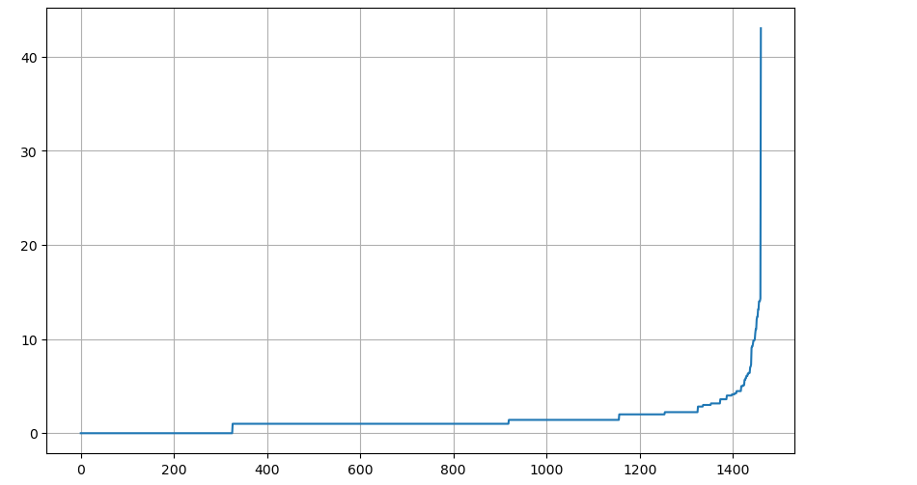
Elbow graph to detect pesilon value:-

Slide 7
Gradient Boosting Regressor Algorithm:-
Gradient descent method: used by algorithm to discover best settings for each weak learner
Advantages and disadvantages of Gradient Boosting, uses in industries such as banking, healthcare, and natural language processing
Current advancements in Gradient Boosting: application of deep neural networks and incorporation of methods for reinforcement learning
Applications of missing air pollution data via Gradient Boosting: increasing precision and completeness of air pollution datasets, assisting air quality monitoring and forecasting, enabling creation of air quality improvement policies

Slide 8
Gradient Boosting Regressor Algorithm:-
Forecasting missing values in meteorological databases: filling data gaps, providing more thorough and precise information about weather conditions, resulting in more accurate weather predictions and better choices across many industries

Slide 9
Gradient Boosting Regressor Algorithm:-
Step - 1:: We first check the dataset for the presence of any null values,then we choose one column whose value needs to be predicted and remove any other null columns from the dataset.
Step - 2::The dataset is then divided into train and test, with the dataset containing NaN values being placed under test data and the remaining dataset being utilised for training.
Step - 3::The tuning of hyperparameters for the implementation of the gradient boosting algorithm is carried out using the GridSearchCV approach. The best parameters are chosen by GridSearchCV from a list of potential values.

Slide 10
Gradient Boosting Regressor Algorithm:-
Step - 4::Finally, we use the Gradient Boosting Regressor along with the parameters given by GridSearchCV and the fit method is implemented and prediction is done using the .predict() method.

Slide 11
Conclusion:-
A air quality missing data prediction project can increase precision of weather forecasts and reduce weather-related disasters
The initiative can assist in closing data gaps and provide accurate information about weather conditions by forecasting missing data values in meteorological databases
The project offers insights into patterns and trends in meteorological data, which can help us better understand the natural world and inform decision-making
The importance of this project will increase if air quality patterns become more erratic and intense

