Slide 1
Predictive Modelling: Donor Reactivation Campaign
GROUP 4
Rémy Doyen
Iva Boishin
Anne Kirika

Slide 2
Base Table Construction Timeline
April 11 2013 (Train Data)
Jan 15 2014 (Test Data)
Predict event
Past
Past
Now
info
target
info
target
Donate >35
Less than 2013/04/11 to 1995
Less than 2014/01/15 to 1995

Slide 3


Data Preparation
Available Data Sets
Donor.csv
Gifts .csv
Campaign20130411.csv
Campaign20140115.csv
Data Cleaning
Read in the data sets as Data Frames into R environment
Explore the different data features in each set for dummy variable creation
Remove all donors from the subset that aren’t available in gifts data set
Filter your data according to the timeline
Dummy Variable Creation
Base table creation for test and train

Slide 4
Dummy Variable List
Dummy Variables
Donor Gender
Female
Male
Company
Unknown
[S]
Language
French
[Dutch]
Other variables from Donor demographics
Region (Missing and available)
Donor Districts
Amount
Total amount donated
Maximum amount donated
Minimum amount donated
Average amount donated
Average amount donated per quarter (Q1,Q2,Q3,Q4)
Timeline
Number of donations per donor
How often the donor donates per year
Active Weeks (Difference between first and last donation)
Whether or not donor donated in a quarter
Evolution of a donor

Slide 5
Predictive Model Building
Models Used :
Models | AUC Train | AUC Test
Forward Stepwise Linear Regression Model built based on best variable selection based on highest predictive power | 0.6392 | 0.6478
Random Forest Model built based on all variables | 0.4665 | 0.5011
Based on AUC evaluation the Forward Stepwise Logistic Regression performs better compared to the RandomForest model as it had higher AUC for the test dataset and the AUC of the test and train were rather close, suggesting that there was not a lot of overtraining. With this regard stepwise logistic regression served the best method for feature selection for the exercise.

Slide 6
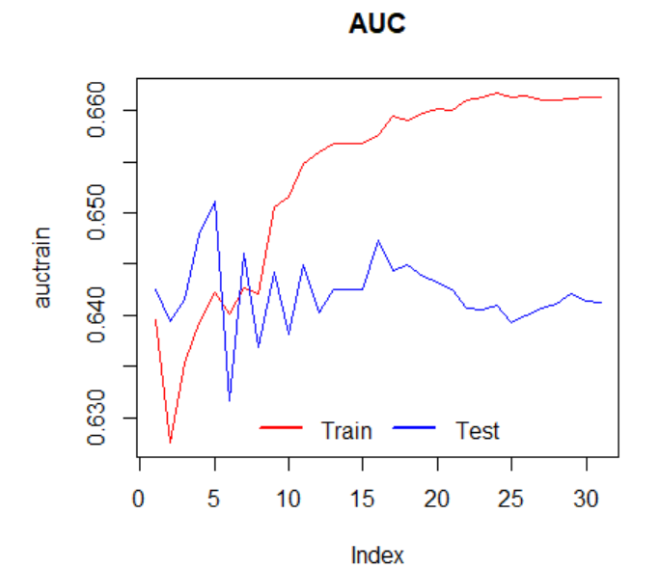
Predictive Model Evaluation
Features selected based on Stepwise Logistic Regression :
Region, Average donation, Active weeks, Donation count , Unknown Gender
Evaluation Method 1. AUC
Cut – off on feature numbers after which over – fitting is introduced

Slide 7
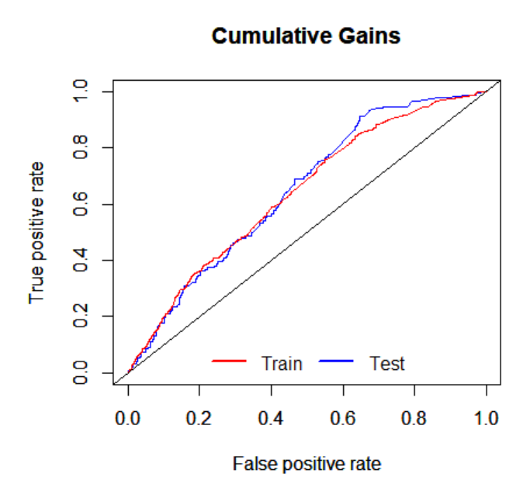
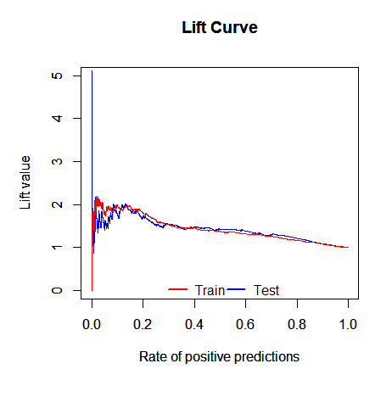
What does this mean for business?

Slide 8
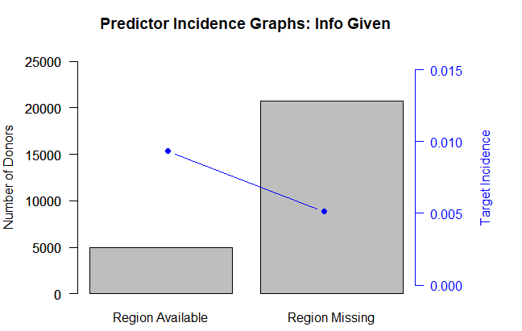
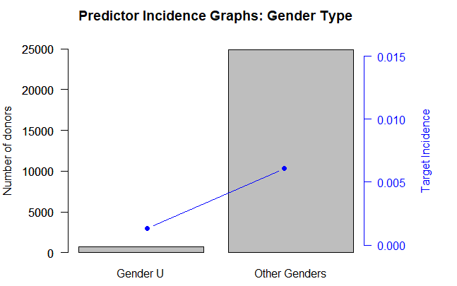
Predictive Insights Graphs
Insights based on Information given on Demographics
Coefficient in model : 0.502
Coefficient in model : -1.259
Key Takeaway: Donors who revealed data about themselves like region and gender had a higher probability of donating more than 35 euros in future campaigns.

Slide 9
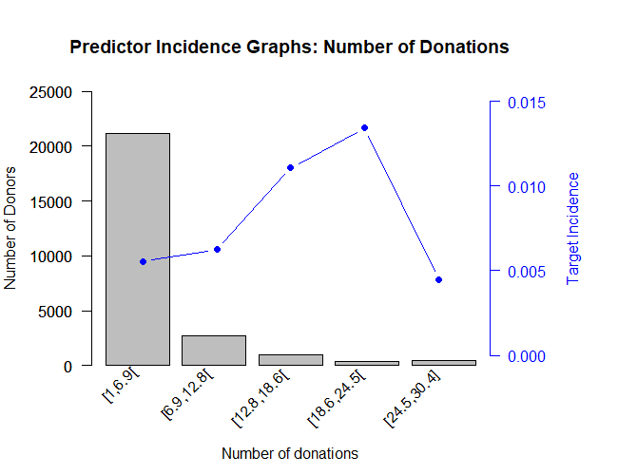
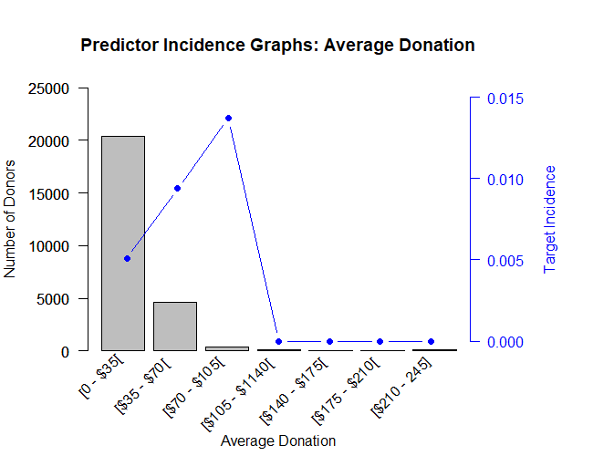
Predictive Insights Graphs
Insights based on Donations
Coefficient in model : -0.038
Coefficient in model : 0.007
Key Takeaway: Donors who donated between around 18 and 24 times had the highest probability of donating more than 35 euros in future campaigns, followed by those who donated between 13 and 18 times. Similarly, donors who normally donate between $35 and $105 are the most susceptible to retargeting campaigns.

Slide 10
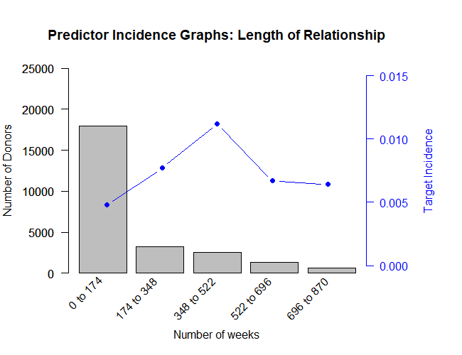
Predictive Insights Graphs
Insights based on Length of Relationship
Key Takeaway: Donors who had a length of relationship of between 348 and 522 weeks had the highest probability of donating more than 35 euros in a reactivation campaigns.
Coefficient in model : 0.0015

Slide 11
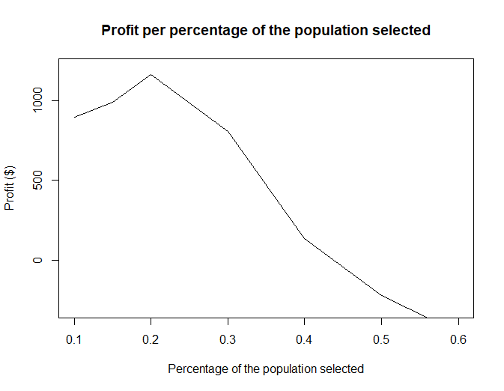
Highest Profit According to the Model
Highest profits for the re-activation campaign running at a cost of 0.5 euro can be achieved if the campaign targets 8,940 donors who represent 20% of the population.
Population size = 44691
Target incidence = 1%
Reward target= 35€
With these parameters, DSC can expect to earn a profit of at least 1161€

Slide 12
Thank you ! Any questions ?

