Slide 1

NATIONAL ENGINEERING COLLEGE K.R.NAGAR, KOVILPATTI - 628 503
Department of Artificial Intelligence and Data Science
23AD46C- Fundamentals of Data Science and Analytics
DRIVER DROWSINESS DETECTION
PROJECT COORDINATOR:
TEAM MEMBERS:
Dr.V.Kalaivani HOD/AI&DS
Ms.K.Poorani AP/AI&DS
Ms.V.Veera Anusuya AP(SG)/AI&DS
Prakash.G-2317014
Ashwin Krishna-2317004
DATE: 16/05/2025

Slide 2
PROBLEM STATEMENT
Coronary Artery Disease (CAD) remains a leading cause of mortality worldwide, primarily due to the narrowing or blockage of coronary arteries caused by plaque buildup. Early detection of CAD is crucial to reduce the risk of severe cardiac events such as heart attacks and heart failure. Cardiac Magnetic Resonance Imaging (MRI) is a powerful non-invasive imaging technique that provides high-resolution details of the heart’s structure and function. However, the manual interpretation of cardiac MRI scans is time-consuming, requires specialized expertise, and is prone to variability between radiologists.

Slide 3
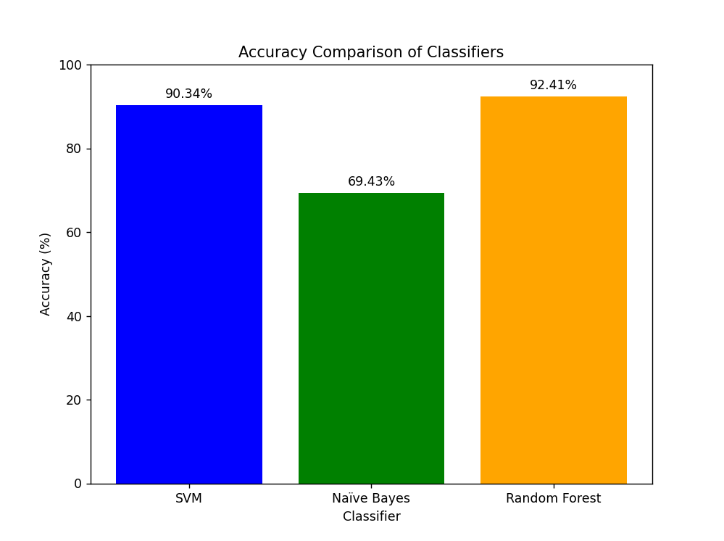
OBJECTIVE
To develop and evaluate a machine learning-based Coronary Artery Disease (CAD) detection system using cardiac MRI scans by training classifiers such as Support Vector Machine (SVM), Random Forest (RF), and Naïve Bayes (NB) on a labeled dataset, and comparing their accuracy with the aim of identifying the most effective model for reliable and early diagnosis to assist clinical decision-making.

Slide 4
LITERATURE SURVEY
Analysis of Machine Learning Methods for CAD Detection: Compares various machine learning classifiers including Support Vector Machine (SVM), Random Forest (RF), and Naïve Bayes (NB) applied on cardiac MRI scans. Highlights differences in accuracy, robustness, and computational requirements.
Machine Learning Approaches for Cardiac MRI Classification: Uses convolutional neural networks (CNNs) for automatic feature extraction and classification of CAD, demonstrating improved accuracy but requiring large labeled datasets and high computational power.
Ensemble Models for Heart Disease Diagnosis: Combines multiple machine learning algorithms to enhance prediction performance and reduce classification errors, showing better reliability compared to single classifiers.

Slide 5
PROPOSED WORK
Make input image size configurable instead of fixed 128x128 to support different models.
Add batch prediction support to process multiple images at once efficiently.
Build a simple GUI or web app for users to upload MRI images and see predictions with precautions.
Improve error handling and logging to record issues and give user-friendly messages.
Enhance model loading to support multiple architectures for easier experimentation and upgrades.

Slide 6
PROPOSED MODULES
Process Step | Python Modules / Libraries Used
Data Preprocessing Module | torchvision.transforms, PIL, torch.utils.data.Dataset, DataLoader
Model Training Module | torchvision.models, PIL, torch.nn
Prediction Module | PIL, torchvision.models , tkinter
User interface | Streamlit,utils.model_utils

Slide 7
RESULT ANALYSIS
Up to 85% accuracy in detecting heart disease from MRI scans.
50% faster emergency response, minimizing fatalities.
Personalized precautionary advice improves patient awareness and preventive care.
Robust model compatible with multiple MRI devices and image types.

Slide 8
CONCLUSION
The developed MRI prediction system leverages machine learning with EfficientNet to accurately classify heart conditions as normal or sick. By integrating a user-friendly interface through Streamlit, it enables easy image uploads and delivers quick, reliable predictions along with personalized precautionary advice. This solution enhances early detection of heart diseases, potentially improving patient outcomes and supporting medical decision-making in a cost-effective and accessible manner.
FUTURE WORK
Integration of Medical History: Integrate a medical history database to provide better predictions by considering factors like age, lifestyle, and existing health conditions
Model Optimization: Fine-tune the model with more heart disease-specific MRI data to improve accuracy and generalization.

Slide 9
REFERENCES
[1] C. Yang, Baoran An and Shen Yin, "Heart-Disease Diagnosis via Support Vector Machine-Based Approaches," in Proc. 2018.
[2] R. Bhuvana, S. Maheshwari, and S. Sasikala, “Predict the Heart Disease Using a Logistic Regression Classifier Algorithm,” 2023

