Slide 1


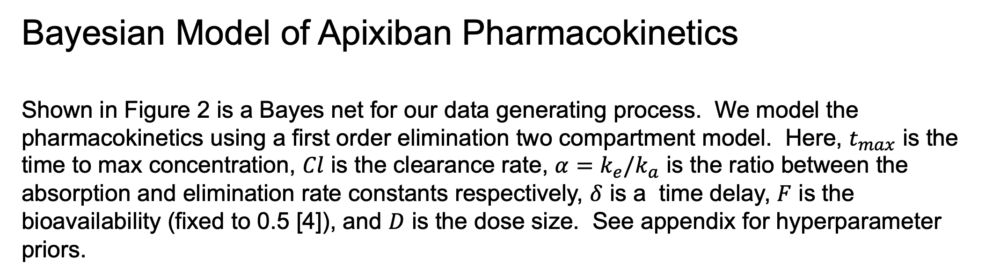
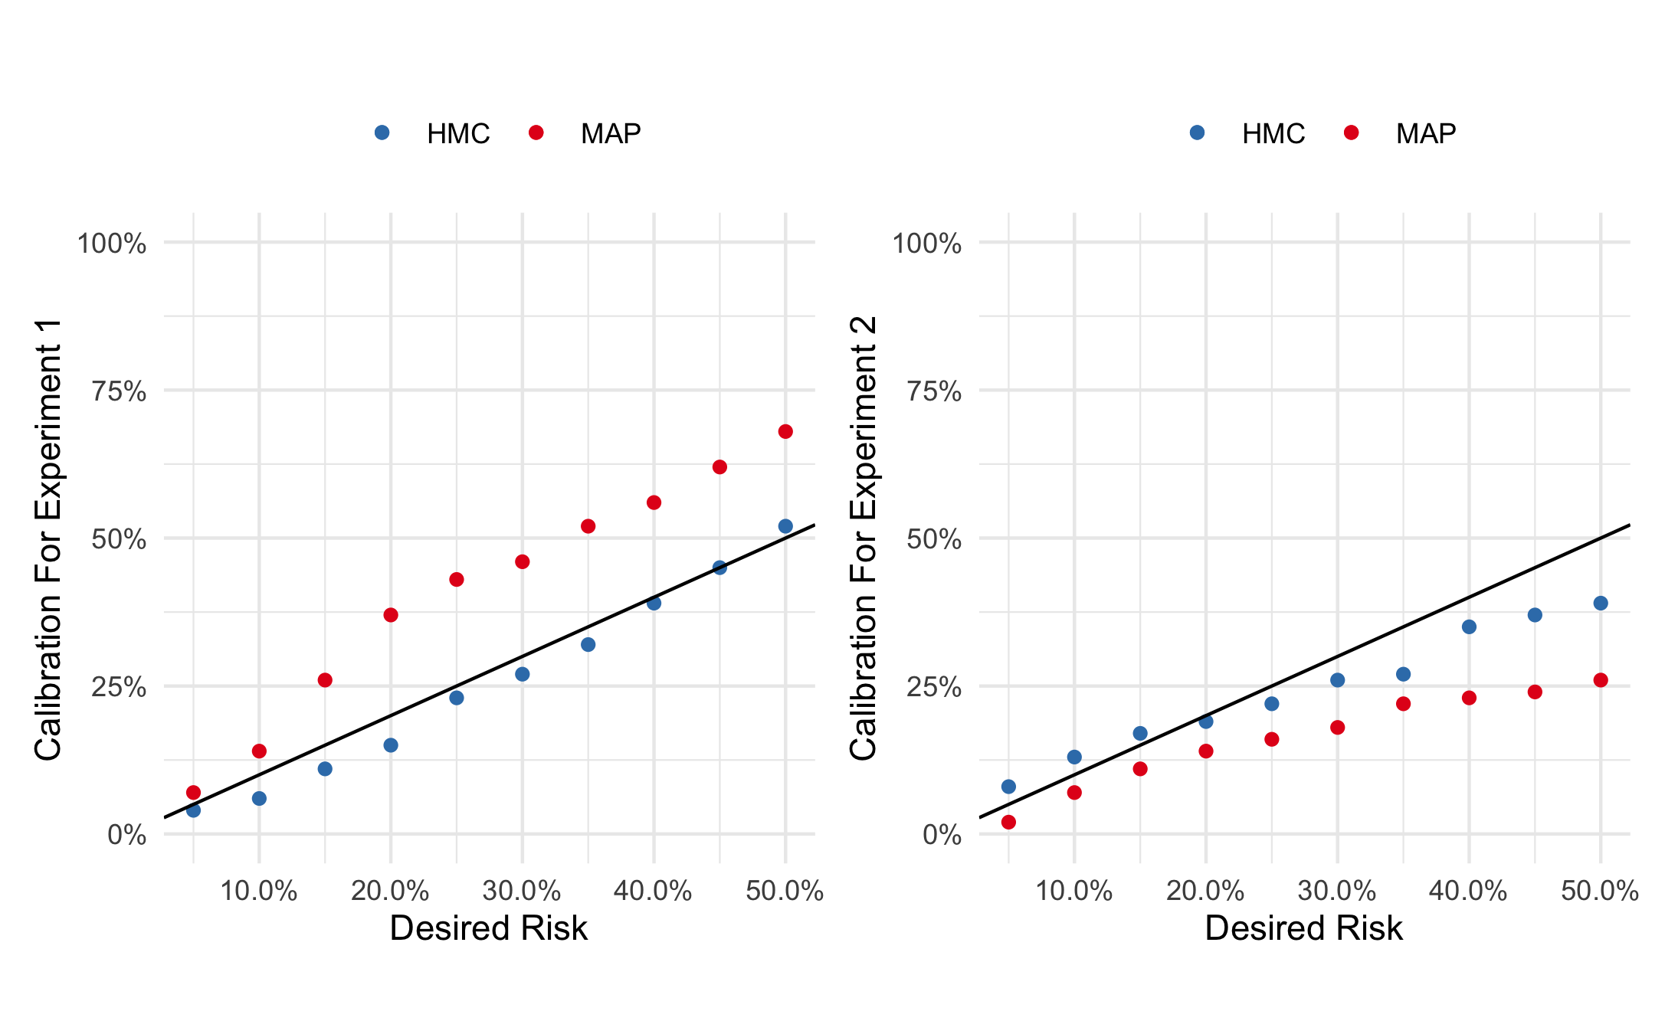
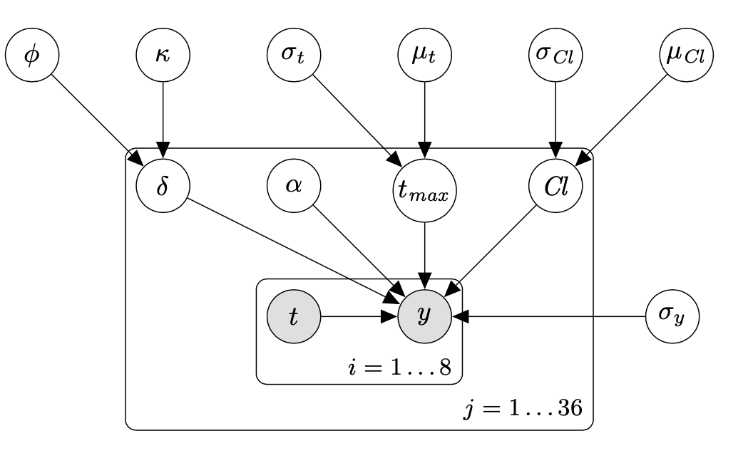
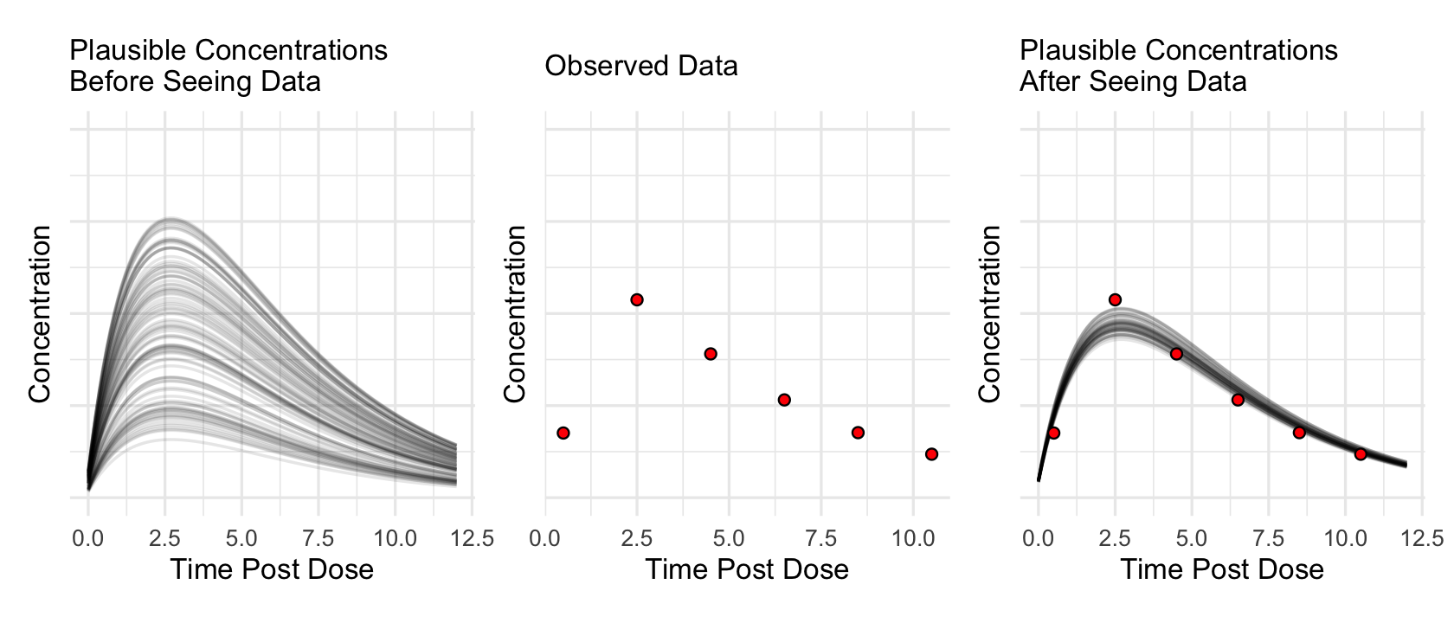
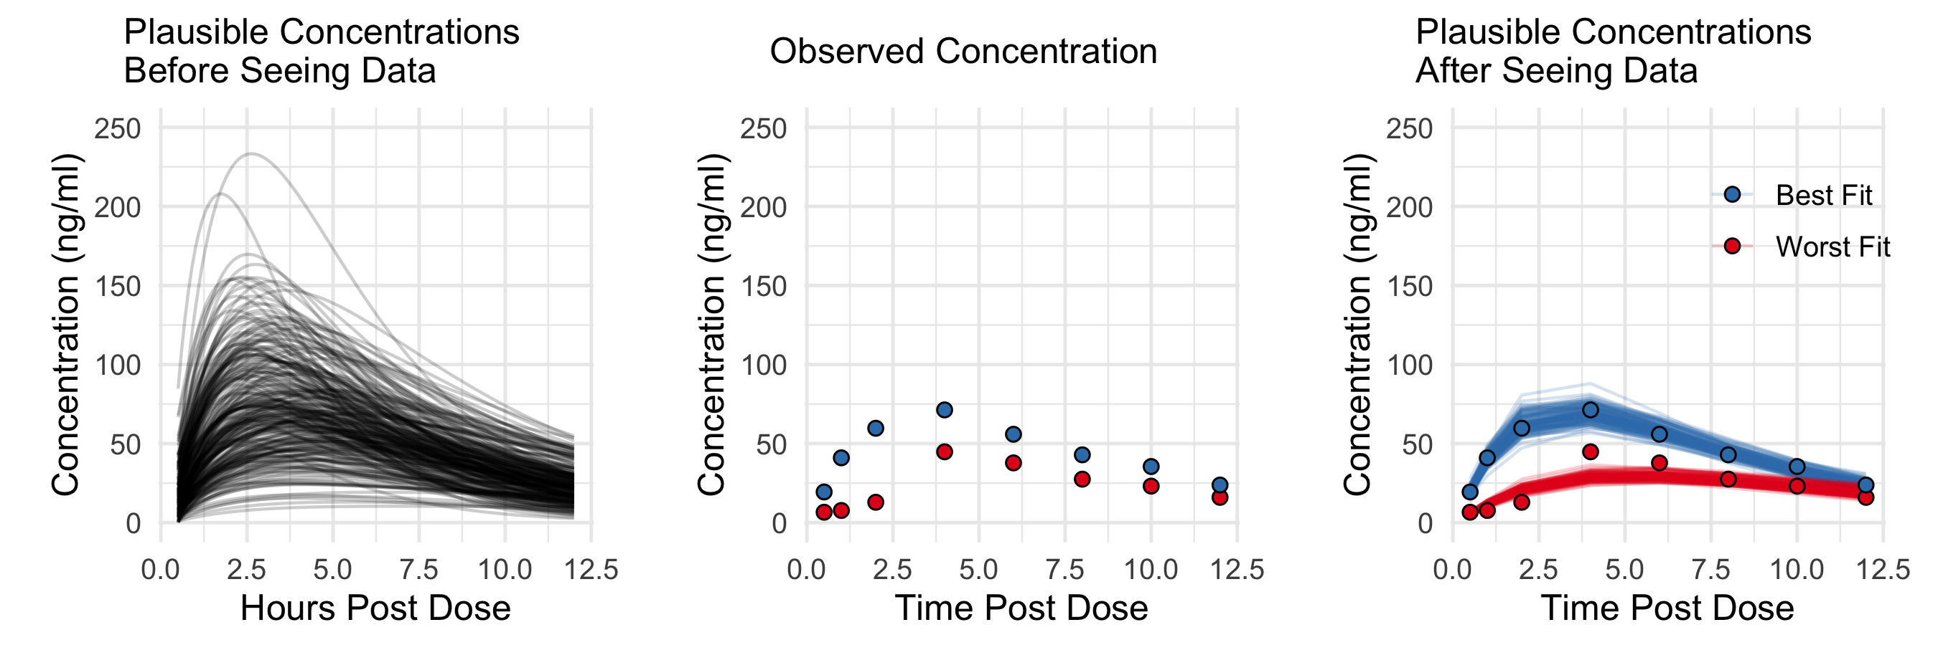
Comparisons Between Hamiltonian Monte Carlo and Maximum A Posteriori For A Bayesian Model For Apixaban Induction Dose & Dose Personalization
A. Demetri Pananos¹, Daniel J. Lizzote^{1,2}
Department of Epidemiology and Biostatistics, Schulich School of Medicine & Dentistry, Western University, London, ON, Canada
Department of Computer Science, Western University, London, ON, Canada
Introduction
Determining the right dose for any one patient can be challenging. Warfarin offers a good example. Physicians choose an initial dose based on guidelines and their own experience, and then closely monitor a measure of how long the patient’s blood takes to clot.
Pharmacokinetic and statistical models of how drugs behave within an individual can alleviate some of these challenges by predicting the effects of different doses based on patient covariates. Both types of models can provide guidance for individual patients, but only when there is enough data so that models are accurate and reliable. For personalized pharmacokinetics-based dosing, this amount of data is rarely available in practice.
When data are limited, Bayesian methods with informative priors have been proposed. All but the simplest of Bayesian models for decision-making requires computational approximation techniques to obtain model estimate and predictions. Several approaches exist, with Hamiltonian Monte Carlo (HMC) being considered the gold standard [1]. Despite HMC being the preferred method, methods like Maximum A Posteriori (MAP) continue to be used in population Bayesian pharmacokinetic studies as late as 2020. This raises questions regarding how decisions in personalized medicine may be affected by different methods of inference.
Generalizable Insights about Machine Learning in the Context of Healthcare
Although predictions made by HMC and MAP may appear to be very similar according to common error metrics, they can lead to very different personalized dosing decisions.
Calibration for Dosing Decisions
Since all pseudopatients were simulated, the true concentration function as a function of dose size was known. To further compare HMC and MAP, we took the estimated dose size to achieve a desired risk of exceeding/failing to exceed the given thresholds and computed the concentration under the given dose. We could then compute the number of pseudopatients which actually exceed/fail to exceed the thresholds. Shown in figure 4 are the calibration curves for HMC and MAP for each experiment.
Figure 2: Bayes net demonstrating our hypothesized data generating process. Priors are placed on the random variables at the top of the net. Shaded plates indicate observed random variables, transparent plates indicate latent quantities. See our appendix for model priors.
Figure 4: Left: Calibration curves for assessing risk of being below 20 ng/ml 12 hours post dose. Each dot represents the proportion of 100 patients which fail to exceed the threshold. Note doses estimated under MAP see many more patients fail to exceed the threshold. Right: Calibration curves for assessing risk of the max concentration being below 80 ng/ml. HMC is better calibrated than MAP in this experiment as well.
Conclusions
We have demonstrated that the inference technique can have an impact on decision making that is as important as model fidelity, even when the impact on point prediction quality is minimal. Specifically, we have shown that MAP-based inference, which is very commonly used in pharmacokinetics, can lead to very different personalized dosing decisions than HMC-based inference, even in a well-validated model.
We recommend that if practitioners do use MAP, that they also compare model results with HMC. Libraries exist to perform HMC in a variety of languages including R, python, and Julia, making HMC widely accessible. Use of these libraries has the added benefit of making analysis more transparent and reproducible for the community at large.
Acknowledgements
Thanks to Drs. Melanie Beaton and Rommel Tirona for feedback on the pharmacokinetic models and for providing the data to fit our model. This work was supported by the Ontario Ministry of Research, Innovation and Science (Ontario Research Fund—Research Excellence [RE08-063], Principal Investigator: Kim RB) and by the Natural Sciences and Engineering Research Council of Canada (NSERC).
Citations
Tripuraneni, Nilesh, et al. "Magnetic Hamiltonian Monte Carlo." International Conference on Machine Learning. 2017.
Carpenter, Bob, et al. "Stan: A probabilistic programming language." Journal of statistical software 76.1 (2017).
Beaton, Melanie D., et al. "Su1495-Apixaban and Rosuvastatin Pharmacokinetics in Nonalcoholic Fatty Liver Disease." Gastroenterology 154.6 (2018): S-1158.
Byon, Wonkyung, et al. "Apixaban: a clinical pharmacokinetic and pharmacodynamic review." Clinical pharmacokinetics (2019): 1-15.
Figure 1: A demonstration of a Bayesian workflow for a pharmacokinetic models. The leftmost panel represents the prior. Each curve corresponds to a unique set of model parameters which induce each concentration curve. The center panel is the data observed from a single patient. Conditioning on this data yields the right most panel.
Figure 3: Leftmost panel shows 250 draws from our prior. Center panel shows data from two patients who achieved the best (blue) and worst (red) model fit as measured through mean absolute percent error. Rightmost panel shows 25 draws from the posterior. Not shown here are the other 34 patients in our data.
Methods
We develop a new Bayesian pharmacokinetic model written in Stan[2] for apixaban using data from a study previously performed at Western [3]. We summarize the posterior predictive distribution to use in our next experiment as a prior. We also generate 100 pseudopatients, observed 24 equally spaced times between 0.5 and 12 hours post dose from our posterior predictive to use as data in our simulation study. Our code and data are available at github.com/Dpananos/PKBayes.
We perform two experiments to compare HMC and MAP. In our first experiment, we determine the posterior probability of failing to exceed a concentration of 20 ng/ml at 12 hours post dose given a dose size, D. In our second experiment, we determine the posterior probability that the max concentration fails to exceed 80 ng/ml. We compare the differences in estimated dose sizes to achieve a desired risk, as well as the calibration for both HMC and MAP.
Results From Simulation
 | HMC | MAP
MSE (SD) | 6.67 (15.93) | 8.57 (19.93)
MAE (SD) | 1.71 (1.94) | 1.97 (2.17)
MAPE (SD) | 0.04 (0.03) | 0.05 (0.03)
Table 1: Prediction error for HMC and MAP. Predictions were computed as expectations of the posterior latent concentration. The error was computed on pseudo-observations not seen by our model.

