Slide 1



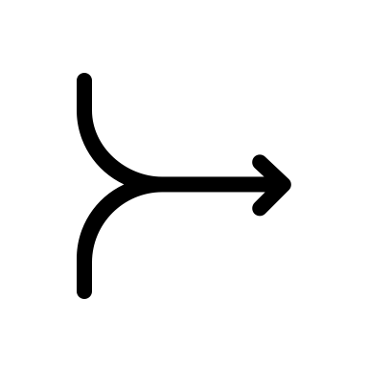













$$C(t)$$
$$C(t)$$
$$p(θ|y)$$
$$C(t)$$
$$C(t)$$
$$C(t)$$
$$C(t)$$
$$t$$
$$t$$

Slide 2



Before Measurement
After Measurement
$$C(t)$$
$$C(t)$$
$$p(θ|y)$$
$$C(t)$$
$$C(t)$$
$$C(t)$$
$$C(t)$$
$$t$$
$$t$$

