Slide 1


5th Semester
Project Presentation
On
Game Rental Management System (ONYXPLAY)
Babu Madhav Institute of Information Technology
Group Number: 05
Group Members:
1. Panchal Dhruvin Dipakkumar (202407100110014)
2. Manjarawala Dhruv Mayankbhai (202407100110020)
3. Rana Prem Vikram (202407100110039)
Guide Name : Dr. Sapan Naik

Slide 2
Table of Content
Project Definition
Functional Requirements
Non-Functional Requirements
Use Case Diagram
Activity Diagram
Data Dictionary

Slide 3
Project Definition

Slide 4
Purpose:
Create a unified web platform (ONYXPLAY) where users can rent gaming consoles, game titles, VR headsets, racing wheels, and digital accounts for flexible periods.
Help gamers save money by paying only for the exact duration they play, avoiding expensive upfront hardware investments.
Help store owners automatically track unit-level serial numbers, prevent double-bookings, process secure Razorpay payments, and dispatch automated email invoices.

Slide 5
Scope:
Visitor Portal: Allows unregistered visitors to browse and search the catalog across 8 categories (Consoles, Games, VR Headsets, Racing Wheels, Controllers, Accessories, Subscriptions, Accounts) with multi-image previews, view daily rates & FAQs, and register with email OTP verification.
Customer Portal: Enables registered customers to select delivery/return dates with live price calculation, manage a multi-item cart, enter structured delivery addresses, pay securely via Razorpay, receive automated email receipts, track order status, and cancel eligible pending orders before dispatch.
Admin Portal: Enables administrators to view real-time analytics on the dashboard, perform full CRUD operations on gadgets with multi-image upload & cropping, manage individual hardware units with unique serial numbers and operational statuses, and manage the complete order fulfillment workflow.

Slide 6
Identification of Need:
High Gaming Costs: Next-gen consoles, VR kits, and racing wheels cost INR 40,000 to 80,000+, making flexible short-term rentals an attractive, economical alternative for gamers.
Digital & Physical Demand: Gamers demand flexible access to both physical hardware (consoles, discs, racing wheels) and digital subscription passes/accounts.
Operational Efficiency: Automated tracking eliminates double-booking, ensures unit-level serial number allocation, automates payment and email receipts, and maintains operational logs efficiently.

Slide 7
Problem Definition

Slide 8
High-end gaming gear like consoles, VR headsets, and racing wheels is prohibitively expensive for casual gamers to purchase, while traditional manual rental management leads to overlapping bookings, untracked inventory damage, and lost customer orders. The ONYXPLAY Game Rental Management System solves this by providing an end-to-end web platform that dynamically validates booking dates, allocates specific available hardware units, processes secure payments via Razorpay, and tracks real-time fulfillment and device statuses.

Slide 9
Functional Requirements
&
Non Functional Requirement

Slide 10
Admin Portal - Functional Requirements
FRN | Description | Comment / Purpose
FR-AD-01 | The system shall allow the Admin to securely log in to the admin portal. | Ensures restricted administrative access using secure credentials and role-based authorization.
FR-AD-02 | The Admin shall be able to Add, View, Update, and Delete (CRUD) gadgets across 8 categories with multi-image gallery upload & crop. | Provides full inventory catalog control over consoles, games, VR kits, and racing gear.
FR-AD-03 | The Admin shall be able to register individual hardware units with unique serial numbers and track operational status. | Enables unit-level asset tracking, hardware maintenance logging, and prevents inventory loss.
FR-AD-04 | The Admin shall be able to update item availability statuses ('Available', 'Rented', 'Under Maintenance'). | Controls real-time catalog stock visibility based on device operational readiness.
FR-AD-05 | The Admin shall be able to view registered customer profiles, contact numbers, email verification status, and recent activity. | Provides operational visibility into customer accounts and incoming booking queues.
FR-AD-06 | The Admin shall be able to update order fulfillment lifecycle statuses ('Pending', 'Confirmed', 'Dispatched', 'Delivered', 'Returned', 'Cancelled'). | Drives logistics management; automatically restores hardware unit stock upon Return or Cancellation.

Slide 11
Customer Portal - Functional Requirements
FRN | Description | Comment / Purpose
FR-CU-01 | Customers shall be able to register with 6-digit email OTP verification, securely log in, and log out. | Manages customer session identity, password security (bcrypt), and account verification.
FR-CU-02 | Customers shall be able to search and browse consoles, games, and gear filtered across 8 categories. | Helps customers quickly locate specific gaming hardware, titles, or digital accounts.
FR-CU-03 | Customers shall be able to select valid delivery and return dates for desired rentals. | Sets the start and end period, automatically computing rental duration (days) and subtotal price.
FR-CU-04 | Customers shall be able to add multiple rental items to a shopping cart and review cart contents prior to checkout. | Enables multi-item rental bookings with real-time stock check in a single transaction.
FR-CU-05 | Customers shall be able to enter detailed shipping addresses including street, landmark, city, state, and pincode. | Captures exact logistics and location details for delivery fulfillment.
FR-CU-06 | The system shall process secure online payments via Razorpay and generate a unique alphanumeric Booking ID. | Confirms the rental transaction, creates booking records, and allocates physical hardware units.

Slide 12
Customer Portal - Functional Requirements(conti…)
FRN | Description | Comment / Purpose
FR-CU-07 | Customers shall receive an automated itemized HTML booking confirmation email via PHPMailer SMTP. | Provides instant payment receipts and rental delivery schedules directly to user inbox.
FR-CU-08 | Customers shall be able to view their complete rental booking history and live order fulfillment status. | Allows customers to track active, dispatched, delivered, and past orders.
FR-CU-09 | Customers shall be able to cancel eligible orders in 'Pending' status prior to dispatch. | Offers self-service order cancellation and automatically releases assigned hardware units back to inventory.

Slide 13
Visitor - Functional Requirements
FRN | Description | Comment / Purpose
FR-VI-01 | Visitors shall be able to browse the public catalog of consoles, games, and gear with multi-image previews. | Allows prospective customers to view available rental products and specifications without logging in.
FR-VI-02 | Visitors shall be able to use search and faceted category filtering to locate specific gear or titles. | Provides direct search functionality across all 8 gaming categories.
FR-VI-03 | Visitors shall be able to view platform FAQs, rental policies, pricing terms, and support details. | Informs users about rental duration rules, security, delivery, and return procedures.
FR-VI-04 | Visitors shall be able to sign up and create a new customer account using email OTP verification. | Converts visitors into authenticated registered users with verified email addresses.

Slide 14
Non-Functional Requirements
Category | NFRN | Description | Comment / Purpose
Security | NFR-01 | User passwords must be stored using cryptographic hashing (bcrypt). Email OTP verification must expire after set duration. Administrative endpoints must enforce role-based access control (isAdmin()). Online checkout must use 256-bit SSL encryption via Razorpay. | Protects user credentials, prevents unauthorized administrative access, and ensures safe financial transactions.
Usability | NFR-02 | The web application interface must feature a responsive dark-mode cyberpunk design with intuitive navigation, calendar date pickers, live cart badge counter, and multi-image photo gallery modals. | Delivers a modern, gamer-centric, and user-friendly experience across smartphones, tablets, and desktop browsers.
Performance | NFR-03 | Page load times for catalog search and item filtering must not exceed 2 seconds. Foreign keys (category_id, user_id, hardware_unit_id) must be indexed for rapid querying. | Delivers fast browsing experiences to prevent user drop-off during peak catalog browsing.

Slide 15
Non-Functional Requirements
Category | NFRN | Description | Comment / Purpose
Data Integrity | NFR-04 | The system must prevent concurrent double-booking of the exact same physical hardware serial number. Checkout and cancellation operations must use atomic database transactions (mysqli_begin_transaction) with rollback on error. | Guarantees stock availability accuracy, prevents orphaned records, and eliminates double-booking errors.
Availability | NFR-05 | The web application should maintain 99.5% operational uptime to support constant online rental bookings and catalog browsing. | Ensures system reliability, fault-tolerant database connections, and continuous availability for customers.

Slide 16
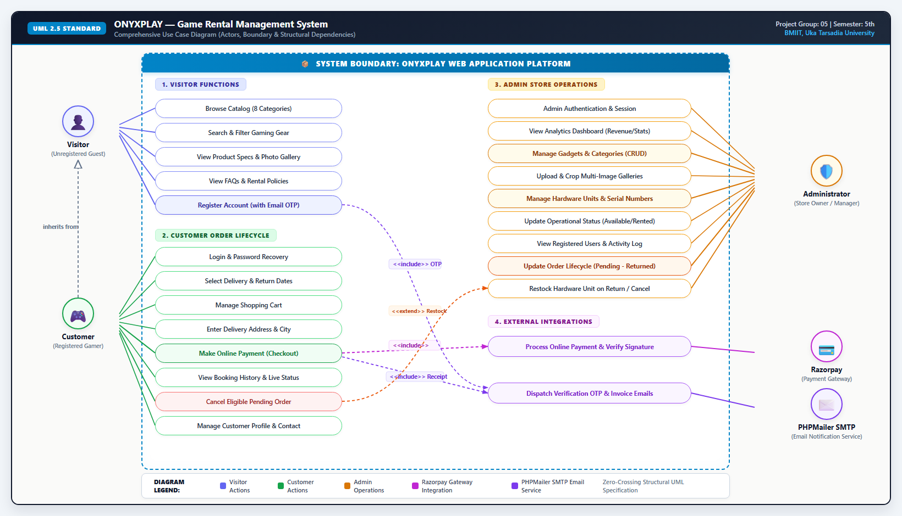
Use Case Diagram

Slide 17
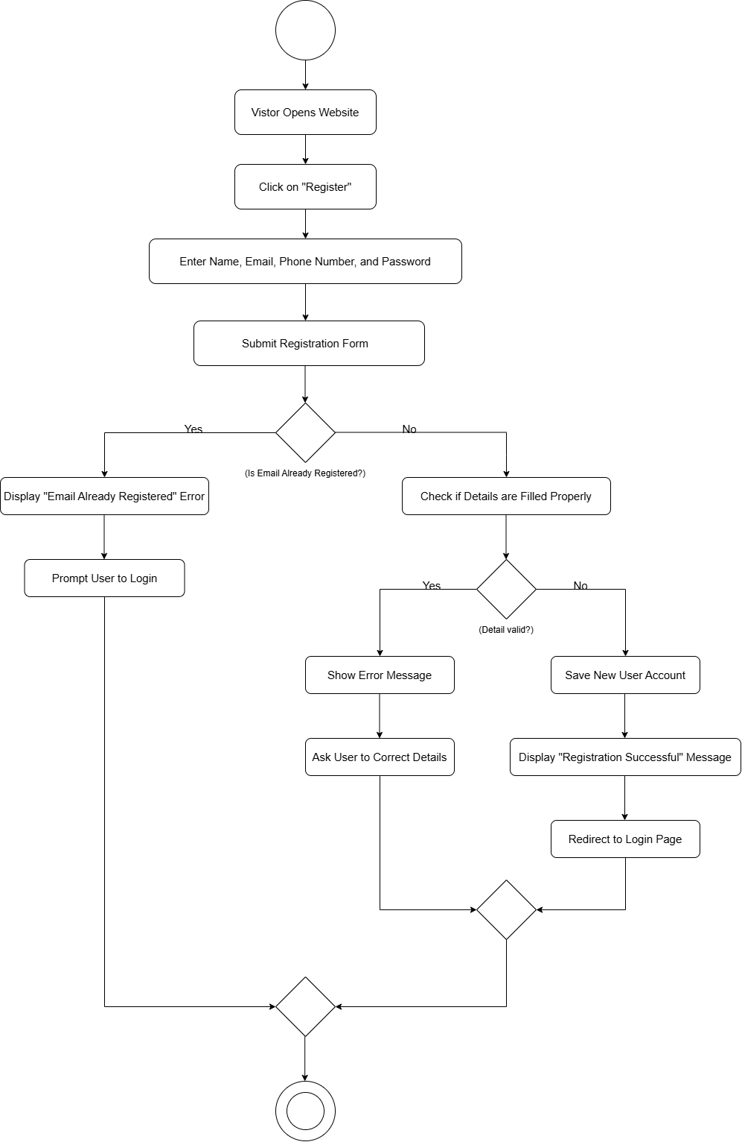
Activity Diagram
User Registration :

Slide 18
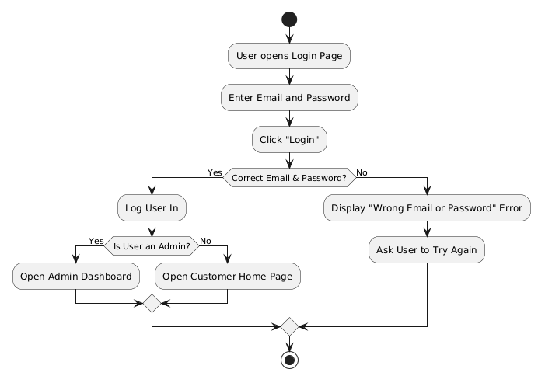
Activity Diagram
User Login :

Slide 19
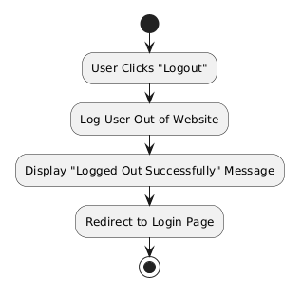
Activity Diagram
User Logout :

Slide 20
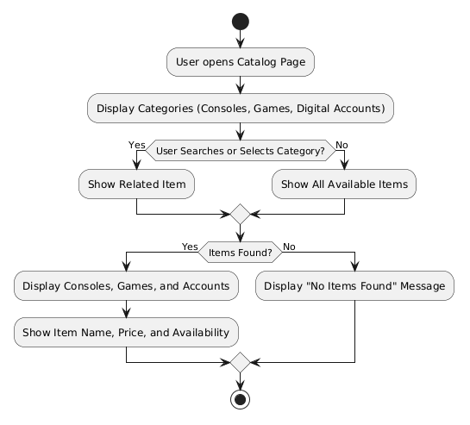
Activity Diagram
Browse And Search :

Slide 21
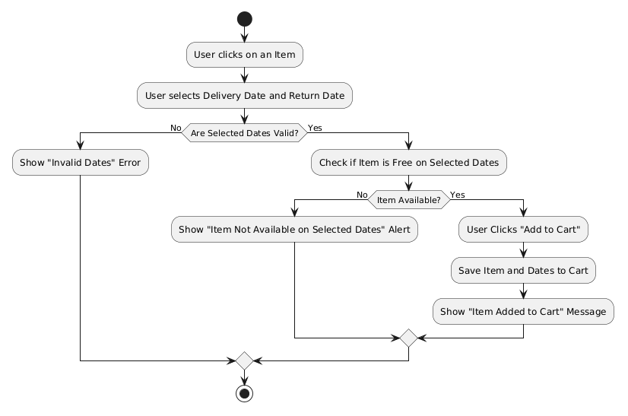
Activity Diagram
Rental Dates :

Slide 22
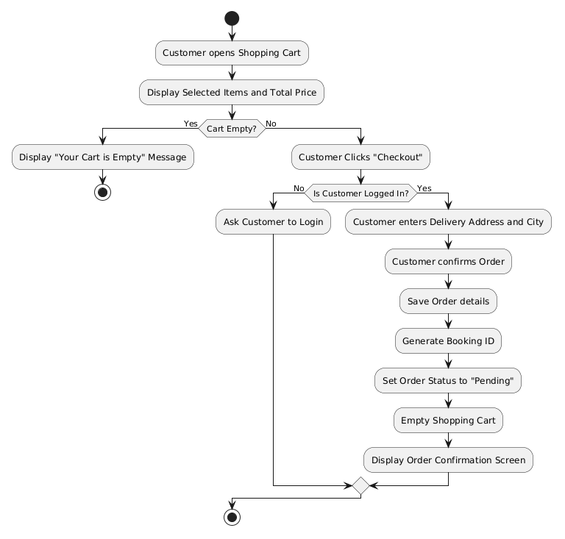
Activity Diagram
Review Cart :

Slide 23
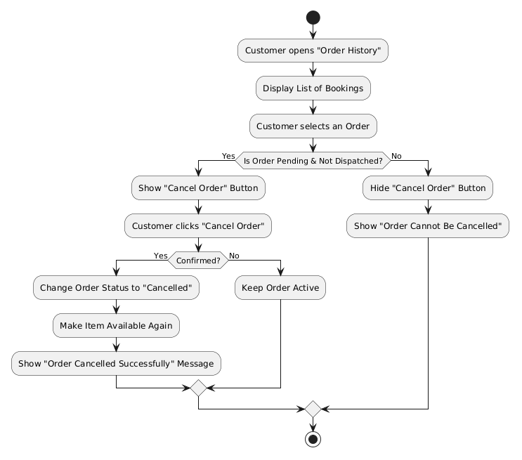
Activity Diagram
Order Cancellation :

Slide 24
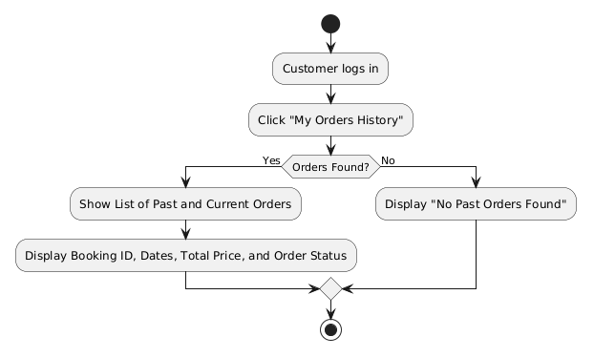
Activity Diagram
View Order History :

Slide 25
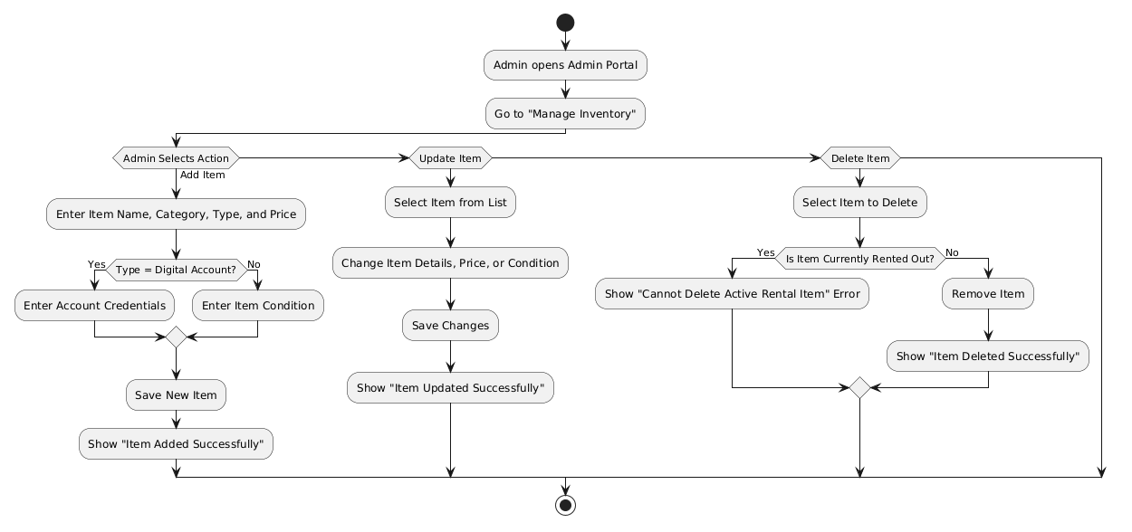
Activity Diagram
Admin Operations(CRUD) :

Slide 26
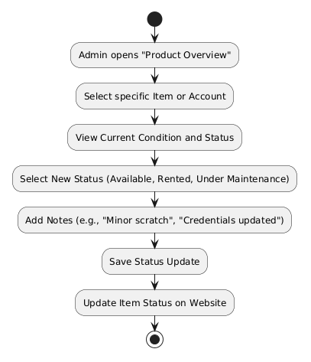
Activity Diagram
Inventory Check(conditions) :

Slide 27
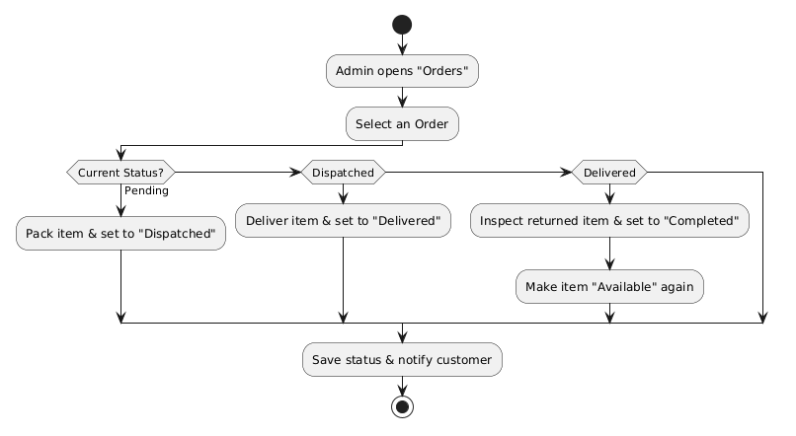
Activity Diagram
Admin Check Order Status :

Slide 28
Data Dictionary

Slide 29
Table: users :
Field Name | Data Type | Size | Constraints | Description
id | INT | 11 | Primary Key, Auto Increment | Unique user/customer identifier
role | ENUM | - | Default 'customer' | User authorization role ('admin', 'customer')
name | VARCHAR | 100 | NOT NULL | User's full name
email | VARCHAR | 100 | UNIQUE, NOT NULL | Customer/Admin email address (used for login)
phone | VARCHAR | 20 | NOT NULL | User contact phone number
password | VARCHAR | 255 | NOT NULL | Hashed password string (bcrypt)
otp_code | VARCHAR | 6 | NULL | 6-digit email verification OTP code
otp_expires_at | DATETIME | - | NULL | Expiration timestamp for active OTP
is_verified | TINYINT | 1 | Default 0 | Email verification status flag (1 = verified)
last_activity | TIMESTAMP | - | NULL | Timestamp of user's most recent activity

Slide 30
Table: categories :
Field Name | Data Type | Size | Constraints | Description
id | INT | 11 | Primary Key, Auto Increment | Unique identifier for gadget category
name | VARCHAR | 100 | NOT NULL | Category name (e.g., console, game, VR Headsets, Racing Wheels, etc.)

Slide 31
Table: gadgets :
Field Name | Data Type | Size | Constraints | Description
id | INT | 11 | Primary Key, Auto Increment | Unique identifier for gaming gear model
title | VARCHAR | 255 | NOT NULL | Title / Model name of the gaming gadget
description | TEXT | - | NULL | Detailed specifications & features
daily_price | DECIMAL | 10,2 | NOT NULL | Daily rental fee in currency (â‚¹/day)
category_id | INT | 11 | Foreign Key, NOT NULL | Links gadget to categories.id
image | VARCHAR | 255 | NULL | Primary product display image filename/path

Slide 32
Table: gadget_images :
Field Name | Data Type | Size | Constraints | Description
id | INT | 11 | Primary Key, Auto Increment | Unique gallery image record ID
gadget_id | INT | 11 | Foreign Key, ON DELETE CASCADE | Links image to gadgets.id
image | VARCHAR | 255 | NOT NULL | Filename/path of additional gallery preview image

Slide 33
Table: hardware_units :
Field Name | Data Type | Size | Constraints | Description
id | INT | 11 | Primary Key, Auto Increment | Unique ID for individual physical hardware item
gadget_id | INT | 11 | Foreign Key, ON DELETE CASCADE | Links unit to gadgets.id
serial_number | VARCHAR | 100 | UNIQUE, NOT NULL | Physical hardware serial number / asset tag
status | ENUM | - | Default 'Available' | Operational status: 'Available', 'Rented', 'Under Maintenance'

Slide 34
Table: bookings :
Field Name | Data Type | Size | Constraints | Description
id | INT | 11 | Primary Key, Auto Increment | Internal booking sequence record ID
booking_id | VARCHAR | 50 | UNIQUE, NOT NULL | Alphanumeric tracking code (e.g. BKG-XXXXX)
user_id | INT | 11 | Foreign Key, NOT NULL | Links order to users.id
delivery_date | DATE | - | NOT NULL | Scheduled rental start / delivery date
return_date | DATE | - | NOT NULL | Scheduled rental return / pickup date
total_days | INT | 11 | NOT NULL | Computed rental duration in days
total_amount | DECIMAL | 10,2 | NOT NULL | Total rental fee amount (days Ã— rate)
delivery_address | TEXT | - | NOT NULL | Complete shipping address and delivery notes
city | VARCHAR | 100 | NOT NULL | Selected delivery city
status | ENUM | - | Default 'Pending' | 'Pending','Confirmed','Dispatched','Delivered','Returned','Cancelled'
created_at | TIMESTAMP | - | Default CURRENT_TIMESTAMP | Date and time when order was placed
payment_id | VARCHAR | 100 | NULL | Razorpay payment gateway transaction reference

Slide 35
Table: booking_items :
Field Name | Data Type | Size | Constraints | Description
id | INT | 11 | Primary Key, Auto Increment | Unique booking line-item ID
booking_id | INT | 11 | Foreign Key, ON DELETE CASCADE | Links line-item to bookings.id
hardware_unit_id | INT | 11 | Foreign Key, NOT NULL | Assigned physical unit from hardware_units.id
price_per_day | DECIMAL | 10,2 | NOT NULL | Locked-in daily rental rate at time of booking

Slide 36
Payment Gateway & Email Notification System :
Entity / Field | Technology | Constraints | Operational Role & Flow Description
Razorpay Gateway | API / JS SDK | 256-Bit SSL | Processes online customer checkout via UPI, Cards, NetBanking; verifies HMAC signature.
payment_id | VARCHAR(100) | Unique Code | Unique payment identifier returned from Razorpay and logged in bookings.payment_id.
payment_method | VARCHAR(50) | 'razorpay' / 'test' | Payment mode recorded at checkout to drive immediate order confirmation.
PHPMailer SMTP | SMTP Service | Port 587 TLS | Automated email sender dispatching branded HTML booking invoices and order receipts.
order_email_log.txt | File Audit Log | Append-Only | Local fallback delivery log recording booking ID, recipient, timestamp & dispatch status.

