Slide 1
#include <iostream>
// Visits and visitors program
#include “presentation.pptx”
Created by Davit Petrosyan

Slide 2
SIGN IN
SIGN UP
EXIT
ubuntu@Ubuntu: ~ Davit_Petrosyan/course_project$ make
ubuntu@Ubuntu: ~ Davit_Petrosyan/course_project$ ./program.exe
Welcome

Slide 3
Sign up
Name
Last name
Gender
Birthday
Email
Phone
Password
Random ID

Slide 4
Confirm menu
Complete captcha: 37 + 45 =
82

Slide 5
SIGN UP
CANCEL
SIGN IN
BACK TO MENU

Slide 6
Email:
Password:
SIGN IN
odinokiVolk2021@gmail.com
***********
Complete captcha: 42 + 15 =
57

Slide 7

HOME
MY PROFILE
MY VISITS
IT SUPPORT
BACK TO MENU
EXIT
WRITE MESSAGE
BACK TO HOME

Slide 8
Your message.
Ցանցը չի աշխատում․․․
Your message was sent successfully.

Slide 9
MY PROFILE
Name
Last name
Gender
Birthday
Email
Phone
Password
Random ID
>>
>>
>>
>>
>>
>>
>>

Slide 10
CONFIRM CHANGES
CANCEL
Complete captcha: 35 + 22 =
57
You have changed your data successfully.
Bug(30%) || HOME(60%)

Slide 11
Your ID:
MY VISITS
#695334
The user left the system last time.
Fri Dec 24 03:38:52 2021 --> Fri Dec 24 03:45:56 2021
Fri Dec 24 03:48:05 2021 --> Fri Dec 24 03:55:26 2021

Slide 12
VISIT
LEAVE
EXIT
ubuntu@Ubuntu: ~ /Davit_Petrosyan/course_project/visits_program$ make
ubuntu@Ubuntu: ~ /Davit_Petrosyan/course_project/visits_program$ ./visists_program.exe
Welcome

Slide 13
VISITS.txt
#635491
leave
2
Fri Dec 24 03:38:52 2021 --> Fri Dec 24 03:45:56 2021
Fri Dec 24 03:48:05 2021 --> Fri Dec 24 03:55:26 2021
##############################

Slide 14
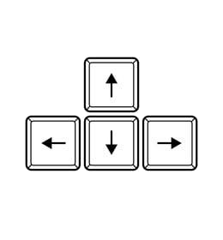
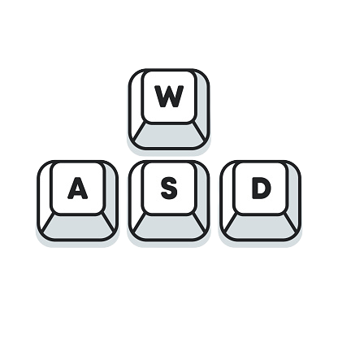

Instructions

Slide 15
Files
login.txt
personal.txt
messages.txt
visits.txt
Email
Password
#8654654
########
Name
Last Name
Gender
Birthday
Phone
Email
Password
#889654
#######
User name
Message
#######
User ID
User’s last actios
User visits
#############

Slide 16

THANKS FOR WATCHING
Promocode: DAVID777

