Slide 1
ENGINEERING ASSESSMENT
Engineering Assessment
Four pillars: Foundations, SQL & Visualisation, Big Data, and Governance
Deepak Shinghal
14 October 2026

Slide 2
PILLAR 01
Foundations
Clean source data and build a warehouse that preserves employee history.
TASK
QUESTION ASKED
WHAT I DID
1.1
Clean projects, parse dates, calculate
four metrics, standardise status and
assign risk.
Loaded 500 projects with Pandas. Added variance, over-budget flag, duration
and utilisation; handled missing amounts/zero budgets; mapped status and
prioritised High risk.
1.2
Design a star schema with SCD Type
2 employee history and validate its
integrity.
Built date, project, employee and vendor dimensions, a bridge and transaction
facts. Added surrogate keys, validity periods and one current employee
version; checked overlaps and foreign keys.
1.3
Find all employee quality issues,
document fixes and report affected
rows.
Checked all 1,000 employees for missing fields, email/date errors,
salary/experience ranges and status conflicts. Applied documented fixes,
logged counts and saved the correction audit.
Evidence: 500 projects • 1,000 employees • 50,000 transactions • 1,826 salary-history records
Deepak Shinghal | Engineering Assessment | 14 October 2026
02 / 06
Notes:
Files: etl_pipeline.py and data_model.sql. Null project amounts become zero; zero-budget utilisation stays missing. Salary/experience corrections use valid same-level medians. Employee history uses the assumed 2025-07-01 export boundary; same-day events retain their final source state. These are implementation assumptions, not confirmed HR policy.

Slide 3
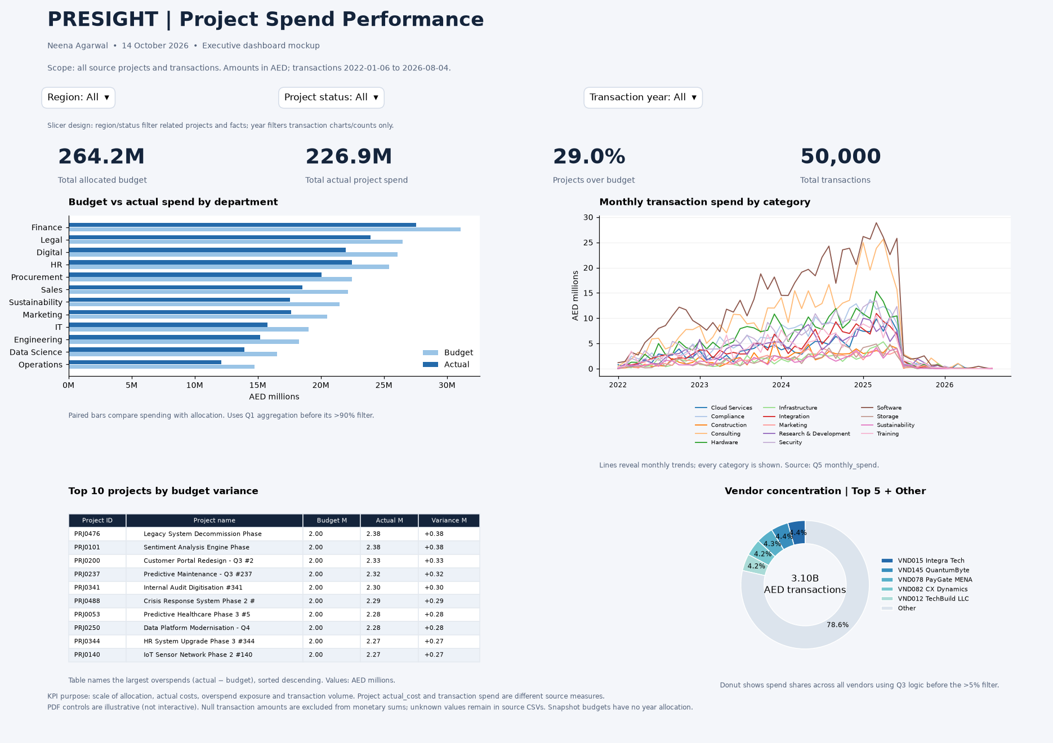
PILLAR 02
SQL & Data Visualisation
Business questions, transaction ETL, SQL optimisation and the executive dashboard.
TASK
QUESTION ASKED
WHAT I DID
2.1 Q1
Departments spending >90% of budget.
Grouped budgets/costs; calculated spend percentage and over-budget flag.
2.1 Q2
Current managers with >3 active projects.
Joined current employees; counted and filtered strictly more than 3 active projects.
2.1 Q3
Vendors with >5% of spend; risk labels.
Calculated vendor shares/risk flags and applied the strict >5% spend filter.
2.1 Q4
Pending/disputed totals >50,000 AED.
Filtered status/currency; grouped projects and applied the value threshold.
2.1 Q5
Monthly spend, running total and change.
Used a calendar grid, SUM OVER and LAG to compare monthly/category spending.
2.1 Q6
Top 20 largest employee salary increases.
Compared adjacent SCD2 versions; calculated and ranked salary increases.
2.2 | Asked: ingest/enrich 50K transactions and export a timed summary.
DASHBOARD PDF
Flattened JSON, parsed dates, used validated LEFT joins and added project / current approver context, approval flag,
amount_aed and reporting month.
2.3 | Asked: benchmark, rewrite and index the query.
Rewrote joins/filtering, added indexes and verified equivalent result rows. Saved timing evidence: 14.42 ms to 6.14 ms,
a measured 2.35x speedup.
2.4 | Asked: an annotated one-page dashboard with six visuals.
Generated the PDF with actual KPIs, budget/spend bars, monthly trends, top-project table, vendor donut and slicer
mockups. The dashboard preview is embedded here.
Q3 correctly returns no rows: the largest vendor share is about 4.36%, below 5%.
Dashboard preview
Deepak Shinghal | Engineering Assessment | 14 October 2026
03 / 06
Notes:
Slide 2 includes the existing dashboard_preview.png and links to the complete dashboard_mockup.pdf. The dashboard displays 264.2M allocated budget, 226.9M actual project spend, 29.0% projects over budget and 50,000 transactions. Project actual_cost and transaction spend are different source measures. PDF slicers are illustrative, not interactive.
All six business questions are summarised above. Q2 uses the required >3 active-project threshold. Q3 applies the required >5% vendor share threshold; no source vendor qualifies. The measured query evidence in query_optimization.sql is 14.425 ms before and 6.143 ms after indexing, about 2.35x. SQLite uses EXPLAIN QUERY PLAN. The PDF now exists, so the earlier missing-export note has been removed.
The PDF hyperlink is relative to this PPTX. Keep the supplied folder layout when sharing.
Submission cleanup: the dashboard preview is embedded in this presentation. Regenerate the separate dashboard PDF with the Pillar 2 script; the old PDF link has been removed.

Slide 4
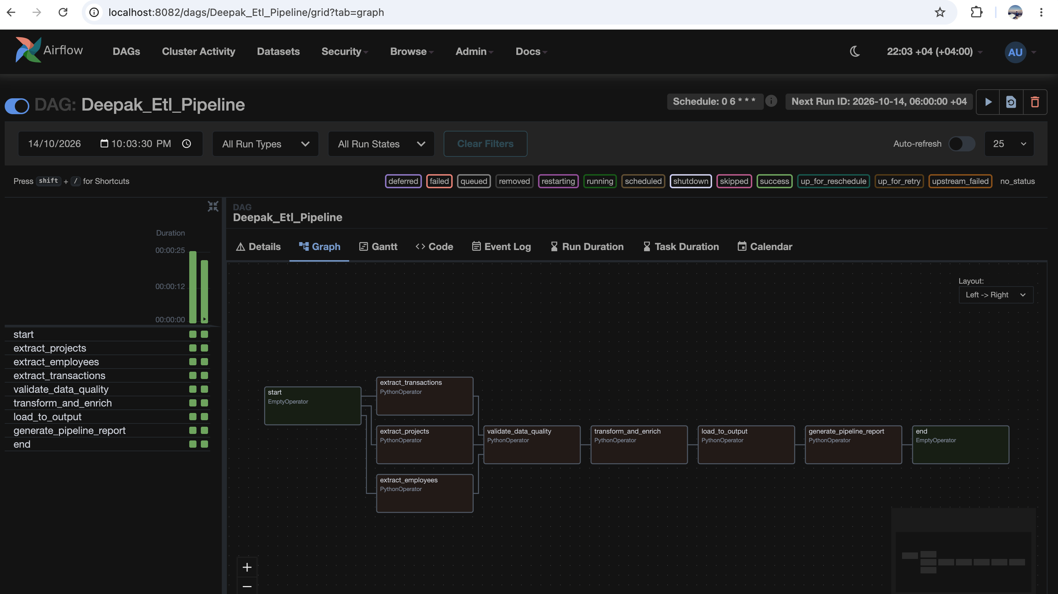
PILLAR 03
Big Data Processing
Task 3.3 | Airflow schedules the ETL and controls the order of work.
WHAT THE WORKFLOW DOES
1. Parallel extraction
Projects, employees and transactions are
read independently.
2. Quality gate
Checks keys and references; completeness
below 80% fails the gate.
3. Transform and enrich
Cleans source data and adds project /
approver context.
4. Load outputs
Writes cleaned CSV files to the shared output
folder.
5. Generate report
Uses XCom counts, quality results and paths
to write the run report.
Green status cells show two successful runs. Schedule: daily at 06:00 Dubai time.
3.1 Spark: five Parquet summaries from 99,996 events across 12 monthly files.
3.2 Kafka: 8,333 January events consumed; 14 Critical escalations forwarded; JSON summary saved.
Deepak Shinghal | Engineering Assessment | 14 October 2026
04 / 06
Notes:
The image is the user's Airflow Graph view for Deepak_Etl_Pipeline at localhost:8082. The left-hand task grid has two columns of green success cells, including the end task, showing two completed successful runs. The graph on the right explains dependencies, while the header shows cron 0 6 * * * and the +04 timezone.
Start branches into three independent extraction tasks. The quality gate waits for all three. If key completeness falls below 80%, it raises an error, and the default all_success dependency blocks downstream tasks. On passing data, transformation and enrichment produce staging files, the load task exports clean CSVs, and the report task pulls small XCom values (counts, quality results and paths). The end task completes the run. Large DataFrames stay in files rather than XCom.
The screenshot shows successful execution, not a deliberately failed quality-gate test. The DAG configuration also includes two retries, a five-minute retry delay, no catchup and one active run. The submission uses the required presight_etl_pipeline ID. This screenshot documents earlier successful runs under the demonstration name Deepak_Etl_Pipeline.
The other Big Data tasks remain part of Pillar 3: Spark reads all monthly files, validates IDs/deduplication and writes five partitioned Parquet summaries with timings; Kafka sends January events, counts them and forwards only Critical escalations. Saved evidence reports 99,996 Spark events and 8,333 Kafka events with 14 Critical forwards. Consumer throughput excludes producer delays.

Slide 5
PILLAR 04
Infrastructure & Governance
Package the ETL, document data controls and make quality checks configurable.
TASK
QUESTION ASKED
WHAT I DID
4.1
Containerise ETL with Python 3.11,
env paths and mounted outputs.
Created a multi-stage Dockerfile, .dockerignore and Compose override. Runs
etl_starter.py, reads DATA_DIR/OUTPUT_DIR and exports host-accessible
files; verified 50K transactions in 2.43 s.
4.2
Inventory/classify all four datasets;
define governance controls.
Prepared data_governance_document.md: all 45 columns classified,
PII/privacy scope documented, ownership, retention and access policies
defined; lineage diagrammed.
4.3
Configurable quality rules, scores,
warnings and reports.
Built rule_config.csv with six fields and 79 rules, plus a Python runner. Reports
each rule’s score in CSV/markdown/JSON; includes freshness and distribution.
Nine tests passed.
GOVERNANCE DOCUMENT | SIX REQUIRED SECTIONS
Inventory • Classification • Ownership • Retention • Access control • Lineage
Salary history has restricted access and separate retention requirements.
Open governance document
Governance describes proposed policies; the local ETL does not enforce production access or retention.
Deepak Shinghal | Engineering Assessment | 14 October 2026
05 / 06
Notes:
The linked data_governance_document.md contains the full Task 4.2 deliverable. It inventories four datasets, classifies every one of their 45 columns, defines owners/stewards/approvers, proposes retention and disposal, sets a least-privilege access matrix and shows source-to-reporting lineage. Sources are linked for UAE PDPL, conditional GDPR scope, labour record retention and corporate-tax evidence retention. Source systems, daily growth estimates and business policy periods are labelled assumptions.
Salary history is personal and highly confidential, with ordinary engineer/analyst/executive access set to None. HR compensation roles and a separate approved service identity handle necessary access. Required payroll/tax evidence may outlast ordinary employee profile data. The document is policy documentation, not proof that the local files enforce these controls.
Task 4.1 uses a multi-stage Python 3.11-slim image and the scoped ETL requirements file. Saved container verification measured 2.429 s for 50K transactions. Task 4.3 uses 79 CSV rules across six required dimensions plus freshness/distribution, with per-rule scores and warnings. New supported rules can be added in the CSV; a new check type still needs a handler.
The governance document is in the Pillar 4 output folder; the hyperlink uses its relative path. The shareable ZIP preserves all document paths.

Slide 6
ENGINEERING ASSESSMENT
Thank you
Questions & discussion
Deepak Shinghal
14 October 2026

