Slide 1
EFFICIENT GAIT CLASSIFICATION USING SKELETON AND PRESSURE DATA: DEEP AND SPIKING NEURAL NETWORK APPROACHES
EDUARDO DAVID LOTTO, DOMENICO PLANTAMURA
Notes:
Intro?

Slide 2
RESEARCH OBJECTIVE
Classify six types of gait, one normal and five pathological (lurching, stiff-legged, antalgic, Trendelenburg, steppage)
Balance classification accuracy and computational efficiency
3D Skeleton data and Foot Pressure data
4 models:
GRU-based model fed with skeleton data (SkGRU)
CNN-based model fed with foot pressure data (PrCNN)
Hybrid model combining features extracted from SkGRU and PrCNN (HyM)
Spiking Neural Network fed with skeleton data (SkSNN)
Notes:
Gait analysis is an important tool in the medical field, as identifying pathological gait patterns can aid in the diagnosis of a wide range of diseases. Classification can be performed by hand, but requires complex steps: hence, ML-based approaches can be highly beneficial.
The research objective is to classify six types of gait, one normal and five pathological using both 3D skeleton data and foot pressure data. We aim to strike a balance between classification accuracy and computational efficiency. We developed 4 models: SkGRU, PrCNN, HyM, SkSNN.

Slide 3
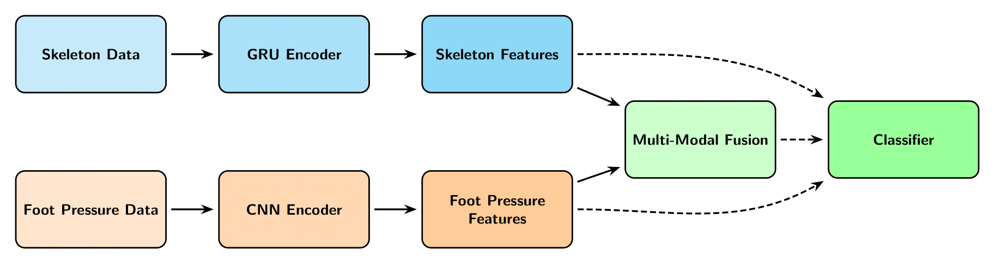
PROCESSING PIPELINE
SkSNN lies outside the main processing pipeline
Notes:
Here an overview of the processing pipeline: Skeleton data and foot pressure data are fed to a GRU encoder and a CNN encoder respectively. The encoders extract relevant features from both the modalities. For both SkGRU and PrCNN, we employed a shared classifier to evaluate classification accuracy and the extracted features. Since the ultimate goal is to combine both modalities, we also propose a hybrid classification model that merges the extracted features through a multi-modal fusion whose performance is evaluated with the same classifier used for single-modal models.
SkSNN lies outside the main processing pipeline

Slide 4
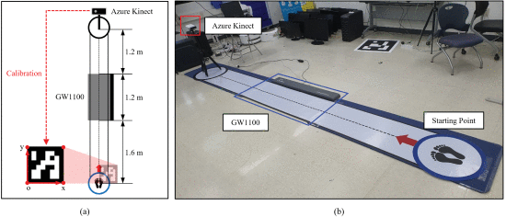
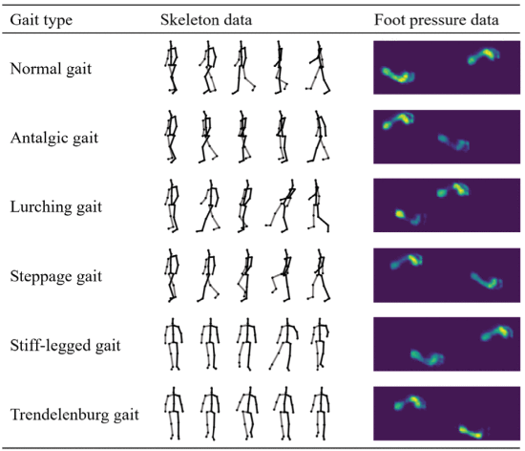
DATA COLLECTION
12 subjects x 6 gaits x 20 trials for both skeleton and foot pressure
Skeleton: 3D coordinates from 33 joints collected through a single depth camera
Foot Pressure: 1280 x 480 mm sized pressure plate (GW1100)
Notes:
Skeleton and foot pressure data were simultaneously collected in a controlled laboratory setup. 12 healthy male subject performed 20 trials for each of the 6 gaits, totaling 1440 skeleton samples and 1440 foot pressure samples. The subjects simulated the pathological gaits (elencarli?).
Skeleton data consists of 3D coordinates from 33 joints collected through a single depth camera.
Foot pressure data are collected from a 1280x480 mm sized pressure plate (GW1100) that can be expressed as 1-channel images with input shape (1,128,48)

Slide 5
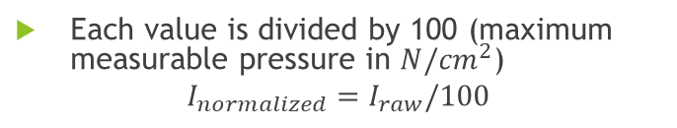
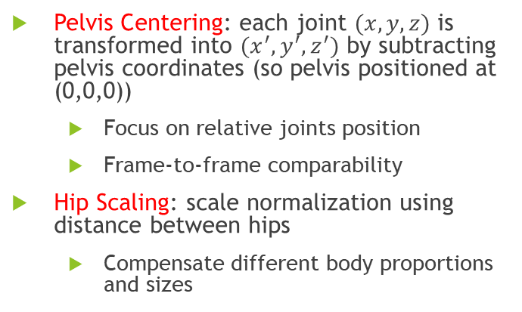
DATA NORMALIZATION AND AUGMENTATION
3D SKELETON DATA
DATA AUGMENTATION
Pelvis Centering: each joint $(x,y,z)$ is transformed into $(x^{′},y^{′}, z^{′})$ by subtracting pelvis coordinates (so pelvis positioned at (0,0,0))
Focus on relative joints position
Frame-to-frame comparability
Hip Scaling: scale normalization using distance between hips
Compensate different body proportions and sizes
Left-to-right flipping
Skeleton:
Random crop
Foot pressure:
Fixed 30° rotation
FOOT PRESSURE DATA
Each value is divided by 100 (maximum measurable pressure in ${N/cm}^{2}$)
$$I_{normalized}=I_{raw}/100$$
SkGRU, PrCNN and SkSNN use L4SO-CV
HyM uses LOSO-CV
Notes:
We normalized skeleton data centering the coordinates of each skeleton joint relatively to the pelvis joint. At each time step in the skeleton sequence every coordinate (x,y,z) is transformed into (x’,y’,z’) by subtracting pelvis coordinates (so pelvis positioned at (0,0,0). This transformation aligns all skeletons relatively to their pelvis joint, ensuring that motion analyses focus solely on the relative positions of joints and ensuring frame-to-frame comparability.
Foot pressure data are normalized dividing each value by 100

Slide 6
MODELS

Slide 7
Skeleton-based single-modal GRU (SkGRU) encoder
Input shape
(100, 42) if excluding face and arms joints
(100, 27) if considering only legs
4 GRU layers
Capture long-term dependencies and mitigate vanishing problem
Notes:
SkGRU to extract relevant features from Skeleton data.
Input shape depends on the considered joints. Starting from 33 joints, we excluded face and arm joints as they have been shown to negatively impact classification performance.
First group: input shape (100,42) considering 14 joints
Second group: input shape (100,27) considering 9 joints (Only pelvis, hips, knees, ankles and feet).
Core: 4 GRUs (gated recurrent units) to capture long-term dependencies and mitigate vanishing gradient problem. We choose GRUs instead of LSTMs (used in several studies) to keep the model lightweight while exploiting typical recurrent neural network advantages. The first 3 GRU layers return the full sequence of hidden states, which are used as input to the subsequent GRU layers. The final GRU layer returns only the last hidden state, which is then passed to the dense layer for converting the features to the desired size.

Slide 8


Pressure-based single-modal CNN (PrCNN) encoder
Features block
Focus block
Increasing number of channels to capture progressively high-level features
Allows the network to focus in the most informative regions
ReLU activations
Dropout(0.5) reduces reliance on specific neurons and encourages the network to learn more robust representations
Notes:
PrCNN to extract relevant features from foot pressure data.
Input shape 128x48x1, 1-channel images.
The input is firstly processed through three blocks that we named feature blocks. Each Feature block includes two 2D convolutional layers with 3x3 filters, stride of 1 and zero padding to preserve the input shape. Then, a 2x2 maxpooling layer to reduce the spatial dimensions. The number of channels increases across the feature blocks to capture progressively high-level features. Subsequently, a block named Focus Block. This module consists of a convolutional layer with 128 filters and the same settings of the feature blocks, followed by a batch normalization layer and a pointwise convolution. Since the foot pressure images are sparse, this design allows the network to focus on the most informative regions.
ReLU activation in the blocks.
The feature maps are then flattened and passed through a fully connected layer with 128 neurons, followed by a dropout layer that reduces reliance on specific neurons and encourages the network to learn more robust representations.

Slide 9
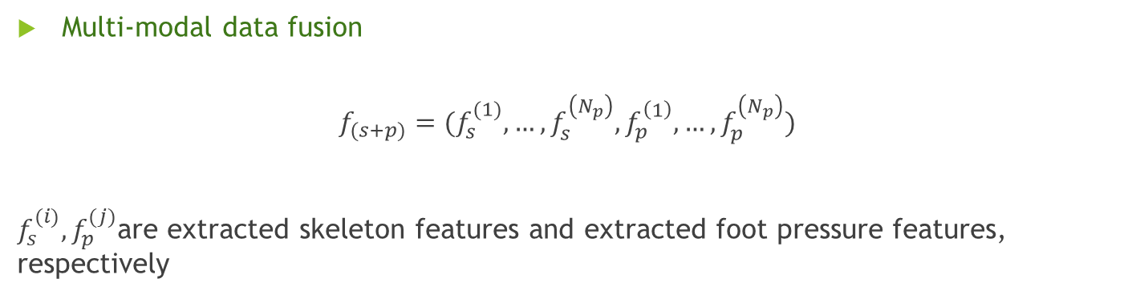
Hybrid model (HyM)
Multi-modal data fusion
$$f_{(s+p)}={(f}_{s}^{(1)},…, f_{s}^{\left(N_{p}\right)}, f_{p}^{\left(1\right)},…,f_{p}^{\left(N_{p}\right)})$$
$f_{s}^{(i)}, f_{p}^{(j)}$are extracted skeleton features and extracted foot pressure features, respectively
Notes:
In the HyM, features extracted from SkGRU and PrCNN are combined through a feature-level data fusion. In this model, the features are integrated to capture both the spatial-temporal dynamics of the mody motion and plantar pressure distribution allowing a more comprehensive representation for gait classification.

Slide 10
Classifier
Shared between SkGRU, PrCNN and HyM
Core: 4 dense layers with decreasing dimensionality and final Softmax activation
Dropout layer and Batch Normalization
L2 Regularization(0.01) controls the weights magnitude
As in every model: Early Stopping(10) and Model Checkpoint
Notes:
The classifier, shared between the models just presented. The input features are firstly processed with a dropout layer, followed by a batch normalizatoin layer to regularize, stabilize and accelerate the learning process.
The core consists of 4 dense layers with decreasing dimensionality, the last one with 6 units corresponding to the number of target classes that is activated with a softmax function. The first three layers include L2 regularization to control the weights magnitude and avoid overfitting.
As in every model, Early stopping and Model checkpoint are applied. Early stopping to prevent overfitting and avoid intense use of computational resources and Model checkpoint to save the at each epoch the modelthat achieved the lowest validation loss

Slide 11
Skeleton-based single-modal Spiking Neural Network (SkSNN)
Skeleton data fitted best in our research scope
Leverage SNN event-driven processing to capture temporal patterns with high precision and efficiency
Loop: two main layers process sequentially each time step
Output spikes are accumulated and the loss is computed with Cross Entropy Spike Count Loss
Notes:
After analyzing which modality fitted best in our research scope, we implemented a spiking neural network to model skeleton data, leveraging its event driven processing to capture temporal patterns with high precision and efficiency. The model is structured as a loop that iteratively scans each time step: two main layers process sequentially each time step. The 42-dimensional input is projected into a dense layer with 64 output units, which are gathered across time producing a tensor of shape (100,64). A feature vector is extracted by summing this tensor along the time step dimension (1° axis). This is followed by a LIF layer, whose resulting spikes are passed through a final dense layer and another LIF layer to generate the output spikes. These are accumulated into a (100,6) tensor for classification.
Output spikes are accumulated and the loss is computed with a Cross entropy spike count loss

Slide 12
RESULTS

Slide 13
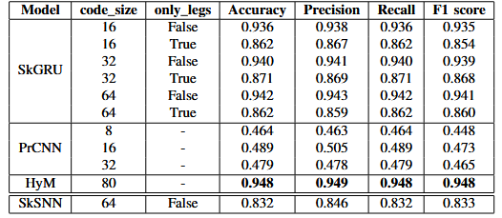
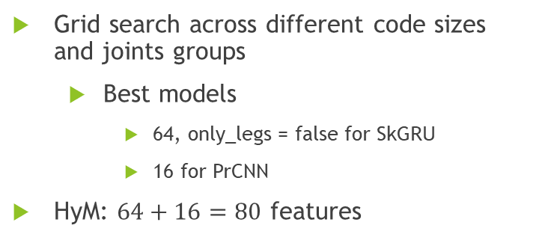
Models performance
Grid search across different code sizes and joints groups
Best models
64, only_legs = false for SkGRU
16 for PrCNN
HyM: $64+16=80$ features
HyM best performance
SkGRU slightly worse but faster inference and less parameters
Skeleton-based single modal SNN with best SkGRU parameters
SkSNN: good accuracy while being relatively simple

Slide 14
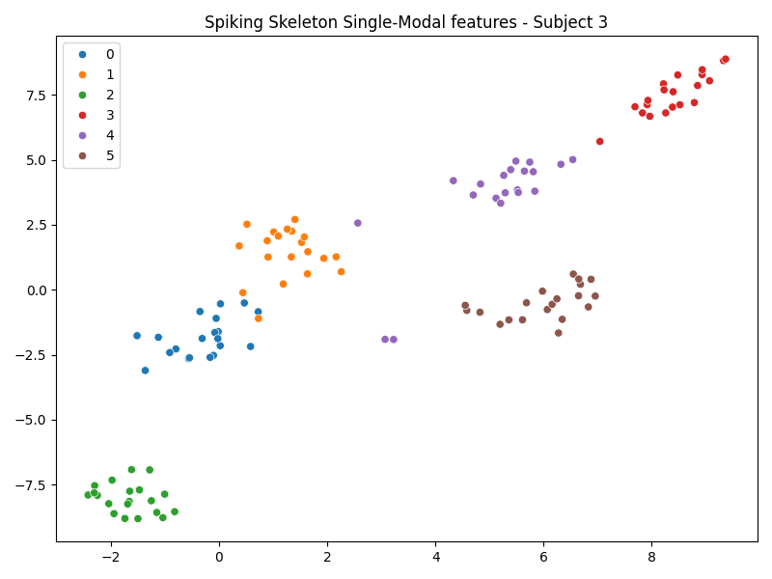
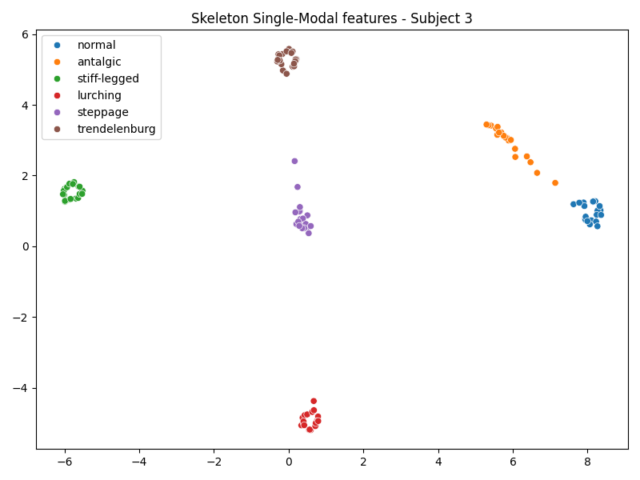
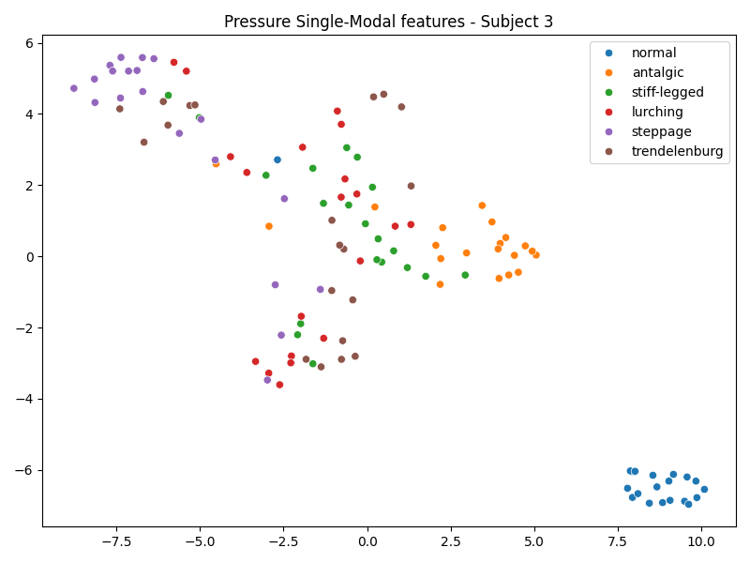
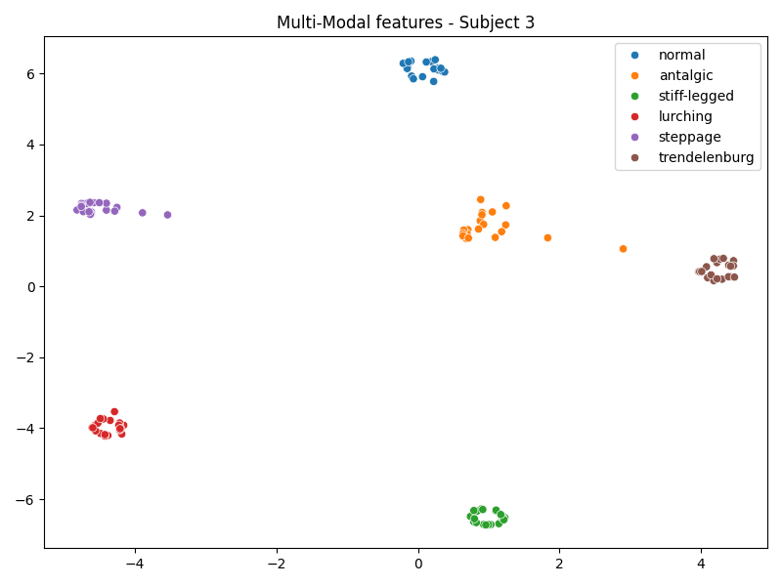
t-SNE (t-distributed Stochastic Neighbor Embedding)
Non-linear dimensionality reduction technique applied to the extracted features to observe their ability in separating the classes
Models’ classification capability confirmed
HyM and SkGRU similar performance
PrCNN poor performance
SkSNN promising performance
t-SNE visualization for subject 3

Slide 15
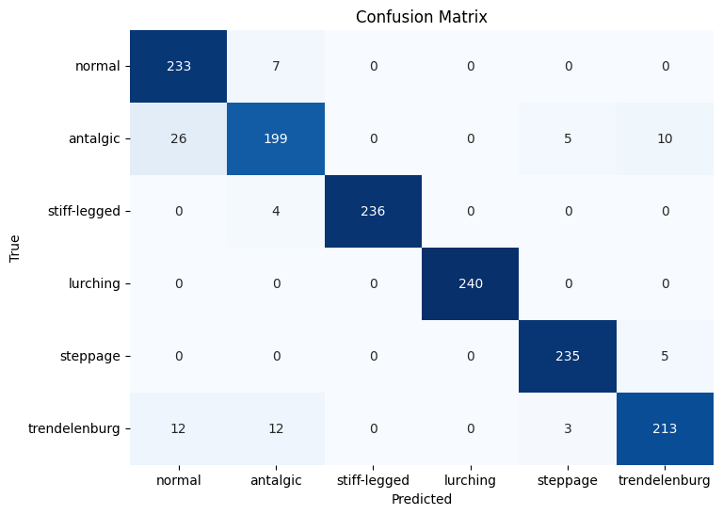
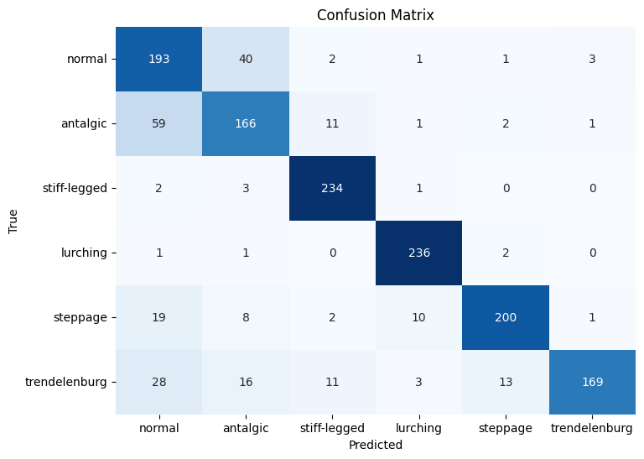
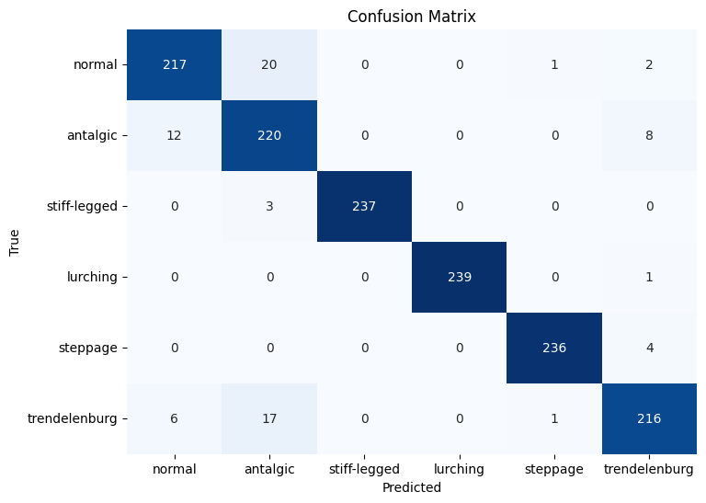
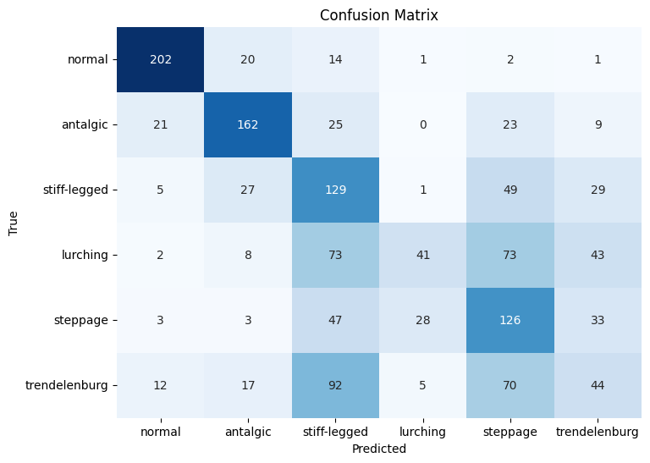
GAIT-SPECIFIC PERFORMANCE
HyM and SkGRU similar performance
SkGRU better for Normal gait
HyM better for Antalgic gait
Antalgic and Trendelenburg misclassified as each other
SkSNN: modest results within Antalgic and Trendelenburg classes
Confusion matrices order: SkGRU, SkSNN, HyM, PrCNN

Slide 16
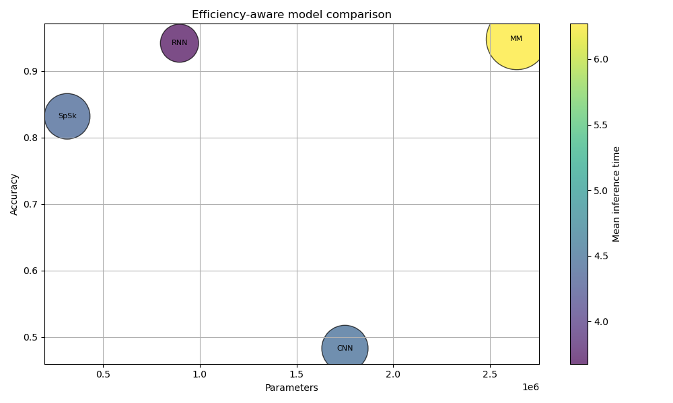
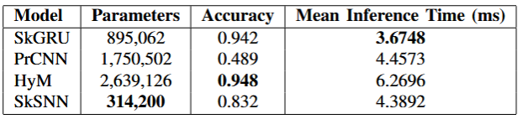
EFFICIENCY-AWARE MODEL COMPARISON
HyM
✔ Accuracy
✖ Parameters
✖ Mean inference time
SkGRU
✔ Accuracy
= Parameters
✔ Mean inference time
SkSNN
= Accuracy
= Mean inference time
✔ Parameters
+ Future developments

Slide 17
CONCLUSIONS
HyM resulted to be the best model in terms of accuracy, but with high spatial and temporal costs
SkGRU, with slightly lower accuracy, allows to save computational resources
SkSNN ensures acceptable performance with very low complexity and its simplicity offers potential for future enhancements
Possible future developments
Models application in a domestic follow-up scenario
Develop an SNN based on foot pressure data

