Slide 1
Transmutation 易行
01 / 13
Notes:
Timing: 5 sec | 0:00–0:05 | Hook
Visual: a title image and the game name. Save the description for Slide 04.
UPDATED VISUAL PLACEMENT
Centered title. Optional shader treatment stays editable. Keep the short line subtle.
Draft based on the first clean version. Typography remains Space Grotesk at 60 / 28 / 20 px. Image and shader artwork intentionally left for the user. All page numbers remain at bottom right.

Slide 2
Imagine
02 / 13
Notes:
Timing: 20 sec | 0:05–0:25 | Hook
Visual: a beautiful natural scene at sunrise. An animal forages beneath a tree, flowers move gently, and bees travel between them. Let the image carry the sense of wonder with very little text.
Possible animation: gradually reveal the sunlight, then the animal and bees. Keep movement subtle enough to invite observation.
UPDATED VISUAL PLACEMENT
Title sits low. Place sunrise scene in the upper space, or use a full-slide background. Protect the bottom text contrast.
Draft based on the first clean version. Typography remains Space Grotesk at 60 / 28 / 20 px. Image and shader artwork intentionally left for the user. All page numbers remain at bottom right.

Slide 3
But this is what it looks like
03 / 13
Notes:
Timing: 50 sec | 0:25–1:15 | Hook / visual demo
Visual: reveal actual game imagery or a demo. Echo the previous scene’s composition and relationships through creatures with radically different appearances. Use a large image or short visual sequence to show the range of the game’s visual language.
Demo pacing: allow about 5 seconds for the reversal to land, 35 seconds to show the world in motion, and 10 seconds to bridge into the introduction. Prioritize atmosphere, creature movement, and visual variety. Save the detailed rules for Slide 08.
Transition idea: match the framing of Slide 02 so the reversal is immediately clear. The imagery should communicate the difference before any explanation.
UPDATED VISUAL PLACEMENT
Title and main point sit upper right. Reserve the lower area for the reversal demo, or place footage behind text.
Draft based on the first clean version. Typography remains Space Grotesk at 60 / 28 / 20 px. Image and shader artwork intentionally left for the user. All page numbers remain at bottom right.

Slide 4
What is
Transmutation?
A first-person exploration game about observation and experimentation
An alien visual world.
Unfamiliar creatures and rules.
Learn to see it again.
04 / 13
Notes:
Timing: 20 sec | 1:15–1:35 | Main explanation
UPDATED VISUAL PLACEMENT
Text on the left, creature cutout on the right of the vertical rule.
Draft based on the first clean version. Typography remains Space Grotesk at 60 / 28 / 20 px. Image and shader artwork intentionally left for the user. All page numbers remain at bottom right.

Slide 5
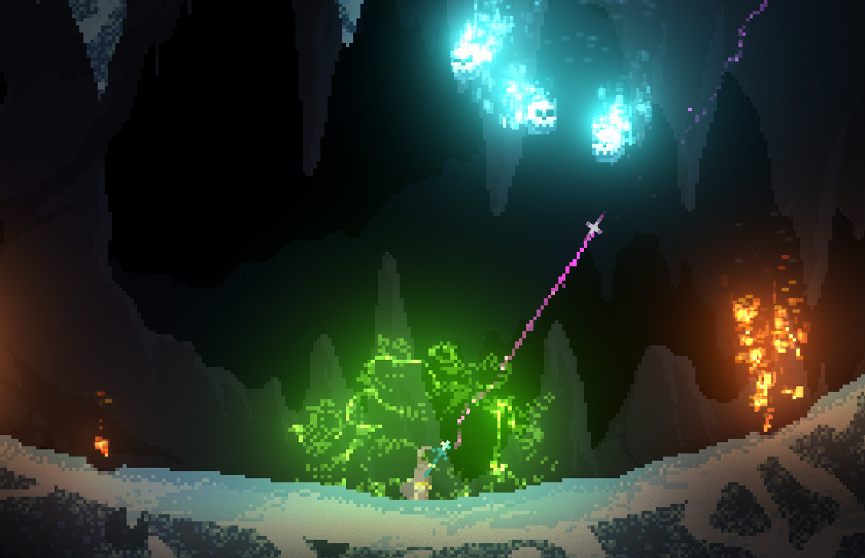
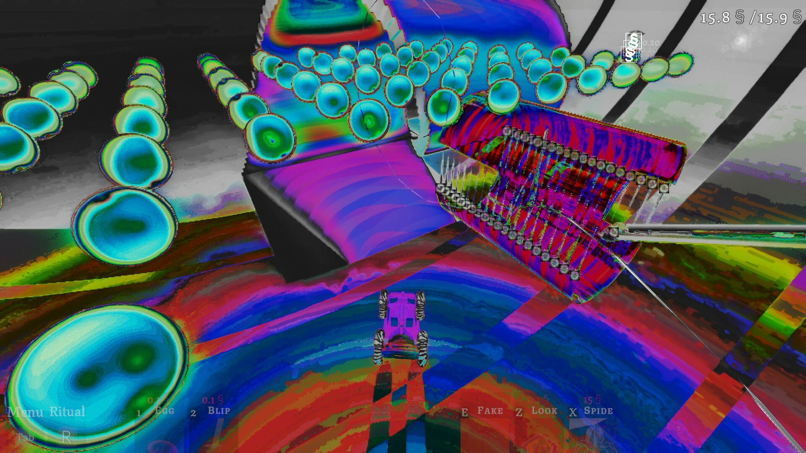
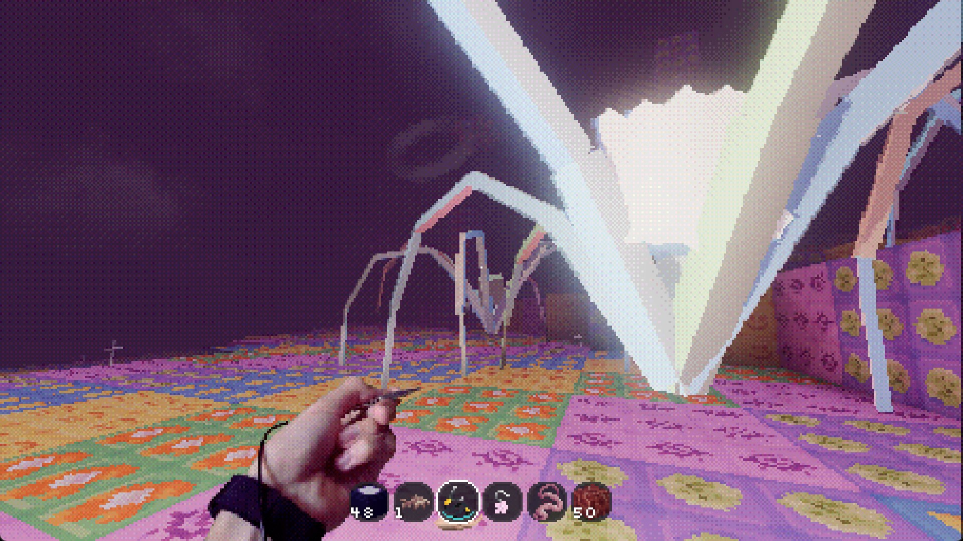
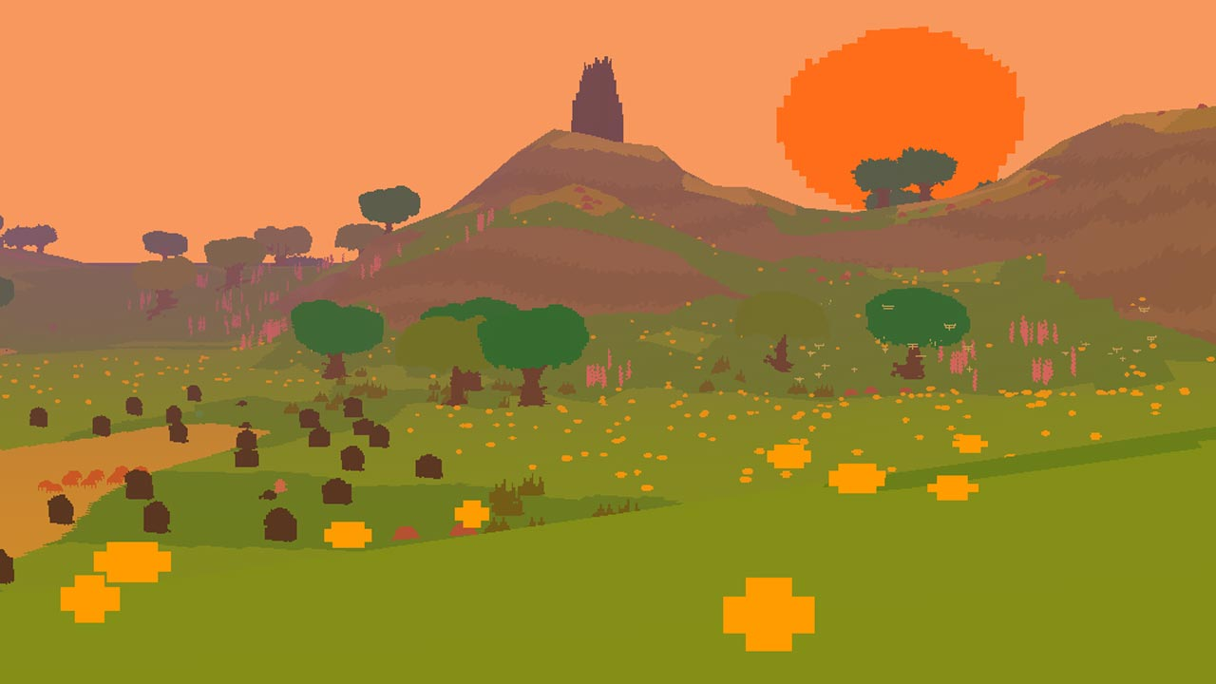
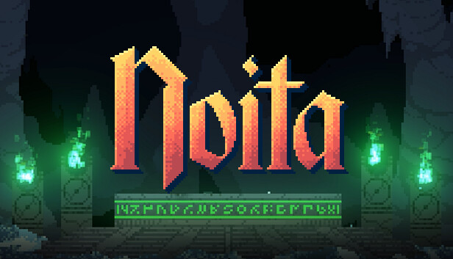

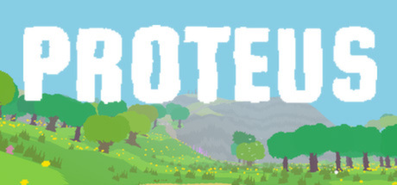
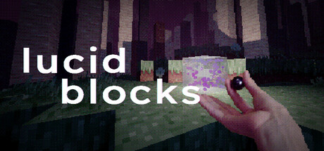
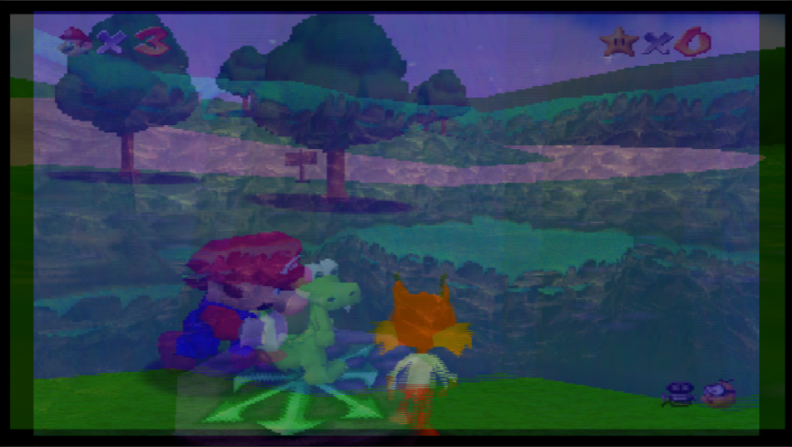
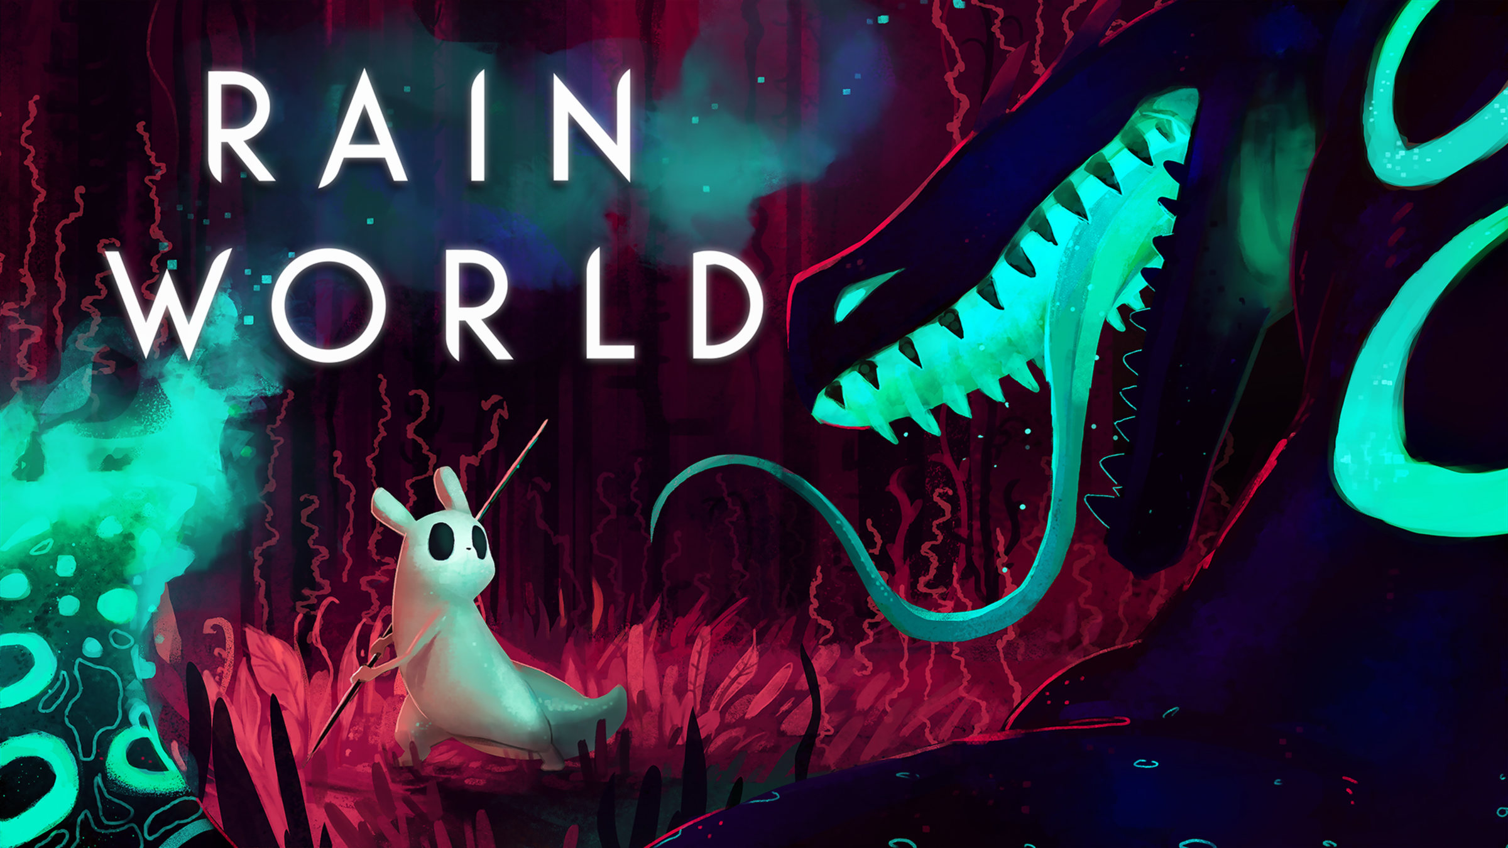
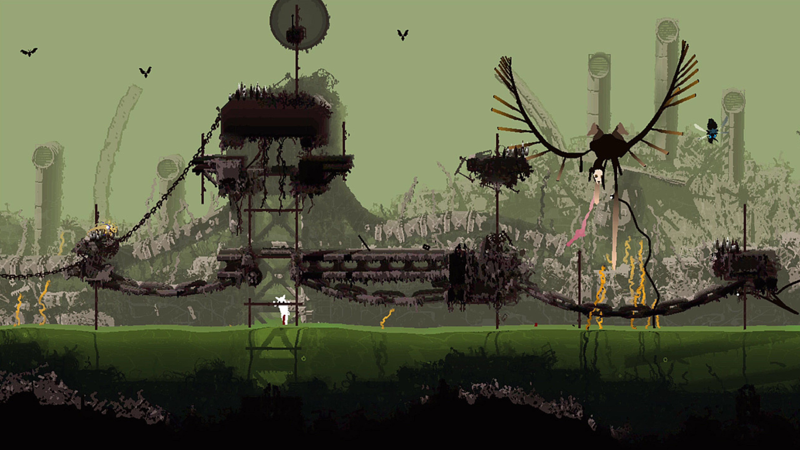
Inspirations
Rain World
05 / 13
Notes:
Timing: 15 sec | 1:35–1:50 | Main explanation
Visual: Mainly Picture of the Games here.
UPDATED VISUAL PLACEMENT
Centered header. Six screenshot spaces above their captions.
Draft based on the first clean version. Typography remains Space Grotesk at 60 / 28 / 20 px. Image and shader artwork intentionally left for the user. All page numbers remain at bottom right.

Slide 6
Explore/Observe/Experiment
Simple actions - Walk and observe. Carry and reposition.
Walk and observe. Carry and reposition.
Wanderer
Observer
Experimenter
06 / 13
Notes:
Timing: 35 sec | 1:50–2:25 | Main explanation
Visual: pictures of wandering, a small intervention, and a larger creature arrangement, with short labels. Let the pictures carry the examples.
Focus: connect the few player actions to different depths of engagement. Low pressure does not mean interventions have no consequences.
UPDATED VISUAL PLACEMENT
Original three-play-style composition retained. Three images above the captions.
Draft based on the first clean version. Typography remains Space Grotesk at 60 / 28 / 20 px. Image and shader artwork intentionally left for the user. All page numbers remain at bottom right.

Slide 7
Learning to see
Unfamiliar appearances. Consistent behavior.
Observe
Intervene
See what changes
07 / 13
Notes:
Timing: 35 sec | 2:25–3:00 | Main explanation
Visual: a picture sequence of one creature before and after an intervention. Use only brief labels for observation, action, and consequence.
Focus: the exploration loop is how players learn the visual language. Lead into the concrete ecosystem example on the next slide.
UPDATED VISUAL PLACEMENT
Header sits upper right. Three observation/action/result frames below.
Draft based on the first clean version. Typography remains Space Grotesk at 60 / 28 / 20 px. Image and shader artwork intentionally left for the user. All page numbers remain at bottom right.

Slide 8
Creatures and
connections
Anything that follows the rules can be a creature.
Fire Source
Warms nearby creatures
Fire Flower
Absorbs heat, releases bubbles
Fire Bubble
Heat changes the outcome
08 / 13
Notes:
Timing: 50 sec | 3:00–3:50 | Main explanation
Visual: use a picture sequence or short Heat ecosystem clip to show one clear interaction and consequence. This explains the behavior behind the earlier visual demo. A creature can also be a plant, weather, rock, or landscape; explain the broader definition aloud. The planned Fire Eater can be added when ready to demonstrate.
UPDATED VISUAL PLACEMENT
Heat ecosystem demo on the left, creature names and behaviors on the right.
Draft based on the first clean version. Typography remains Space Grotesk at 60 / 28 / 20 px. Image and shader artwork intentionally left for the user. All page numbers remain at bottom right.

Slide 9
Fall in love with
the world again
What felt alien becomes a place you know.
09 / 13
Notes:
Timing: 25 sec | 3:50–4:15 | Main explanation
Visual: return to the alien scene from Slide 03. Echo the sunrise scene from Slide 02. After seeing how its inhabitants behave, the audience can recognize the life and relationships within it.
UPDATED VISUAL PLACEMENT
Centered emotional return. Add the earlier alien scene below or behind the text.
Draft based on the first clean version. Typography remains Space Grotesk at 60 / 28 / 20 px. Image and shader artwork intentionally left for the user. All page numbers remain at bottom right.

Slide 10
Scope and plan
One ecosystem first. One complete region.
Now
Semester 1
Semester 2
Movement + interaction
Heat ecosystem
Complete heat interactions
Test visuals and curiosity
Build the region
Audio, ending, polish
Long-term vision: four connected living islands.
10 / 13
Notes:
Timing: 35 sec | 4:15–4:50 | Operations
Confirm semester commitments and implemented features before presenting. The four-island vision is aspirational.
UPDATED VISUAL PLACEMENT
Header sits upper right. Three original milestone columns remain.
Draft based on the first clean version. Typography remains Space Grotesk at 60 / 28 / 20 px. Image and shader artwork intentionally left for the user. All page numbers remain at bottom right.

Slide 11
Success criteria
Players choose to look closer.
The world feels alive.
Cause and effect becomes readable.
A player stops to test an idea.
Wandering is satisfying on its own.
11 / 13
Notes:
Timing: 20 sec | 4:50–5:10 | Operations
Evaluate through playtesting, including players who prefer to observe rather than experiment.
UPDATED VISUAL PLACEMENT
Left text column and right cutout separated by a subtle vertical line.
Draft based on the first clean version. Typography remains Space Grotesk at 60 / 28 / 20 px. Image and shader artwork intentionally left for the user. All page numbers remain at bottom right.

Slide 12
Risks and
uncertainties
Unfamiliar, yet understandable.
Readability: can players see the rules?
Direction: is curiosity enough?
Complexity: can interactions stay manageable?
Completion: what makes a satisfying ending?
12 / 13
Notes:
Timing: 20 sec | 5:10–5:30 | Operations
These are open design questions. Use the small ecosystem to test the first three before expanding. The main path and narrative framing remain undecided.
UPDATED VISUAL PLACEMENT
Centered heading with a single list of questions below.
Draft based on the first clean version. Typography remains Space Grotesk at 60 / 28 / 20 px. Image and shader artwork intentionally left for the user. All page numbers remain at bottom right.

Slide 13
The team
Help us make an unfamiliar world feel alive.
YoYo
Lam
Design, programming, shaders
Synthesizers
Design, programming, shaders
Beginner 3D modeling
Looking for sound + systemic music,
3D art + animation, creature programming.
13 / 13
Notes:
Timing: 15 sec | 5:30–5:45 | Operations
Confirm Lam’s preferred responsibilities. Sound design is the current strongest additional need.
UPDATED VISUAL PLACEMENT
Title sits upper right. Optional cutout upper left, people and recruitment below.
Draft based on the first clean version. Typography remains Space Grotesk at 60 / 28 / 20 px. Image and shader artwork intentionally left for the user. All page numbers remain at bottom right.

