Slide 1

Rating discovery and genre classification from book reviews
Text Analytics
Group 7

Slide 2





Our Team
Lia Trapanese
Davide Innocenti
Data Science and Business Informatics
Data Science and Business Informatics
Ludovico Lemma
Maria Grazia Antico
Data Science and Business Informatics
Data Science and Business Informatics
Chiara Germelli
Digital Humanities

Slide 3

Why this proposal?
Reviews allow optimal purchasing choices for book buyers
New platforms give the opportunity to users to express their opinions regarding their reading experience

Slide 4

The Goal
Developing an automatic system for predictive product evaluation based on reviews
Retrieving customer experiences for the classification of the book genre
… How?
Analyzing the structure of the reviews to get insights regarding a book

Slide 5

The dataset
It has been taken from Kaggle and contains more than 1.3M book reviews (rows), about 25,475 books and 18,892 users from the Goodreads website
From…
To…
User id
Book id
Review id
Rating
Review text
Date added
Date updated
Read at
Started at
N° votes
N° comments
User id (int)
Book id (int)
Review id (int)
Rating (from 0 to 5)
Review text (string)
Genre (string)
Target
Target
Source:
https://www.kaggle.com/competitions/goodreads-books-reviews-290312/overview

Slide 6

How we reach the “Genre” variable?
… Web Scraping!
+
https://www.goodreads.com/book/show/
{ book_id }
XPath on the page
In total we found 76 genres

Slide 7
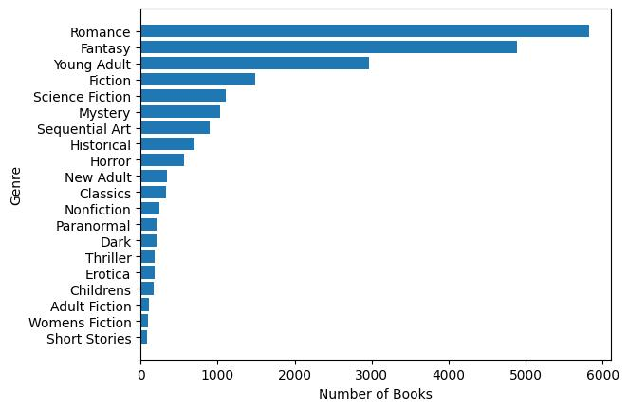
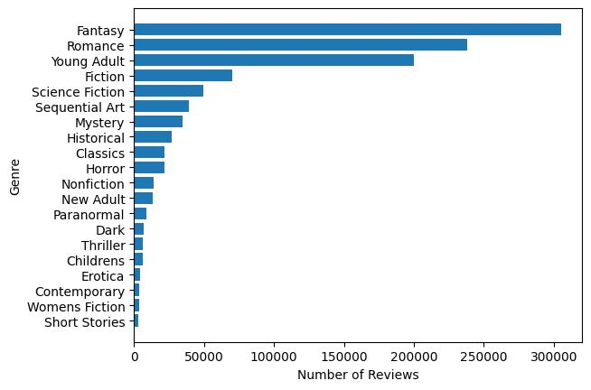
More on “Genre” variable
Since there is a strong genre imbalance, we will group similar genres and, if necessary, apply other techniques
In the following bar plots are represented only the first 20 genres
Mercury is the smallest planet
3.3K / 25K Books with NULL values
280K / 1M Reviews with NULL values

Slide 8
Classification
Target variable: Genre
Aim: Identifying the book genre from the “shelves” of users on the platform
SVM
Neural Network (like BERT)
Naïve Bayes

Slide 9
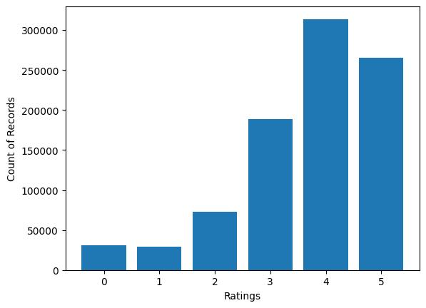
Target variable: Rating
Regression
Aim: Identifying the rating of the books from the user emotions expressed by book reviews

Slide 10




Web scraping using XPath to extract the new variable “Genre”
Workflow
EDA (Exploratory Data Analysis)
Regression task using “Ratings” as target variable
Classification task using “Genre” as target variable
Feature Extraction and Explainability (if meaningful) with SHAP to explain the prediction of a black box classifier
5

Slide 11
Thank you!

