Slide 1
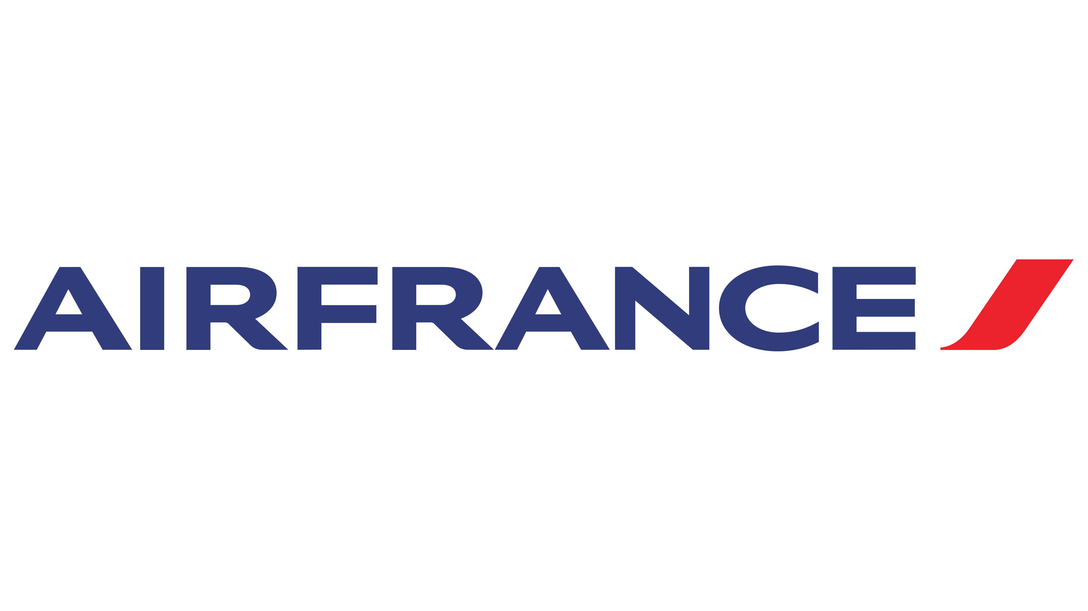
Marketing Strategy For Air France
Team 11
Diego Polar
Veera Thota
Timothy Naman
Tri Dung Dinh
Takahito Komori
November 7, 2021

Slide 2
更新中
Backgrounds & Objectives
Publisher Insights
Campaign Insights
Bid Strategy Insights
Recommendation

Slide 3

1: Backgrounds & Objectives
Challenges are using EC efficiently and generate profits in the competitive travel market
Background on Travel Market & Air France
Objectives
Hyper-competitive U.S. air travel market
Growing demand for economy air travel (ex: low-fare airline)
New airlines have emerged to target specific customer segments. (Less price-sensitive business traveler)
E-commerce Marketing had become a phenomenon in Travel industry
The airlines own Direct Web sites to provide several services beyond the ability to purchase flights
Consumers choose aggregator Web sites because they can do flight purchase, booking hotel.
Affiliated Web sites drive a growing volume of visitors to Air France
Revenue from online ticket sales are growing
They want to know more effective way to gain revenue through online Ads & ROA
Increase market share and profitability in US
Improve customer bookings
Increase revenue
Targeting the campaigns with Maximum profit margin.
Increase the conversion rate from the E-commerce bookings
Source: Air France Marketing by Kellogg School of Management

Slide 4
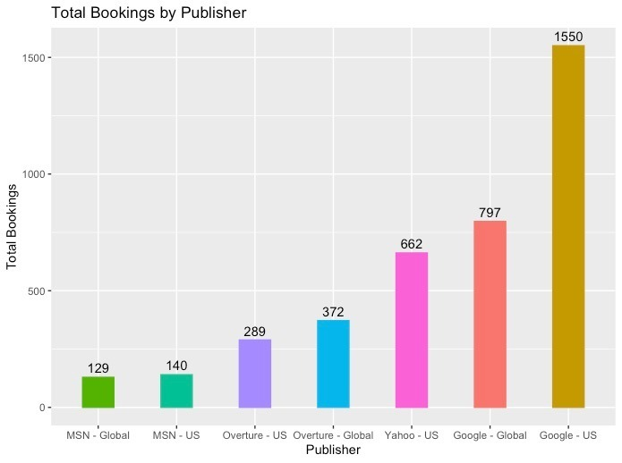
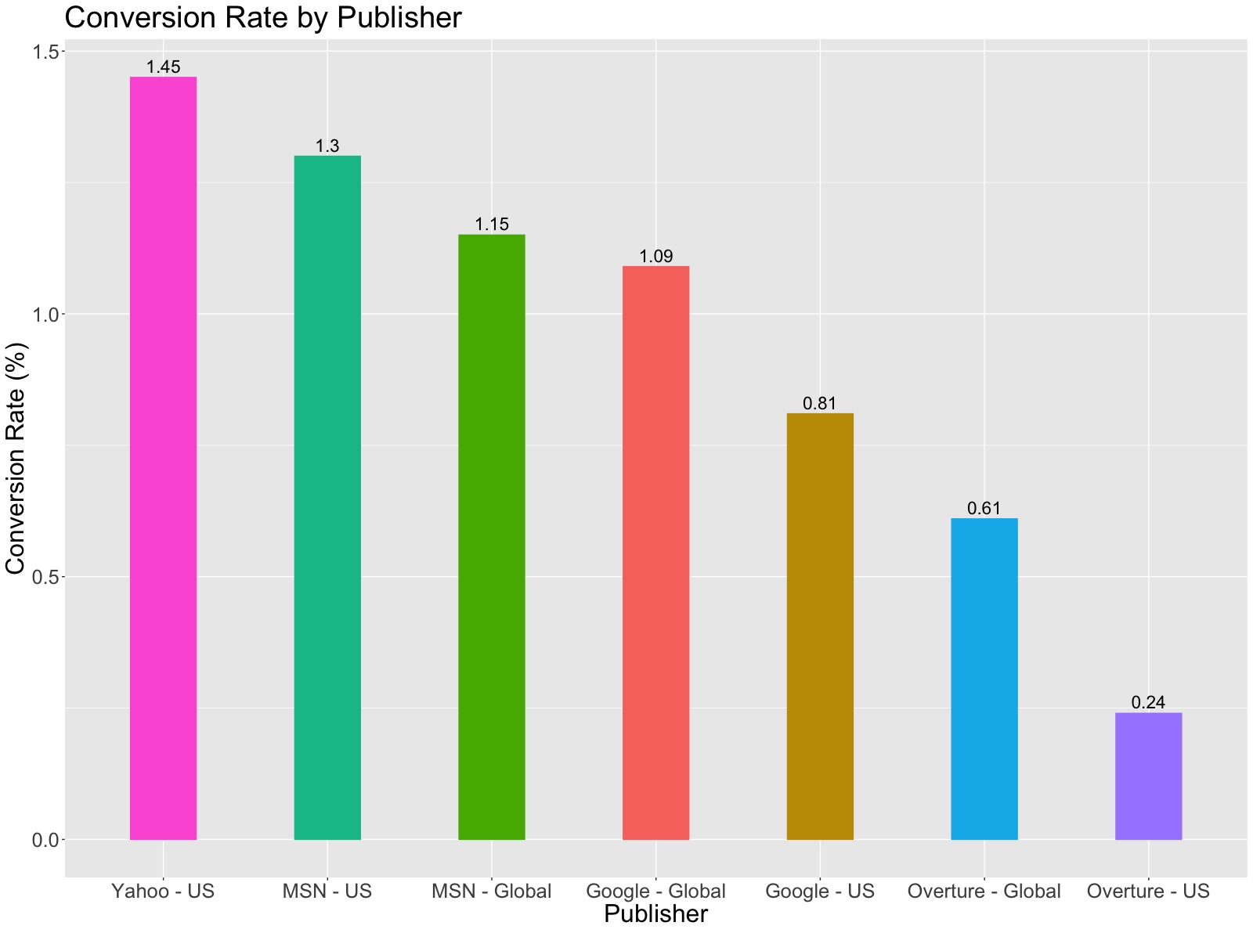
3: Publisher Insights
Depending on the parameter of interest we will choose the preferred search engine
Total Bookings by Search Engines
Conversion Rates by Search Engines

Slide 5
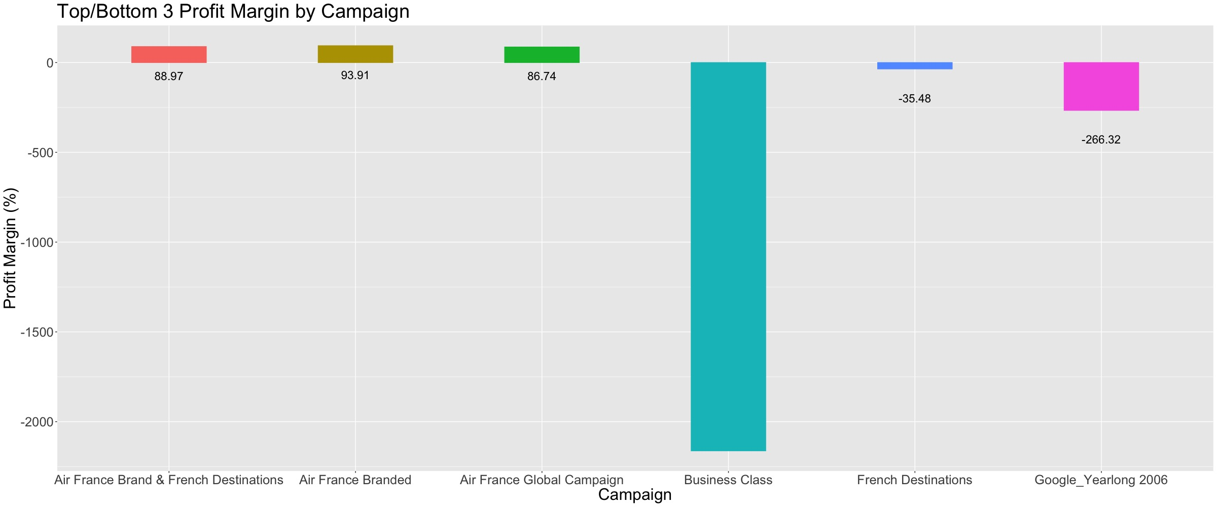
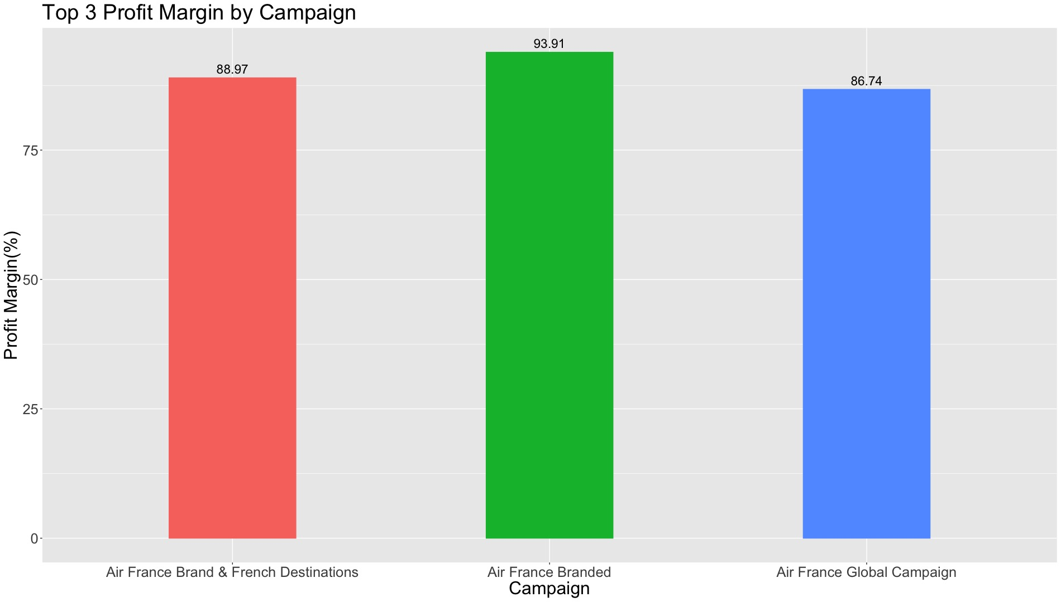
4: Search Engines Insights
Maximizing The Revenue By Choosing The Campaingn With Highest Converstion Rate
Profit margin by Campaign
TOP 3 Profit margin by Campaign

Slide 6
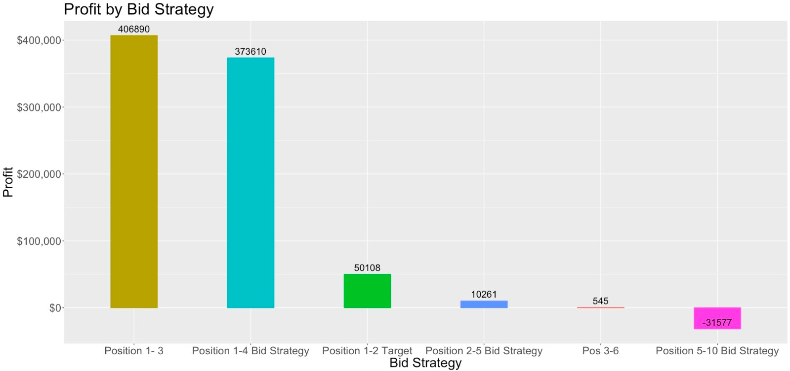
5:Bid Strategy Insights
Profit V/S Bid Strategy
Title of below charts
Key findings
The profit is shows $400000 when the position if the bid is top 3.
The profit is shows $373610 when the position if the bid is in top 4
The number of bid straegety increase the profit. Targeting the top position in the bid gives us increase in revenue.
Notes:
Pub
Cam

Slide 7
5:Page Title
Summary of this slide by 1 sentence
Recommendations
Search Engines
We ran an analysis focusing on search engines regarding their performance based on bookings produced and their specific conversion rate
if the goal of the company is to reach more easily the global market we would suggest to opt for Google as it is the one with more access to the masses
Instead if the company is concerned about search engine performance we recommend to go for yahoo instead of google
Campaigns
We analyzed the campaigns in order to understad wich one of them is worth considering for AIRFRANCE
By analyzing the top and bottom three it is clear that ther is a specific strategy generates a much greater loss compared to the others and is the business class strategy so wichever search engine the company chooses we recommend to avoid businessclass campaigns
From the top three campaign we see air france branded to be the highest profit margin of all the campaign that is correlated either to yahoo or Google
Bid Strategy
We choose to analyze the bid strategy and understand wich one of them will produce the best outcome for the company
From the outcome of the analysys it is clear that when the bid strategy includes the 5th onwards position the profit margin are going to shrink a lot
The best option is either implement a bid strategy for the first 4 position or buy one of the first three position directly

