Slide 1
Battleship
Sam Grenon
Jacob Butler

Slide 2
Version Control
Use an already built git ignore and add onto it.
Don’t push assets more than 100 megabyte.

Slide 3
Public Variables
It is easy to make public variables and access them in other scripts. This is bad practice, however the problem is that many of Microsoft’s examples, and Unity examples all use public variables when they could be private. This is a big issue because many individuals using unity aren’t trained. Then these guys make tutorial videos of specific unity functions with public variables that cause other new programmers to copy and it just gets out of control.

Slide 4
If you don’t need it don’t create it.

Slide 5
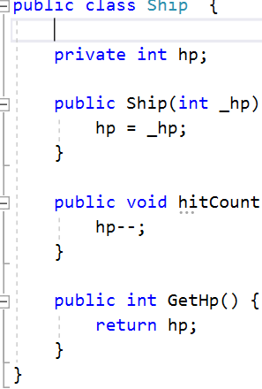
What I actually ended up with.

Slide 6
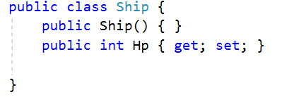
Good Code

