Slide 1

YieldSense AI
Crop yield prediction and agricultural productivity intelligence
Durga Prasad A · Infosys Springboard · Milestones 1–4
Notes:
Introduce yourself and the project. YieldSense AI estimates crop yields and turns weather, soil and risk data into recommendations. This presentation covers all four milestones: data and setup, the yield model, the platform, and testing and deployment. Then a short live demo.

Slide 2



Farm decisions come before the harvest
Uncertain yields
Weather and soil vary
Risk is spread thin
Planting, inputs and sales are planned months before anyone knows the harvest.
Rainfall, temperature and soil quality differ by place and year.
Drought, heat and pests hit some regions far harder than others.
Goal: estimate yield from historical, weather and soil data, and turn it into clear, honest advice for farmers, agronomists and administrators.
Notes:
The problem: farmers and organisations commit money long before the harvest. Yields depend on weather, soil and pests, which vary by region and year. The goal of YieldSense is to estimate yields from data and turn the estimate into practical, honest advice.

Slide 3






Every module in the specification, working
User management
Data collection
Yield prediction
Weather analysis
Sign-in, three roles, profiles, farms
CSV/Excel import, soil tests, records
XGBoost with a P10–P90 range
Live forecast, ERA5 climate trend
Soil analysis
Analytics
Recommendations
Risk assessment
SoilGrids soil, nutrient ratings
Trends, farm comparison, reports
Rules, model impact, AI rationale
Matrix, timeline, anomalies
Notes:
The specification asks for seven modules; risk assessment is split out as its own screen, so there are eight areas. All of them are implemented and work on real data, with the caveats I will cover later.

Slide 4
Architecture
PostgreSQL
users · farms · records
FastAPI
auth · prediction · farms · risk · weather · soil · reports
Browser
React 19 · TypeScript
Nginx
web app + /api proxy
MongoDB
uploads · caches
XGBoost v2.1
model.pkl
External data: Open-Meteo (forecast, ERA5 climate) · ISRIC SoilGrids (soil) · Groq LLM (optional text)
Every service runs in Docker; one Compose file starts the whole stack.
Notes:
The browser talks to Nginx, which serves the React app and forwards API calls to FastAPI. PostgreSQL holds relational data such as users, farms and predictions; MongoDB holds raw uploads and caches for the external services. The model is a serialised XGBoost pipeline. External data comes from Open-Meteo, SoilGrids and, optionally, Groq for plain-language text.

Slide 5
Know which data is real
Real
Region · crop · year · yield · rainfall · temperature · pesticides
28,242 FAOSTAT rows, 101 countries, 10 crops, 1990–2013
Synthetic
Soil pH · moisture · humidity · sunlight · irrigation · fertilizer · disease · crop duration
Generated to fill the schema: never used by the model
Derived
NDVI
Computed from the yield itself: removed (target leakage)
Every column carries an R / S / D badge in the app, and the model card lists what was excluded and why.
Notes:
An early finding: the first model scored very well because NDVI had been generated from the yield itself. That is target leakage. I audited every column: only seven are real. The synthetic ones are kept for the reference view but never feed the model, and the app labels each column as real, synthetic or derived.

Slide 6
Six model families, tested on unseen years
Temporal split
Train on 1990–2008, test on 2009–2013: like forecasting a future season.
Selection rule
Lowest error; within 1% counts as a tie and the faster model wins. XGBoost is served; the Keras MLP would add TensorFlow to the API.
Notes:
Six model families were trained on raw and log-transformed yields and evaluated on three splits. The main one is temporal: train up to 2008 and test on 2009 to 2013, years the model never saw. Linear models are far behind. The top four are close; the Keras MLP is 1% better than XGBoost, but by the selection rule the faster model wins, and XGBoost keeps TensorFlow out of the API.

Slide 7
The served model: XGBoost v2.1
0.953
2,065
74.5%
16 ms
R² on unseen years
RMSE, kg/ha
of yields inside P10–P90 (target 80%)
p95 single prediction
Six real inputs: crop, region, year, rainfall, temperature, pesticides.
v2.0 → v2.1: dropping the synthetic crop-duration column: R² 0.9514 → 0.9528, RMSE 2,096 → 2,065.
Validation gate: CI refits the model on 1990–2008 and fails the build if accuracy drops below the thresholds.
Notes:
The served model explains about 95% of the variation in yields on years it never saw, with a typical error of about 2,000 kilograms per hectare. The likely-range band covers 74.5% of real yields against an 80% target, so it is slightly too narrow, and the app says so. Removing a synthetic column in version 2.1 slightly improved every metric. A validation gate in CI protects these numbers.

Slide 8
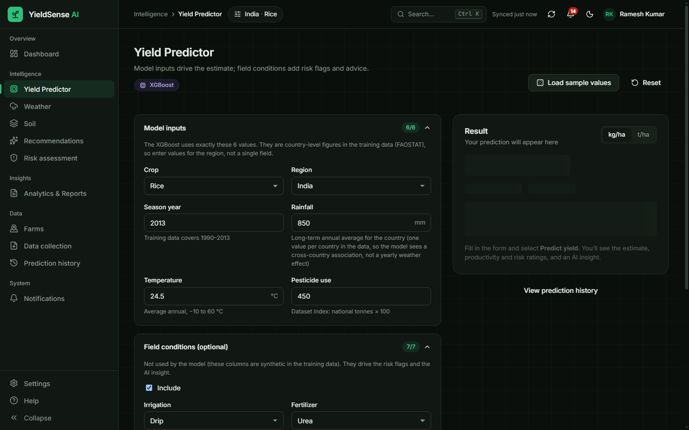
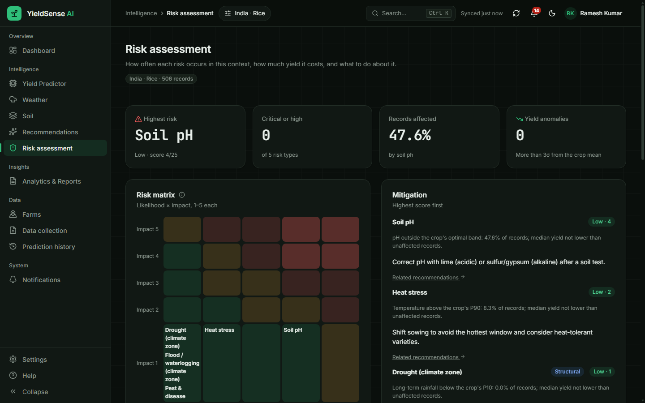
Predict, then act on the risk
Yield Predictor
Model inputs separate from field conditions; P10–P90 range, harvest in tonnes, what-if scenarios.
Risk assessment
Likelihood × impact matrix, yearly timeline, yield anomalies and mitigation advice.
Notes:
Two core screens. The predictor separates the six model inputs from optional field conditions, which only drive risk flags. It shows a likely range and, for a selected farm, the expected harvest in tonnes. The risk page rates each risk by likelihood and impact, shows how it changes over the years and suggests mitigation.

Slide 9
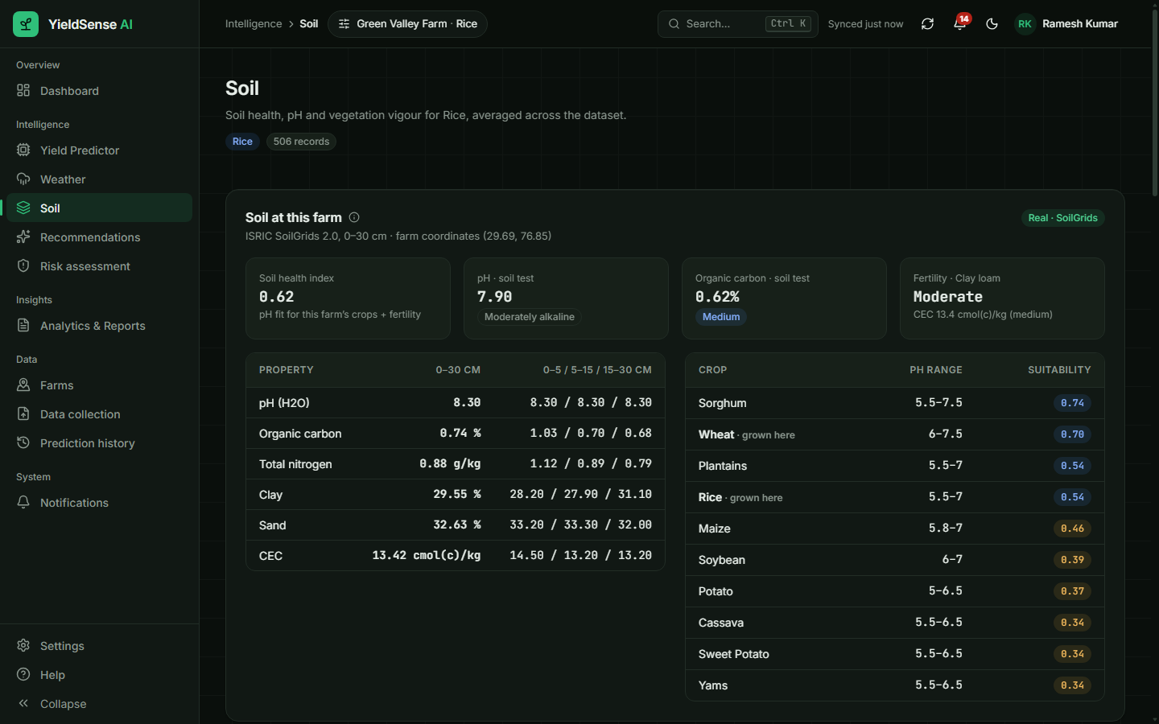

Real soil data for every farm
ISRIC SoilGrids
pH, organic carbon, nitrogen, texture, CEC at 0–30 cm
Nutrient ratings
Soil tests rated against Soil Health Card limits, with fertilizer advice
No silent fallback
If the service is down, the page says so instead of showing fake values
Notes:
Because the dataset's soil columns are synthetic, farm soil comes from ISRIC SoilGrids for the farm's coordinates, combined with the farm's own lab tests. Nutrients are rated against Indian Soil Health Card limits, with fertilizer guidance. If SoilGrids is unavailable, the page shows an error; it never quietly substitutes made-up numbers.

Slide 10

From numbers to decisions
Recommendations
Rules compare a context with top-yielding records; each shows evidence, model-estimated impact and a deadline. Tasks are saved per user.
Analytics & reports
Yearly trend with next-year forecast, farms vs regional reference, CSV/Excel export and printable reports.
Roles
Farmer, Agronomist and Admin see different screens; every API route is protected and tested for all three roles.
Plain-language AI
Groq writes short explanations from the evidence only; a labelled rule-based fallback is used otherwise.
Notes:
Recommendations come from rules that compare the selected region and crop with the best-yielding records. Where the model uses the input, it estimates the impact in kilograms per hectare. Analytics show trends and compare a user's farms with the regional average. AI text is optional and always labelled; I tightened the prompt so it only states what the evidence shows.

Slide 11
Tested at every level
130
41
38
100
backend tests
every route and role
frontend unit tests
browser checks
3 roles · 0 console errors
Lighthouse
accessibility, SEO, best practices
Also checked: type checking, linting, formatting, a model validation gate, load tests, security review (JWT, rate limits, upload content checks, no secrets in git), and a rehearsed database backup and restore.
Notes:
Testing covers the API with 130 tests, including access for every route and role, frontend unit tests, and a browser test that signs in as all three roles and fails on any console error. Lighthouse scores are 99 to 100. I also ran load tests and rehearsed restoring a database backup.

Slide 12



Milestone 4: containerised and automated
Push
Test + model gate
Build images
Deploy to VM
Health check
Docker stack measured locally
4 services healthy (PostgreSQL, MongoDB, API, web) · 28,242 rows seeded in 6.9 s
20 concurrent users: 72 requests/s, p95 507 ms, 0 errors
API image 831 MB with CPU-only XGBoost (half the size, identical predictions) · web image 77 MB
Cloud: same Compose stack on an AWS EC2 or Azure VM, HTTPS via Caddy, daily backups
Notes:
For Milestone 4 the whole platform runs in Docker. GitHub Actions runs the tests and the model validation gate on every push, builds the images and, on demand, deploys them to a cloud virtual machine and checks the health endpoint. Measured locally, the stack handles 72 requests per second from 20 concurrent users with no errors. Switching to the CPU-only build of XGBoost halved the image size without changing a single prediction.

Slide 13
What the model cannot do yet
Country-level, not field-level
Yields are national averages; a farm prediction is the national expectation for that crop and year.
New countries are hard
On countries held out entirely, R² falls to 0.67 (RMSE 5,861 kg/ha).
No year-to-year rainfall
Rainfall is one long-term value per country in the data, so its effect is a country difference.
Range slightly narrow
74.5% coverage against an 80% target; reported in the app.
Notes:
Being honest about limits matters as much as the scores. The data is national, so predictions are national expectations. The model struggles with countries it has never seen. Rainfall does not vary by year in this dataset. And the likely range is a little too narrow. All of this is documented in the checklist and shown in the app.

Slide 14

Next steps
Go live
Managed databases
Field-level data
First cloud deployment on AWS or Azure with HTTPS; record production load-test results.
Move to managed PostgreSQL and MongoDB for automatic backups and failover.
Add harvested area, production and field measurements to go beyond national averages.
Notes:
Next: the first public deployment, managed databases for reliability, and better data — harvested area, production and field measurements — so predictions can move from national to field level.

Slide 15
Live demo, then questions
Sign in as a farmer → predict → risk → soil → recommendations → admin metrics
Thank you · Durga Prasad A
Notes:
Demo path (about 5 minutes): sign in with the farmer demo account; run a prediction for Rice in India and show the range and harvest; open the risk page; show real soil for Green Valley Farm; create a task from a recommendation; sign in as admin to show system metrics. Then take questions.

