Slide 1
OpenCV & TensorFlow
Diego Pujols

Slide 2
Why OpenCV?
Easily Access, modify, and showcase images
Simplified pipelining with integrated NumPy support
Supports multiple image and color formats:
JPG, PNG etc.
RGB, BGR, GRAYSCALE

Slide 3
Why TensorFlow?
Standardized input and output structures
Existing tutorials and decently understandable documentation
Allows for some extensive finetuning
Downsides: syntax can be confusing, handling raw data and inputs can be frustrating
Biggest Upside: KERAS

Slide 4
KERAS
Simplicity
Accessibility
Easily usable Pretrained Models (hub.load)

Slide 5
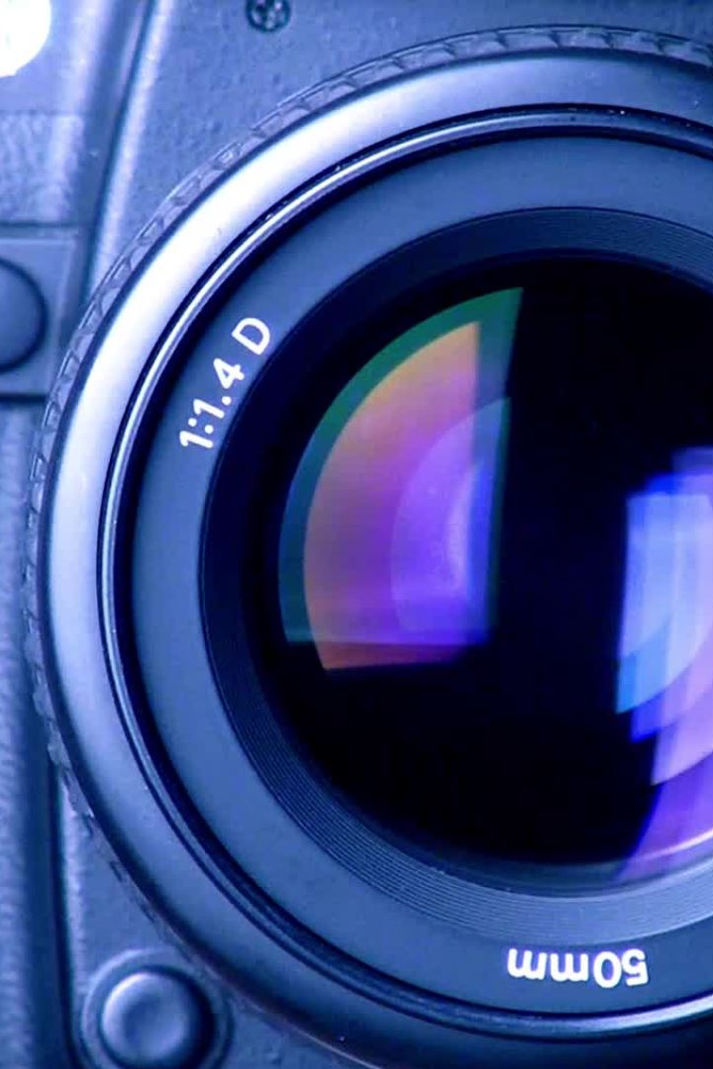
What can they do?
Individually they're powerful:
OpenCV allows for fast modifying and access of image and video streams
TensorFlow with Keras makes creating and using ML models simple – you just need to manage inputs and outputs
Together?
Just about anything!
All you really need a model and an image or camera feed
Data Collection, Experimentation etc.

