Slide 1
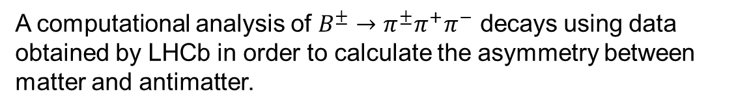
Matter-antimatter asymmetries at LHCb
A computational analysis of $B^{±}→π^{±}π^{+}π^{−}$ decays using data obtained by LHCb in order to calculate the asymmetry between matter and antimatter.
Harriet Watson & Qichen Dong

Slide 2
Introduction
State final results (?)
Background theory
Past experiment results
Why this experiment is worth doing

Slide 3
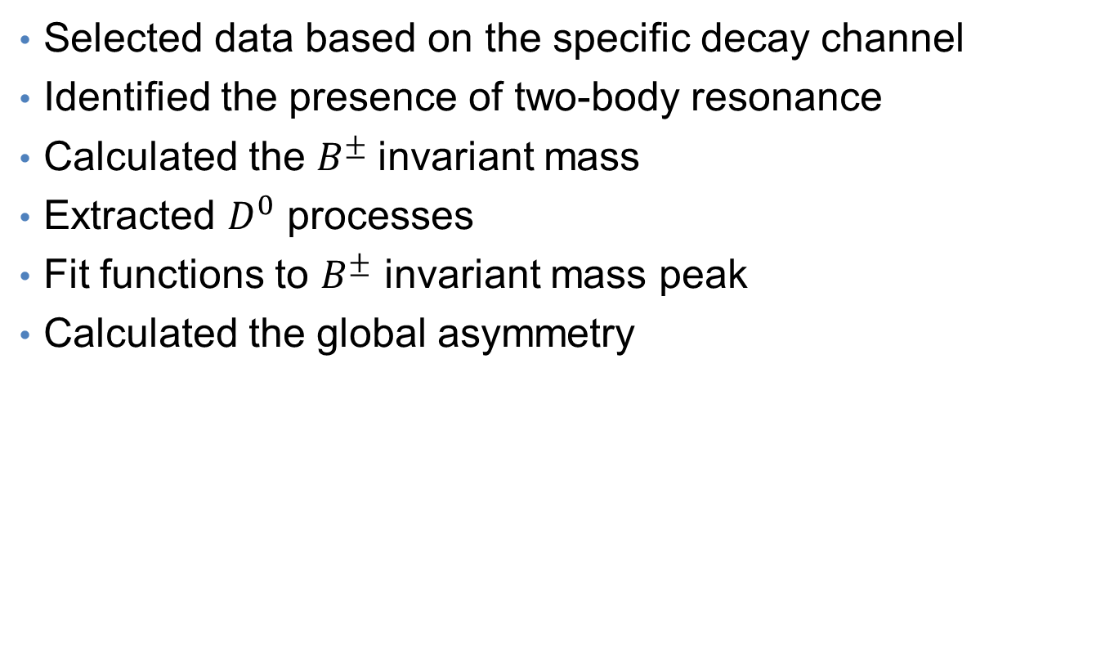
Method
Selected data based on the specific decay channel
Identified the presence of two-body resonance
Calculated the $B^{±}$invariant mass
Extracted $D^{0}$ processes
Fit functions to $B^{±}$ invariant mass peak
Calculated the global asymmetry

Slide 4
Results
Final value for A with uncertainty
Fitting graphs
Dalitz plots

Slide 5
Error evaluation and justification
Systematic and random sources of error

Slide 6
Conclusion
Restate all results
Implications for the standard model (?)
Relate to further experiments/implications

