Slide 1

Angular
https://www.youtube.com/watch?v=DTIYVffhJuU

Slide 2

TypeScript

Slide 3
npm install -g @angular/cli
ng new nomProjet-app
--minimal --style=css

Slide 4
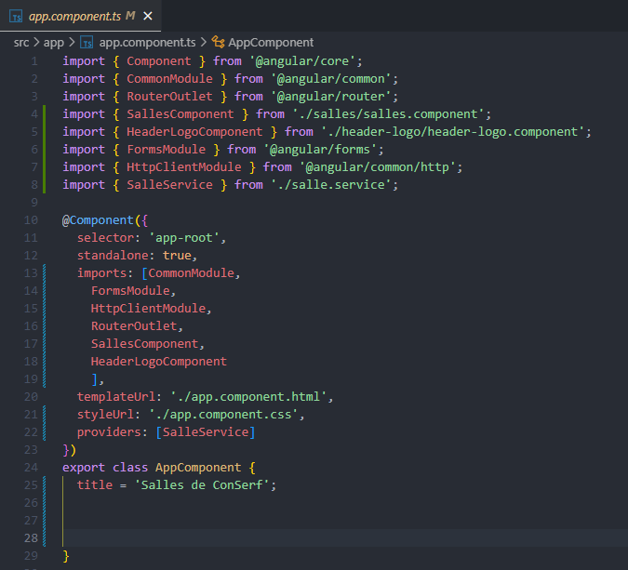
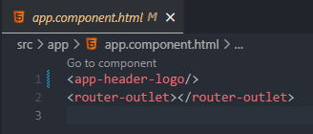

Slide 5
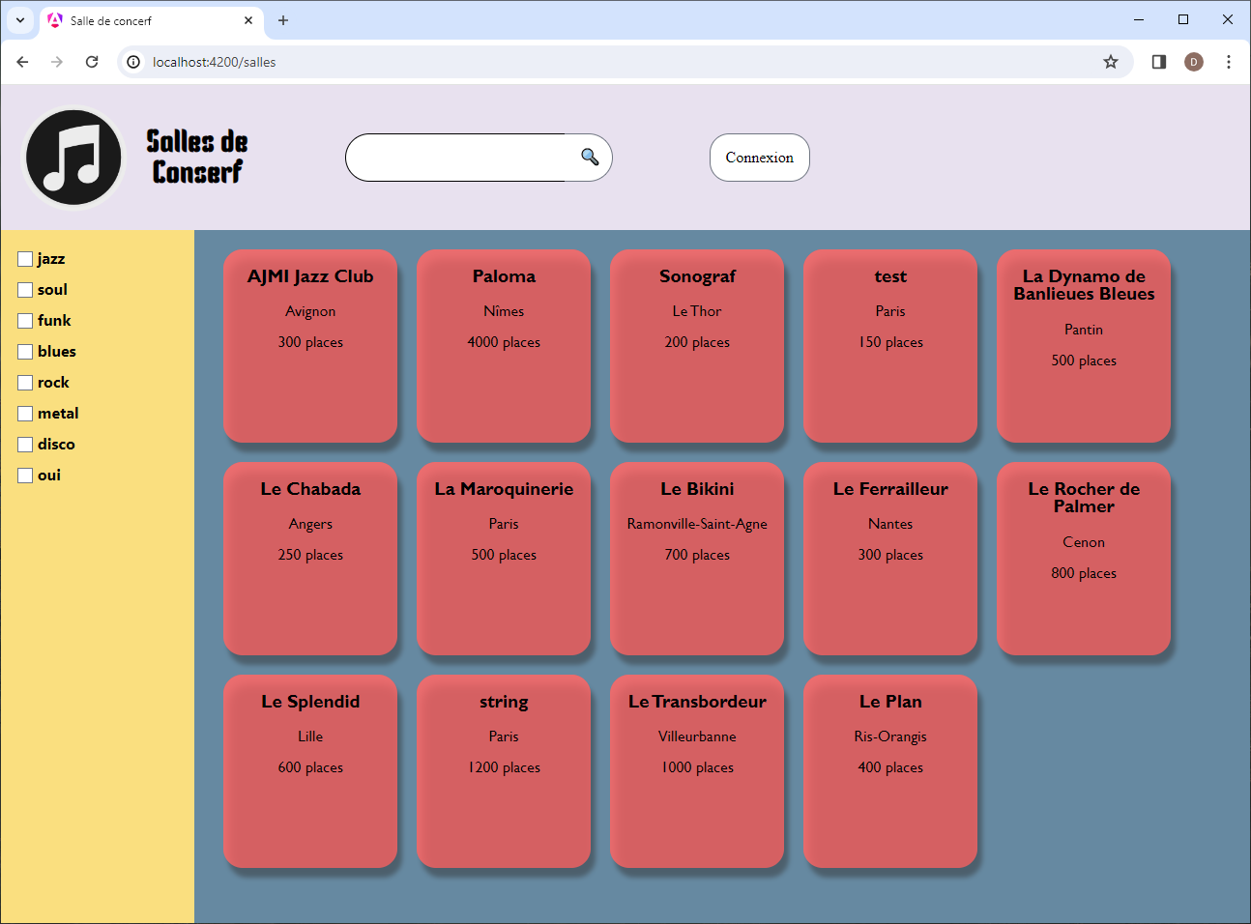

Slide 6
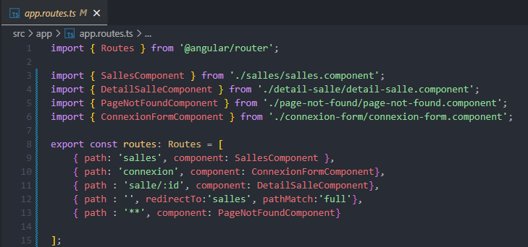

Slide 7
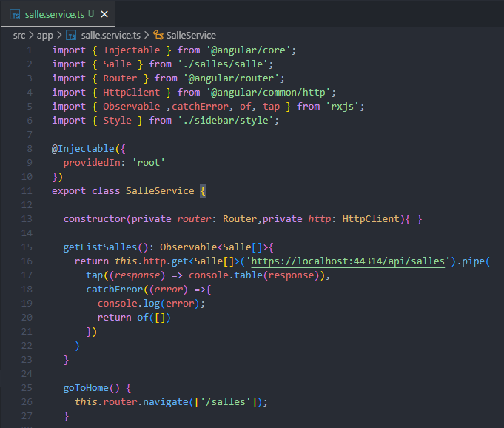

Slide 8
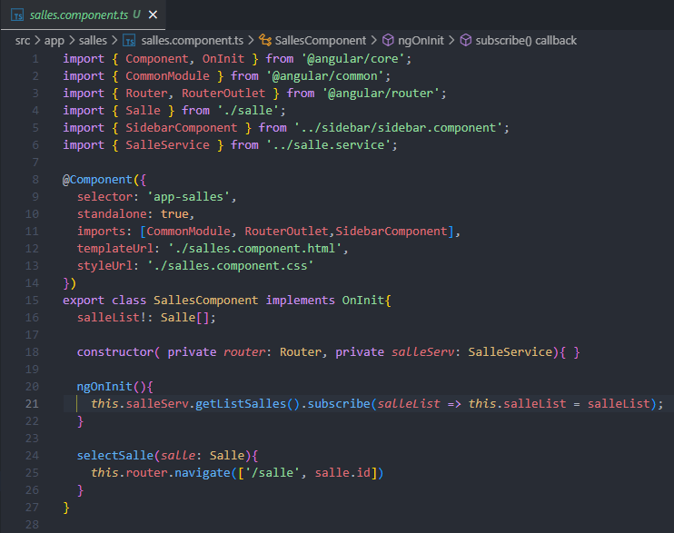
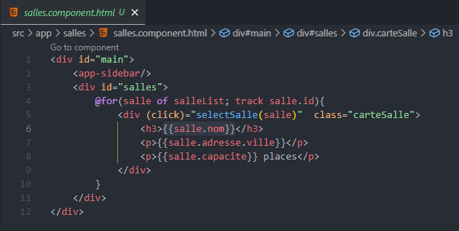
ng generate component nomComponent

