Slide 1

Infrastructure as Code
Foundations
Part 1 — From cloud strategy to IaC architecture
SEAtS | 424812

Slide 2
Intended
By the end of this session you will be able to:
Learning
1. Deﬁne cloud computing (NIST) and explain how cloud infrastructure
has evolved.
2. Compare cloud deployment models, and on-premises vs cloud
Outcomes
computing.
3. Distinguish IaaS, PaaS and SaaS by who manages which layer of the
stack.
4. Explain when to apply service-communication, data-ﬂow, and
processing/control architectural patterns.
5. Explain how DevOps and "cattle not pets" thinking enable
reproducible infrastructure.
6. Compare manual, ad hoc and IaC approaches, and deﬁne IaC and its
requirements.
7. Decompose infrastructure into modules and compare declarative and
imperative approaches.
2
SEAtS | 424812
© University of Southampton

Slide 3
Agenda
1. Cloud context, evolution, and deployment
models.
2. Service models: who manages what.
3. Architectural patterns.
4. As-a-Service, cattle vs pets, DevOps.
5. The problem IaC solves; deﬁnition and
requirements.
6. System architecture for IaC.
7. Summary.
3
SEAtS | 424812
© University of Southampton

Slide 4
What is Cloud Computing?
“A model for enabling convenient, on-demand network access to a shared pool of conﬁgurable computing
resources… that can be rapidly provisioned and released with minimal management eﬀort or service provider
interaction.” — NIST SP 800-145.
1. On-demand self-service
Improved security and “unlimited” capacity.
2. Broad network access
Cost eﬃciencies; zero up-front capital.
3. Resource pooling
Elastic scaling as system grows.
4. Rapid elasticity
Time eﬃciencies via virtual resources.
5. Measured service
Power eﬃciency and visibility into consumption.
Improved process control and quick recovery.
4
SEAtS | 424812
© University of Southampton

Slide 5
timeline title Evolution of Cloud Infrastructure Wave 1 : Static infrastructure : Single VMs accessed via SSH
Wave 2 : Growing complexity : Containers : Provisioning tools (Docker, Datadog) Wave 3 : Modern cloud :
Containers : Serverless : Managed services
5
SEAtS | 424812
© University of Southampton

Slide 6
Each wave adds more moving pieces — and more edges connecting them. IaC is the glue between those
edges. Counter-intuitively, a more complex-looking modern architecture diagram can be
easier
to
maintain than an old simple one, because the slice of it that's actually your own hand-written code (as
opposed to managed service conﬁguration) keeps shrinking — less operational burden sits on your team as
the cloud provider absorbs more of the plumbing.
6
SEAtS | 424812
© University of Southampton

Slide 7
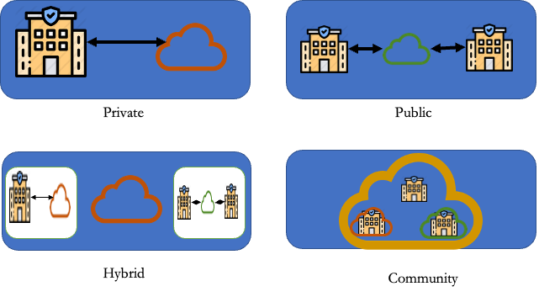
Cloud Deployment Models
1. Public: Infrastructure available to general
public, owned by service provider.
2. Private: Dedicated to a single
organisation, managed on/oﬀ premise.
3. Community: Shared by organisations
with common concerns.
4. Hybrid: Combination of cloud types.
7
SEAtS | 424812
© University of Southampton

Slide 8
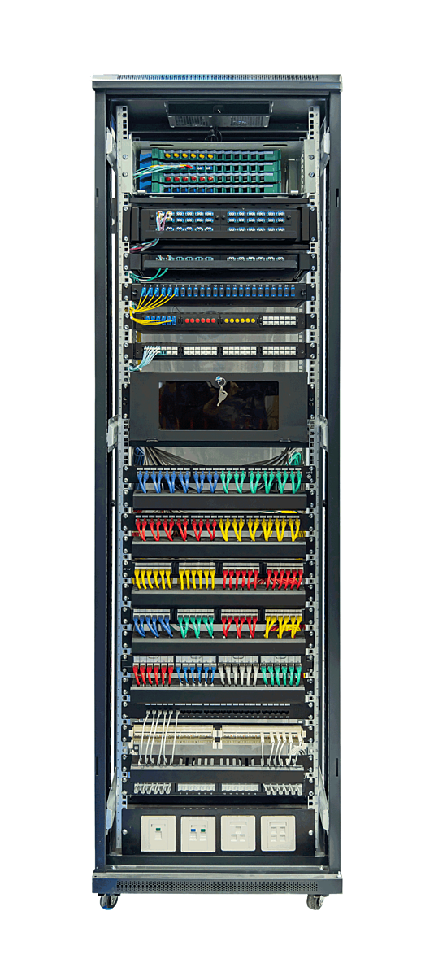
On premises Computing vs.
Cloud
_x0001_
Computing
On Premises
Cloud
Manually provisioned
Self-provisioned
Dedicated hardware
Shared hardware
Fixed capacity
Elastic capacity
Pay for capacity
Pay for use
CapEx + OpEx
Operational expenses
Managed via sysadmins
Managed via APIs
8
SEAtS | 424812
© University of Southampton

Slide 9
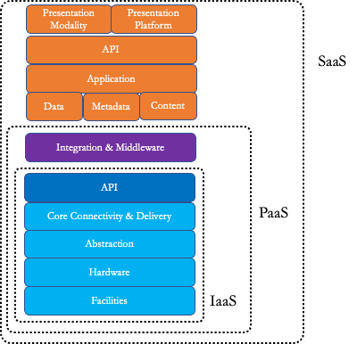
Main Service
Delivery Models
IaaS: Provision virtual machines, networks, and storage
inside the providerʼs infrastructure to run any OS or
application stack.
Control over guest OS and runtimes.
Examples: EC2, Virtual Networks.
PaaS: Build and deploy custom applications using
provider-supported runtimes and tooling.
Auto elasticity and built-in CI/CD.
Examples: App Engine, Azure App Service.
SaaS: Consume fully managed provider applications
delivered over the cloud.
No infrastructure management; pay per use.
Examples: Gmail, Salesforce.
9
SEAtS | 424812
© University of Southampton

Slide 10
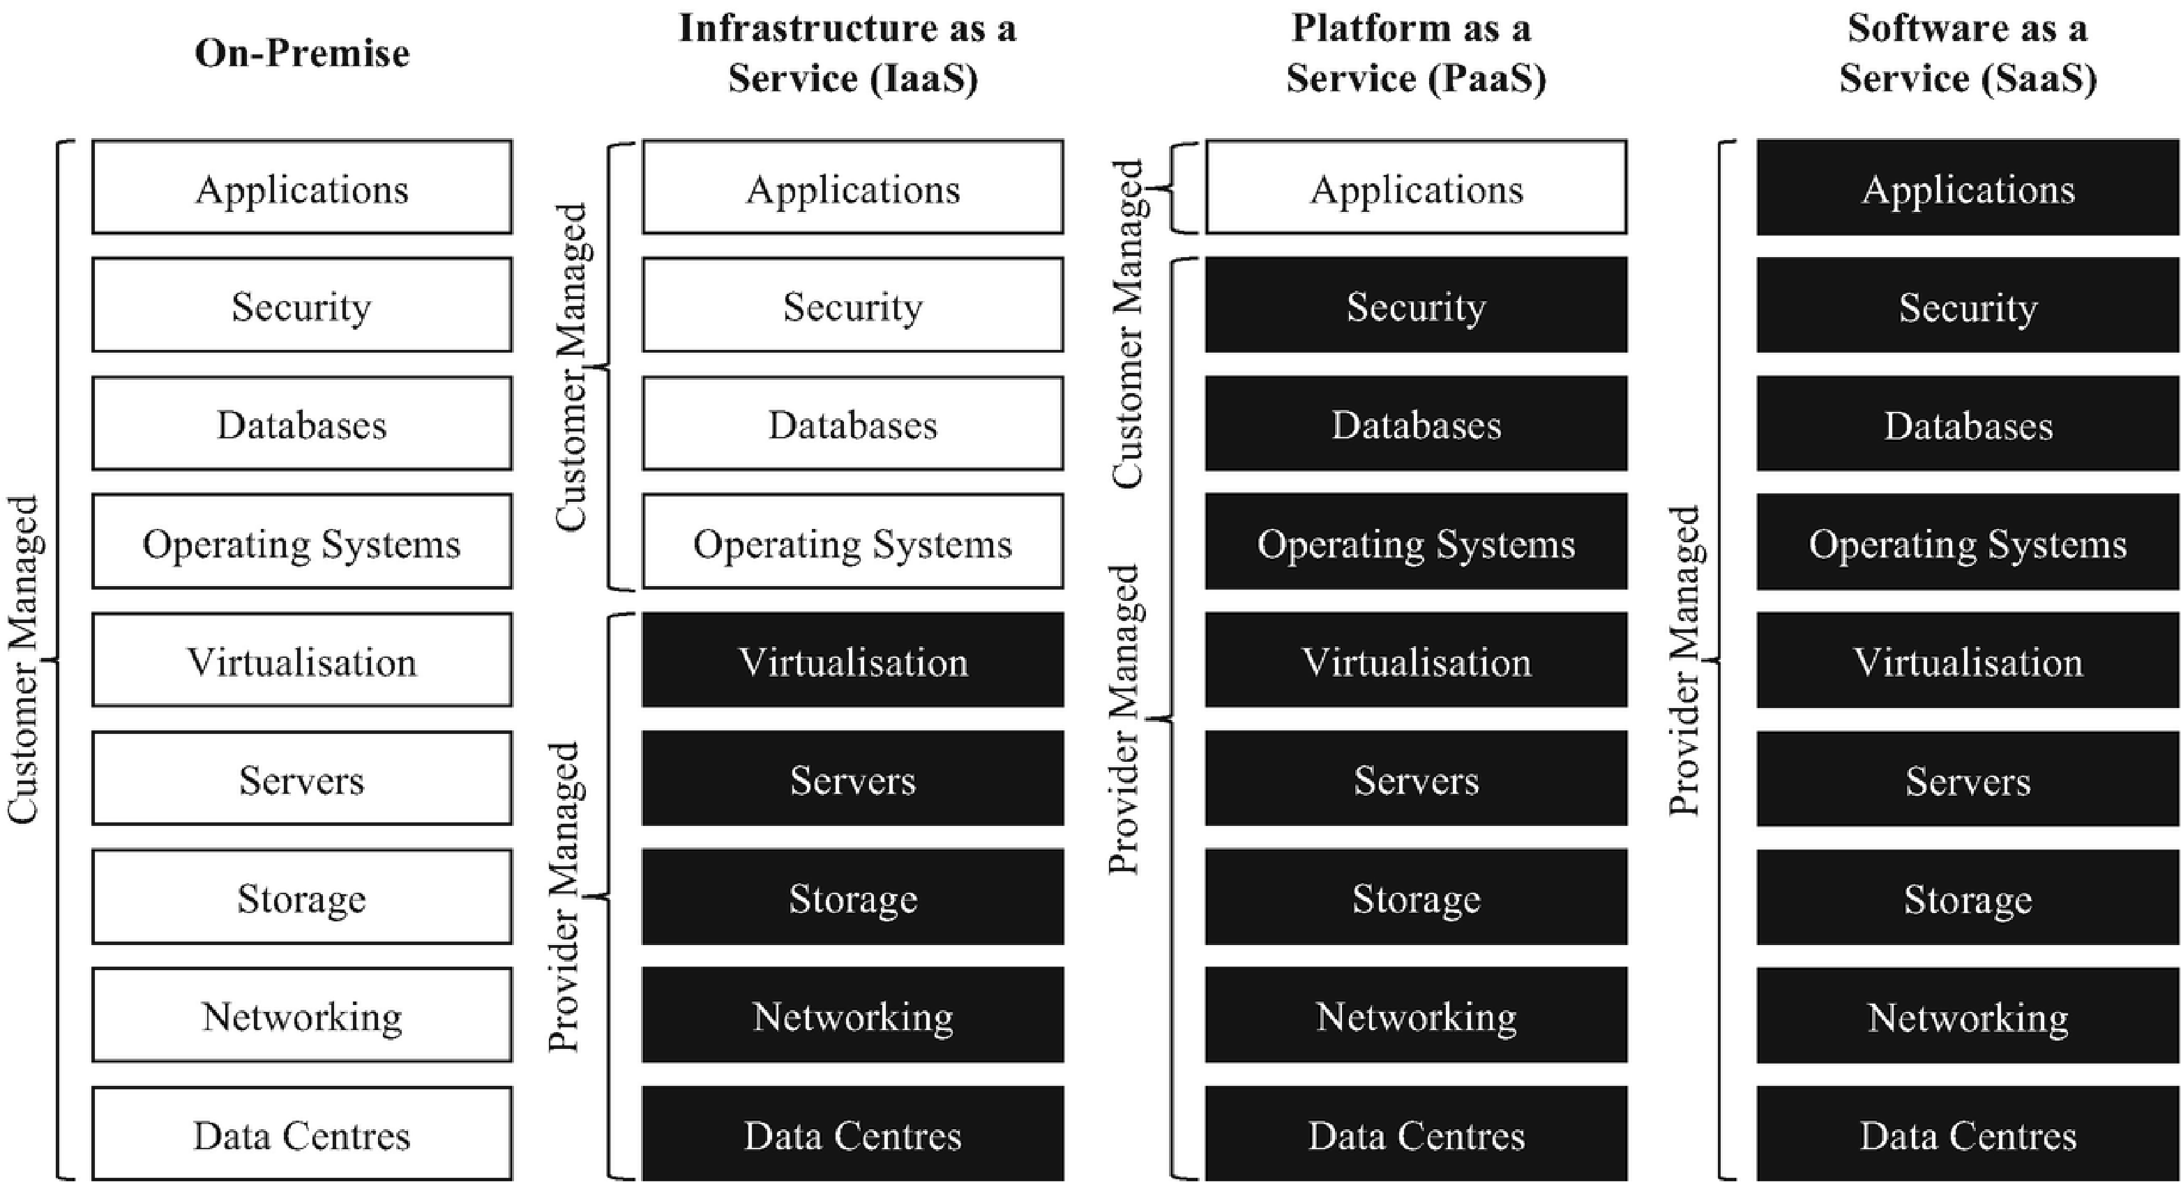
10
SEAtS | 424812
© University of Southampton

Slide 11
Service Delivery Models — Who Manages What
IaaS: You manage from the OS up — runtime, middleware, data, and the application.
PaaS: You manage your application and data; the provider manages the OS, runtime, and middleware.
SaaS: The provider manages everything — you just use the application.
IaC's job: write the code that manages the IaaS resources — and the SaaS-like managed services — a cloud provider
gives you. The inner the layer, the more of it your Pulumi/Terraform code is responsible for.
11
SEAtS | 424812
© University of Southampton

Slide 12
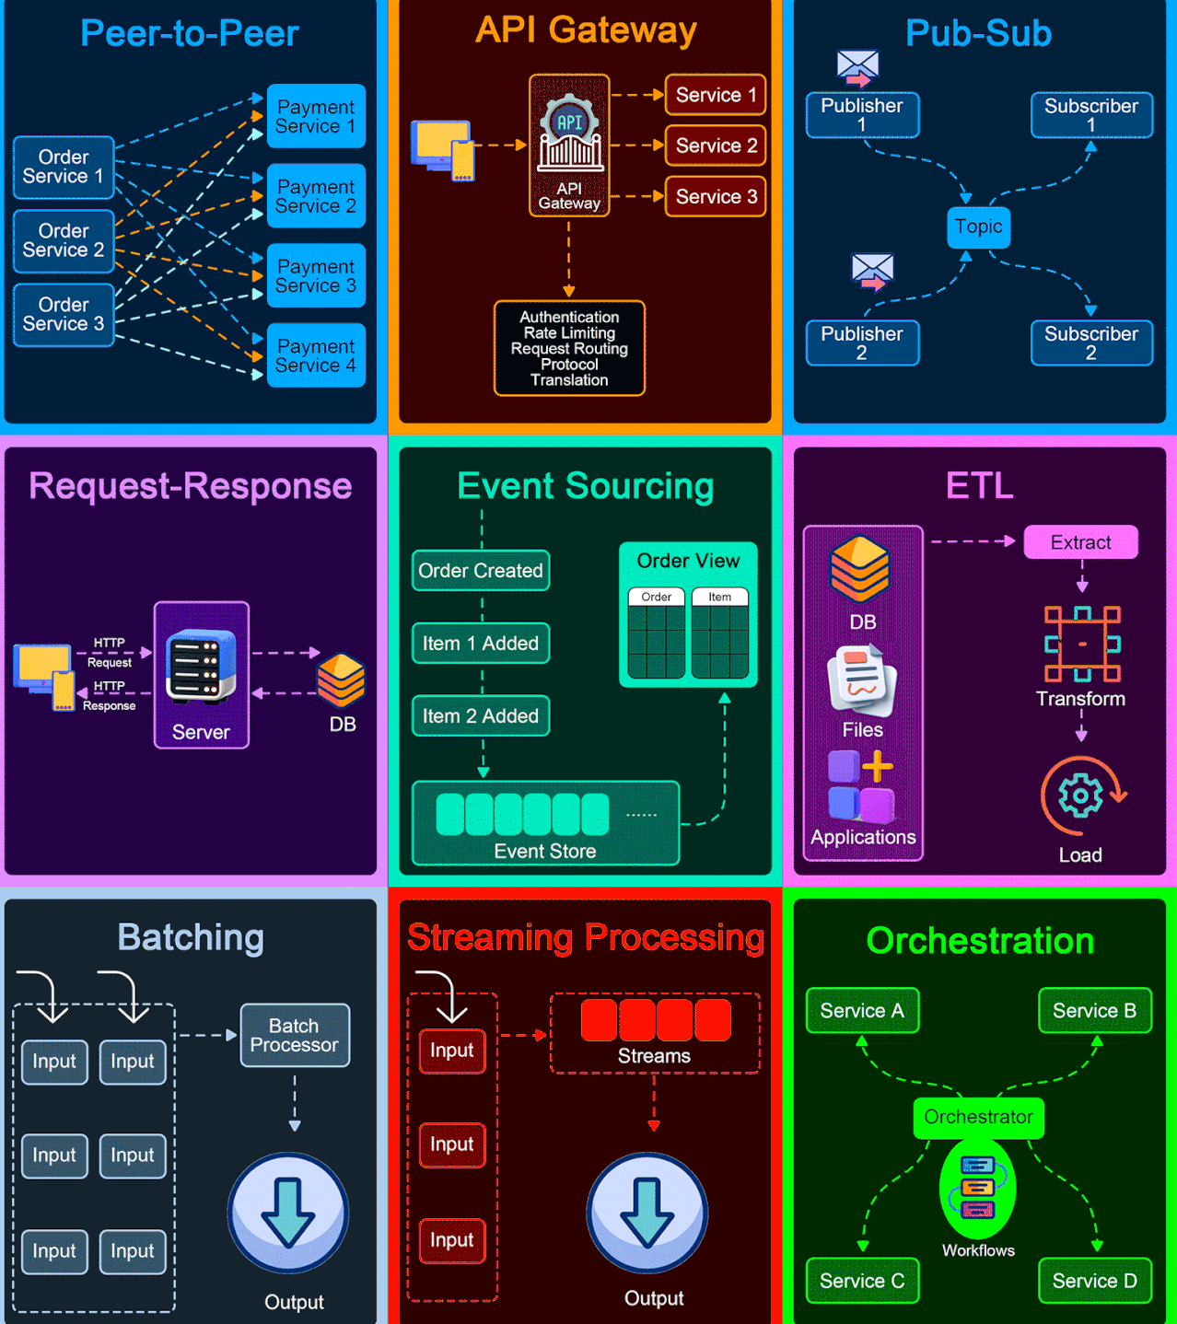
Architectural
Patterns
Pattern
Description
Peer-to-Peer
Direct communication between two
components without a central coordinator.
API Gateway
Single entry point for all client requests to
the backend services of an application.
Pub-Sub
Decouples publishers from subscribers
through a message broker.
Request–
Client sends a request to a server and waits
Response
for a response.
Event Sourcing
Store application state changes as a
sequence of immutable events.
ETL
Gather data from sources, transform it, and
load into a destination.
Batching
Accumulate data over time/threshold
before processing as a group.
Streaming
Continuously ingest, process, and analyse
Processing
data in real time.
Orchestration
Central coordinator manages interactions
between distributed components.
12
SEAtS | 424812
© University of Southampton

Slide 13
Architectural Patterns — Service
Communication (1/3)
Peer-to-Peer
ﬂowchart LR
"] -.->
"] O1 -.->
"]
"] -.-> P2 O2 -.-
"]
"] -.-> P3 O3 -.-
"]
O1["Order Svc
P1["Payment
P2["Payment
O2["Order
> P3["Payment
O3["Order
> P4["Payment
1
Svc 1
Svc 2
Svc 2
Svc 3
Svc 3
Svc 4
13
SEAtS | 424812
© University of Southampton

Slide 14
API Gateway
ﬂowchart LR Client -->
"] GW -->
"] GW -->
"] GW -->
"] GW -.-> Cross["Auth ·
"]
GW["API Gateway
S1["Service 1
S2["Service 2
S3["Service 3
Rate Limit · Routing
14
SEAtS | 424812
© University of Southampton

Slide 15
Pub-Sub
ﬂowchart LR
"] -->
"))
"] --> Topic Topic -->
"] Topic -->
"]
Pub1["Publisher 1
Topic(("Topic
Pub2["Publisher
Sub1["Subscriber 1
Sub2["Subscriber 2
2
15
SEAtS | 424812
© University of Southampton

Slide 16
Architectural Patterns — Data
Flow (2/3)
Request–Response
ﬂowchart LR Client -- "HTTP
" --> Server Server -- "HTTP
" --> Client Server <-->
")]
Request
Response
DB[("Database
16
SEAtS | 424812
© University of Southampton

Slide 17
Event Sourcing
ﬂowchart TD
"] --> E2["Item 1
"] --> E3["Item 2
"] -->
")] Store -->
"]
E1["Order Created
Added
Added
Store[("Event
View["Order View
Store
17
SEAtS | 424812
© University of Southampton

Slide 18
ETL
ﬂowchart LR Src[("DB · Files · Apps
")] --> Extract --> Transform --> Load --> Dest[("Destination
")]
18
SEAtS | 424812
© University of Southampton

Slide 19
Architectural Patterns —
Processing & Control (3/3)
Batching
ﬂowchart LR I1["Input
"] & I2["Input
"] & I3["Input
"] --> BP["Batch Processor
"] --> Out["Output
"]
19
SEAtS | 424812
© University of Southampton

Slide 20
Streaming Processing
ﬂowchart LR
"] -->
"] --> Proc["Continuous
"] -->
"]
I1["Input
Stream["Stream
Processing
Out["Output
20
SEAtS | 424812
© University of Southampton

Slide 21
Orchestration
ﬂowchart TD
")) -->
"] Orch -->
"] Orch -->
"] Orch -->
"]
Orch(("Orchestrator
A["Service A
B["Service B
C["Service C
D["Service D
21
SEAtS | 424812
© University of Southampton

Slide 22
Many “as-a-Service” Oﬀerings
Examples include Analytics, API, AI, Backend, Banking, Big Data, Blockchain, Business Process, Code, Content,
Construction, Container, Crane, Edge Compute, Contact Centre, Communications Platform, Data, Desktop, Drone,
Database, Distribution, Energy, Engagement, EV, Function, Farming, Firewall, Games, Governance, Hadoop,
Hardware, Housing, Identity, Image, IoT, IT, Knowledge, Load Balancing, Logging, Management, Microgrid, Mobility,
Monitoring, Metal, Mobile Backend, Machine Learning, Network, Network Defense, Payments, Policy, Product, Push
Notiﬁcation, QA, RAN, Recovery, Recycling, Robot, Search, Security, Solar, Shared Storage, Transportation, Testing,
Time Series DB, Uniﬁed Communications, and “Anything as a Service.”
22
SEAtS | 424812
© University of Southampton

Slide 23

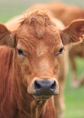
Infrastructure:
Cattle vs Pets
Development environments should be
consistent and reproducible, like managing
“cattle” (identical, disposable instances) rather
than unique “pets” (customised desktops). This
ensures faster onboarding, predictable testing,
and reliable automation.
23
SEAtS | 424812
© University of Southampton

Slide 24
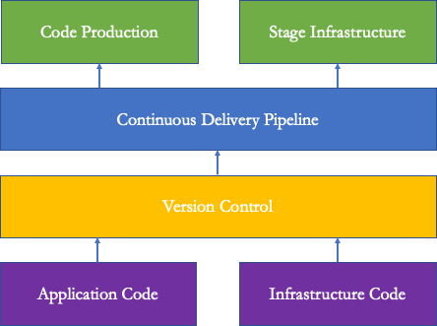
DevOps =
Development + Operations
Development view: Focus on delivering
features quickly with automated builds, tests,
and infrastructure deﬁnitions.
Operations view: Focus on reliability,
monitoring, capacity planning, and incident
response.
DevOps bridge: Shared tooling (CI/CD, IaC),
common metrics (SLOs), and collaborative
culture align both perspectives.
24
SEAtS | 424812
© University of Southampton

Slide 25
Naming the Problem IaC Solves
Modern applications can deploy to production up to 100 times a day, and infrastructure often needs to scale up or
down automatically in response to load — neither is viable with manual, one-oﬀ changes.
"] -->
"} B --
"|
"] B --
"|
"] B --
"|
a
B{"How?
>|"Point-
in a
Manual["Manual
>|"One-
commands
scripts
AdHoc["Ad
automation
>|"Declare
state
IaC["Infras
e
resource
and-click
console
oﬀ CLI
/
hoc
desired
in
code
25
SEAtS | 424812
© University of Southampton

Slide 26
Three Ways to Manage Infrastructure
Approach
What it is
Manual
Point-and-click resource creation/modiﬁcation directly in a console
Ad hoc automation
CLI commands or scripts — some code, but not structured for reuse
Infrastructure as
Provisioning (declaratively creating/modifying resources) + conﬁguration
Code
(changing an existing resource's state)
26
SEAtS | 424812
© University of Southampton

Slide 27
IaC Deﬁnition & Motivation
Infrastructure as Code (IaC): Deﬁne and manage infrastructure via machine-readable ﬁles instead of manual
provisioning.
Why essential?
Rapid provisioning for software, hardware, and learning integration.
Reduces conﬁguration drift and enables CI/CD pipelines.
Enhances repeatability, testing, and formal speciﬁcation.
Critical for distributed cloud systems.
27
SEAtS | 424812
© University of Southampton

Slide 28
Requirements in IaC
Functional examples: Deploy VPC/VNet; automate Kubernetes clusters; create IAM roles.
Non-functional examples: Scalability, security hardening, fault tolerance, cost-eﬃciency, auditability, compliance.
IaC formalises both sets of requirements in code.
Cloud provider selection (AWS, Azure, GCP).
State storage (S3, Blob, GCS).
Secrets management (Vault, Secrets Manager).
Access patterns (SSH, API gateways, private endpoints).
Compliance constraints (residency, logging).
Integration requirements (CI, monitoring, networks).
Methods: stakeholder interviews, architecture diagrams, threat modelling.
28
SEAtS | 424812
© University of Southampton

Slide 29
System Architecture for IaC
IaC encourages decomposition into modules:
Networking (VPC, subnets, ﬁrewalls).
Compute (VMs, containers).
Storage (S3, RDS).
Identity (IAM roles, policies).
Monitoring (metrics, logging).
Declarative vs Imperative
Approach
Description
Examples
Declarative
Describe desired state; engine reconciles
Terraform, CloudFormation, Bicep
Imperative
Execute procedural steps
Ansible, Pulumi, scripts
Declarative scales better for large multi-component systems.
29
SEAtS | 424812
© University of Southampton

Slide 30
Summary
Cloud computing delivers on-demand, elastic, pay-per-use resources; each wave of cloud adds moving
pieces, and IaC is the glue between them.
Deployment models (public, private, community, hybrid) and service models (IaaS, PaaS, SaaS) set what
you manage and what the provider manages.
Architectural patterns group into service communication (API Gateway, Pub-Sub), data ﬂow (Event
Sourcing, ETL), and processing & control (Streaming, Orchestration).
DevOps and "cattle not pets" demand consistent, disposable, reproducible environments.
IaC replaces manual and ad hoc changes with machine-readable deﬁnitions — reducing drift and
enabling CI/CD.
Capture functional and non-functional requirements, decompose into modules, and prefer declarative
deﬁnitions for large systems.
30
SEAtS | 424812
© University of Southampton

