Slide 1
AICE2005 - Systematic Design
Formal Specification and Verification
Asieh Salehi Fathabadi
University of Southampton
2026-2027

Slide 2
Week 4-5 Overview
Lecture 1: Introduction to Formal Methods
Lecture 2: Formal Specification Techniques
Lecture 3: Mathematical Foundations
Lecture 4: Formal Verification Methods
Lecture 5: Tools and Applications

Slide 3
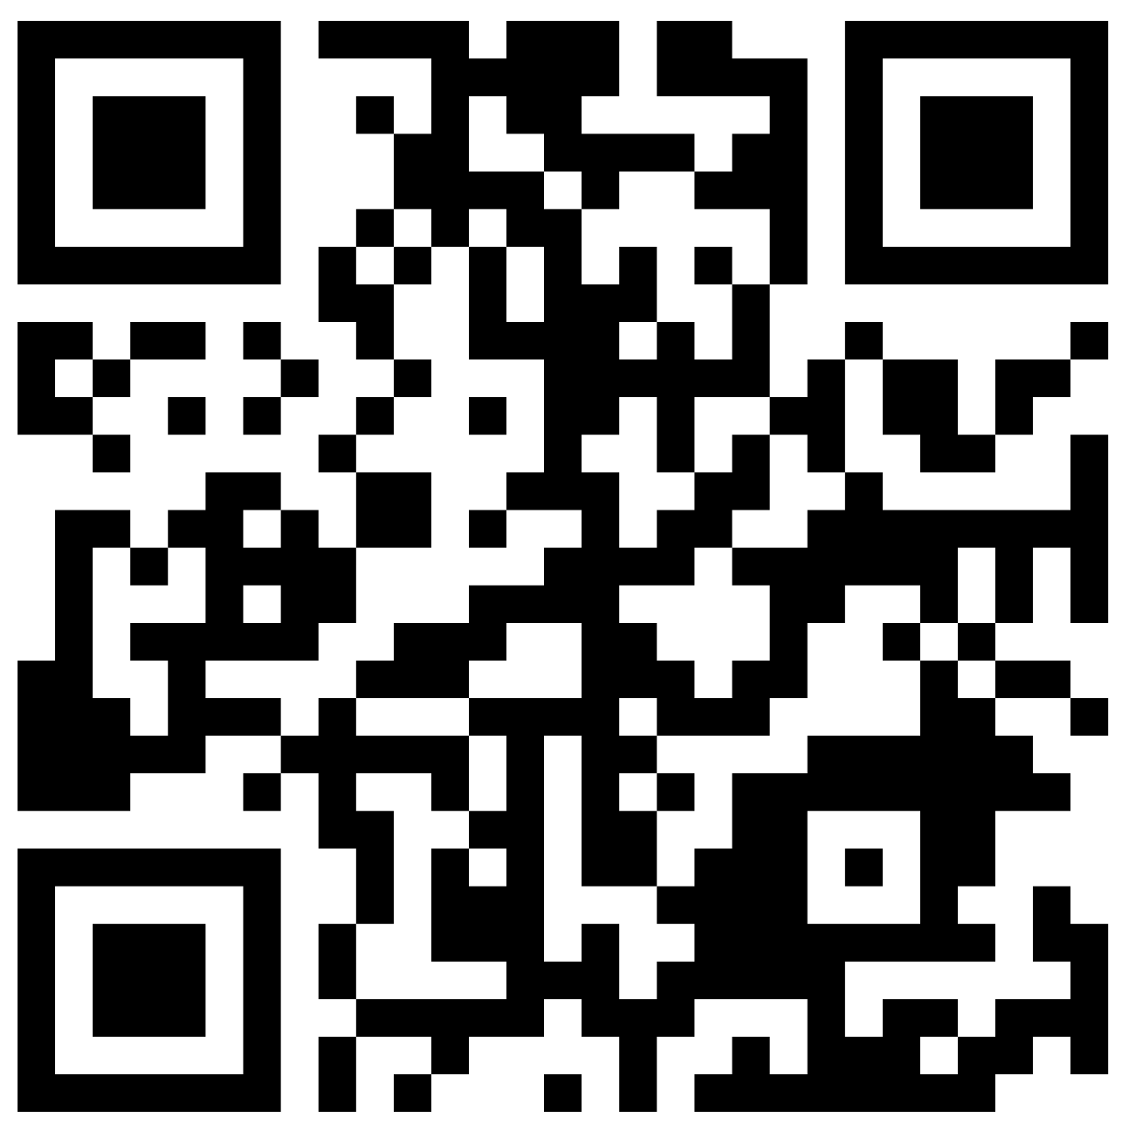
LECTURE 1:
INTRODUCTION TO FORMAL METHODS
857647

Slide 4
Lecture 1 Overview
What are Formal Methods?
Historical Context & Motivation
Types of Formal Methods
Industry Applications
Learning Objectives:
Define formal methods and their role in systems engineering
Identify when formal methods are appropriate to use
Classify different types of formal methods

Slide 5
Why Formal Methods?
Formal Methods = Design it right, not just test it later.
turn uncertainty into proof
Software is everywhere: from AI to aerospace, errors can be catastrophic
Traditional testing ≠ enough: can only show presence, not absence of bugs
Ambiguous requirements → Precise, mathematical specifications
Hidden design errors → Early detection via proofs & formal analysis
Complex AI systems → Rigorous reasoning about safety & security
Informal Spec
Formal model
Verified System
Formal methods = mathematical confidence in correctness

Slide 6
What are Formal Methods?
Formal methods are mathematically rigorous techniques for the specification, development, and verification of
software and hardware systems.
Key Characteristics:
Mathematical Foundation: Based on mathematical logic, set theory, and discrete mathematics
Precision: Eliminate ambiguity through precise mathematical notation
Rigor: Enable mathematical reasoning about system properties
Tool Support: Automated analysis and verification capabilities
Informal vs Formal Methods:
Informal: Natural language requirements → Ambiguous interpretations → Manual review and testing → Error detection during testing
Formal: Mathematical specifications → Precise, unambiguous meaning → Mathematical proof and verification → Error prevention during design

Slide 7
Formal Modelling vs Programming
Formal modelling helps ensure the design is correct before writing any code.
Formal modelling: “Prove it.”
Programming: “Make it run.”
Formal Modelling | Programming
Focuses on what the system should do | Focuses on how to implement it
Abstract, high-level representation | Concrete, low-level instructions to a computer
Uses mathematical notation (e.g., sets, logic, invariants) | Uses executable programming languages (e.g., Python, C, Java)
Detects design errors early (before coding) | Errors often discovered later (testing/debugging)
Prioritizes correctness, consistency, and safety | Prioritizes functionality and performance
Tool support: proof, model-checking, animation | Tool support: compilers, debuggers, test frameworks

Slide 8

Informal - Semi-Formal - Formal
Let's think and reflect

Slide 9
Historical Context & Famous Failures
Software Crisis of 1960s-70s:
Problem: Projects consistently over budget, late, unreliable
NATO Conference (1968): Coined "software engineering"
Response: Need for more rigorous development methods
Costly Software Failures:
1994 - Intel Pentium: Floating-point division bug ($475 million recall)
1996 - Ariane 5: Integer overflow in guidance ($370 million rocket destroyed)
1999 - Mars Climate Orbiter: Unit conversion error ($125 million spacecraft lost)
2003 - Northeast Blackout: Race condition in alarm system (55 million people affected)
Notes:
The term "software engineering" was popularized by the 1968 NATO Software Engineering Conference in Garmisch, Germany, which was held to address the "software crisis"

Slide 10
Types of Formal Methods
Specification Methods:
Z Notation: Set theory, predicate logic → Data-intensive systems → Z/EVES, CZT
B Method: Set theory, refinement → Sequential systems → Atelier B, ProB
Event-B: Set theory, events → Distributed/concurrent systems → Rodin Platform
VDM: Model-based specification → Sequential systems → VDMTools, Overture
CSP: Process algebra → Concurrent systems → FDR, PAT
TLA+: Temporal logic, set theory → Distributed systems → TLC, TLAPS
Verification Methods:
Model Checking: Automatically explores all possible system states to ensure no bad behavior can occur → Exhaustive state space exploration
Theorem Proving: Interactive proof construction: uses mathematical logic and proofs (often with human guidance, Interactive) to show a system always meets its specification.
Static Analysis: Analyzes source code without running it to find potential bugs and vulnerabilities.
Runtime Verification: Monitors a running system to ensure its behavior matches expected properties during execution.

Slide 11
When to Use Formal Methods
Strong Candidates:
Safety-critical systems: Lives depend on correctness
Security-critical systems: High-value assets to protect
High-cost failures: Financial impact of bugs is severe
Regulatory requirements: Standards mandate formal methods
Complex concurrent systems: Race conditions possible
Cost-Benefit Analysis:
Learning curve: High initial training effort → pays off through fewer defects and rework
Tooling Costs: Licensing investment → typically positive ROI in high-assurance domains
Specification Effort: Requires upfront rigor → yields clearer requirements and fewer design errors
Maintenance: Moderate ongoing effort → improved system maintainability
Notes:
Poor Candidates:
Prototype systems: Requirements evolving rapidly
Simple applications: Low complexity, low risk
Short-term projects: Cost exceeds benefits
UI/UX focused: User experience is primary concern

Slide 12

When to use Formal Methods (FM)
Let's think and reflect

Slide 13
Industry Applications
Aerospace & Defense:
Flight Control Systems: Airbus A380 uses SCADE
Avionics Software: DO-333 recommends formal methods for Level A
Satellite Systems: NASA uses formal verification
Military Systems: Cryptographic protocols
Transportation:
Paris Metro Line 14: Event-B for automatic train control
Railway Signaling: B Method for interlocking systems
Automotive: ISO 26262 promotes formal methods
Medical Devices:
Pacemakers: Boston Scientific uses formal verification
Insulin Pumps: FDA encourages formal methods
Radiation Therapy: Post-Therac-25 requirements
Success Story - Paris Metro Line 14:
Event-B for Automatic Train Operation system
Zero safety incidents since 1998

Slide 14
Summery
What is a Formal Method (FM):
mathematical techniques to specify and verify sw and hw systems
Why FM:
earlier bug detection
When FM:
Safety-critical and Security-critical Systems
Types of FM:
Z, B, Event-B, CPS, TLA, …
  Systems Engineering Principles and Practice, Alexander Kossiakoff et. al., 2011
  Modeling in Event-B: System and Software Engineering
  by Jean-Raymond Abrial, 2010
Let’s read and explore

