Slide 1
AICE2005 - Systematic Design
Formal Specification and Verification
Asieh Salehi Fathabadi
University of Southampton
2025-2026

Slide 2
Course Introduction
Lecture 1: Introduction to Formal Methods
Lecture 2: Formal Specification Techniques
Lecture 3: Mathematical Foundations
Lecture 4: Formal Verification Methods
Lecture 5: Tools and Applications

Slide 3

LECTURE 3:
Mathematical Foundations
369272

Slide 4
Lecture 3 Overview
Review & Mathematical Foundations (Bank case study)
Set Theory & Relations
Logic Foundations
Temporal Logic
Learning Objectives:
Apply set theory operations in formal specifications
Construct logical formulas using first order logic
Understand mathematical foundations underlying Event-B

Slide 5
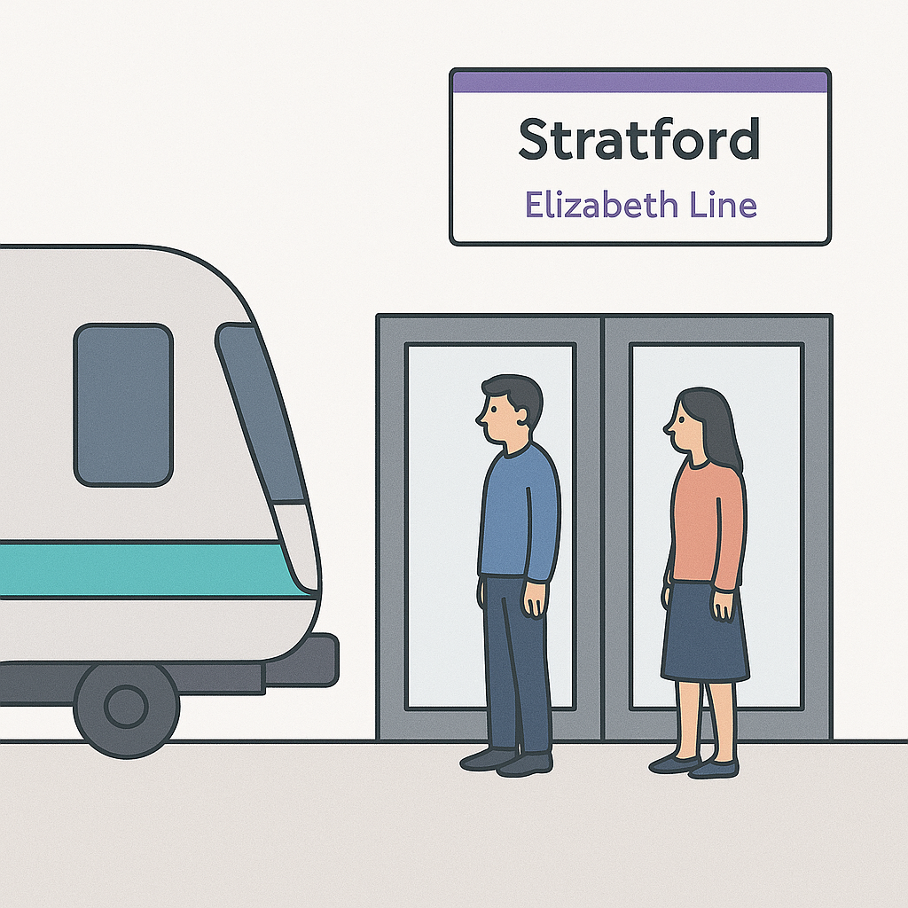
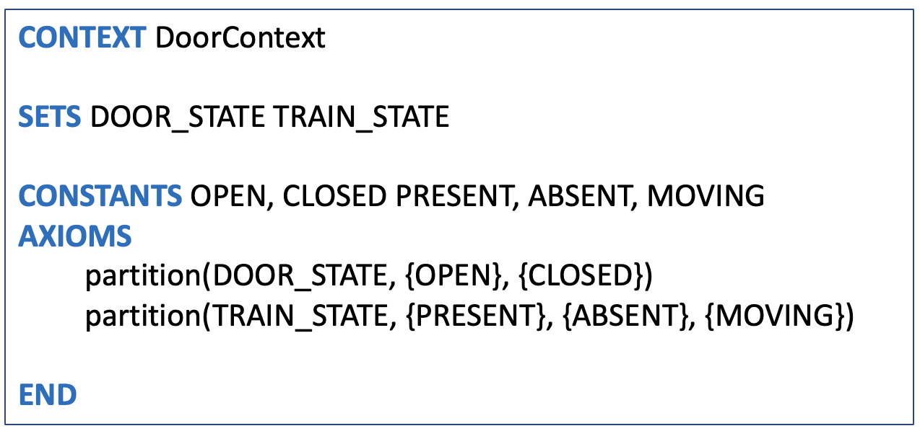
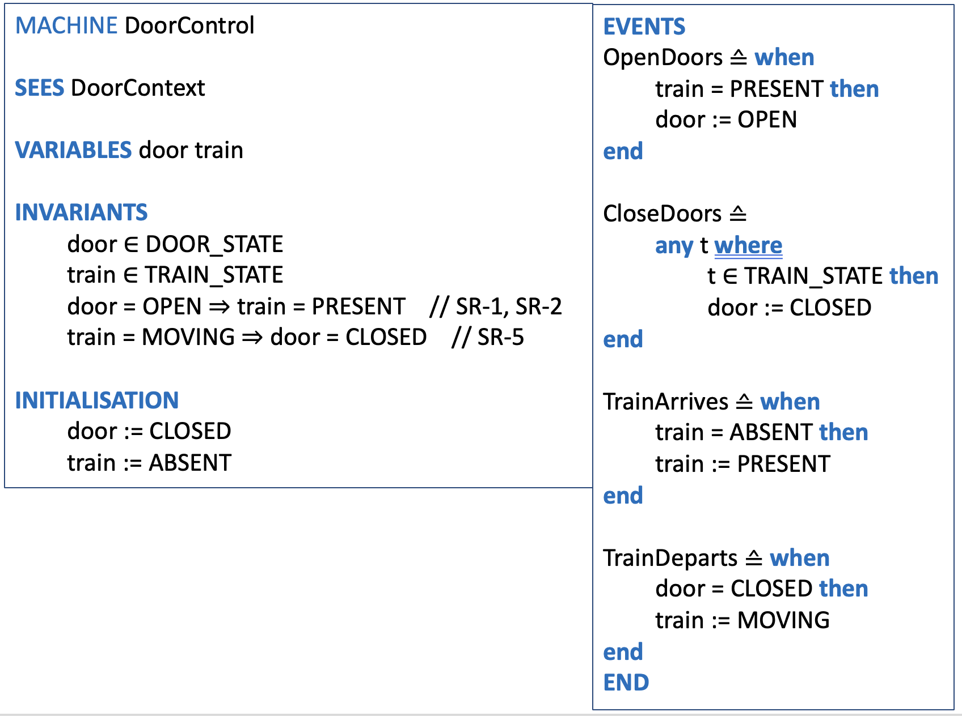
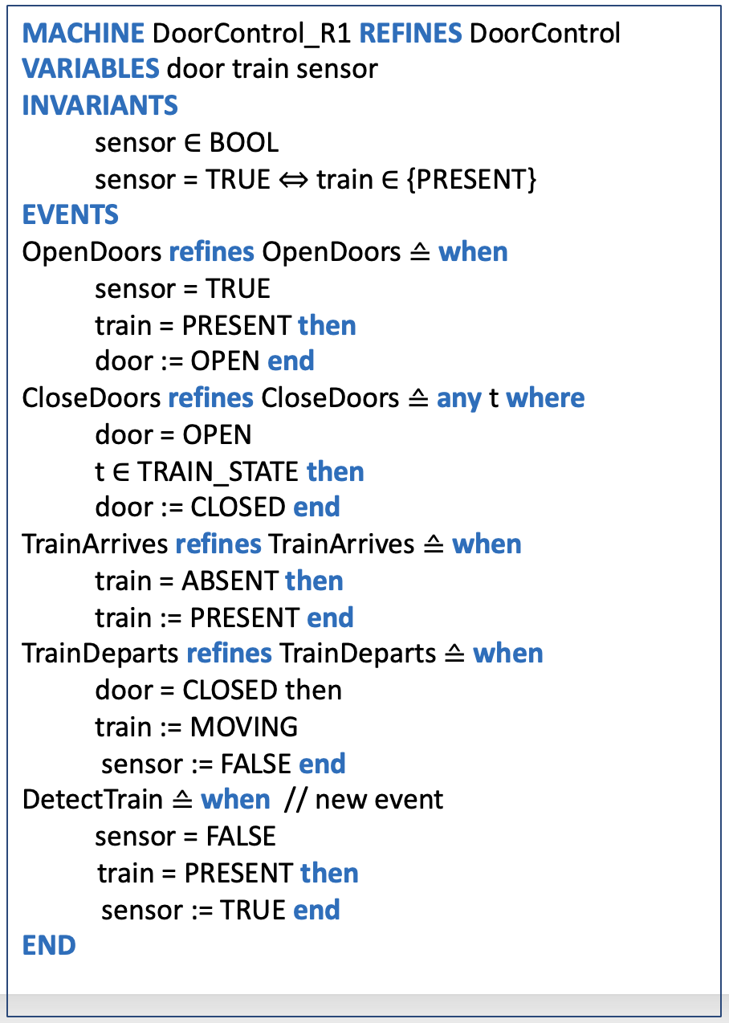
Recap: Safety Requirements and
Event-B Specification
Safety Requirement identification
Safety properties specification
First Event-B model construction
Platform Screen Door Control System
  System Goal:
  Ensure passenger safety at station platforms.
* The figure is guided AI-generated

Slide 6
Set Theory Fundamentals
Basic Set Operations:
Union: A ∪ B = {x | x ∈ A ∨ x ∈ B}
Example: {1,2} ∪ {2,3} = {1,2,3}
Intersection: A ∩ B = {x | x ∈ A ∧ x ∈ B}
Example: {1,2} ∩ {2,3} = {2}
Difference: A \ B = {x | x ∈ A ∧ x ∉ B}
Example: {1,2,3} \ {2} = {1,3}
Power Set: ℙ(A) = {S | S ⊆ A}
Example: ℙ({1,2}) = {∅, {1}, {2}, {1,2}}

Slide 7
Set Theory Fundamentals
Relations and Functions:
Relation: R ⊆ A × B (subset of Cartesian product)
Domain: dom(R) = {a | ∃b • (a,b) ∈ R}
Range: ran(R) = {b | ∃a • (a,b) ∈ R}
Function: Relation where each input maps to exactly one output
B/Event-B Relation Types:
Relation: A ↔ B | Any relation from A to B
Partial Function: A ⇸ B | Each input maps to at most one output
Total Function: A → B | Each input maps to exactly one output
Injection: A ↣ B | One-to-one mapping
Surjection: A ↠ B | Onto mapping
Bijection: A ⤖ B | One-to-one and onto

Slide 8

Set Theory Exercise
Let's think and reflect
Given
enrolled = { (alice, math), (bob, math), (charlie, chemistry) }
Find
dom(enrolled) = ?
ran(enrolled) = ?

Slide 9

Function Types Exercise
Let's think and reflect
Given
Fill with Yes or No
A = { 1, 2, 3 }
B = { x, y, z }
Q1: { 1→x, 2→y }
Q2: { 1→x, 2→x, 3→x }
Q3: { 1→x, 1→y }
Q4: { 1→x, 2→y, 3→z }
Question | Function | Total | Injective | Surjective | Bijective
Q1 | ? | ? | ? | ? | ?
Q2 | ? | ? | ? | ? | ?
Q3 | ? | ? | ? | ? | ?
Q4 | ? | ? | ? | ? | ?

Slide 10
Relations in Formal Specifications
Set Comprehension in B/Event-B:
-- General form: {expression | predicate}
{x² | x ∈ ℕ ∧ x < 5} = {0, 1, 4, 9, 16}
-- Set operations in Event-B context
valid_accounts = {acc | acc ∈ ACCOUNT ∧ balance(acc) ≥ 0}
Relational Operations:
-- Relational composition (R ; S)
parent = { (john, mary), (mary, susan) }
grandparent = parent ; parent = { (john, susan) }
-- Relational inverse (R⁻¹)
teaches = { (prof_smith, math), (prof_jones, physics) }
taught_by = teaches⁻¹ = { (math, prof_smith), (physics, prof_jones) }
-- Domain/Range restriction
R ◁ S = { (x,y) | (x,y) ∈ R ∧ x ∈ S } -- Domain restriction
R ▷ S = { (x,y) | (x,y) ∈ R ∧ y ∈ S } -- Range restriction
Notes:
The set of x squared such that x is a natural number and x is less than 5.”
R composed with S

Slide 11

Relations Exercise
Let's think and reflect
Given
accounts = {acc1, acc2, acc3}
customers = {alice, bob, charlie}
owns = {alice ↦ acc1, alice ↦ acc2, bob ↦ acc3}
balance = {acc1 ↦ 1000, acc2 ↦ 500, acc3 ↦ 2000}
Find
Customers balance relation ?
Customers with account balance less than 1500 ?

Slide 12
Logic Foundations
Propositional Logic in Formal Methods:
Negation: ¬P | not P | True when P is false
Conjunction: P ∧ Q | P & Q | True when both P and Q are true
Disjunction: P ∨ Q | P or Q | True when P or Q (or both) true
Implication: P → Q | P ⇒ Q | False only when P true and Q false
Equivalence: P ↔ Q | P ⇔ Q | True when P and Q same truth value
Predicate Logic in B/Event-B:
Universal:
∀x • P(x) | ∀x·(x ∈ S ⇒ P(x)) | For all x in S, P(x)
Existential:
∃x • P(x) | ∃x·(x ∈ S ∧ P(x)) | Exists x in S such that P(x)

Slide 13
Logic Example
-- Banking system invariants
∀acc· ( acc ∈ accounts ⇒ balance(acc) ≥ overdraft_limit(acc) )
∃mgr· (mgr ∈ managers ∧ responsible_for(mgr, accounts) )
card ∈ accepted_cards ⇒ valid_pin_entered = TRUE
-- Event guards using logic
ANY customer, account WHERE
customer ∈ customers ∧
account ∈ accounts ∧
owns(customer, account) ∧
balance(account) ≥ amount
THEN
balance := balance <+ {account ↦ (balance(account) - amount)}
END

Slide 14

Logic Exercise
Let's think and reflect
Context
SETS
CUSTOMERS
ACCOUNTS
Machine
VARIABLES
customers
accounts
owns
balance
INVARIANTS
inv1: customers ⊆ CUSTOMERS
inv2: accounts ⊆ ACCOUNTS
inv3: owns ⊆ customers × accounts
inv4: balance ∈ accounts → ℤ
Invariant specifying
"Every customer owns at least one account"
?
Invariant specifying
"No account can have negative balance"
?

Slide 15
Linear Temporal Logic (LTL)
Why Temporal Logic?
Static Logic Limitation: Classical logic describes single states
Dynamic Systems: Real systems change over time through events
Temporal Properties: "Eventually," "always," "until," "next"
Event-B Connection: Events cause state transitions
LTL Operators:
Next: ○φ | φ holds after next event
○(balance > 0)
Eventually: ◊φ | φ will hold after some events
◊(transaction_complete)
Always: □φ | φ holds after all event sequences
□(balance ≥ overdraft_limit)
Until: φ U ψ | φ holds until ψ becomes true
authenticating U authenticated

Slide 16
LTL Examples
Safety Properties ("Bad things never happen")
-- Mutual exclusion in concurrent ATM access
□(¬(atm1_processing ∧ atm2_processing ∧ same_account))
-- Account balance never goes below limit
□(∀acc·(acc ∈ accounts ⇒ balance(acc) ≥ overdraft_limit(acc)))
-- System security
□(sensitive_operation ⇒ authenticated)
Liveness Properties ("Good things eventually happen")
-- Every transaction request eventually completes
□(transaction_requested → ◊transaction_completed)
-- Every authentication attempt gets response
□(pin_entered → ◊(authenticated ∨ authentication_failed))
-- System progress
□(session_started → ◊session_ended)

Slide 17
Summery
Overview of Set theory
Overview of Logic
Overview of Linear Temporal Logic
Application of set theory and logic in formal specification
  Modeling in Event-B: System and Software Engineering
  by Jean-Raymond Abrial
Let’s read and explore

