Slide 1
AICE2005 - Systematic Design
Formal Specification and Verification
Asieh Salehi Fathabadi
University of Southampton
2025-2026

Slide 2
Course Introduction
Lecture 1: Introduction to Formal Methods
Lecture 2: Formal Specification Techniques
Lecture 3: Mathematical Foundations
Lecture 4: Formal Verification Methods
Lecture 5: Tools and Applications

Slide 3
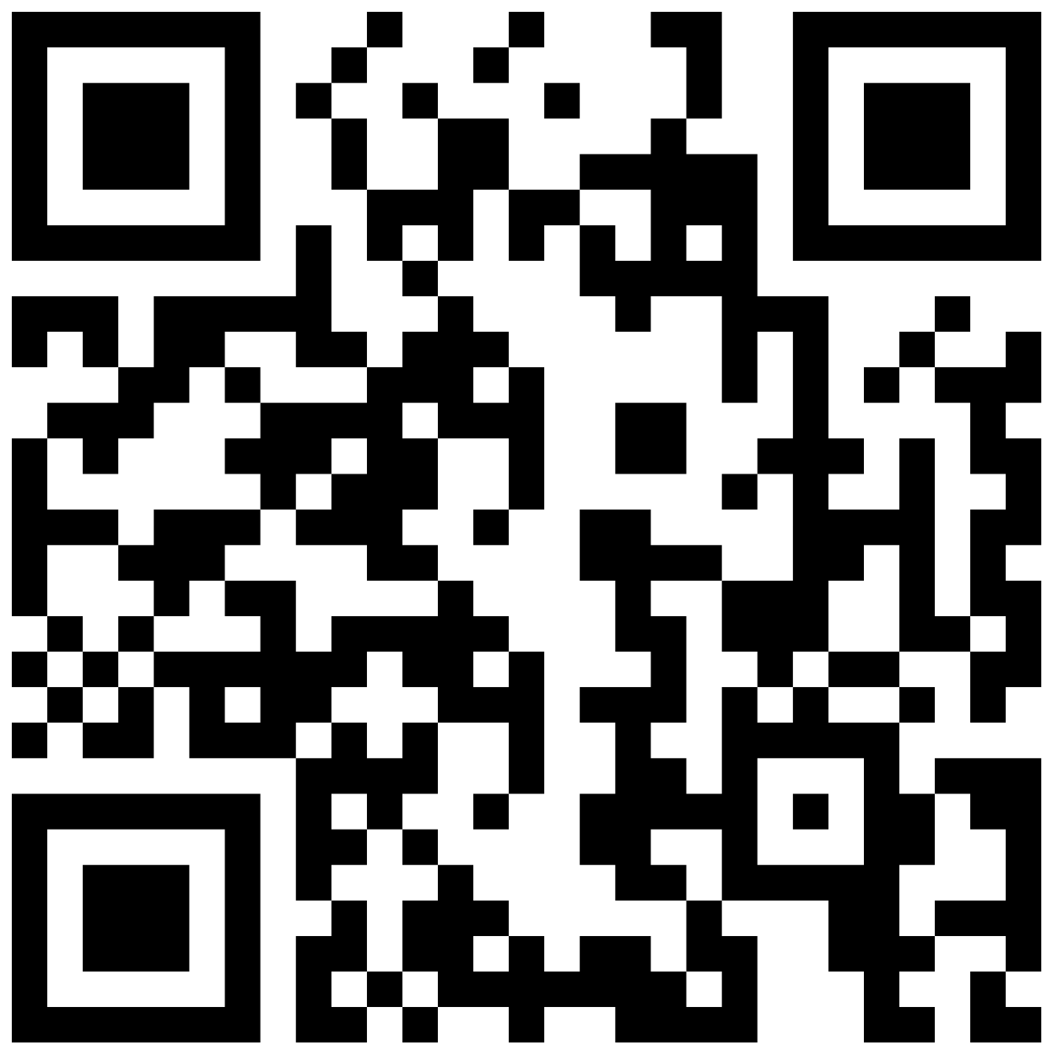
LECTURE 4:
Formal Verification Methods
467636

Slide 4
Lecture 4 Overview
Verification Overview
V & V : Validation and Verification
Model Checking and Animation
Theorem Proving and Proof Obligations (Event-B focus)
Learning Objectives:
Understand model checking process and limitations
Understand the role of animation in validation
Apply proof obligation techniques in Event-B

Slide 5
Recap: Set theory and Logic Foundation
Basic Set Operations:
Union: A ∪ B, Intersection: A ∩ B Difference: A \ B Power Set: ℙ(A)
Relations and Functions:
Total Relation: A ↔ B, Partial Function: A ⇸ B, Injection: A ↣ B, Surjection: A ↠ B, Bijection: A ⤖ B
Logic Foundation:
Negation: ¬, Conjunction: P ∧ Q, Disjunction: P ∨ Q, Implication: P → Q, Equivalence: P ↔ Q
Universal: ∀x, Existential: ∃x
Linear Temporal Logic (LTL):
Next: ○φ, Eventually: ◊φ, Always: □, Until: φ U

Slide 6
What is Formal Verification?
Formal verification is the use of mathematical methods to
prove or disprove the correctness of a system with respect to its specification.
Verification vs Validation
Verification: "Are we building the System right?"
  Mathematical correctness
  Formal proofs
Validation: "Are we building the right system?"
  Stakeholder requirements satisfaction
  User acceptance, testing

Slide 7
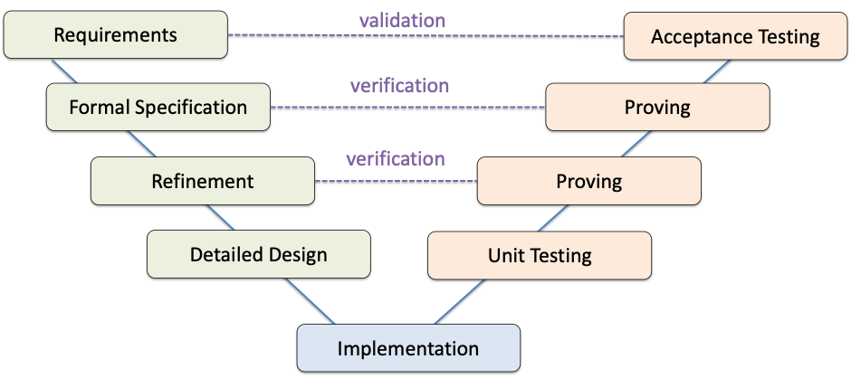
Verification & Validation
V & V

Slide 8
Model Checking for Verification
Purpose: Automatically explore ALL possible states to verify safety properties
What is Model Checking?
Automatic exploration of your formal model where a tool checks ALL possible states to verify that safety properties always hold.
Model Checking for Event-B (ProB):
State Space Exploration: Generate all reachable states
Invariant Checking: Verify invariants hold in all states
Deadlock Detection: Find states with no enabled events
State Explosion Problem:
Consider ATM with multiple cards and accounts:
10 card types × 5 account types × 4 session states × 3 PIN attempt counts = 600 states
Add concurrency: 2 ATMs = 600² = 360,000 states
Mitigation: Use abstraction, limit parameter ranges

Slide 9
Model Checking Example
MACHINE DoorControl
SEES DoorContext
VARIABLES door train
INVARIANTS
door ∈ DOOR_STATE
train ∈ TRAIN_STATE
door = OPEN ⇒ train = PRESENT
train = MOVING ⇒ door = CLOSED
INITIALISATION
door := CLOSED
train := ABSENT
EVENTS
OpenDoors ≙ when
train = PRESENT then
door := OPEN end
CloseDoors ≙ when
door = OPEN then
door := CLOSE end
TrainArrives ≙ when
train = ABSENT then
train := PRESENT end
TrainDeparts ≙ when
door = CLOSED then
train := MOVING end
TrainContinues ≙ when
train = MOVING then
train := ABSENT end
END
Formal Specification:
SAFETY PROPERTY: ¬(door = OPEN ∧ train = MOVING)
Model Checker explores ALL possible state sequences:
State 1: door=CLOSED, train=ABSENT ✓
↓ [TrainArrives]
State 2: door=CLOSED, train=PRESENT ✓
↓ [OpenDoors]
State 3: door=OPEN, train=PRESENT ✓
↓ [CloseDoors]
State 4: door=CLOSED, train=PRESENT ✓
↓ [TrainDeparts]
State 5: door=CLOSED, train=MOVING ✓
↓ [TrainContinues]
State 5: door=CLOSED, train=ABSENT ✓
Model Checker Result: ✓ Safety PROPERTY HOLDS

Slide 10
Model Checking Example
MACHINE DoorControl
SEES DoorContext
VARIABLES door train
INVARIANTS
door ∈ DOOR_STATE
train ∈ TRAIN_STATE
door = OPEN ⇒ train = PRESENT
train = MOVING ⇒ door = CLOSED
INITIALISATION
door := CLOSED
train := ABSENT
EVENTS
OpenDoors ≙ when
train = PRESENT then
door := OPEN end
TrainArrives ≙ when
train = ABSENT then
train := PRESENT end
TrainDeparts ≙ when
door = CLOSED then
train := MOVING end
TrainContinues ≙ when
train = MOVING then
train := ABSENT end
END
BUGGY MODEL (With Deadlock)
Bug: CloseDoors Event Missing
Deadlock Scenario:
State 1: door=CLOSED, train=ABSENT ✓
↓ [TrainArrives]
State 2: door=CLOSED, train=PRESENT ✓
↓ [OpenDoors]
State 3: door=OPEN, train=PRESENT ✓
⚠️ DEADLOCK DETECTED ⚠️
System is stuck! No events can execute!

Slide 11
Animation for Validation
Purpose: Simulate specific scenarios with domain experts to validate requirements
What is Animation?
Interactive simulation of your formal model where you execute events step-by-step to see how the system behaves.
Step | Current State | Expert Action | New State
1 | door=CLOSED train=ABSENT | "Train arrives" → TrainArrives | door=CLOSED train=PRESENT
2 | door=CLOSED train=PRESENT | "Open doors" → OpenDoors | door=OPEN train=PRESENT
3 | door=OPEN train=PRESENT | "Close doors" → CloseDoors | door=CLOSED train=PRESENT
4 | door=CLOSED train=PRESENT | "Train departs" → TrainDeparts | door=CLOSED train=MOVING
Expert: ✓ "Yes! This is exactly how our system operates!"

Slide 12
Proof Obligations in Event-B
What are Proof Obligations?
Proof obligations are mathematical formulas that must be proven to ensure the correctness of Event-B specification.
Well-Definedness (WD): Ensure all expressions are well-defined
(e.g. Division by zero check)
Invariant Preservation (INV): Prove invariants are maintained by all events
Guard Strengthening (GRD): In refinement, concrete guards must imply abstract guards
Action Simulation (SIM): Concrete actions must simulate abstract actions

Slide 13
Proof Obligations Example
Prove that OpenDoors event preserve invariant invx
INVARIANTS
invx: door = OPEN ⇒ train = PRESENT
EVENT
OpenDoors ≙ when
train = PRESENT then
door := OPEN
end
What we know BEFORE the event:
• Invariant holds:
door = OPEN ⇒ train = PRESENT
• Guard: train = PRESENT
What the event does:
• door := OPEN
What we have AFTER the event:
• door' = OPEN (just assigned)
• train' = PRESENT (unchanged)
Check invariant after event:
door' = OPEN ⇒ train' = PRESENT
↓ ↓
TRUE ⇒ TRUE
Result: TRUE ⇒ TRUE = TRUE ✓
WHY IT WORKS:
The guard "train = PRESENT" protects us! We can only open the door when the train is present, so the invariant is always satisfied.
✅ PROOF OBLIGATION DISCHARGED

Slide 14

Industrial Verification Example*
Paris Metro Line 14
Verification Results:
27,800 proof obligations
~90% automatically discharged
Industrial Impact:
Zero Safety Incidents since deployment in 1998
https://www.railwaysignalling.eu/formal-methods-railway-signalling-systems

Slide 15
Best Practice
Event-B Model (Rodin)
↓
Proof Obligations → Automatic Provers → Interactive Proofs
↓
Animation (ProB) → Stakeholder Validation → Model Refinement
↓
Model Checking (ProB) → Deadlock Detection → Safety Property Verification
Start Abstract: Begin with high-level model, refine gradually
Prove Incrementally: Discharge proof obligations at each refinement step
Animate Early: Validate with stakeholders before detailed refinement
Check Properties: Use model checking for complex properties

Slide 16
Summery
Validation vs Veirificaiton
  Building the right system - Building the system Right
Model Checking for verification
  Explore all possible state to check safety properties
Animation for validation
  Validate specific scenario with doamin expert
Proof Obligations
  Theorem proving in Event-B
  Modeling in Event-B: System and Software Engineering
  by Jean-Raymond Abrial
Let’s read and explore

