Slide 1
AICE2005 - Systematic Design
Formal Specification and Verification
Asieh Salehi Fathabadi
University of Southampton
2025-2026

Slide 2
Course Introduction
Lecture 1: Introduction to Formal Methods
Lecture 2: Formal Specification Techniques
Lecture 3: Mathematical Foundations
Lecture 4: Formal Verification Methods
Lecture 5: Tools and Applications

Slide 3
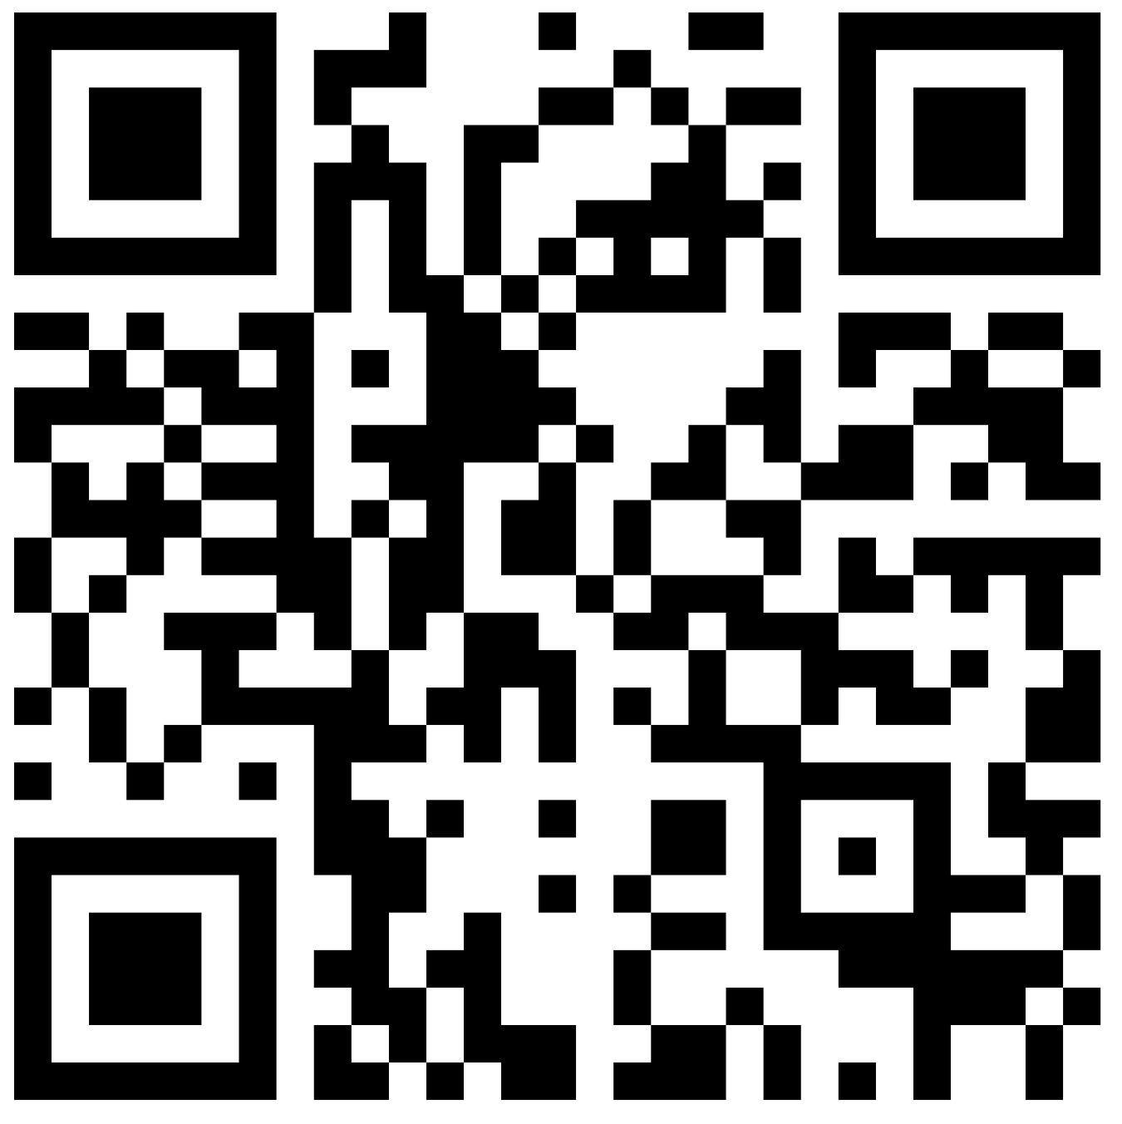
LECTURE 5:
Tools and Applications
266001

Slide 4
Lecture 5 Overview
Tool Landscape Overview
B/Event-B Tools (Rodin Platform, ProB, Atelier B)
Event-B Case Study (Automatic Level Crossing)
Course Summary and Assessment
Learning Objectives:
Apply Event-B to simple realistic system modeling
Understand industrial integration practices

Slide 5
Recap: Verificarion and Validation
Validation vs Veirificaiton
  Building the right system - Building the system Right
Model Checking for verification
  Explore all possible state to check safety properties
Animation for validation
  Validate specific scenario with doamin expert
Proof Obligations
  Theorem proving in Event-B

Slide 6
Event-B Tool Ecosystem
Rodin Platform (Event-B):
Type: Eclipse-based IDE for Event-B
Features: Modeling, proof management, refinement support
Provers: Automatic (PP, ML), Interactive (manual proof)
Extensions: ProB integration, code generation, documentation
Key Rodin Features:
Event-B Editor: Model creation and editing | Syntax checking
Proof Obligation View: Track proof progress | Visual proof status, statistics
Prover UI: Interactive theorem proving | Step-by-step proof construction
Refinement Support: Multi-level development | Automatic refinement checking

Slide 7
Event-B Tool Ecosystem
ProB (Model Checker and Animator):
Animation: Interactive model exploration
Model Checking: Automatic verification of properties
Atelier B (Classical B Method):
Focus: Industrial B Method development
Strengths: Mature tool, proven track record
Applications: Safety-critical systems (railway, avionics)

Slide 8
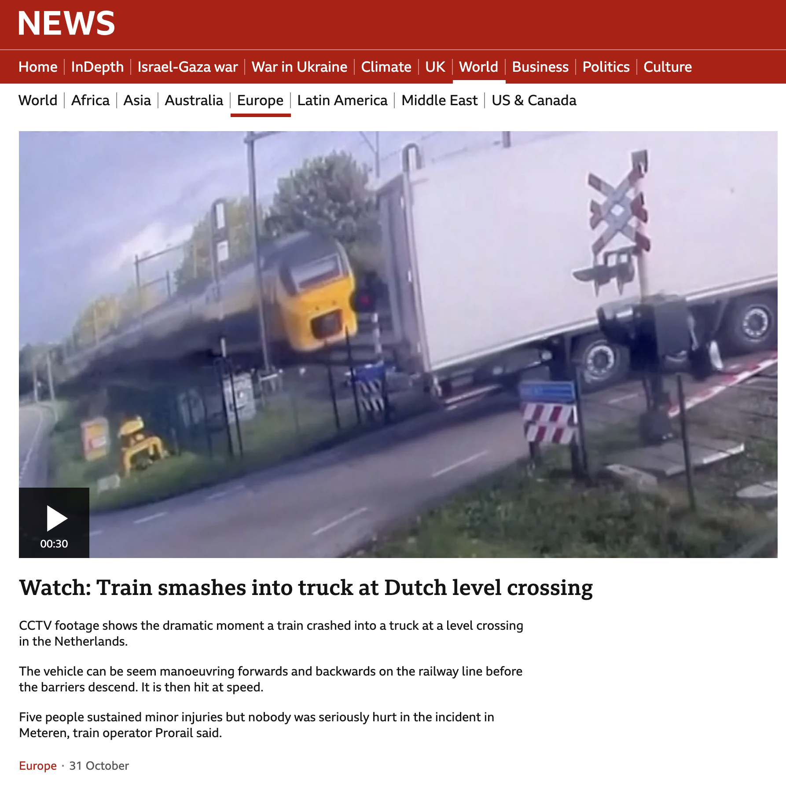
https://www.bbc.co.uk/news/videos/ced65d0gl2eo?app-referrer=search

Slide 9
Automatic Level Crossing Control System
System Description
A railway level crossing protects road users from trains by lowering barriers when a train is approaching and raising them after the train passes. The system includes:
Train sensors (detect train state)
Barriers (open or closed)
Signal lights (green for cars to pass, red when barrier closed)
Controller (manages synchronization)
Identify Safety Requirements
Let's think and reflect
ID | Safety Requirement | Meaning
SR1 | Barriers shall be closed whenever a train is near or crossing. | Prevents collisions
SR2 | Barriers shall be open only when no train is detected. | Allows road traffic safely
SR3 | Signal lights must be red whenever barriers are closed. | Warns vehicles
SR4 | System must never have barriers open and train detected simultaneously. | Core invariant safety property

Slide 10
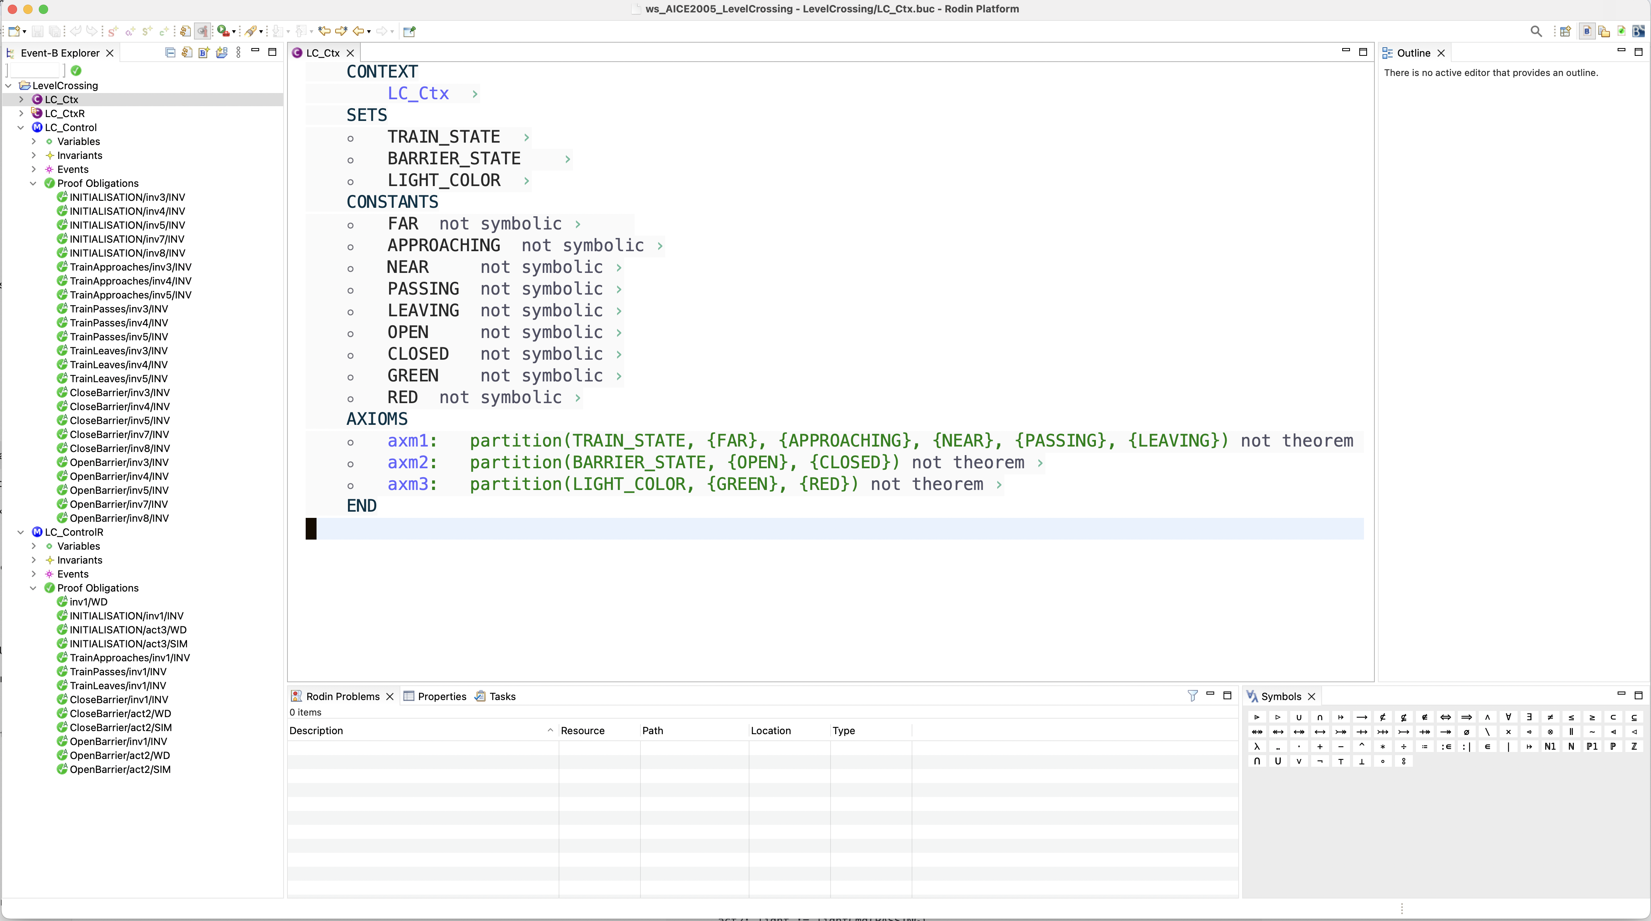
Event-B Model
Rodin tool experience (demo)
Play Here

Slide 11
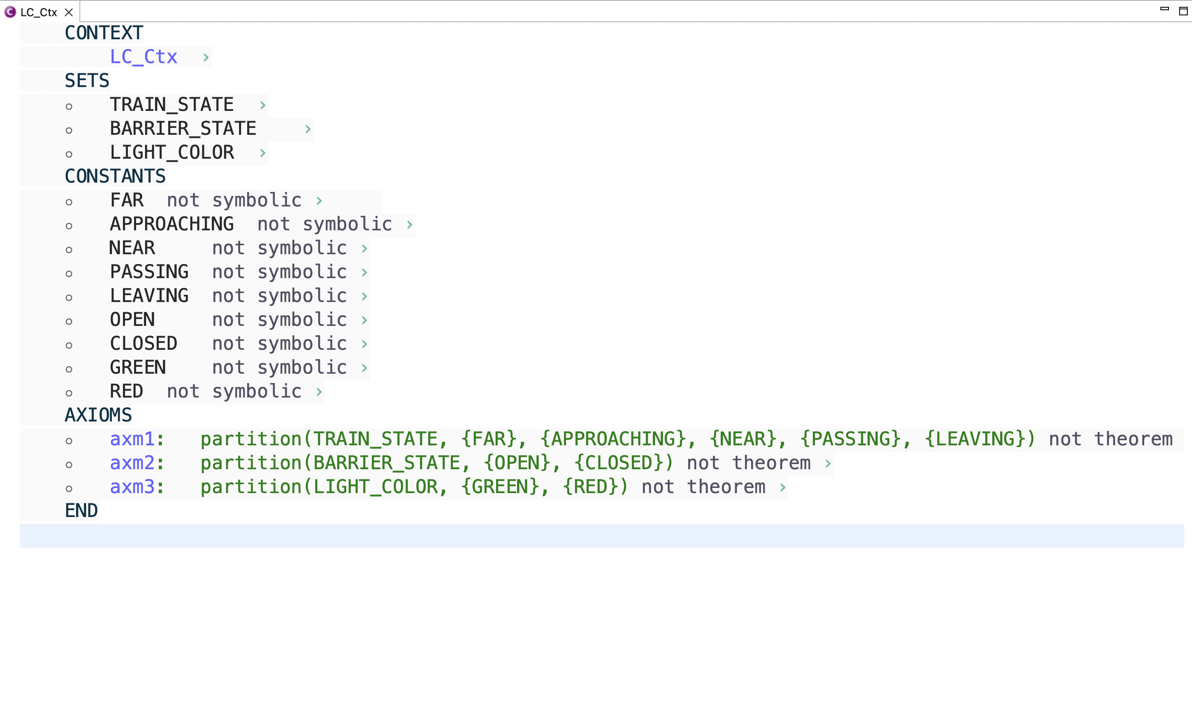

Slide 12
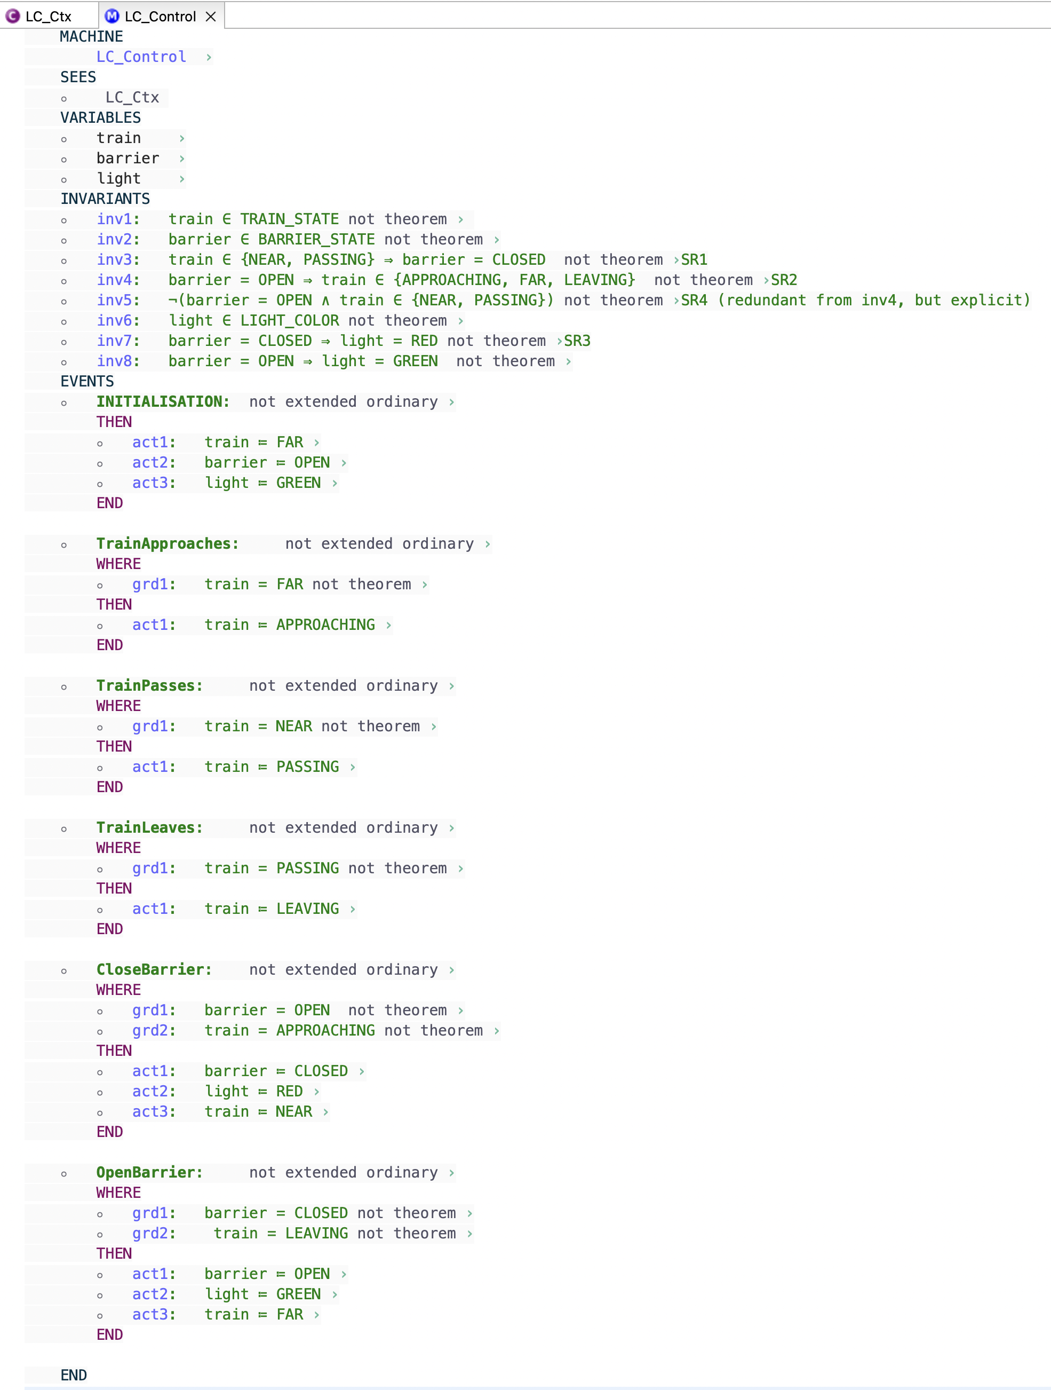

Slide 13
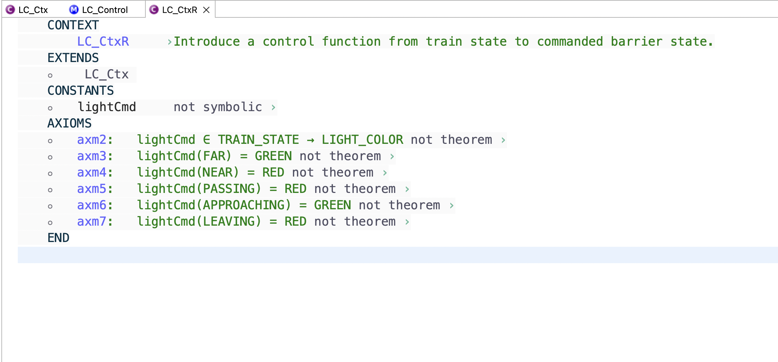

Slide 14
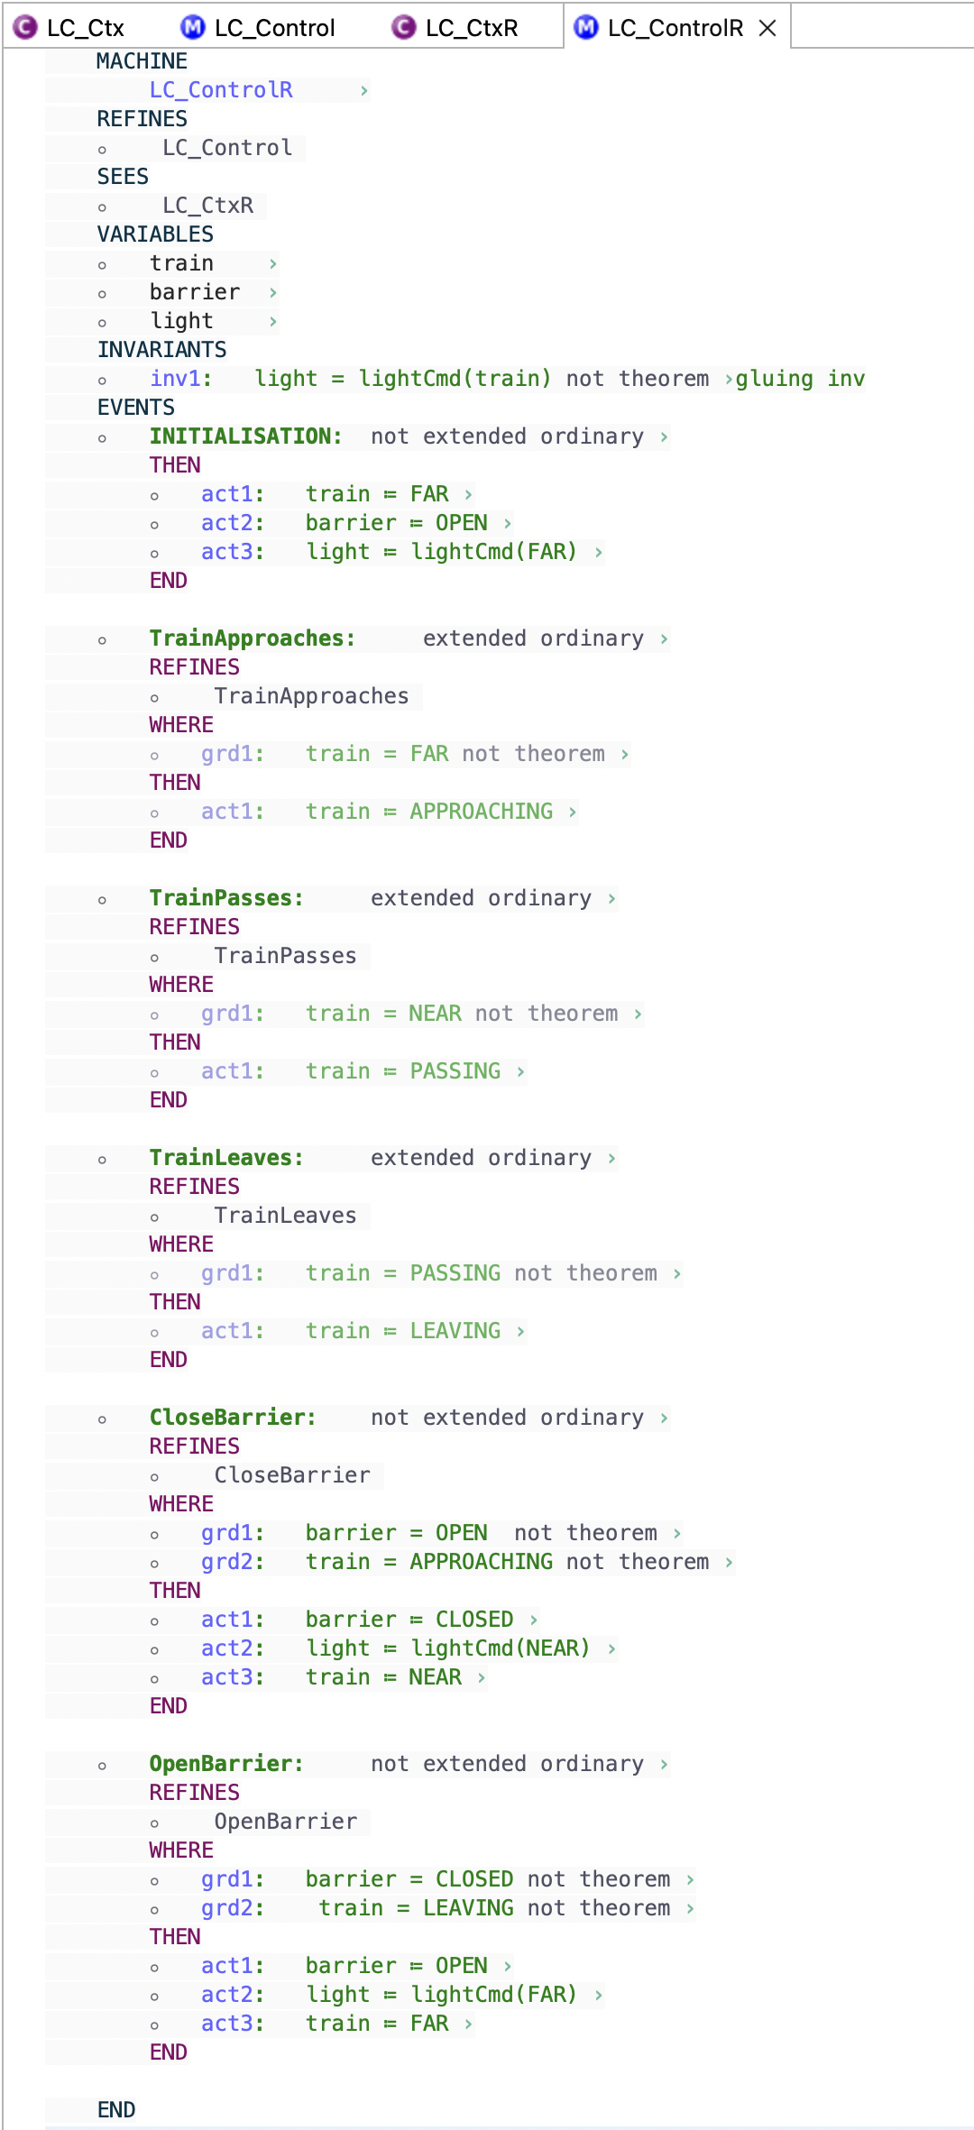

Slide 15
Summery
Event-B tool (Rodin) overview
Automatic Level Crossing Control System:
  Formal modelling and Formal V&V overview
  Modeling in Event-B: System and Software Engineering
  by Jean-Raymond Abrial
  https://wiki.event-b.org/index.php/Main_Page
Let’s read and explore

