Slide 1

Infrastructure as Code
Foundations
Part 2 — From IaC design to automated delivery
SEAtS | 424812

Slide 2
Intended
Learning
By the end of this session you will be able to:
1. Decompose an IaC system into modules with clear, versioned
Outcomes
interfaces.
2. Explain how IaC integrates provider APIs, third-party providers, and
reusable internal IP.
3. Use formal speciﬁcation (schemas, typed variables, policy-as-code)
to make infrastructure enforceable.
4. Plan a testing strategy for IaC, from static analysis to security tests.
5. Design a CI/CD and GitOps pipeline for infrastructure changes.
6. Distinguish provisioning, deployment, orchestration and
conﬁguration management.
7. Identify common IaC risks and anti-patterns and propose mitigations.
2
SEAtS | 424812
© University of Southampton

Slide 3
Agenda
1. Designing IaC systems: modules, interfaces,
providers, third-party IP.
2. Service delivery platform and formal
speciﬁcation.
3. Conﬁguration examples in code.
4. Testing IaC systems.
5. Build systems, CI/CD, GitOps, and managing
development.
6. Provisioning, deployment, orchestration,
conﬁguration management.
7. Risks, anti-patterns, and summary.
3
SEAtS | 424812
© University of Southampton

Slide 4
Designing IaC Systems
Decomposing
Identifying
Designing
Integrating
Managing
into Blocks
Interfaces
APIs &
Providers & IP
Third-Party IP
Protocols
Example module
Interfaces via:
Cloud providers
Version pinning
folders:
Input variables.
IaC interacts with:
(AWS, Azure,
and lifecycle
/networking
Output
Cloud provider
GCP).
management.
/identity
variables.
APIs.
Third-party
Licensing and
/compute
Remote state
Terraform
providers
compliance
references.
provider
(Cloudﬂare,
considerations.
/database
Datadog).
Security
Interfaces must be
schemas.
/monitoring
Internal
scanning of
clear, versioned,
Kubernetes
documented, and
manifests/CRDs
libraries reused
modules/provid
stable.
.
across teams.
ers.
4
SEAtS | 424812
© University of Southampton

Slide 5
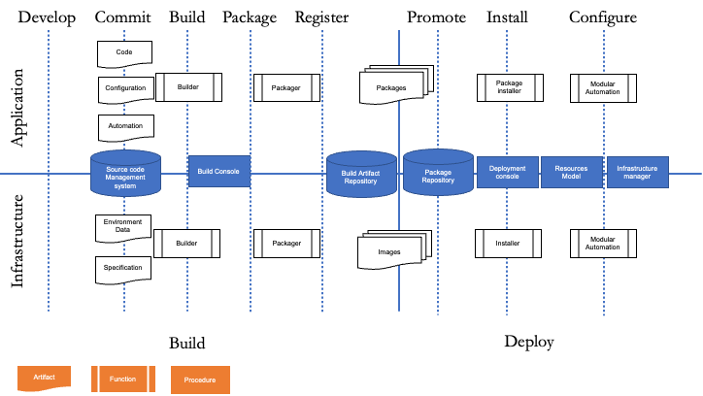
Service Delivery
Platform
Artifact: Versioned,
tested, deployed
units.
Procedures
(Imperative):
Commands to
produce desired state
(e.g., Bash).
Functions
(Declarative): Deﬁne
desired state; tooling
conforms system
(e.g., SQL, makeﬁles).
5
SEAtS | 424812
© University of Southampton

Slide 6
Formal Speciﬁcation in IaC
JSON/YAML schemas (CloudFormation, Kubernetes).
Terraform variable typing and module interfaces.
Policy-as-Code (OPA/Rego) for compliance.
Cloud policies (AWS Conﬁg, Azure Policy) to enforce encryption, logging, segmentation.
Formalisation supports reproducibility and enforcement.
6
SEAtS | 424812
© University of Southampton

Slide 7
YAML Examples
Vagrant.configure("2") do |config|
servers = YAML.load_file('servers.yaml')
config.vm.box = "peru/ubuntu-18.04-desktop-amd64"
Vagrant.configure(VAGRANTFILE_API_VERSION) do |config|
config.vm.box_version = "2.3"
servers.each do |server|
config.vm.provider "virtualbox" do |vb|
config.vm.define server["name"] do |srv|
vb.gui = true
srv.vm.box = server["box"]
vb.memory = "1024"
srv.vm.network "private_network", ip: server["ip"]
vb.name = "ubuntudesktopscyther"
srv.vm.provider :virtualbox do |vb|
end
vb.name = server["name"]
end
vb.memory = server["ram"]
end
end
end
end
7
SEAtS | 424812
© University of Southampton

Slide 8
Testing IaC Systems
Testing types:
1. Static testing (linting: tﬂint, checkov; policy-as-code).
2. Unit tests (Terratest, Molecule).
3. Integration tests (ephemeral deployments).
4. Acceptance tests (VPC routing, IAM permissions).
5. Security tests (CSPM, IaC scanning).
8
SEAtS | 424812
© University of Southampton

Slide 9
Build Systems & CI
Standard Pipeline
Continuous Deployment
Managing
(GitOps)
Development
1. Validate (
terraform validate
).
2. Lint (tﬂint, checkov).
ArgoCD / Flux for declarative
Methodologies: Agile, DevOps,
sync.
GitOps, infrastructure release
3. Plan (static analysis, diﬀs).
management.
4. Approvals (human-in-loop).
Atlantis, Spacelift, Terraform
5. Apply (automated, controlled).
Cloud for collaboration.
Multi-team decomposition,
6. Post-deploy tests (Terratest,
Automated rollbacks based on
module backlogs, environment
smoke tests).
policy drivers.
versioning.
Branch protection, review bots
(tfsec), semantic versioning.
Automated changelogs and
release notes.
9
SEAtS | 424812
© University of Southampton

Slide 10
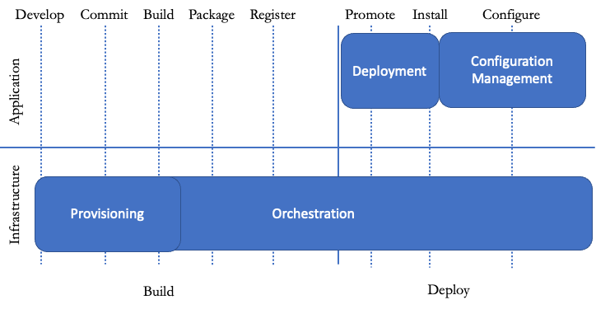
Deployment /
Orchestration
/ CM
Provisioning: Prepare server (hardware, OS,
services, network).
Deployment: Automated app deployment &
upgrades.
Orchestration: Coordinated operations
across systems.
Conﬁguration Management: Maintain app
dependencies.
10
SEAtS | 424812
© University of Southampton

Slide 11
Risks & Anti-Patterns
Conﬁguration drift.
Hard-coded secrets.
Unversioned remote state.
No testing or code reviews.
Monolithic Terraform ﬁles, parallel changes without locking.
Black-box modules with no documentation.
Mitigation: code reviews, state locking, policy-as-code, decomposition.
11
SEAtS | 424812
© University of Southampton

Slide 12
Summary
Decompose infrastructure into modules whose interfaces (inputs, outputs, remote state) are clear,
versioned and stable.
Manage providers and third-party modules with version pinning, licence checks and security scanning.
Formal speciﬁcation (schemas, typed variables, policy-as-code) makes infrastructure reproducible and
enforceable.
Test IaC at every level: static, unit, integration, acceptance and security.
CI/CD pipelines (validate → lint → plan → approve → apply → test) and GitOps keep changes controlled
and auditable.
Mitigate anti-patterns (drift, secrets, unlocked state, monoliths) through reviews, locking, policy-as-
code and decomposition.
12
SEAtS | 424812
© University of Southampton

