Slide 1

Project Management for
Multi-Component Systems
Coordinating work across HW, SW, and people
SEAtS | 834694

Slide 2
Intended
Learning
By the end of this lecture, you will be able to:
Outcomes
1. Apply MoSCoW prioritisation to manage scope and stakeholder
expectations.
2. Use T-shirt sizing for early-stage eﬀort and complexity estimation.
3. Compare agile, stage-gate, and hybrid delivery approaches for multi-
domain projects.
4. Create Gantt and burn-down charts to monitor progress.
5. Integrate systemic design principles to coordinate scheduling,
workload, and feedback loops across subsystems.
2
SEAtS | 834694
© University of Southampton

Slide 3
Agenda
Why Systemic Project Management
Systems Thinking to Planning
MoSCoW Prioritisation
T-shirt Eﬀort Sizing
Agile in Systemic Projects
Scheduling with Gantt Charts
Tracking with Burn-down Charts
Preventing Burnout
Integrated Feedback Ecosystem
Summary
3
SEAtS | 834694
© University of Southampton

Slide 4
Why Systemic Project
Management
Project management in engineering is more than tasks and timelines—it orchestrates interacting
subsystems and the humans who enable them. Traditional linear planning fails when hardware, software,
and testing workstreams depend on each other.
Systemic viewpoint
Projects behave like adaptive systems with feedback loops and emergent risks.
Systemic design combines systems thinking with design thinking to handle this complexity.
4
SEAtS | 834694
© University of Southampton

Slide 5
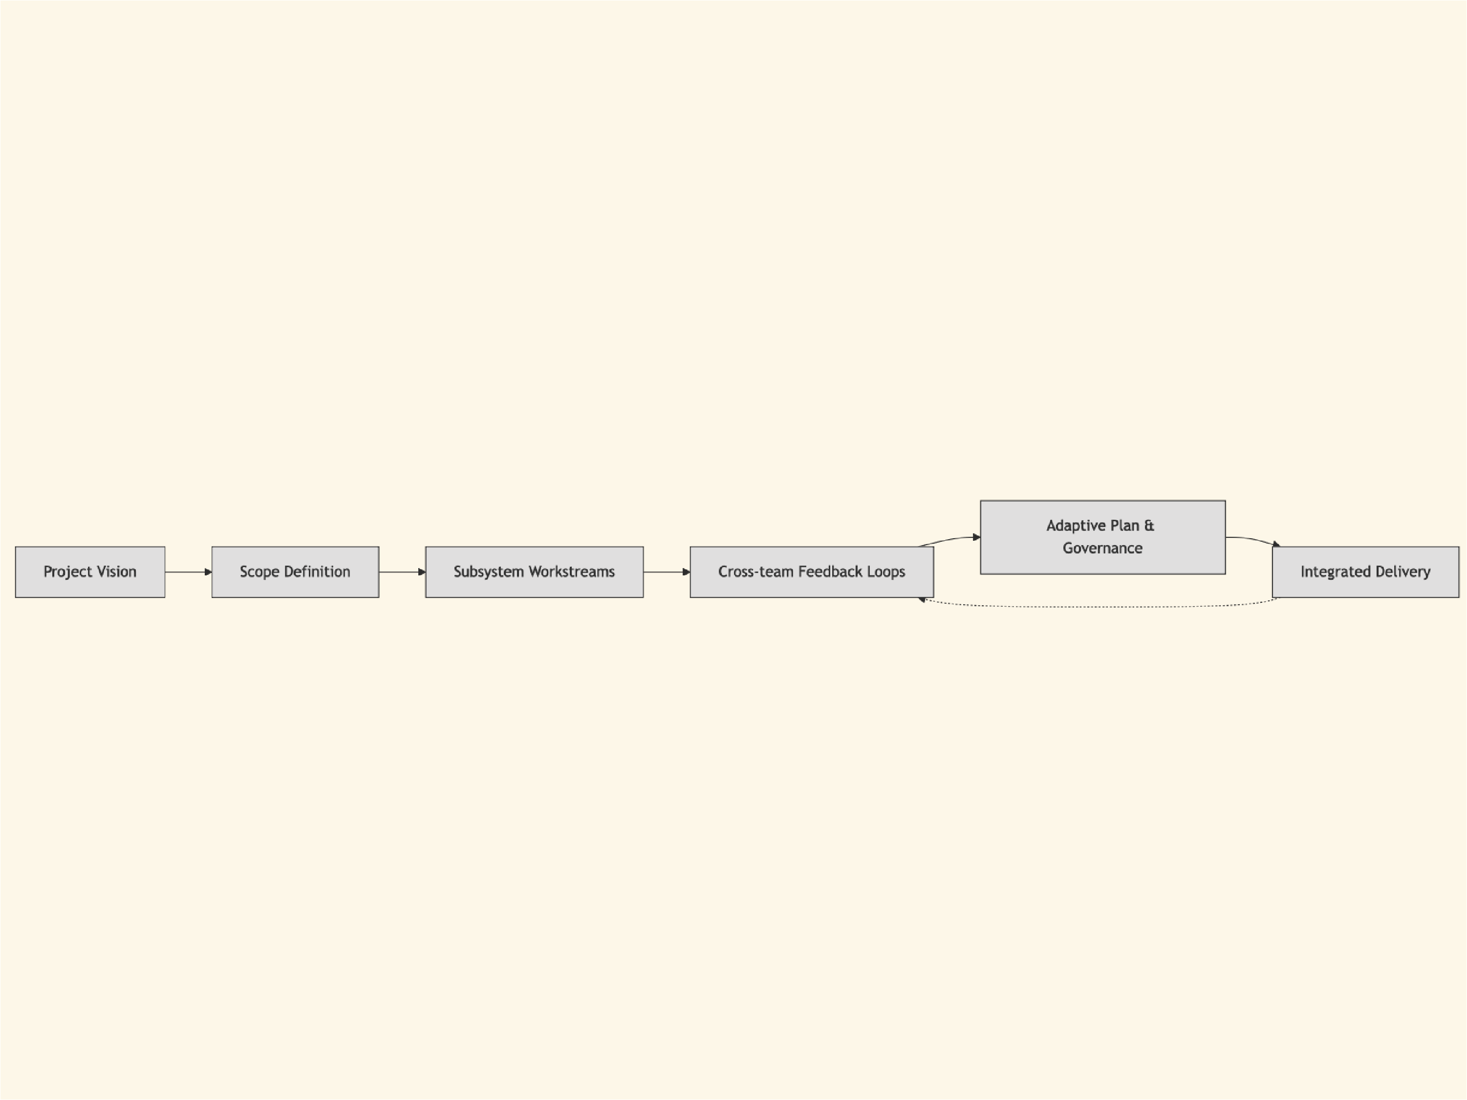
Systemic
project
planning cycles
plans through
continuous
feedback
instead of
ﬁxed
schedules.
5
SEAtS | 834694
© University of Southampton

Slide 6
Systems Thinking to Planning
Systemic design integrates high-level vision with detailed interactions.
Informed decomposition
Feedback-aware planning
Break large optimisation problems so components
View subsystems as nodes in a network.
improve independently yet converge on system
Adjust eﬀort, time, and resources using feedback
goals.
reviews rather than rigid baselines.
Mirrors project work breakdown structures with
feedback milestones.
6
SEAtS | 834694
© University of Southampton

Slide 7
MoSCoW Prioritisation
Not every requirement is equally important; MoSCoW keeps ambitions aligned with limited time and
resources.
Category
Description
Example (Autonomous Drone)
Must-Have
Essential for success
Stable ﬂight control loop
Should-Have
Important but not critical
Auto-return on signal loss
Could-Have
Nice if time permits
Custom mission planner UI
Wonʼt-Have
Explicitly out of scope
Fully autonomous parcel drop
Why it matters
Prevents scope creep and aligns stakeholders.
Systemically manages variety: team eﬀort matches system complexity.
7
SEAtS | 834694
© University of Southampton

Slide 8
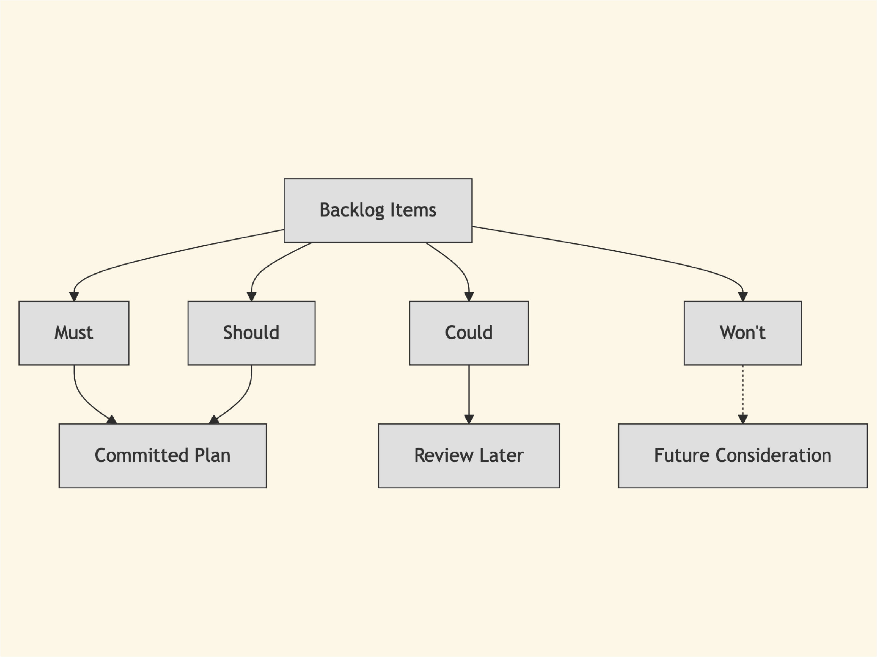
Visualising
MoSCoW
categories
clariﬁes
commitments
versus stretch
goals.
8
SEAtS | 834694
© University of Southampton

Slide 9
T-shirt Eﬀort Sizing
Detailed estimates are unreliable early on; use relative sizing for fast alignment.
Size
Interpretation
Approximate Eﬀort
XS
Trivial task
< 1 day
S
Small module
1–2 days
M
Moderate complexity
3–5 days
L
Complex feature
1–2 weeks
XL
Multi-team, high complexity
> 2 weeks
Subsystem teams (mechanical, software, controls, testing) size their backlogs independently, then
harmonise at integration planning.
Systemic alignment
Relative sizes act like meta-models—fast approximations reﬁned as knowledge grows.
Supports sequencing and capacity planning before detailed scheduling.
9
SEAtS | 834694
© University of Southampton

Slide 10
Agile in Systemic Projects
Deﬁnition: Agile is an iterative, incremental way of delivering value where cross-functional teams pull work
from a prioritised backlog, ship in short cycles, and adapt plans through frequent feedback.
Agile is one option in a spectrum of delivery models; picking the right blend depends on regulatory load,
hardware lead times, and integration cadence.
Approach
Cadence & Structure
Where it shines
Systemic risk when misapplied
Agile / Scrum
1–4 week increments,
Fast-learning domains, software-heavy
Hardware and compliance teams left out,
empirical backlog
subsystems
leading to desynchronised releases
Stage-Gate /
Sequential phases with
Certiﬁable artefacts, long-lead
Late discovery of integration issues; rework
Waterfall
tollgates
procurement
propagates across domains
Hybrid /
High-level gates with agile
Multi-discipline programmes needing
Requires explicit integration reviews or the
Wagile
delivery inside
both assurance and adaptability
layers drift apart
Critical Chain /
Buﬀer-managed, resource-
Shared tooling or labs with tight
Buﬀers erode if feedback signals are
Flow
constrained chains
capacity
ignored
10
SEAtS | 834694
© University of Southampton

Slide 11
Choosing the mix
Map subsystem lead times and regulatory checkpoints; use gates where evidence is mandated, sprints where
learning is rapid.
Synchronise cadences: align sprint reviews with milestone demos so mechanical, ﬁrmware, and operations teams
stay on the same rhythm.
Keep artefacts interoperable—MoSCoW priorities, T-shirt sizes, and burn-down data should update whichever
method a team follows.
11
SEAtS | 834694
© University of Southampton

Slide 12
When agile clicks
When agile fails
Integrated robotics squad plans two-week “ﬂyable
Only the software team sprints; hardware,
slice” sprints covering ﬁrmware, airframe tweaks,
compliance, and training follow quarterly gates, so
and pilot rehearsal.
integrations collapse.
Shared Deﬁnition of Done requires telemetry review,
Stand-ups stay task-focused and siloed, hiding
updated risk register, and demo to safety engineers.
cross-team blockers until just before test windows.
Sprint reviews feed MoSCoW priorities, so newly
Velocity targets pressure teams to inﬂate story
surfaced hazards replace lower-value backlog items
points while veriﬁcation debt and safety cases slip.
immediately.
12
SEAtS | 834694
© University of Southampton

Slide 13
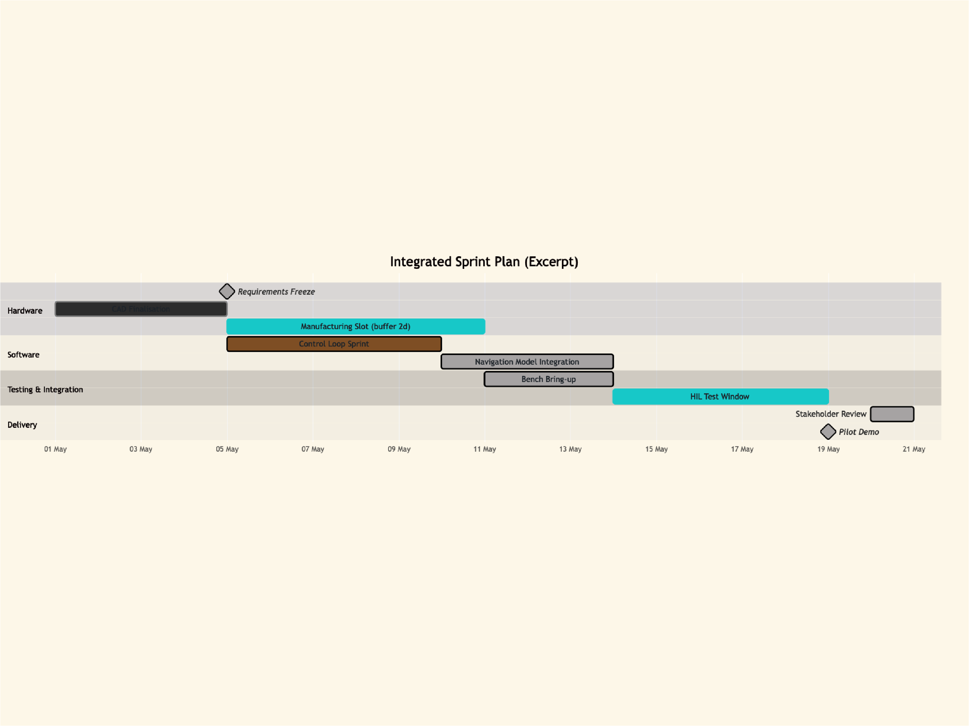
Gantt
Charts
Gantt charts
map duration,
dependencies,
and milestones
across teams.
13
SEAtS | 834694
© University of Southampton

Slide 14
Coordination cues
Maintain subsystem-speciﬁc Gantts plus a system-level integration view.
Use milestones and
crit
ﬂags to surface system constraints; keep buﬀers visible.
Update schedules through feedback cycles, revising dependencies as learnings emerge.
14
SEAtS | 834694
© University of Southampton

Slide 15
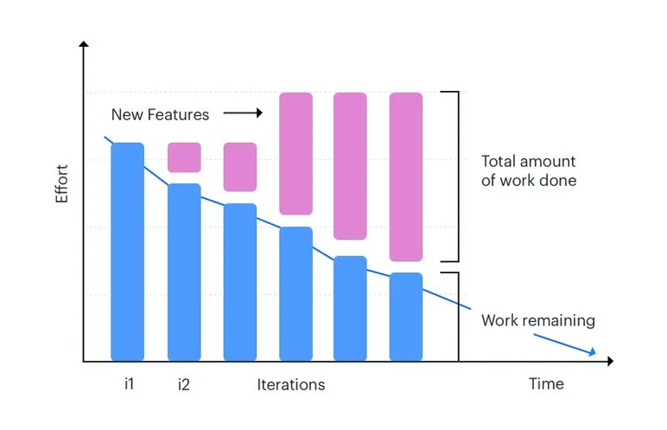
Tracking with Burn-down Charts
A burn-down chart shows remaining work versus time—driving continuous feedback between planning and
execution.
Signals resource overload early.
Shows whether eﬀort distribution aligns with MoSCoW
priorities.
Supports reﬂection on convergence akin to distributed
optimisation monitoring.
15
SEAtS | 834694
© University of Southampton

Slide 16
Preventing Burnout
Burn-down charts also surface human stress. Steep slopes before deadlines or early plateaus indicate
overload or poor estimates.
Human feedback loops
Run short burnout check-ins during weekly stand-ups.
Ask “Howʼs workload and focus?” to catch unsustainable patterns.
Adjust priorities or reassign tasks based on MoSCoW and T-shirt insights.
Systemic project plans must balance performance with well-being to stay sustainable.
16
SEAtS | 834694
© University of Southampton

Slide 17
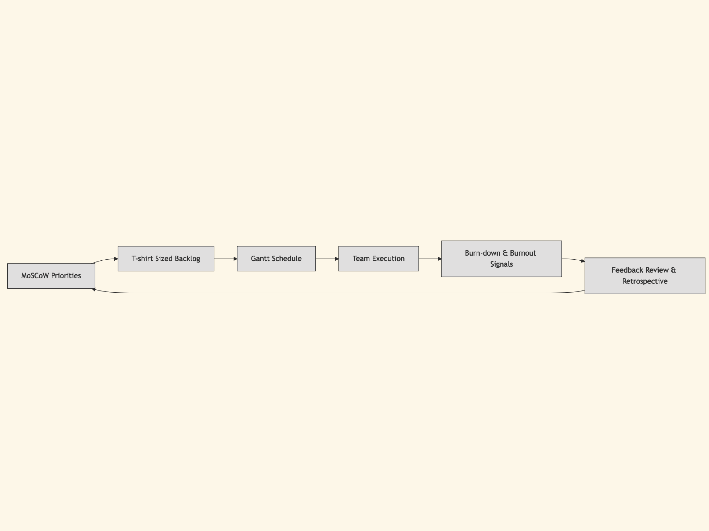
Project control
becomes a
feedback
ecosystem
linking
prioritisation,
estimation,
scheduling,
and human
signals.
17
SEAtS | 834694
© University of Southampton

Slide 18
Integrated Feedback Ecosystem
Systemic project management brings together:
MoSCoW prioritisation for scope clarity.
T-shirt sizing for fast estimation.
Gantt charts for dependency-aware scheduling.
Burn-down charts and burnout chats for monitoring.
Feedback reviews to recalibrate continuously.
Together these create a human-technical control loop that adapts to uncertainty across subsystems.
18
SEAtS | 834694
© University of Southampton

Slide 19
Summary
Complex engineering projects require systemic planning, not linear task lists.
Prioritisation (MoSCoW) and estimation (T-shirt sizing) align stakeholders and resources.
Gantt and burn-down charts provide visibility into schedule health and workload.
Delivery approaches must be chosen intentionally—blend agile, gated, and ﬂow methods to match
subsystem realities.
Agile ceremonies add value when they bridge hardware, software, and people workﬂows.
Continuous feedback loops sustain both technical progress and team well-being.
19
SEAtS | 834694
© University of Southampton

