Slide 1

L7.1 — UML Diagram
Types
AICE2005 | Self-Study

Slide 2
This session is self-reading
No live lecture for L7.1 — work through these notes at your own pace before the week 8 workshop.
UML Cheat Sheet — quick-reference summary of the notation covered below
Optional: LinkedIn Learning course — Software Design: Modeling with UML — not assessed, for anyone
who wants a video walkthrough alongside these notes
2
AICE2005 | Self-Study
© University of Southampton

Slide 3
UML — The 14 Diagram Types
UML diagrams split into two families: structure diagrams (what the system is made of — static) and
behavior diagrams (what the system does — dynamic).
0. Why UML, and why so many diagrams?
UML (Uniﬁed Modeling Language) is a standardized set of diagram notations for deﬁning, visualizing, and
documenting the artifacts of a software system — and sometimes a business model. It gives object-
oriented teams a shared vocabulary to communicate designs, explore alternatives, and validate architecture
before writing code.
3
AICE2005 | Self-Study
© University of Southampton

Slide 4
UML — The 14 Diagram Types
There isn't one "UML diagram" because no single view can serve everyone on a project — an architect, a
coder, a tester, and a technical writer each need a diﬀerent angle and level of detail on the same system.
UML covers that by splitting into 14 diagrams across two families:
Family
Diagrams
Structure
Class, Object, Component, Deployment, Package, Composite Structure, Proﬁle
(7)
Use Case, Activity, State Machine, Sequence, Communication, Interaction Overview,
Behavior (7)
Timing
4
AICE2005 | Self-Study
© University of Southampton

Slide 5
Structure Diagrams
1. Class Diagram
The central modeling technique in object-oriented design. Describes the types of objects in a system and
the static relationships between them. A class box has three compartments: name (top, the only mandatory
part), attributes (middle,
type
after the colon), methods (bottom, return type after the colon).
Visibility modiﬁers on attributes/methods:
Symbol
Visibility
+
Public
-
Private
#
Protected
~
Package
5
AICE2005 | Self-Study
© University of Southampton

Slide 6
1. Class Diagram — perspectives
Method parameter direction:
in
(used, not changed by the method),
inout
(used and changed),
out
(purely a return channel).
Three perspectives for drawing the same class diagram, depending on project stage:
Conceptual — real-world domain entities, language-independent.
Speciﬁcation — software abstractions/interfaces, no implementation detail.
Implementation — the actual classes in a speciﬁc language/technology.
6
AICE2005 | Self-Study
© University of Southampton

Slide 7
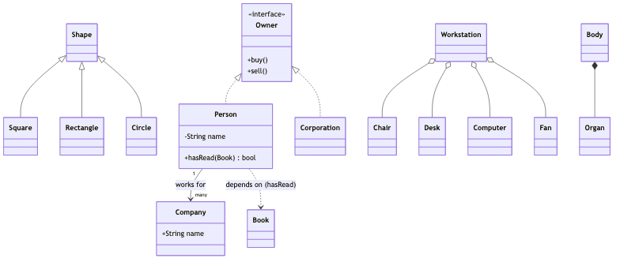
1. Class Diagram — six relationship types
This single diagram threads all six relationship types through one running example:
7
AICE2005 | Self-Study
© University of Southampton

Slide 8
1. Class Diagram — relationships reference (1/2)
Relationship
Arrow
Meaning
-->
plain line, optional verb +
A connects to B (e.g.
Person works for
Association
multiplicity
Company
)
Inheritance /
Square/Rectangle/Circle are kinds of
<|--
hollow triangle → parent
Generalization
Shape
<|..
dashed hollow triangle →
Person/Corporation implement the Owner
Realization
interface
interface
8
AICE2005 | Self-Study
© University of Southampton

Slide 9
1. Class Diagram — relationships reference (2/2)
Relationship
Arrow
Meaning
..>
dashed arrow →
Dependency
Person.hasRead() uses Book without storing it
depended-on class
o--
hollow diamond →
Workstation = Chair + Desk + Computer + Fan; delete
Aggregation
whole
the workstation, the parts survive
*--
ﬁlled diamond →
A Body is made of Organs; delete the body, the organs
Composition
whole
die with it
9
AICE2005 | Self-Study
© University of Southampton

Slide 10
1. Class Diagram — takeaway
UML is a planning tool, not decoration — sketch the class diagram
before
writing the code, not after.
10
AICE2005 | Self-Study
© University of Southampton

Slide 11
2. Object Diagram
An instance of a class diagram: a snapshot of concrete objects, their attribute values, and the links
between them at one point in time. Limited but useful scope — mainly for illustrating data-structure
examples or validating a class diagram against a test case. Object names are written
objectName :
ClassName
, underlined.
11
AICE2005 | Self-Study
© University of Southampton

Slide 12
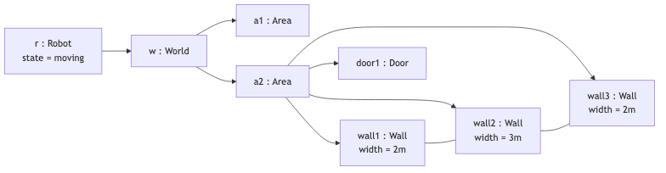
2. Object Diagram — example
A robot's world-view: it has identiﬁed an enclosed area with three walls and a door.
12
AICE2005 | Self-Study
© University of Southampton

Slide 13
3. Component Diagram
Shows how components are wired together into larger components or systems — the architecture of
components and their dependencies, including runtime, executable, and source-code components. Each
component exposes a provided interface (lollipop symbol — services it oﬀers) and/or a required
interface (socket symbol — services it needs) on its ports.
A subsystem is a special kind of component — same notation, marked
«subsystem»
instead of
«component»
.
13
AICE2005 | Self-Study
© University of Southampton

Slide 14

3. Component Diagram — example
14
AICE2005 | Self-Study
© University of Southampton

Slide 15
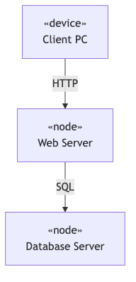
4. Deployment Diagram
Models the physical aspect of a system: hardware nodes and the software artifacts deployed on them. A 3D
box represents a node (hardware or software); lines between nodes represent communication paths,
optionally stereotyped with the protocol.
15
AICE2005 | Self-Study
© University of Southampton

Slide 16
4. Deployment Diagram — planning checklist
Condensed from the full list: installation procedure and failure points, backups and rollback, data
conversion, version-compatibility during rollout, staﬀ/user training and documentation, integration with
existing systems, reliability/failover equipment, and post-deployment security (ﬁrewalls, physical access).
16
AICE2005 | Self-Study
© University of Southampton

Slide 17
5. Package Diagram
Groups related model elements into packages (UML's folders) to manage scope and show dependencies
between subsystems/modules — e.g. a layered application. Packages can nest. One package depends on
another (dashed arrow) if a change in the second can force a change in the ﬁrst.
Element visibility inside a package:
Symbol
Visibility
Visible to
+
Public
Everyone who can see the namespace
#
Protected
Elements related by generalization
~
Package
Elements inside the same package
-
Private
Nothing outside the owning namespace
17
AICE2005 | Self-Study
© University of Southampton

Slide 18
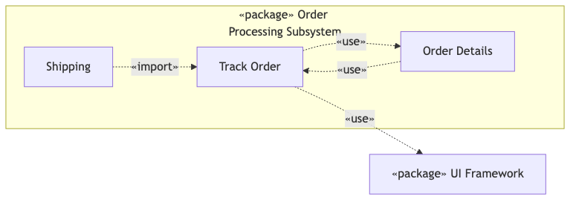
5. Package Diagram — dependency stereotypes
«use»
(default — client uses supplier's public elements by name),
«import»
(supplier's public elements
become public in the client),
«access»
(supplier's public elements become private in the client),
«trace»
(historical link between model versions, rare in practice).
Track Order and Order Details depend on each other (bidirectional use); Shipping imports Track Order for
easier navigation; Track Order depends on the UI framework.
18
AICE2005 | Self-Study
© University of Southampton

Slide 19
6. Composite Structure Diagram
Zooms inside a single class (or collaboration) to show its internal parts, ports, and connectors — the
micro-level view that a plain class diagram's aggregation/composition arrows can't express. A part is
named
partName : PartType[multiplicity]
. References to objects
outside
the class being modeled are
drawn as dashed rectangles.
19
AICE2005 | Self-Study
© University of Southampton

Slide 20
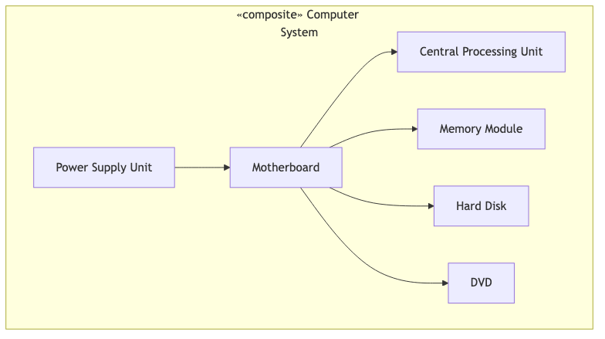
6. Composite Structure Diagram — example
20
AICE2005 | Self-Study
© University of Southampton

Slide 21
6. Composite Structure Diagram — collaboration
A collaboration is the related concept at the behavior level: it names only the roles and connectors needed
to achieve one speciﬁc goal (e.g. a car's
wheels
and
engine
as parts,
front axle
/
rear axle
as connectors),
rather than modeling the whole structured classiﬁer.
21
AICE2005 | Self-Study
© University of Southampton

Slide 22
7. Proﬁle Diagram
A general extension mechanism for customizing UML for a speciﬁc domain (aerospace, medical, ﬁnance) or
platform (J2EE, .NET), via three mechanisms:
Mechanism
Purpose
Notation
New domain-speciﬁc "building block" derived from an
«stereotypeName»
above the
Stereotype
existing metaclass
class name
Extra keyword–value metadata on an element (version,
Tag
{key = value}
in curly braces
author, test status)
[constraint text]
in square
Constraint
A semantic rule/condition that must always hold
brackets
22
AICE2005 | Self-Study
© University of Southampton

Slide 23
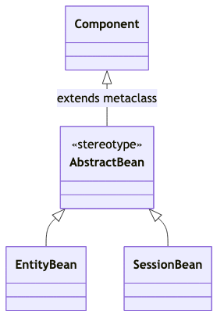
7. Proﬁle Diagram — example
A stereotype extends a metaclass (solid arrow, ﬁlled head, stereotype → metaclass). To use the stereotypes
elsewhere, a package applies the proﬁle (dashed arrow, open head, labeled
«apply»
, pointing from the
application package to the proﬁle).
23
AICE2005 | Self-Study
© University of Southampton

Slide 24
Behavior Diagrams
8. Use Case Diagram
Captures the functional requirements of a system as a set of use cases, the actors who trigger them, and
the relationships between use cases — without specifying the order of steps (that's what Activity/Sequence
diagrams are for). Keep it simple: more than ~20 use cases on one diagram is a sign you're modeling
wrong.
24
AICE2005 | Self-Study
© University of Southampton

Slide 25
8. Use Case Diagram — relationships
Relationship
Notation
Meaning
Dashed arrow, open head, → base use
Optional behavior under a condition (e.g.
Extend
case, labeled
«extend»
Invalid Password
extends
Login
)
Dashed arrow, open head, → included
Mandatory reused behavior (e.g.
Request
Include
use case, labeled
«include»
Schedule
includes
Search
)
Solid line, hollow triangle → parent
Generalization
Child inherits/overrides the parent's behavior
use case
25
AICE2005 | Self-Study
© University of Southampton

Slide 26
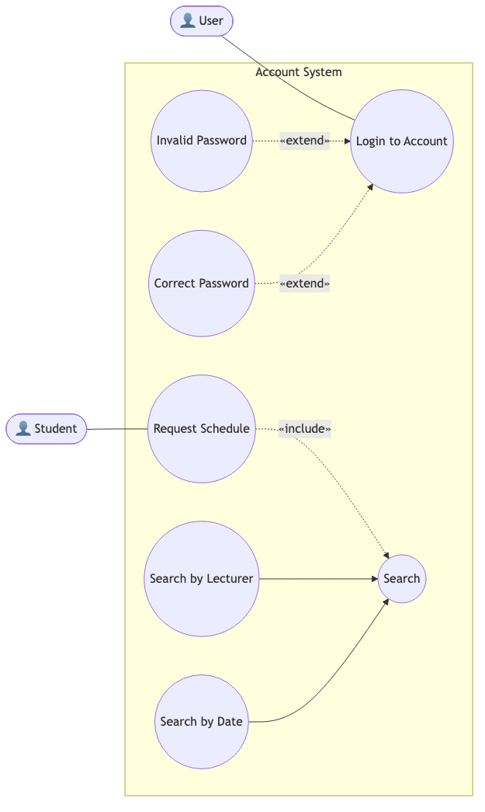
8. Use Case Diagram — example
26
AICE2005 | Self-Study
© University of Southampton

Slide 27
9. Activity Diagram
An extended ﬂowchart modeling workﬂow: how activities/actions are coordinated, including choice,
iteration, and concurrency.
Node
Meaning
Initial / Final node
Starts / terminates the ﬂow
Action
A task to perform
Decision / Merge node
Splits down one path / rejoins the paths
Fork / Join node
Splits into parallel ﬂows / combines them back
Object node
An object produced/consumed by the ﬂow (optional)
Swimlane
Groups activities by the actor responsible for them
27
AICE2005 | Self-Study
© University of Southampton

Slide 28
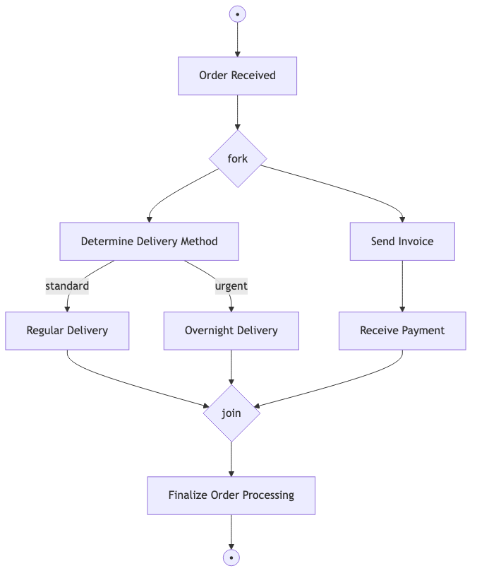
9. Activity Diagram — example
Order-processing: received order forks into a fulﬁllment path and a billing path that rejoin before
ﬁnalizing.
28
AICE2005 | Self-Study
© University of Southampton

Slide 29
9. Activity Diagram — swimlanes
Swimlanes add "who does this" on top of the same ﬂow — e.g. an onboarding process split into
Salesperson
(books the meeting, writes the follow-up),
Consultant
(presents, runs the meeting, drafts the
contract), and
Secretary
(prepares the room) lanes.
29
AICE2005 | Self-Study
© University of Southampton

Slide 30
10. State Machine Diagram
Describes an object's state-dependent behavior: the states it can be in, the events that trigger transitions,
and the actions those transitions perform. Based on Harel statecharts. Used alongside sequence diagrams:
a state diagram covers
all
events/states/transitions for
one
object; a sequence diagram covers
one
interaction across
all
objects.
Event types: signal (async message arrives), call (procedural operation invoked), time (a duration elapses),
change (a watched condition becomes true).
30
AICE2005 | Self-Study
© University of Southampton

Slide 31
10. State Machine Diagram — transitions & substates
A transition ﬁres when its event occurs
and
its guard condition holds; an action executes on the transition
(not interruptible). A composite state holds substates, which can nest; a ﬁlled circle marks the
initial
state, a circle-with-ring marks the
ﬁnal
state, and a circled
H
marks a history state (re-enter whichever
substate was active when the composite was last exited).
31
AICE2005 | Self-Study
© University of Southampton

Slide 32
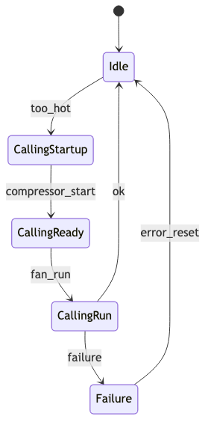
10. State Machine Diagram — simple transitions
A heating controller:
32
AICE2005 | Self-Study
© University of Southampton

Slide 33
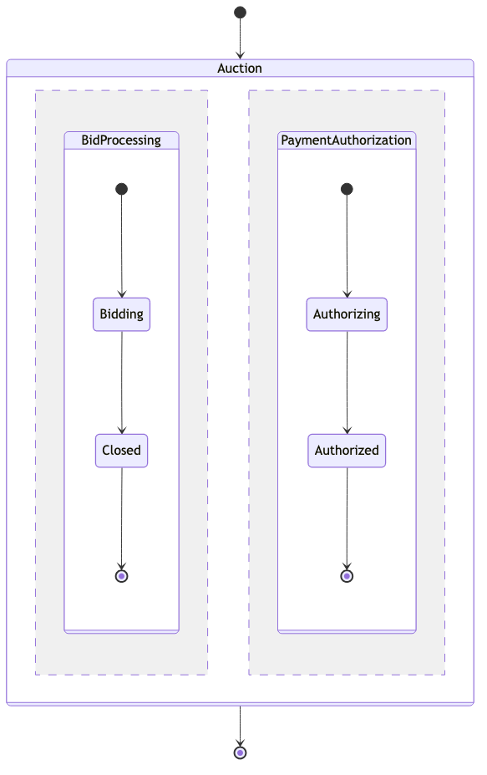
10. State Machine Diagram — concurrent substates
An auction processes a bid and authorizes payment in parallel; both must ﬁnish before the composite state
exits.
33
AICE2005 | Self-Study
© University of Southampton

Slide 34
11. Sequence Diagram
Shows how objects/actors interact over time for one scenario: participants laid out horizontally (lifelines),
time ﬂowing down the page. A thin rectangle on a lifeline (focus of control / activation) marks the span
during which that element is executing. Arrow styles: ﬁlled-head solid = synchronous (caller waits), open-
head solid = asynchronous (caller continues), dashed = return, arrow to self = self-message, arrow into
a new box = create, large
X
= destroy.
34
AICE2005 | Self-Study
© University of Southampton

Slide 35
11. Sequence Diagram — combined fragments
Operator
Meaning
alt
/
opt
If/else alternatives / optional block
par
/
loop
Concurrent fragments / repeats while true
break
/
critical
Early exit / must run uninterrupted
neg
/
assert
Invalid interaction / only valid continuation
strict
/
seq
Strictly ordered / loosely ordered messages
ignore
/
ref
/
sd
Drop listed messages / reference elsewhere / frame whole diagram
35
AICE2005 | Self-Study
© University of Southampton

Slide 36
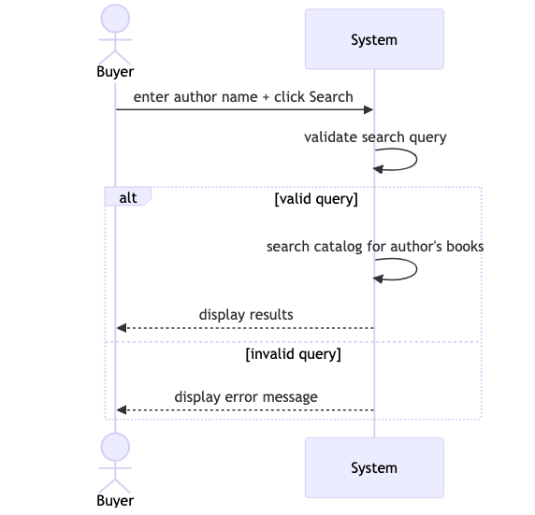
11. Sequence Diagram — example
Hotel search example, using
alt
for the validation branch:
36
AICE2005 | Self-Study
© University of Southampton

Slide 37
12. Communication Diagram
Semantically equivalent to a sequence diagram (either can be derived from the other) — the diﬀerence is
purely organizational: a sequence diagram arranges messages by time; a communication diagram
arranges objects by space/relationship and numbers the messages instead (
1
,
1.1
,
1.2
,
2
, …) to show
order. Best when the thing worth seeing is
who talks to whom
, not
when
.
37
AICE2005 | Self-Study
© University of Southampton

Slide 38

12. Communication Diagram — example
Objects are either suppliers (receive the message) or clients (send it). A message an object sends to itself
is drawn as a self-loop, same as in a sequence diagram.
38
AICE2005 | Self-Study
© University of Southampton

Slide 39
13. Interaction Overview Diagram
A high-level activity diagram whose nodes are interactions (small sequence diagrams, or
ref
pointers
to interactions deﬁned elsewhere) instead of plain actions — useful for stitching several sequence diagrams
into one controlled ﬂow without redrawing them inline.
39
AICE2005 | Self-Study
© University of Southampton

Slide 40
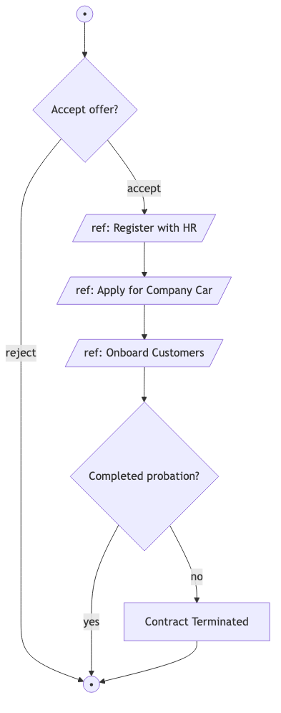
13. Interaction Overview Diagram — example
40
AICE2005 | Self-Study
© University of Southampton

Slide 41
13. Interaction Overview Diagram — walkthrough
Employee onboarding: rejecting the oﬀer skips straight to the end; accepting routes through three
referenced interactions before the probation decision.
41
AICE2005 | Self-Study
© University of Southampton

Slide 42
14. Timing Diagram
A specialized sequence diagram for showing when state or value changes happen, not just their relative
order. Lifelines run horizontally (left → right = elapsed time); a state lifeline plots which state the object is
in at each moment, a value lifeline plots a changing value — both change level only when the underlying
state/value actually changes. Must stay consistent with the matching sequence/state diagrams for the same
object.
42
AICE2005 | Self-Study
© University of Southampton

Slide 43
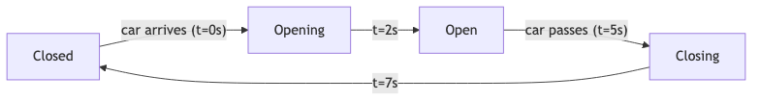
14. Timing Diagram — example
A car-park gate's state over time — the same object modeled as a state machine diagram, just read along a
time axis instead of as a graph of transitions.
43
AICE2005 | Self-Study
© University of Southampton

