Slide 1

Software Architecture
Models: Monolithic, N-Tier,
and Microservices Models
structure, trade-oﬀs, and evolution
SEAtS | 188398

Slide 2
Intended
Learning
Outcomes
By the end of this lecture you will be able to:
1. Describe the deﬁning characteristics of monolithic, N-tier, and
microservices architectures.
2. Compare the strengths, weaknesses, and ideal use cases for each
model.
3. Explain how architectural evolution inﬂuences deployment,
scalability, and maintenance.
2
SEAtS | 188398
© University of Southampton

Slide 3
Architecture as System Structure
In software engineering, architecture is the fundamental organisation of a system—its components,
relationships, and guiding principles.
Architecture articulates a strategic balance between delivery speed, operational stability, and future
evolution. We explore this balance by contrasting three widely adopted paradigms.
3
SEAtS | 188398
© University of Southampton

Slide 4
Evolution of Enterprise
Architecture
Software architecture evolution reﬂects a move from tight coupling toward modular independence.
Monolithic (pre-2000s)
N-tier (2000s)
Microservices (2010s–present)
Uniﬁed codebases, single
Layered separation of presentation,
Distributed services with independent
deployment artefacts.
application logic, and data.
deployment.
4
SEAtS | 188398
© University of Southampton

Slide 5
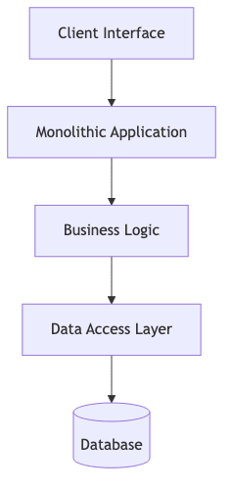
Monolithic
Architecture
A monolithic architecture packages all functionality—user interface,
business logic, and data access—into a single executable. Deployment
and scaling are performed as one unit.
5
SEAtS | 188398
© University of Southampton

Slide 6
Monolithic Architecture
Advantages
Simple initial development and deployment.
Straightforward debugging within a single codebase.
High performance through in-process communication.
Disadvantages
Limited horizontal scalability—the entire application must scale.
Redeploying any change requires redeploying the whole system.
Technology lock-in around a single language and framework.
Example: Early e-commerce platforms and legacy ERP suites.
6
SEAtS | 188398
© University of Southampton

Slide 7
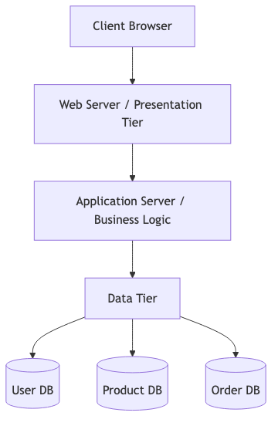
N-Tier Architecture
N-tier (layered) architecture separates responsibilities across tiers,
typically presentation, application, and data. Layers interact via well-
deﬁned interfaces, often REST or RPC APIs.
7
SEAtS | 188398
© University of Southampton

Slide 8
N-Tier Architecture
Advantages
Separation of concerns improves maintainability and testing.
Individual tiers can scale independently.
Facilitates integration via APIs and middleware.
Disadvantages
Network hops introduce latency and complexity.
Coordination required between teams managing diﬀerent tiers.
Application tier can still become a scaling bottleneck.
Example: Online banking portals built with Java EE or .NET MVC.
8
SEAtS | 188398
© University of Southampton

Slide 9
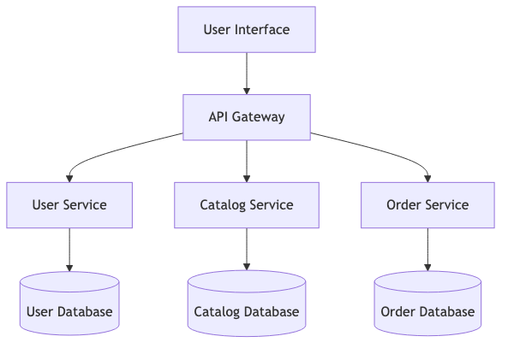
Microservices
Architecture
Microservices architecture decomposes an
application into independently deployable
services, each encapsulating a bounded
context. Services communicate via
synchronous APIs or asynchronous
messaging.
9
SEAtS | 188398
© University of Southampton

Slide 10
Microservices Architecture
Advantages
Independent development, deployment, and scaling per service.
Fault isolation—individual service failures need not topple the system.
Technology heterogeneity—teams choose the best-ﬁt stack.
Enables continuous delivery and rapid experimentation.
Disadvantages
Distributed systems complexity: latency, consistency, monitoring, security.
Requires mature DevOps, CI/CD, and orchestration platforms.
Higher operational overhead, especially for smaller organisations.
Example: Netﬂix, Amazon, and Spotify underpin their platforms with microservices.
10
SEAtS | 188398
© University of Southampton

Slide 11
Comparative View
Feature
Monolithic
N-Tier
Microservices
Deployment
Single artefact
Multiple coordinated tiers
Independent services
Scalability
Limited
Moderate, tier-based
Fine-grained, service-level
Maintainability
Low as apps grow
Moderate
High with strong governance
Complexity
Low initially
Medium
High operationally
Best For
Simple, stable apps
Enterprise web workloads
Large, cloud-native ecosystems
11
SEAtS | 188398
© University of Southampton

Slide 12
Transitioning in Practice
Enterprises rarely jump directly from monolith to microservices. Common path:
1. Refactor monolith into modular N-tier or “modulith” structure.
2. Identify bounded contexts where autonomy delivers value.
3. Gradually extract services, backed by automation and observability.
Case example: Amazon evolved from a monolithic retail platform to service-oriented architecture before
embracing microservices (Newman, 2021).
12
SEAtS | 188398
© University of Southampton

Slide 13
Selection Criteria
When choosing an architecture, assess:
1. System complexity – microservices add overhead unless scale demands it.
2. Team size and autonomy – small teams beneﬁt from simpler deployments.
3. Scalability requirements – evaluate load patterns and bottlenecks.
4. Operational maturity – CI/CD pipelines, monitoring, incident response.
5. Data integrity needs – monoliths simplify ACID transactions.
13
SEAtS | 188398
© University of Southampton

Slide 14
Design Principles Across Models
Regardless of architecture, adhere to:
Separation of concerns – isolate distinct responsibilities.
Loose coupling – minimise cross-component dependencies.
High cohesion – keep related functionality together.
Clear contracts – document APIs and service agreements.
Automation & testing – use CI/CD and observability to preserve architectural integrity.
These principles underpin sustainable enterprise software.
14
SEAtS | 188398
© University of Southampton

Slide 15
Closing Thought
“Architecture is the art of determining whatʼs important in a system and suppressing everything else.” —
David Parnas (1972). Skilled architects balance simplicity, ﬂexibility, and scalability to match organisational
maturity.
15
SEAtS | 188398
© University of Southampton

Slide 16
Summary
Monolithic architectures favour simplicity but limit scaling and agility.
N-tier architectures introduce separation of concerns without fully decoupling teams.
Microservices deliver ﬁne-grained scalability at the cost of operational complexity.
Choose architectures based on system complexity, organisational maturity, and measurable outcomes.
16
SEAtS | 188398
© University of Southampton

Slide 17
References
Bass, L., Clements, P., & Kazman, R. (2021).
Software Architecture in Practice
(4th ed.). Addison-Wesley.
Kruchten, P. (1995). Architectural blueprints—The 4 + 1 view model of software architecture.
IEEE
Software, 12(6).
Newman, S. (2021).
Building Microservices
(2nd ed.). OʼReilly Media.
TatvaSoft. (2022). Enterprise application architecture and its types. Retrieved from
https://www.tatvasoft.com/outsourcing/2022/10/enterprise-application-architecture.html
ISO/IEC/IEEE 42010:2011. Systems and software engineering—Architecture description.
17
SEAtS | 188398
© University of Southampton

Slide 18

18
SEAtS | 188398
© University of Southampton

