Slide 1

Software Architecture
Models – Part 2
Distributed and interaction-centric paradigms
SEAtS | 641230

Slide 2
Intended
Learning
By the end of this lecture you will be able to:
Outcomes
1. Describe ﬁve major interaction-oriented software architecture
models.
2. Diﬀerentiate their communication patterns and structural
organisation.
3. Evaluate their strengths and weaknesses in real-world applications.
4. Apply these models to design scalable, maintainable, and resilient
systems.
2
SEAtS | 641230
© University of Southampton

Slide 3
Agenda
Refresh: interaction patterns and concept
deﬁnitions.
Deep dives: client–server, SOA, event-driven,
MVC, pipe-and-ﬁlter.
Comparative analysis and integration
patterns.
Hybrid use cases and design exercises.
3
SEAtS | 641230
© University of Southampton

Slide 4

Client–Server
Model
The client–server model underpins
networked systems. Clients request resources
or services; servers respond with data or
actions—forming the backbone of the web,
email, and database ecosystems.
4
SEAtS | 641230
© University of Southampton

Slide 5
Client–Server
Advantages
Clear separation of presentation (client) and core logic (server).
Centralised control over data, security, and auditing.
Servers can be updated independently of clients.
Disadvantages
Single point of failure if the server crashes.
Scalability constrained by server capacity.
Network latency impacts responsiveness.
Evolution:
2-tier: client
↔
database (desktop apps).
3-tier: client
↔
app server
↔
database (web apps).
N-tier: distributed services and microservices.
5
SEAtS | 641230
© University of Southampton

Slide 6
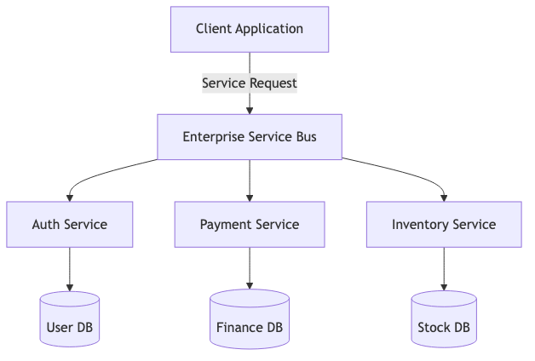
Service-Oriented
Architecture (SOA)
SOA exposes business capabilities as services that communicate
through standard interfaces and protocols (e.g., SOAP, WSDL,
XML) via an enterprise service bus (ESB).
6
SEAtS | 641230
© University of Southampton

Slide 7
Service-Oriented Architecture
(SOA)
Advantages
Interoperability across platforms.
Service reuse for business agility.
Modularity supports scaling by function.
Disadvantages
Heavyweight ESB and XML overhead.
Complex governance and versioning.
Limited ﬁne-grained scalability—precursor to microservices.
Evolution:
Loose coupling via deﬁned interfaces.
Services registered for discoverability and reuse.
Standard protocols (SOAP, XML, UDDI) enable interoperability.
7
SEAtS | 641230
© University of Southampton

Slide 8
Transition to Microservices
SOA introduced modularity but relied on central ESBs. Microservices evolved this concept by decentralising
integration, using lightweight APIs, and aligning services with bounded contexts. Understanding SOA
provides context for modern microservice design patterns.
8
SEAtS | 641230
© University of Southampton

Slide 9
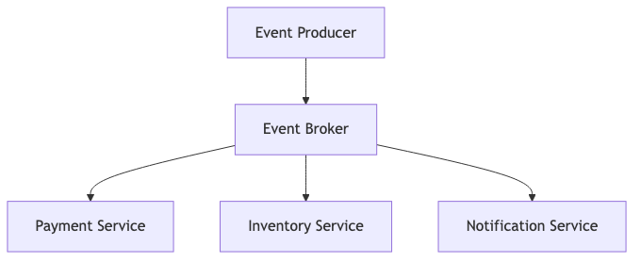
Event-Driven
Architecture (EDA)
In EDA, components communicate via events rather than
direct requests. Producers emit events; consumers
subscribe and react asynchronously—ideal for reactive and
real-time systems.
9
SEAtS | 641230
© University of Southampton

Slide 10
Event-Driven Architecture (EDA)
Advantages
Highly scalable and fault tolerant.
Enables real-time analytics and reactive behaviour.
Decouples producers and consumers.
Disadvantages
Complex debugging and tracing across events.
Eventual consistency challenges.
Requires rigorous monitoring and schema governance.
Example domains: IoT, marketplaces, ﬁnancial monitoring using Kafka, RabbitMQ, AWS SNS/SQS.
10
SEAtS | 641230
© University of Southampton

Slide 11
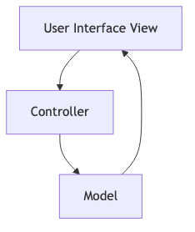
Model–View–
Controller (MVC)
MVC separates presentation, business logic, and data access to
simplify UI-centric applications.
11
SEAtS | 641230
© University of Southampton

Slide 12
MVC – Principles & Variants
Advantages:
Promotes separation of concerns and testability.
Supports multiple views over shared data models.
Widely adopted in web and GUI frameworks (Django, Rails, Spring MVC).
Disadvantages: Controller–View coupling can expand in complex applications, requiring refactoring.
Variants:
MVVM (Model–View–ViewModel) for data-binding UIs.
MVP (Model–View–Presenter) for heavily interactive interfaces.
12
SEAtS | 641230
© University of Southampton

Slide 13
Pipe-and-Filter
Architecture
The pipe-and-ﬁlter model structures
applications as sequential processing steps
(ﬁlters) connected by channels (pipes). Each ﬁlter
transforms input before passing it onward.
13
SEAtS | 641230
© University of Southampton

Slide 14
Pipe-and-Filter – Architecture
Advantages
Simple, modular processing steps.
Filters can be reused and replaced independently.
Fits ETL workﬂows, compilers, and streaming pipelines.
Disadvantages
Ineﬃcient for complex branching or backtracking ﬂows.
Intermediate data storage introduces overhead.
Handling bidirectional streams is challenging.
14
SEAtS | 641230
© University of Southampton

Slide 15
Comparative Summary
Model
Focus
Typical Domain
Client–Server
Centralised request–response
Internet, databases
Service-Oriented Architecture (SOA)
Modular services on an integration bus
Enterprise systems
Event-Driven Architecture (EDA)
Asynchronous event communication
IoT, real-time processing
Model–View–Controller (MVC)
Separation of presentation, logic, data
Web frameworks
Pipe-and-Filter
Sequential data transformations
Compilers, data pipelines
Model
Communication Type
Coupling
Primary Use
Client–Server
Request–response
Medium
Web, databases
SOA
Message-based via ESB
Low
Enterprise integration
EDA
Publish–subscribe
Very low
Real-time, reactive systems
MVC
Controller-driven updates
Medium–High
Web & GUI apps
Pipe-and-Filter
Sequential data ﬂow
Low
Data pipelines, compilers
15
SEAtS | 641230
© University of Southampton

Slide 16
Architectural Integration
Modern enterprises combine these paradigms to meet diverse requirements:
Client–server frontends often implement MVC or MVVM.
Backends expose services via SOA or microservices.
Internal data processing uses pipe-and-ﬁlter pipelines.
Asynchronous workﬂows leverage event-driven messaging.
Hybrid architectures allow teams to choose patterns that best ﬁt each subsystem while maintaining coherence.
16
SEAtS | 641230
© University of Southampton

Slide 17
Summary
Interaction-centric architectures deﬁne how components communicate and collaborate.
Selection depends on scalability, consistency, and operational maturity needs.
Combining paradigms yields ﬂexible, resilient enterprise solutions.
17
SEAtS | 641230
© University of Southampton

Slide 18
References
Bass, L., Clements, P., & Kazman, R. (2021).
Software Architecture in Practice.
Papazoglou, M. (2007).
Service-Oriented Architecture: Concepts, Technology, and Design.
Chen, L. (2019). Event-driven microservices: lessons learned.
IEEE Software, 36(6).
Kruchten, P. (1995). The 4+1 view model of software architecture.
IEEE Software, 12(6).
Fowler, M. (2003).
Patterns of Enterprise Application Architecture.
18
SEAtS | 641230
© University of Southampton

