Slide 1
AICE2005 - Systematic Design
Gathering and Validating Requirements
Asieh Salehi Fathabadi
A.Salehi@Soton.ac.uk
University of Southampton
2026-2027
Notes:
[about 0 min] Week 2, Lecture 2 of 3. Plan: 50 minutes = 20 main slides, one exercise, plus hidden appendix slides at the end.

Slide 2
Week Overview
Week 2 | Analysing systems: requirements
Lecture 1: Functional and Non-Functional Requirements
What must the system do, and how well must it do it?
Lecture 2: Gathering and Validating Requirements
How do we find out what stakeholders need, and check we got it right?
Lecture 3: Use Cases and Personas
How do we capture users and their goals as scenarios?
Notes:
[about 1 min] Lecture 1's vocabulary (FR, NFR, measurable NFRs) tells us what a good requirement looks like. Today: how to find them and how to check them.

Slide 3
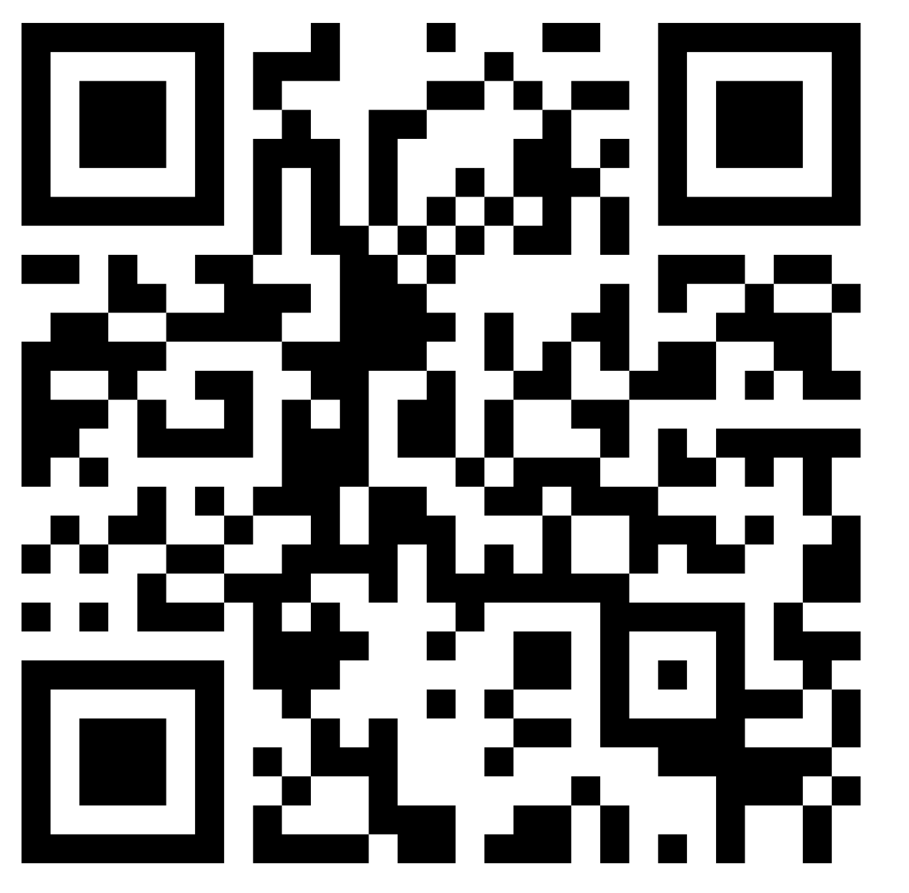
Record your attendance
368074
Notes:
[about 1 min] Attendance (SEAtS) slide.

Slide 4
Recap: Lecture 1
FR vs NFR: what the system does vs how well it does it
Measurable NFRs: value, unit, condition, proportion and method
Precise wording: five questions, logic, EARS templates
Trade-offs: NFRs conflict and are allocated across components
Notes:
[about 1 min] Two quick recall questions before starting: 'Give me an example of a vague NFR' and 'How would you make it measurable?'

Slide 5
Lecture 2 Overview
The requirements lifecycle
Stakeholders and elicitation techniques
Validating requirements
Conflicts, trade-offs, security and ethics
Case study: a child-monitoring toy duck
Learning Objectives:
Apply appropriate techniques to gather user and stakeholder requirements
Validate requirements for completeness, consistency and feasibility
Evaluate trade-offs in complex system requirements
Identify challenges in multi-stakeholder systems and propose resolution strategies
Notes:
[about 1 min] Bracketed codes map objectives to module outcomes (A3 best practice and risk identification for group projects, B4 trade-offs, B5 ethical and security responsibilities). Adjust the mapping if you prefer.

Slide 6
The Requirements Lifecycle
1
Elicitation
Discover requirements from stakeholders: interviews, workshops, observation.
2
Analysis
Resolve conflicts, prioritise and refine for clarity and feasibility.
3
Specification
Document in a standard format (ISO/IEC/IEEE 29148:2018).
4
Validation
Check correctness, consistency, completeness and testability.
Management: track and update requirements throughout the system lifecycle.
Notes:
[about 2 min] Walk through the five activities. Stress the loop: what we learn in validation changes what we elicit. The lifecycle aligns with ISO/IEC/IEEE 29148:2018. The rest of the lecture follows it: elicitation (slides 7-12), validation (13-14), analysis and conflicts (15).

Slide 7
Stakeholders and Sources
Stakeholders
Sources of requirements
Users
Project sponsors
Regulatory bodies
Developers and testers
Maintainers
Adjacent systems (yes, systems too)
User interviews and observation
Existing systems and documentation
Standards and regulations
Competitive benchmarking
Internal expertise and R&D insights
Identify stakeholders early: a missed stakeholder is a missed requirement. Stakeholders are more than users.
Notes:
[about 2 min] Ask: 'Who are the stakeholders of a smart toy that monitors children?' Expect parents; push for regulators, retailers, paediatricians, the child, the app store, the battery supplier. Adjacent systems (phone OS, Bluetooth stack, cloud service) impose requirements too.

Slide 8
Case Study: Child-Monitoring Duck
Design a child-monitoring system embedded in a toy duck, used by caregivers for indoor safety monitoring.
Duck
Temperature, sound-level and presence sensors, microcontroller, BLE radio
Phone / gateway
relays data
Caregiver app
alerts and history
secure link
< 2 s delay
System constraints
Must resemble a rubber duck in size, shape and texture.
Must be safe and non-intrusive for children aged 2 to 5.
Must monitor room temperature and sound levels, and detect presence.
All data must reach the caregiver app securely with minimal latency (< 2 s).
Notes:
[about 2 min] The case study from the old deck, with the missing image replaced by a simple block diagram (the original slides showed images that did not survive the PDF). Ask: which stakeholders and which NFRs are hiding in these four constraints? (safety, size, latency, security, energy).

Slide 9
Mapping Stakeholders: Power and Interest
Keep satisfied
Regulators (toy safety, data protection), retail partners
Manage closely
Parents and caregivers, product owner, sponsor
High
Power ↑
Low
Monitor
Component and battery suppliers
Keep informed
Children (through parents), paediatricians, child psychologists
Low Interest → High
Children have limited decision-making power but are primary users and affected stakeholders;
their requirements should therefore be actively represented.
Notes:
[about 3 min] Power-interest grid (after Mendelow, 1991). Power is the ability to affect the project; interest is how much they care about the result. The vertical axis runs from high power at the top to low power at the bottom. Use the child-monitoring duck (case study later) as the example. The point: different quadrants call for different elicitation effort. Children as users are a special case ethically.
Parents/carers: High power + high interest → Manage closely
Children: Low power + high interest → Keep informed / actively involve
The statement means that even when parents have the power to make decisions about the toy, children's requirements should not simply be assumed to be the same as their parents' requirements.
For example:
Parent requirement: “I want the toy to allow me to monitor my child's activity.”
But the child may have a different requirement:
Child requirement: “I want privacy and control over when the toy listens to me.”
So the RE lesson is:
High-power stakeholders can make decisions, but they don't necessarily represent the requirements of all users.
I'd therefore change your bottom sentence to something very clear for students:
Children have low power but high interest: their requirements may differ from those of parents and should be explicitly considered.
This works particularly well with your Power–Interest matrix, because it demonstrates why stakeholder mapping matters in requirements engineering rather than just stakeholder management.
https://osuva.uwasa.fi/server/api/core/bitstreams/a8a938fe-dad1-49c6-8205-03fe3a5e750e/content

Slide 10
Elicitation Techniques
Technique | Best for | Watch out for
Interviews | Deep insight, implicit concerns | Interviewer bias, small samples
Questionnaires and surveys | Many or dispersed users, trends | Shallow answers, badly worded questions
Workshops and focus groups | Brainstorming, resolving conflicts | Dominant voices
Observation (ethnography) | Tacit workflows, real context | Time-consuming, observer effect
Document and system analysis | Legacy systems, standards | Outdated documentation
Prototyping | Feasibility, concrete reactions | Users fixate on the look
User stories and use cases | Actor-system interactions, agile | Quality requirements get missed
Notes:
[about 3 min] interviews, questionnaires, workshops and focus groups, ethnographic observation, document and system analysis, prototyping, user stories and use cases. No technique is best; combine several (triangulation).

Slide 11
Asking Good Questions
Ask
Avoid
"Walk me through the last time you…"
"What happens when it goes wrong?"
"What must it never do?"
"Who else should we talk to?"
Leading: "Don't you find the app confusing?"
Double-barrelled: "Is it fast and easy?"
Hypothetical: "Would you use it?" (ask about past behaviour instead)
People cannot tell you what they do without noticing. Combine interviews with observation, and use closed questions to quantify what open questions reveal.
Notes:
[about 3 min] Structured interviews allow comparison across sessions; semi-structured interviews encourage dialogue. Closed questions in surveys quantify trends, open questions elicit qualitative feedback. Tacit knowledge: skilled users often cannot describe what they do, which is why observation matters.

Slide 12

Exercise: Which technique?
Let's think and reflect
Pick the best technique on Vevox
Interview, survey, workshop, observation, document analysis or prototype.
See how nurses really use a ward tablet while walking.
Get quick feedback from 800 students on several campuses.
Resolve a clash between the sensor team and the app team.
Find out what an undocumented legacy system really does.
Test whether users grasp a new dashboard idea before building it.
Explore a lecturer's worries about automated marking.
Notes:
[about 3 min] Vevox multiple-choice poll, six options each time. About 20 seconds per scenario, show the result, then go to the next slide. Answers: 1 observation, 2 survey, 3 workshop, 4 document and system analysis, 5 prototype, 6 interview.

Slide 13
Which technique? Discussion
# | Scenario | Best fit | Why
1 | Nurses using a ward tablet | Observation | Tacit workflows only show in context
2 | 800 students, several campuses | Survey | Reach and quantify
3 | Sensor team vs app team clash | Workshop | Negotiate trade-offs face to face
4 | Undocumented legacy system | Document / system analysis | The system is the evidence
5 | Unbuilt dashboard idea | Prototype | React to something concrete
6 | Lecturer's worries | Interview | Depth and follow-up questions
Rule of thumb: match the technique to what you need to learn, and combine at least two (e.g. observation to find what people do, an interview to learn why).
Notes:
[about 2 min] Several scenarios could use more than one technique; that is the point. Ask students which second technique they would add to each.

Slide 14
Validating Requirements
Validation
Are we building the right system?
Checks requirements against real stakeholder needs.
Verification
Are we building the system right?
Checks the design and code against the requirements.
Requirements must be:
Correct: reflect true stakeholder intent
Consistent: no internal contradictions
Complete: cover all relevant scenarios
Feasible: achievable within constraints
Verifiable: can be tested or demonstrated
Validation catches wrong requirements before they are built, when the cost of change is lowest.
Notes:
[about 2 min] Do not confuse the two. Verification asks whether we built it to the specification; validation asks whether the specification is what stakeholders actually need. Both are needed

Slide 15
Validation Techniques
Technique | What it checks | Example
Requirement reviews | Ambiguity, omissions, inconsistency | Walkthrough with reader, reviewer, moderator
Simulation and prototyping | Can it be met in real conditions? | FEA for hardware; wireframes for software
Test-case derivation | Is it verifiable? | "The arm must lift 1 kg in 5 s in 90% of trials"
Traceability (RTM) | Is every requirement covered? | Requirement to design to test; impact analysis
Feasibility checks | Time, cost, technical limits | Are interoperable interfaces available?
Stakeholder review sessions | Are human needs kept? | Usability and accessibility walkthroughs
Requirement modelling | Does the model satisfy properties? | SysML, model checking, formal methods
Notes:
[about 3 min] Seven techniques from the old deck in one table. Pick two to demonstrate: test-case derivation (turn a requirement into a pass/fail test) and traceability (a Requirements Traceability Matrix links each requirement to design and tests; tools include IBM DOORS, Jama Connect and Jira plugins). The hidden appendix has a small traceability matrix example.

Slide 16
Conflicts and Prioritisation
Must
Dashboard shows room temperature
Should
Occupancy history for the last week
Could
Study-tip suggestions
Won't (this release)
Voice assistant
MoSCoW: Must, Should, Could, Won't
Managing conflicts
Rank with stakeholders, then decide and record the reason.
Quantify the conflict: turn opinions into numbers.
Model the system (system maps, giga-mapping) to see conflicts and leverage points.
Notes:
[about 3 min] MoSCoW prioritisation with Smart Study Room examples. Emphasise that 'Won't' means not in this release, not never. Giga-mapping (from the old deck) is a way to visualise a whole system and its conflicts on one large map. Exercise 2 practises MoSCoW.

Slide 17
Duck: How We Gather and Validate
Gathering
Validating
Stakeholder interviews with parents, paediatricians and child psychologists.
Competitive analysis of baby monitors and smart toys.
Meta-models to explore trade-offs between sensor placement, battery capacity and toy softness.
Functional: embedded system simulation (microcontroller, BLE, sensor modules).
Safety: compliance check against toy safety standards (e.g. EN 71).
Stakeholder: physical prototypes tested in supervised play environments.
Each validation type answers a different question: does it work, is it safe, do people accept it?
Notes:
[about 3 min] Link back to the techniques table and the validation table. Meta-models are cheap approximations of expensive simulations, used to explore trade-offs early (see the appendix slide on requirements in multi-component systems).

Slide 18
Security and Ethics Are Requirements Too
Data in motion
Data at rest
Ethics and privacy
Duck-to-app link shall be encrypted and paired.
Cloud traffic shall use TLS 1.3.
Stored data shall be encrypted (AES-256).
Access limited to the caregiver's account.
Sound level only: no audio is recorded.
Data minimised; deleted after 30 days.
Ask about every piece of data:
Who can see it, and why do we collect it at all?
How long do we keep it, and who can delete it?
Young children cannot consent: parents do. UK GDPR gives children's data special protection.
Notes:
[about 3 min] Covers learning outcome B5 (ethical and security responsibilities for data in motion and at rest). Requirements for security and privacy are NFRs with measurable statements. Design choices such as sound level only, never audio, are ethical requirements expressed as constraints. Elicitation is also subject to ethics: informed consent for interviews, anonymised notes, secure storage.

Slide 19
Summary and What's Next
Lifecycle: elicit, analyse, specify, validate, manage: a loop
Stakeholders: identify early, map power and interest
Techniques: match the technique to what you need to learn
Validation: right system, then system right
Trade-offs and ethics: prioritise, record decisions, protect data
Let's read and explore
ISO/IEC/IEEE 29148:2018. Requirements engineering.
https://www.iso.org/standard/72089.html
Sommerville, I. Software Engineering, Ch. 4 Requirements engineering.
https://www.oreilly.com/library/view/software-engineering-10th/9780137586691/xhtml/fileP7000495926000000000000000000AD0.xhtml?utm_source=chatgpt.com
Robertson, S. and Robertson, J. Mastering the Requirements Process.
https://www.oreilly.com/library/view/-/9780132942850.
Errikos, S. et al. Managing Ethical Requirements Elicitation
https://link.springer.com/chapter/10.1007/978-3-031-42307-9_19
Next Lecture: Use Cases and Personas: how do we capture users and their goals as scenarios?
Notes:
[about 2 min] Close with the takeaways and preview Lecture 3.
The slides after this one are hidden appendix slides.

Slide 20
Appendix: Why Requirements Matter
Foundation for success
Risk mitigation
Cross-disciplinary communication
Requirements set the trajectory and feasibility of system design, whether for digital platforms, autonomous robots or hybrid cyber-physical systems.
Without accurate requirements, even well-engineered systems may miss user needs, cause costly rework or expose the system to security and performance risks.
In multi-component systems, requirements let software, hardware and human-systems teams communicate, enabling decomposition and integration planning.
Notes:
Hidden appendix slide, from the old deck.

Slide 21
Appendix: Requirements in Multi-Component Systems
System requirements
define overall system needs
Decompose requirements
break down to subsystems
Allocate to components
assign tasks to components
Component design
detail the design per component
System-level requirements define global goals (e.g. total weight < 5 kg, accuracy < 1 mm).
Component-level requirements derive from meta-models, stiffness matrices and feasibility constraints (Krischer et al., 2024).
Meta-models and active learning can estimate physical feasibility during early validation.
Notes:
Hidden appendix slide. Large systems such as lightweight robots or intelligent tutoring systems need top-level goals decomposed into component-level specifications.

Slide 22
Appendix: A Traceability Matrix
ID | Requirement | Design element | Test case | Status
R1 | Show room temperature | Dashboard widget | T-01 display test | Passed
R2 | Update within 2 s (95%) | Backend queue | T-07 load test | Failing
R3 | Sensor accuracy ±0.5 °C | Sensor node ADC | T-12 calibration | Passed
R4 | Data encrypted in transit | TLS gateway | T-15 security scan | Not run
Each requirement is accounted for and supports impact analysis: if R2 changes, we can see which design element and test are affected.
Notes:
Hidden appendix slide. A small Requirements Traceability Matrix (RTM) for the Smart Study Room. Tools: IBM DOORS, Jama Connect, Jira plugins.

