Slide 1
AICE2005 - Systematic Design
Use Cases and Personas
Asieh Salehi Fathabadi
A.Salehi@Soton.ac.uk
University of Southampton
2026-2027
Notes:
[about 0 min] Week 2, Lecture 3 of 3. Plan: 50 minutes = 20 main slides, one exercise, plus hidden appendix slides at the end.

Slide 2
Week Overview
Week 2 | Analysing systems: requirements
Lecture 1: Functional and Non-Functional Requirements
What must the system do, and how well must it do it?
Lecture 2: Gathering and Validating Requirements
How do we find out what stakeholders need, and check we got it right?
Lecture 3: Use Cases and Personas
How do we capture users and their goals as scenarios?
Notes:
[about 1 min] Lecture 1 gave the vocabulary, Lecture 2 the techniques to find and check requirements. Today: two tools that make requirements concrete, use cases and personas.

Slide 3
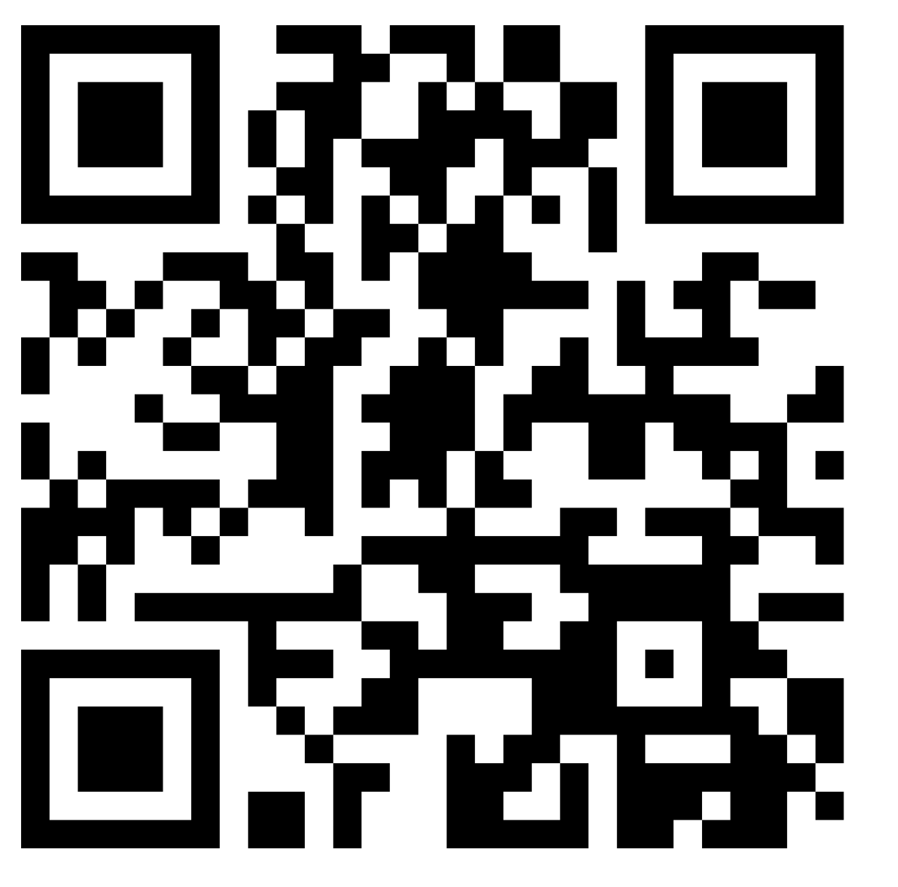
Record your attendance
392856
Notes:
[about 1 min] Attendance (SEAtS) slide.

Slide 4
Recap: Lectures 1 and 2
Lecture 1: FRs, NFRs and how to make them measurable and unambiguous
Lecture 2: eliciting requirements from stakeholders and validating them
Open problem: lists of "shall" statements can still miss how real people work
Notes:
[about 1 min] Ask: 'A list of shall statements is complete and correct. Can the system still fail its users? How?' Lead into the need for scenarios and people.

Slide 5
Lecture 3 Overview
Why requirements still fail
User-centred design and use cases
Use case anatomy, levels and a worked example
Personas and how to build them
Integrating and critically evaluating both
Learning Objectives:
Define and differentiate use cases and personas as complementary techniques
Construct well-formed use case specifications and persona profiles from research data
Integrate use cases and personas into systems analysis workflows
Critically evaluate the strengths, limitations and contexts of these methods
Notes:
[about 1 min] Bracketed codes map objectives to module outcomes (B1 decomposing at the system boundary, B2 interfaces, A3 group-project practice, B5 ethical responsibility). Adjust if you prefer.

Slide 6
Why Requirements Still Fail
Persistent risk: industry surveys continue to cite incomplete requirements and limited user involvement as leading causes of project failure.
Experienced practitioners warn that requirements specification is often the hardest, and most dangerous, stage of systems development.
Traditional elicitation (interviews, surveys, document reviews) regularly produces abstract statements that ignore lived user context.
Use cases and personas inject narrative, empathy and testable structure into socio-technical requirements.
Notes:
[about 2 min] Motivation slide. 'Socio-technical' means the system includes people, organisations and technology together. Use cases add testable structure; personas add empathy and context. The claim about industry surveys is from the original deck; cite the specific survey you prefer if asked.

Slide 7
User-Centred Design Foundations
Core principles
Systems lens
Shift design priorities from technology capabilities to human needs and contexts.
Base design decisions on an explicit understanding of users, tasks and environments.
Iterate solutions with continuous user participation and evaluation.
Systems thinking highlights multiple stakeholder perspectives in socio-technical change.
Personas humanise those viewpoints within complex ecosystems.
Use cases map the interactions stakeholders have at the system boundary, helping engineers reason about feedback loops and constraints.
Human-centred design: ISO 9241-210:2019
Notes:
[about 2 min] Two ideas: user-centred design (principles) and a systems lens (why one persona is never enough). The boundary idea leads to use cases: what happens where the system meets its users and other systems.

Slide 8
Use Cases: What and Why
Describe interactions between an actor and the system that accomplish a goal.
1
A contract for behaviour stating what the system will do, without prescribing how.
2
A bridge between business and technical audiences, because they sit at the system boundary.
3
Key terms: actor (who or what acts), goal (what they want), system boundary (what is inside the system we are building).
Notes:
[about 2 min] Use cases were popularised by Ivar Jacobson and developed by Alistair Cockburn. Stress 'without prescribing how': a use case says what the actor and the system do at the boundary, not how the software is built.

Slide 9
A Use Case Diagram: Smart Study Room
Smart Study Room
Check availability
«include»
Sensor node
Book study room
Sign in
«include»
Student
«extend»
Join waiting list
Report faulty sensor
Facilities staff
«include»: always part of the goal. «extend»: optional or exceptional behaviour. Keep diagrams high-level; put detailed logic in text.
Notes:
[about 3 min] Read the diagram: the Student is the primary actor of 'Book study room'. Booking always includes checking availability and signing in, and may be extended by 'Join waiting list' when no room is free. The Sensor node and Facilities staff are other actors. UML use case diagrams give stakeholders a quick overview; the detail lives in the text specification (next slides).

Slide 10
Use Case Anatomy
1
Name and identifier
2
Actors and stakeholders
verb + noun, e.g. UC-03 Book study room
who acts, and who else cares
3
Preconditions and triggers
4
Main success scenario
what must be true first; what starts it
numbered steps: actor intention, system response
5
Alternative flows and exceptions
6
Postconditions and business rules
what if: errors and other choices
what is true afterwards; rules that always apply
Describe intentions ("student selects a time"), not clicks ("student clicks the blue button").
Notes:
[about 3 min] The six parts of a fully dressed use case. Point out the last line: use intention words (selects, enters, confirms) instead of interface words (click, type, display), so the use case survives a redesign of the interface.

Slide 11
Use Case Levels
Summary
cloud, kite
Strategic, multi-session goals. Give context but need decomposing.
e.g. Manage campus study space
User goal
sea level
One actor, one sitting, clear value. The primary focus for specifications.
e.g. Book a study room
Subfunction
fish
Supporting steps, reused by several use cases.
e.g. Check availability, Sign in
Too low (clam): "Type the student ID" is a step inside another use case, not a use case of its own.
Notes:
[about 2 min] Cockburn's altitude metaphor: cloud and kite are summary levels above the water; sea level is the user goal, where most specification effort belongs; fish and clam are below. Correction to the old slides: they labelled kite as the user-goal level and sea as the subfunction level; in Cockburn's model the user goal is sea level.

Slide 12
Worked Example: Book a Study Room
Context
Main success scenario
Alternative flows
Primary actor: student
Stakeholders: facilities, timetabling
Precondition: student is signed in
Trigger: student selects "Book a room"
System lists rooms and current availability.
Student selects a room and time slot.
System checks the booking rules.
System presents a summary.
Student confirms.
System records the booking and marks the slot taken.
System sends a confirmation.
No room free: offer the waiting list.
Outside opening hours: show error, return to step 2.
Sensor offline: show "status unknown", allow booking.
Business rules: maximum 2 hours per booking; 3 bookings per week; cancel at least 15 minutes before the start.
Notes:
[about 4 min] The same structure as the old 'Transfer Funds' example (kept as a hidden appendix slide), moved to the Smart Study Room. Walk the columns left to right. Ask: what alternative flow is missing? (e.g. student loses connection at step 5; the room is booked by someone else between steps 2 and 5).

Slide 13
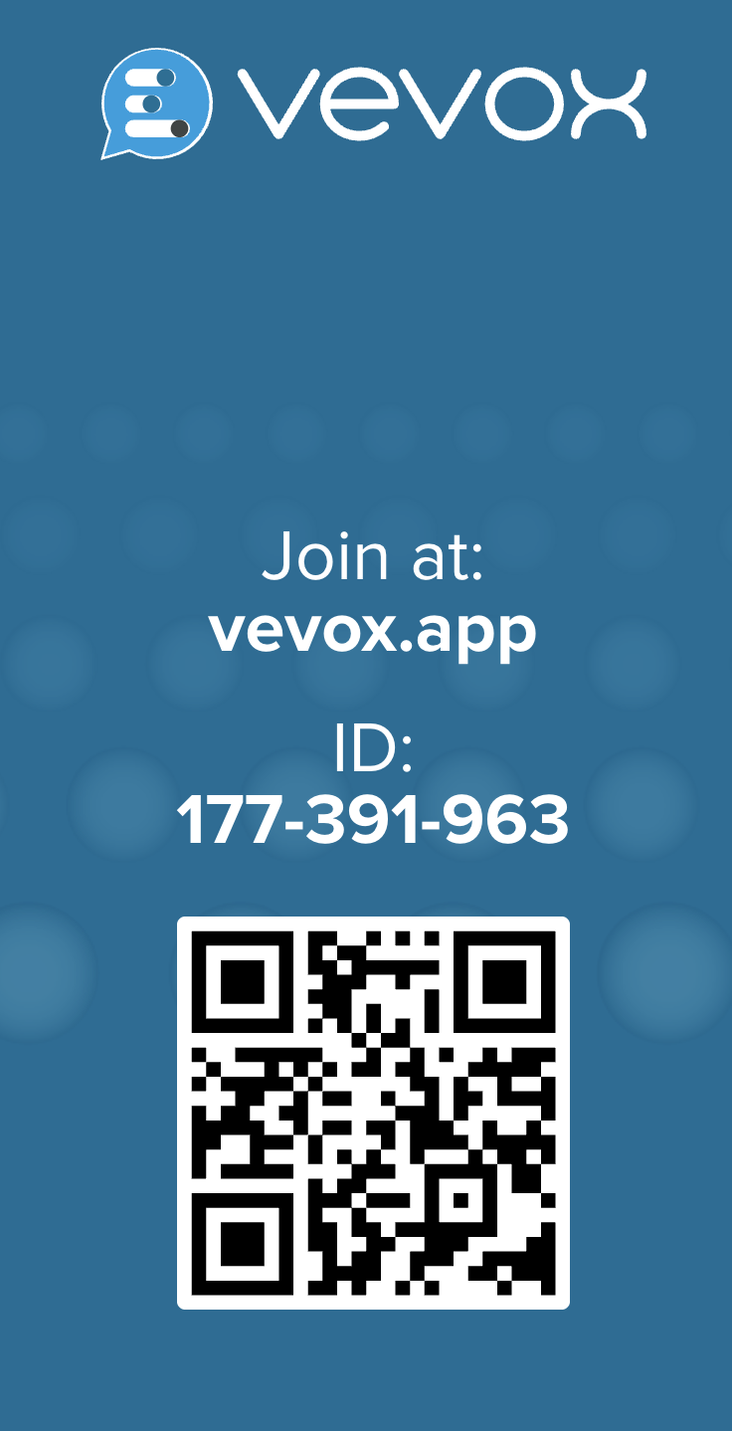
Exercise: Which level?
Let's think and reflect
Vote on Vevox
Summary, user goal, subfunction, or too low to be a use case?
Manage campus study space.
Book a study room.
Validate a booking against the rules.
Cancel a booking.
Reduce energy use across all campus buildings.
Type the student ID into the form.
Notes:
[about 3 min] Vevox multiple-choice poll with four options. About 20 seconds per statement. Answers: 1 summary, 2 user goal, 3 subfunction, 4 user goal, 5 summary, 6 too low.

Slide 14
Which level? Discussion
# | Goal | Level | Why
1 | Manage campus study space | Summary | Many user goals over weeks
2 | Book a study room | User goal | One sitting, clear value
3 | Validate a booking | Subfunction | Supports booking and changing
4 | Cancel a booking | User goal | One sitting; frees the room
5 | Reduce campus energy use | Summary | Strategic, many systems
6 | Type the student ID | Too low | A step in another use case
User-goal test: can the actor walk away satisfied after one sitting? If it is only a piece of that, it is a subfunction; if it spans days, it is a summary.
Notes:
[about 2 min] Statement 3 could be argued either way; if a student opened a tool just to validate a booking it would be a user goal. That is the point: the level depends on the actor and the goal.

Slide 15
Personas: What and Why
A persona is a fictional but evidence-based profile of a group of typical users, used to make design decisions about real people.
Use cases: behaviour
What the system does for an actor to reach a goal. Text, testable.
Personas: context
Who the users are and why they act: goals, frustrations, situation.
Keep users in view
Align the team
Test decisions: "Would Priya manage this?"
A persona is not an average user and not a stereotype: every attribute should trace back to research data.
Notes:
[about 2 min] Paired toolkit: use cases capture behaviour, personas anchor it in lived context. The persona idea was popularised by Alan Cooper. Personas humanise stakeholder viewpoints in a complex ecosystem, which links back to the systems lens.

Slide 16
Building Personas from Research Data
1
Collect data
interviews, surveys, observation, usage analytics
2
Find patterns
cluster goals, behaviours and contexts (affinity mapping)
3
Draft
name, goals, frustrations, context, a representative quote
4
Validate
check with real users; remove invented detail
5
Use and review
refer to it in decisions; update or retire it when stale
Evidence first: if you cannot point to the data behind an attribute, leave it out.
Notes:
[about 3 min] Persona creation as a small research process. Affinity mapping: write observations on notes and group them. Validation matters: show the draft to participants and ask 'does this sound like someone you know?'. Stale personas are a risk (see critical evaluation).

Slide 17
Example Persona: Priya
P
Goals
Find a quiet, step-free room without wasting a journey.
Book by keyboard and screen reader in under two minutes.
Priya, 20
2nd-year engineering student
Screen reader user
Commutes 30 minutes
Studies in 2 to 3 hour blocks
Frustrations
Dashboards that show room status only as colours or icons.
Rooms that are full or noisy on arrival.
"I just want to know a room is free before I leave home."
Illustrative fictional persona, based on 8 interviews and 120 survey responses (numbers invented for the example).
Notes:
[about 2 min] A short persona card: identity, goals, frustrations, context, a quote and, importantly, the evidence base. This persona is invented for teaching. It uses a disability as an accessibility need relevant to the system, without making it the whole identity; call this out. Exercise 2 uses Priya.

Slide 18
Integrating Personas and Use Cases
Use case | Priya | Sam | Alex
Book a study room | ● | ● | -
Cancel a booking | ○ | ● | -
Check availability before travelling | ● | ● | ○
Report a faulty sensor | - | ○ | ●
Get an audible "room free" alert | ● | Conflict | -
● primary ○ occasional - not needed. Sam: commuter. Alex: facilities technician.
An empty row: a use case nobody needs. An empty column: a persona nobody serves.
A conflict (Priya needs audio alerts; Sam studies in a silent library) is a design decision to make early.
A scenario tells one persona's use case as a short story in context.
Notes:
[about 3 min] Map personas to use cases to expose coverage gaps, conflicting needs and improvement opportunities. Here the conflict cell shows a requirement conflict caught before design. A scenario combines persona, goal and context into a short narrative (for example: Priya, at home before a 9am lab, checks that a step-free room is free).

Slide 19
Strengths and Limitations
Strengths
Limitations
Build empathy and a shared picture of users.
Make behaviour concrete and testable.
Expose coverage gaps and conflicting needs.
Bridge business and technical audiences.
Bias and stereotype drift from invented detail.
Stale specifications if never reviewed.
Cost and over-documentation.
Typical users are covered; edge cases and inclusion can be missed.
Right-size the documentation: lightweight for agile iterations, richer artefacts for regulated or high-risk domains. Plan reviews to keep insights current.
Notes:
[about 3 min] Critical evaluation for learning outcome 4 (and B5): personas can encode bias. Ask: whose voices are missing from the data? Invented details (a stock photo, a hobby) add false certainty. Future directions (AI-assisted personas, living personas) are in the hidden appendix.

Slide 20
Summary and What's Next
Use cases: capture behaviour at the system boundary
Personas: anchor it in evidence about real users
Levels: specify at user-goal level, with alternative flows
Integration: map personas to use cases to find gaps and conflicts
Care: watch for bias, stereotypes and stale documents
Let's read and explore
Cockburn, A. (2001). Writing Effective Use Cases. Addison-Wesley.
Jacobson, I. et al. (1992). Object-Oriented Software Engineering: A Use Case Driven Approach.
Cooper, A. (1999). The Inmates Are Running the Asylum.
Pruitt, J. and Adlin, T. (2006). The Persona Lifecycle.
ISO 9241-210:2019. Human-centred design for interactive systems.
Next: System architecture: turning requirements into components and interfaces.
Notes:
[about 2 min] Close with the takeaways and preview the next block. Ask students to keep Priya's use case and the requirement lists from this week: they feed the architecture work. The slides after this one are hidden appendix slides.

Slide 21
Appendix: Worked Example, Transfer Funds
Context
Main success scenario
Alternative flows
Primary actor: account holder
Stakeholders: bank compliance, fraud monitoring
Preconditions: authenticated user holds 2 or more accounts
Trigger: user selects "Transfer Funds"
System lists accounts and balances.
User selects source and destination.
User enters amount.
System validates funds.
System displays summary.
User confirms.
System executes transfer, updates balances, logs the transaction.
Invalid amount: display error, return to entry.
Insufficient funds: display balance, retry.
Technical failure: roll back, log error, notify user.
Business rules: daily limit £10k; transfers over £5k require step-up authentication; minimum £1.
Notes:
Hidden appendix slide, from the old deck.

Slide 22
Appendix: Transfer Funds as a Flow
List accounts and balances
Select source and destination
Enter amount
Validate funds
Display summary
Confirm transfer
Process transfer
Update balances and record audit log
Actors: Account Holder (primary), Core Banking System (invoked by Process transfer), Fraud Monitoring, Compliance Team.
Handle transfer errors (extends the flow): invalid amount, insufficient funds or technical failure lead to an error message, then a retry prompt or escalation to support, and a record in the audit log for compliance and fraud monitoring.
Notes:
Hidden appendix slide: a condensed version of the three banking use case diagrams in the old deck (Execute Transfer, Review Transfer Summary, Handle Transfer Errors).

Slide 23
Appendix: Use Cases vs User Stories
 | Use case | User story
Form | Structured scenario with steps and flows | "As a [user], I want [function], so that [goal]."
Level | Usually one user goal | A small slice of a goal
Detail | Preconditions, flows, business rules | Conversation plus acceptance criteria
Best for | Multi-actor, regulated, complex interactions | Agile teams iterating quickly
Weakness | Heavier to write and maintain | The big picture can be lost
Notes:
Hidden appendix slide. Both are effective in multi-component systems where software, hardware and user interaction must be aligned. Many teams use both: use cases for the overview, stories for the backlog.

Slide 24
Appendix: Future Directions
Living personas: update them with analytics and feedback rather than filing them away.
AI-assisted drafting: language models can draft personas or use cases, but treat the output as a hypothesis, validate it with real users, and never paste personal interview data into public tools.
Inclusive design from the start: include accessibility needs and edge cases in the persona set.
Continuous discovery: keep talking to users after launch.
Notes:
Hidden appendix slide covering the 'Future Directions' item in the old agenda, which had no slide.

