Slide 1

Welcome to Systematic
Design
SEAtS | 544403

Slide 2
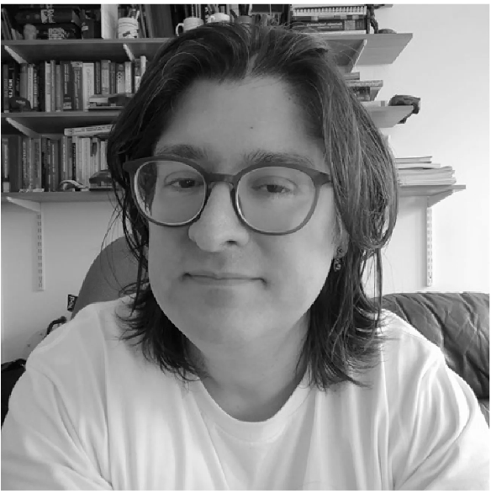
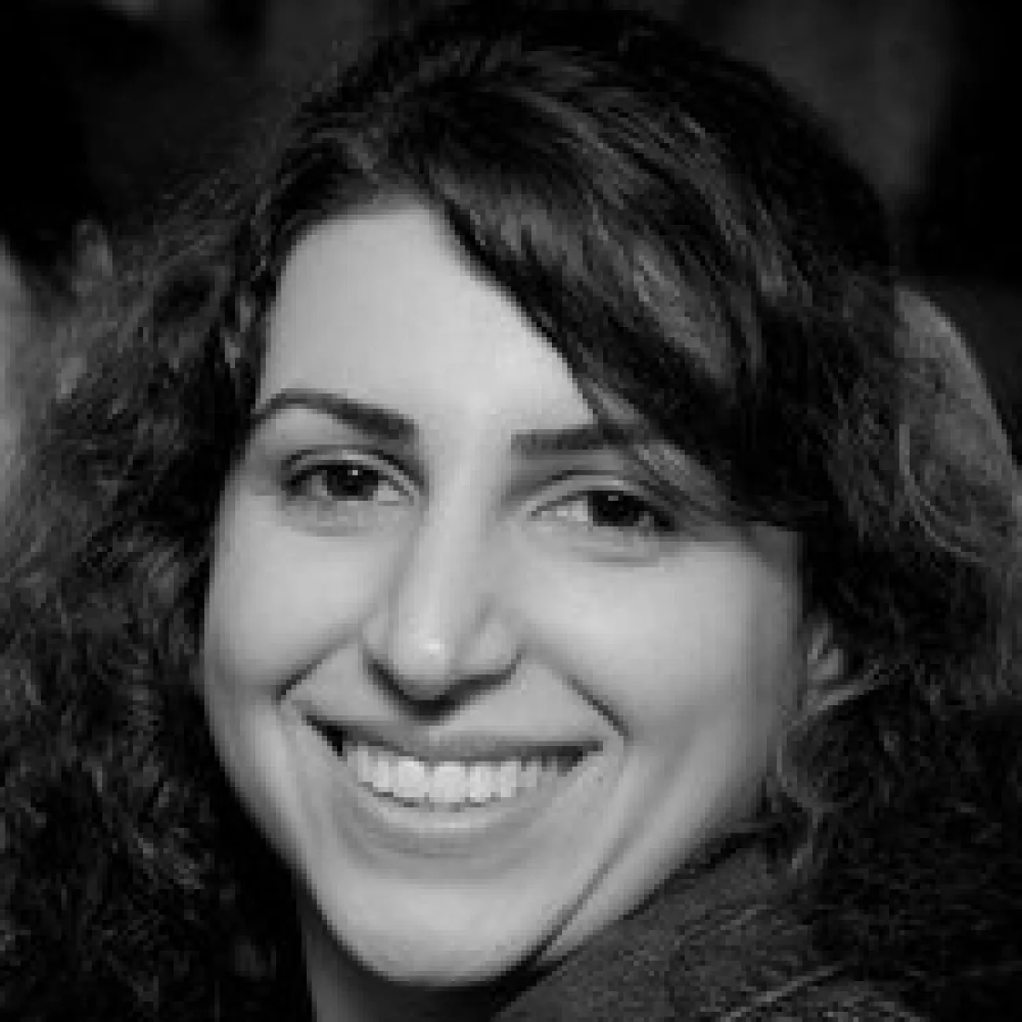
Nawfal Al Hashimy
Asieh Salehi Fathabadi
nawfal@soton.ac.uk
A.Salehi-Fathabadi@soton.ac.uk
Lectures, Assignment Workshops
Lectures, Formal Methods workshop
2
SEAtS | 544403
Version: GITREVISION | © 22.09.2026 University of Southampton

Slide 3
Purpose of this Module
The goal of this module is to give students an overview of the theory and methods for designing and
delivering large multi-component systems.
There will be a particular emphasis on systems which combine requirements and functionality from
learning, software, and hardware, and the ways in which the boundaries between them can be identiﬁed
and managed.
This module provides preparatory tools and techniques for the group project module in semester 2.
3
SEAtS | 544403
Version: GITREVISION | © 22.09.2026 University of Southampton

Slide 4

Motiviation
4
SEAtS | 544403
Version: GITREVISION | © 22.09.2026 University of Southampton

Slide 5
Syllabus
Analysing systems
Designing systems
Functional and non-functional requirements
Decomposing into blocks
Requirements gathering
Identifying interfaces
System architecture
Designing APIs and protocols
Integrating libraries and IP
Formal speciﬁcation
Testing systems
Managing
Build systems
development
Continuous integration (both hw and sw)
Development methodologies
Testing hardware+software+network systems
Project management
Formal veriﬁcation
Advanced source control
(e.g. review, bots, …)
5
SEAtS | 544403
Version: GITREVISION | © 22.09.2026 University of Southampton

Slide 6
Course Structure
Three 1-hour lectures per week
Tuesday 09:00 (35/1005)
Tuesday 17:00 (35/1005)
Thursday 14:00 (02/1039)
One 3-hour Workshop per week
Wednesday 09:00-12:00 (02/1039)
6
SEAtS | 544403
Version: GITREVISION | © 22.09.2026 University of Southampton

Slide 7
Coursework and Exams
Coursework
(Tentative) Set in Week 4
You can start early, but some material up to Week 8 will be required.
Due in Week 11 (before the X-mas break)
Feedback in the new year
Final exam
Semester 1 Exam period (in the New Year)
ß2-hour Computer-Aided Assessment (CAA)
7
SEAtS | 544403
Version: GITREVISION | © 22.09.2026 University of Southampton

Slide 8
Course Management
Moodle
(Required login with your University ID)
https://moodle.ecs.soton.ac.uk/course/view.php?id=1022
Annoucements will be sent via Moodle.
8
SEAtS | 544403
Version: GITREVISION | © 22.09.2026 University of Southampton

Slide 9
Timetables
Your timetable shows all of the sessions/workshops allocated to your
modules
Modules do not always use all of those sessions!
For example, we have a Reading Week
So check the notes pages of each course for more info and adjust your
timetable accordingly!
9
SEAtS | 544403
Version: GITREVISION | © 22.09.2026 University of Southampton

Slide 10
Reminder AICE2005 Tentative Timetable
10
SEAtS | 544403
Version: GITREVISION | © 22.09.2026 University of Southampton

Slide 11
How to Get Help
Refrain from emailing (get lost in the avalanche)
Donʼt drop by the oﬃce without schedule (often busy)
Do come down to ask questions at the end of the lecture
Do ask questions in the workshop
Do ask each other!
Be careful of academic responsibility and conduct.
11
SEAtS | 544403
Version: GITREVISION | © 22.09.2026 University of Southampton

Slide 12
Your Special Circumstances
If you have a special circumstance that might aﬀect your assessments
(e.g., coursework, exams):
Donʼt panic
Donʼt ask us (the module team) for extensions, etc.
Do talk to your personal academic tutor
Do apply to the Special Circumstance Board (SCB).
You need evidence to support your claim, e.g., doctor letter
Contact the Student Hub to ﬁll out the relevant forms
To extend the deadline (if the deadline has not yet passed)
To waive the late penalty (if the deadline has already passed).
To resit an exam
12
SEAtS | 544403
Version: GITREVISION | © 22.09.2026 University of Southampton

Slide 13
Our Special Circumstances
If we have a special circumstance that aﬀects the delivery of a lecture:
Donʼt panic
If feasible, we (the module team) will arrange to cover lecture
Else, we will rearrange the timetable if it makes sense
(We have a couple of free back-up slots)
Otherwise, we will provide a lecture recording for the missing lecture.
13
SEAtS | 544403
Version: GITREVISION | © 22.09.2026 University of Southampton

Slide 14

Thank you
Dr Nawfal Al Hashimy
Lecturer in Cyber Physical Security
Universtity of Southampton | Faculty of Engineering and Physical
Sciences
Cyber Physical Systems Research Group
☎
+44 (0) 23 8059 6659
@ Nawfal@soton.ac.uk
Highﬁeld Campus, Building 53, Room 4049
Burgess Road, Southampton SO17 1BJ, UK

