Slide 1

Infrastructure as Code:
Foundations
From cloud strategy to automated delivery
SEAtS | 749131

Slide 2
Intended
By the end of this lecture you will be able to:
Learning
1. Summarise cloud characteristics and deployment/service models that
inﬂuence IaC.
Outcomes
2. Explain how DevOps and "cattle not pets" thinking enable
reproducible infrastructure.
3. Decompose infrastructure requirements into declarative modules and
interfaces.
4. Compare manual, ad hoc, and Infrastructure-as-Code approaches,
and the three ways to
write
IaC.
5. Trace the Pulumi project/stack workﬂow from
pulumi new
through
up
to
destroy
.
6. Plan testing, CI/CD, and policy-as-code workﬂows for IaC.
7. Identify common risks/anti-patterns in IaC projects and propose
mitigations.
2
SEAtS | 749131
© University of Southampton

Slide 3
Agenda
1. Cloud context: characteristics,
deployment/service models.
2. DevOps mindset & naming the IaC problem.
3. IaC building blocks, modules, interfaces.
4. Pulumi fundamentals: declarative vs
imperative, projects and stacks.
6. Testing, CI/CD, and policy-as-code.
7. Risks, anti-patterns, and closure.
3
SEAtS | 749131
© University of Southampton

Slide 4
What is Cloud Computing?
"A model for enabling convenient, on-demand network access to a shared pool of conﬁgurable computing
resources… that can be rapidly provisioned and released with minimal management eﬀort or service provider
interaction." — NIST SP 800-145.
1. On-demand self-service
Improved security and "unlimited" capacity.
2. Broad network access
Cost eﬃciencies; zero up-front capital.
3. Resource pooling
Elastic scaling as system grows.
4. Rapid elasticity
Time eﬃciencies via virtual resources.
5. Measured service
Power eﬃciency and visibility into consumption.
Improved process control and quick recovery.
4
SEAtS | 749131
© University of Southampton

Slide 5
timeline title Evolution of Cloud Infrastructure Wave 1 : Static infrastructure : Single VMs accessed via SSH
Wave 2 : Growing complexity : Containers : Provisioning tools (Docker, Datadog) Wave 3 : Modern cloud :
Containers : Serverless : Managed services
5
SEAtS | 749131
© University of Southampton

Slide 6
Each wave adds more moving pieces — and more edges connecting them. IaC is the glue between those
edges. Counter-intuitively, a more complex-looking modern architecture diagram can be
easier
to
maintain than an old simple one, because the slice of it that's actually your own hand-written code (as
opposed to managed service conﬁguration) keeps shrinking — less operational burden sits on your team as
the cloud provider absorbs more of the plumbing.
6
SEAtS | 749131
© University of Southampton

Slide 7
Cloud Deployment Models
1. Public: Infrastructure available to general public, owned by service provider.
2. Private: Dedicated to a single organisation, managed on/oﬀ premise.
3. Community: Shared by organisations with common concerns.
4. Hybrid: Combination of cloud types.
")] end
"]
"] <-->
")]
"] <--> PuC
"]
"] <-->
")] HO <-->
")] end subgraph
subgraph
PuO1["Org
PuC[("Public
PuO2["Org
end subgraph
HO["Organisation
HC1[("Private
HC2[("Public
Community["Commu
Public["Public
A
Cloud
B
Hybrid["Hybrid
Cloud
Cloud
7
SEAtS | 749131
© University of Southampton

Slide 8
On premises Computing vs. Cloud Computing
On Premises
Cloud
Manually provisioned
Self-provisioned
Dedicated hardware
Shared hardware
Fixed capacity
Elastic capacity
Pay for capacity
Pay for use
CapEx + OpEx
Operational expenses
Managed via sysadmins
Managed via APIs
ﬂowchart
"] direction TB
"] -->
"] -->
"] end
"]
"] -->
"] -->
"] end H3
"|
LR
H1["Dedicated
H2["Fixed
H3["Manually
by
subgraph
direction
S2["Elastic
S3["Self-
via
-.-
S1
subgraph
Hardware
Capacity
Provisioned
Sysadmins
Cloud["Cloud
TB
Capacity
Provisioned
APIs
>|"modern
OnPrem["On
S1["Shared
teams
Premises
Hardware
move this
way
8
SEAtS | 749131
© University of Southampton

Slide 9
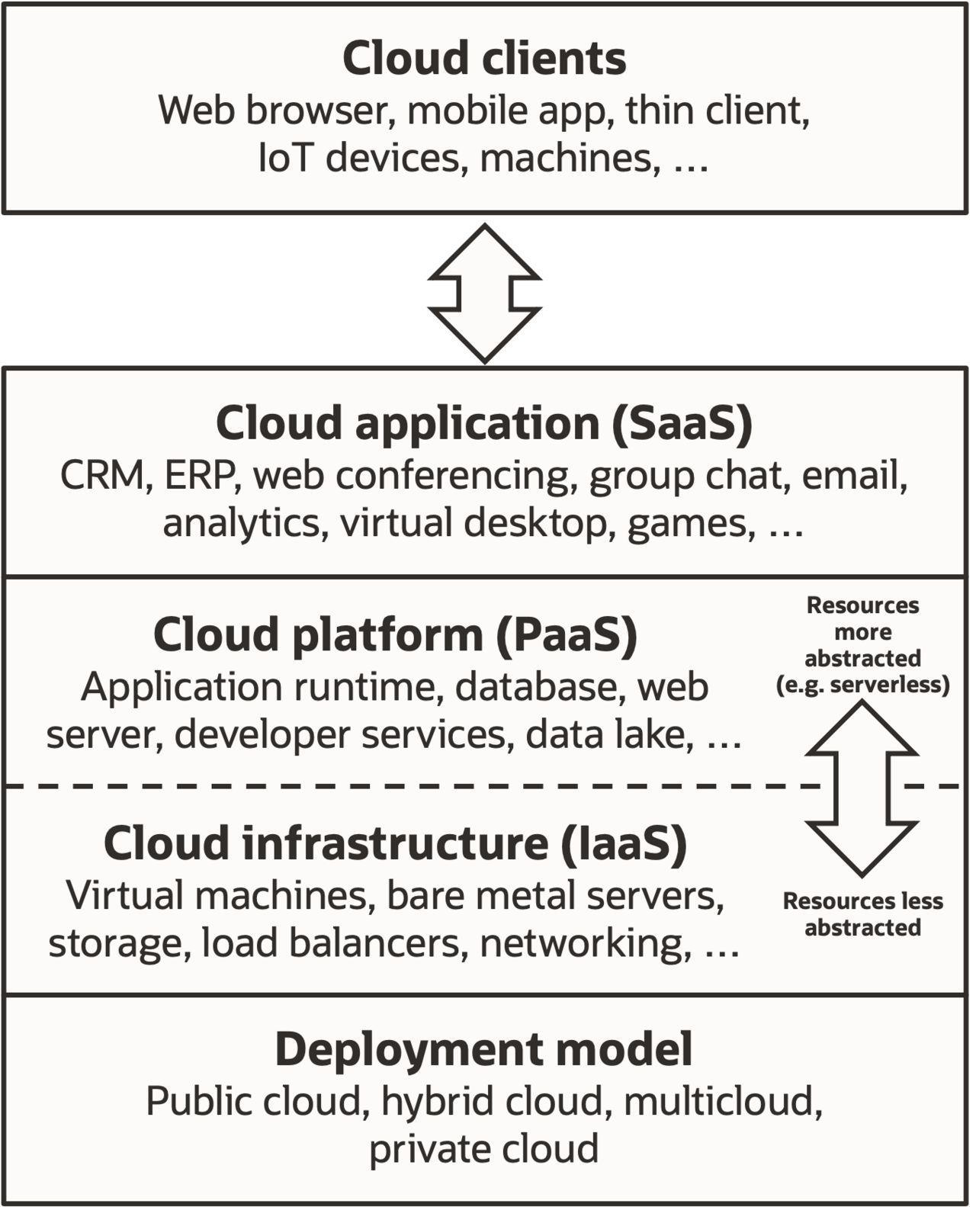
Main Service Delivery
Models
IaaS: Provision virtual machines, networks, and storage inside the
provider's infrastructure to run any OS or application stack.
Control over guest OS and runtimes.
Examples: EC2, Virtual Networks.
PaaS: Build and deploy custom applications using provider-supported
runtimes and tooling.
Auto elasticity and built-in CI/CD.
Examples: App Engine, Azure App Service.
SaaS: Consume fully managed provider applications delivered over the
cloud.
No infrastructure management; pay per use.
Examples: Gmail, Salesforce.
9
SEAtS | 749131
© University of Southampton

Slide 10
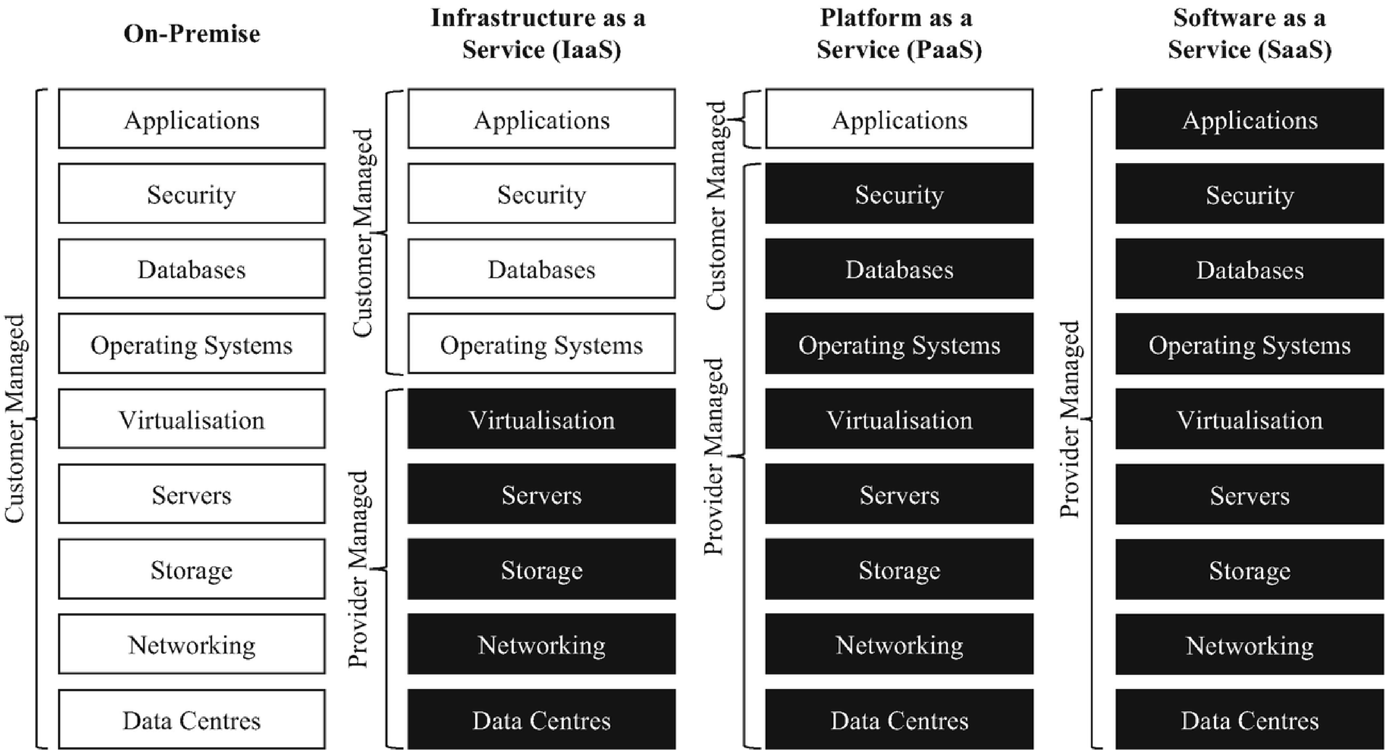
10
SEAtS | 749131
© University of Southampton

Slide 11
Service Delivery Models — Who Manages What
IaaS: You manage from the OS up — runtime, middleware, data, and the application.
PaaS: You manage your application and data; the provider manages the OS, runtime, and middleware.
SaaS: The provider manages everything — you just use the application.
IaC's job: write the code that manages the IaaS resources — and the SaaS-like managed services — a cloud provider
gives you. The inner the layer, the more of it your Pulumi/Terraform code is responsible for.
11
SEAtS | 749131
© University of Southampton

Slide 12
Architectural Patterns
Pattern
Description
Peer-to-Peer
Direct communication between two components without a central coordinator.
API Gateway
Single entry point for all client requests to the backend services of an application.
Pub-Sub
Decouples publishers from subscribers through a message broker.
Request–Response
Client sends a request to a server and waits for a response.
Event Sourcing
Store application state changes as a sequence of immutable events.
ETL
Gather data from sources, transform it, and load into a destination.
Batching
Accumulate data over time/threshold before processing as a group.
Streaming ProcessingContinuously ingest, process, and analyse data in real time.
Orchestration
Central coordinator manages interactions between distributed components.
12
SEAtS | 749131
© University of Southampton

Slide 13
Architectural Patterns — Service
Communication (1/3)
Peer-to-Peer
ﬂowchart LR
"] -.->
"] O1 -.->
"]
"] -.-> P2 O2 -.-
"]
"] -.-> P3 O3 -.-
"]
O1["Order Svc
P1["Payment
P2["Payment
O2["Order
> P3["Payment
O3["Order
> P4["Payment
1
Svc 1
Svc 2
Svc 2
Svc 3
Svc 3
Svc 4
13
SEAtS | 749131
© University of Southampton

Slide 14
API Gateway
ﬂowchart LR Client -->
"] GW -->
"] GW -->
"] GW -->
"] GW -.-> Cross["Auth ·
"]
GW["API Gateway
S1["Service 1
S2["Service 2
S3["Service 3
Rate Limit · Routing
14
SEAtS | 749131
© University of Southampton

Slide 15
Pub-Sub
ﬂowchart LR
"] -->
"))
"] --> Topic Topic -->
"] Topic -->
"]
Pub1["Publisher 1
Topic(("Topic
Pub2["Publisher
Sub1["Subscriber 1
Sub2["Subscriber 2
2
15
SEAtS | 749131
© University of Southampton

Slide 16
Architectural Patterns — Data
Flow (2/3)
Request–Response
ﬂowchart LR Client -- "HTTP
" --> Server Server -- "HTTP
" --> Client Server <-->
")]
Request
Response
DB[("Database
16
SEAtS | 749131
© University of Southampton

Slide 17
Event Sourcing
ﬂowchart TD
"] --> E2["Item 1
"] --> E3["Item 2
"] -->
")] Store -->
"]
E1["Order Created
Added
Added
Store[("Event
View["Order View
Store
17
SEAtS | 749131
© University of Southampton

Slide 18
ETL
ﬂowchart LR Src[("DB · Files · Apps
")] --> Extract --> Transform --> Load --> Dest[("Destination
")]
18
SEAtS | 749131
© University of Southampton

Slide 19
Architectural Patterns —
Processing & Control (3/3)
Batching
ﬂowchart LR I1["Input
"] & I2["Input
"] & I3["Input
"] --> BP["Batch Processor
"] --> Out["Output
"]
19
SEAtS | 749131
© University of Southampton

Slide 20
Streaming Processing
ﬂowchart LR
"] -->
"] --> Proc["Continuous
"] -->
"]
I1["Input
Stream["Stream
Processing
Out["Output
20
SEAtS | 749131
© University of Southampton

Slide 21
Orchestration
ﬂowchart TD
")) -->
"] Orch -->
"] Orch -->
"] Orch -->
"]
Orch(("Orchestrator
A["Service A
B["Service B
C["Service C
D["Service D
21
SEAtS | 749131
© University of Southampton

Slide 22
Many "as-a-Service" Oﬀerings
Examples include Analytics, API, AI, Backend, Banking, Big Data, Blockchain, Business Process, Code, Content,
Construction, Container, Crane, Edge Compute, Contact Centre, Communications Platform, Data, Desktop, Drone,
Database, Distribution, Energy, Engagement, EV, Function, Farming, Firewall, Games, Governance, Hadoop,
Hardware, Housing, Identity, Image, IoT, IT, Knowledge, Load Balancing, Logging, Management, Microgrid, Mobility,
Monitoring, Metal, Mobile Backend, Machine Learning, Network, Network Defense, Payments, Policy, Product, Push
Notiﬁcation, QA, RAN, Recovery, Recycling, Robot, Search, Security, Solar, Shared Storage, Transportation, Testing,
Time Series DB, Uniﬁed Communications, and "Anything as a Service."
22
SEAtS | 749131
© University of Southampton

Slide 23
Infrastructure: Cattle vs Pets
Development environments should be consistent and reproducible, like managing "cattle" (identical, disposable
instances) rather than unique "pets" (customised desktops). This ensures faster onboarding, predictable testing, and
reliable automation.
ﬂowchart
"]
"]
"] end
"]
"]
"]
"] end
"] -.-
LR
P1["web-
hand-
never
P2["db-
one-
subgraph
C1["web-
C2["web-
C3["web-
Note["Any
dies?
the
>
subgraph
server-
tuned
rebuilt
server-
oﬀ
Cattle["Cattle
01
02
03
instance
Re-
same
Cattle
Pets["Pets
dave
janet
conﬁg
run
code.
23
SEAtS | 749131
© University of Southampton

Slide 24
DevOps =
Development + Operations
Development: fast, automated builds & tests. Operations: reliability, monitoring, incident response. Bridge: shared
CI/CD + IaC tooling and SLOs align both.
"] -->
"]
"] --> VC VC -
"] CD -->
"] CD -->
ationCode
VC["VersionControl
InfraCode["InfrastructureCode
->
Pipeline
CodeProd["CodeProduction
StageInfra["Sta
CD["Continuous
Delivery
24
SEAtS | 749131
© University of Southampton

Slide 25
Naming the Problem IaC Solves
Modern applications can deploy to production up to 100 times a day, and infrastructure often needs to scale up or
down automatically in response to load — neither is viable with manual, one-oﬀ changes.
"] -->
"} B --
"|
"] B --
"|
"] B --
"|
a
B{"How?
>|"Point-
in a
Manual["Manual
>|"One-
commands
scripts
AdHoc["Ad
automation
>|"Declare
state
IaC["Infras
e
resource
and-click
console
oﬀ CLI
/
hoc
desired
in
code
25
SEAtS | 749131
© University of Southampton

Slide 26
Three Ways to Manage Infrastructure
Approach
What it is
Manual
Point-and-click resource creation/modiﬁcation directly in a console
Ad hoc automation
CLI commands or scripts — some code, but not structured for reuse
Infrastructure as
Provisioning (declaratively creating/modifying resources) + conﬁguration
Code
(changing an existing resource's state)
26
SEAtS | 749131
© University of Southampton

Slide 27
Three Ways toWrite IaC
Method
Description
Resources (EC2 instance, security group, …) listed as structured data
JSON
for the provider to consume
Domain-speciﬁc language
A custom syntax built for one tool/provider — looks code-like, isn't a
(DSL)
general-purpose language
General-purpose
A real language (Pulumi supports TypeScript, JavaScript, Python, Go,
programming language
.NET) used to describe infrastructure
The general-purpose-language approach brings loops, conditionals, classes, and packages to infrastructure
deﬁnitions — e.g. a
for
loop that creates one instance per availability zone — plus normal IDEs, linters, and test
frameworks.
27
SEAtS | 749131
© University of Southampton

Slide 28
IaC Deﬁnition & Motivation
Infrastructure as Code (IaC): Deﬁne and manage infrastructure via machine-readable ﬁles instead of manual
provisioning.
Why essential?
Rapid provisioning for software, hardware, and learning integration.
Reduces conﬁguration drift and enables CI/CD pipelines.
Enhances repeatability, testing, and formal speciﬁcation.
Critical for distributed cloud systems.
28
SEAtS | 749131
© University of Southampton

Slide 29
Requirements in IaC
Functional examples: Deploy VPC/VNet; automate Kubernetes clusters; create IAM roles.
Non-functional examples: Scalability, security hardening, fault tolerance, cost-eﬃciency, auditability, compliance.
IaC formalises both sets of requirements in code.
Cloud provider selection (AWS, Azure, GCP).
State storage (S3, Blob, GCS).
Secrets management (Vault, Secrets Manager).
Access patterns (SSH, API gateways, private endpoints).
Compliance constraints (residency, logging).
Integration requirements (CI, monitoring, networks).
Methods: stakeholder interviews, architecture diagrams, threat modelling.
29
SEAtS | 749131
© University of Southampton

Slide 30
System Architecture for IaC
IaC encourages decomposition into modules:
Networking (VPC, subnets, ﬁrewalls).
Compute (VMs, containers).
Storage (S3, RDS).
Identity (IAM roles, policies).
Monitoring (metrics, logging).
Declarative vs Imperative
Approach
Description
Examples
Declarative
Describe desired state; engine reconciles
Terraform, CloudFormation, Bicep
Imperative
Execute procedural steps
Ansible, scripts
30
SEAtS | 749131
© University of Southampton

Slide 31
Designing IaC Systems
Decomposing
Identifying
Designing
Integrating
Managing
into Blocks
Interfaces
APIs &
Providers & IP
Third-Party IP
Protocols
Example module
Interfaces via:
Cloud providers
Version pinning
folders:
Input variables.
IaC interacts with:
(AWS, Azure,
and lifecycle
/networking
Output
Cloud provider
GCP).
management.
/identity
variables.
APIs.
Third-party
Licensing and
/compute
Remote state
Terraform /
providers
compliance
references.
Pulumi provider
(Cloudﬂare,
considerations.
/database
Datadog).
Security
Interfaces must be
schemas.
/monitoring
Internal
scanning of
clear, versioned,
Kubernetes
documented, and
manifests/CRDs
libraries reused
modules/provid
stable.
.
across teams.
ers.
31
SEAtS | 749131
© University of Southampton

Slide 32
Service Delivery Platform
"] -->
"] -->
"] -->
")] end
"] direction LR
"] -->
vironment+
InfraBuild["Builder
InfraPkg["Packager
InfraRepo[("Package
subgraph
AppRepo -->
ModAuto1["
Speciﬁcation
Repository
Deploy["Deploy
Installer["Package
Automation
Installer
Artifact: Versioned, tested, deployed units.
Procedures (Imperative): Commands to produce desired state (e.g., Bash).
Functions (Declarative): Deﬁne desired state; tooling conforms system (e.g., SQL, makeﬁles).
32
SEAtS | 749131
© University of Southampton

Slide 33
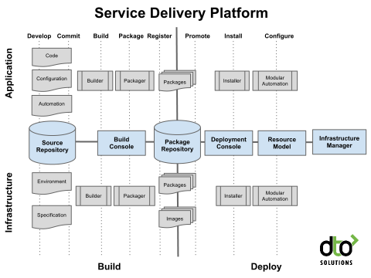
33
SEAtS | 749131
© University of Southampton

Slide 34
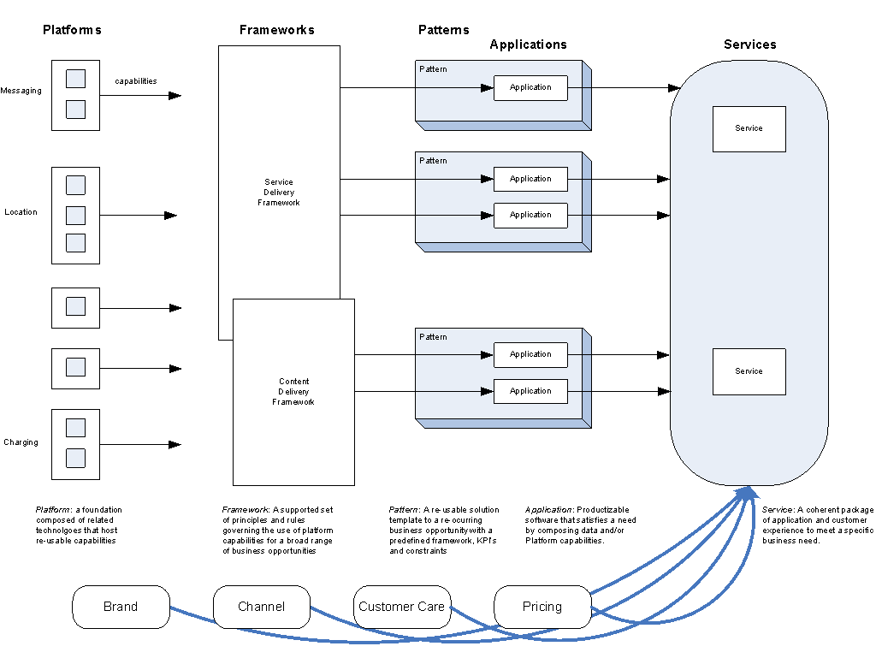
34
SEAtS | 749131
© University of Southampton

Slide 35
Formal Speciﬁcation in IaC
JSON/YAML schemas (CloudFormation, Kubernetes).
Terraform variable typing and module interfaces.
Policy-as-Code (OPA/Rego) for compliance.
Cloud policies (AWS Conﬁg, Azure Policy) to enforce encryption, logging, segmentation.
Formalisation supports reproducibility and enforcement.
35
SEAtS | 749131
© University of Southampton

Slide 36
IaC as JSON / DSL — Vagrant
Examples
Vagrant.configure("2") do |config|
servers = YAML.load_file('servers.yaml')
config.vm.box = "peru/ubuntu-18.04-desktop-amd64"
Vagrant.configure(VAGRANTFILE_API_VERSION) do |config|
config.vm.box_version = "2.3"
servers.each do |server|
config.vm.provider "virtualbox" do |vb|
config.vm.define server["name"] do |srv|
vb.gui = true
srv.vm.box = server["box"]
vb.memory = "1024"
srv.vm.network "private_network", ip: server["ip"]
vb.name = "ubuntudesktopscyther"
srv.vm.provider :virtualbox do |vb|
end
vb.name = server["name"]
end
vb.memory = server["ram"]
end
end
end
end
36
SEAtS | 749131
© University of Southampton

Slide 37
Pulumi : hybrid?
Pulumi is a hybrid, not a straightforward "imperative" tool: its
state model
is declarative — you describe desired
infrastructure and
pulumi up
diﬀs it against reality, exactly like Terraform — but its
authoring language
is a real
general-purpose language (Python), which is imperative. Two separate axes: what gets reconciled vs how you
express it.
Declarative state reconciliation scales better than hand-written procedural steps for large multi-component systems
— true whether you write that declaration in HCL (Terraform) or in Python (Pulumi).
37
SEAtS | 749131
© University of Southampton

Slide 38
From Theory to Pulumi: The
Workﬂow
A project is a single program that declares desired infrastructure; a stack is one deployed instance of that project
(e.g.
dev
vs
prod
) — same program, diﬀerent conﬁg (region, parameters), deployed independently. Neither term
appears in the theory chapters above — this is the vocabulary that was missing.
sequenceDiagram actor Dev participant CLI as Pulumi CLI participant Cloud as AWS Dev->>CLI: pulumi new
<template> CLI-->>Dev: scaﬀolds project + "dev" stack Dev->>CLI: pulumi conﬁg set aws:region ... Dev-
>>CLI: pulumi up CLI->>CLI: diﬀ desired state (code) vs actual state CLI-->>Dev: preview of resources to
create/update Dev->>CLI: conﬁrm (yes) CLI->>Cloud: create/update resources Cloud-->>CLI: resulting
resource state CLI-->>Dev: outputs (e.g. bucket name, URL) Dev->>CLI: pulumi stack output <name>
CLI-->>Dev: exported value Note over Dev,CLI: edit main.py, re-run "pulumi up" — only the minimal diﬀ is
applied Dev->>CLI: pulumi destroy CLI->>Cloud: tear down all stack resources Dev->>CLI: pulumi stack
rm <name>
38
SEAtS | 749131
© University of Southampton

Slide 39
Testing IaC Systems
Testing types:
1. Static testing (linting: tﬂint, checkov; policy-as-code).
2. Unit tests (Terratest, Molecule).
3. Integration tests (ephemeral deployments).
4. Acceptance tests (VPC routing, IAM permissions).
5. Security tests (CSPM, IaC scanning).
39
SEAtS | 749131
© University of Southampton

Slide 40
Build Systems & CI
Standard Pipeline
Continuous Deployment
Managing
(GitOps)
Development
1. Validate (
pulumi preview
/
terraform validate
).
ArgoCD / Flux for declarative
Methodologies: Agile, DevOps,
2. Lint (tﬂint, checkov).
sync.
GitOps, infrastructure release
Atlantis, Spacelift, Terraform
management.
3. Plan (static analysis, diﬀs).
4. Approvals (human-in-loop).
Cloud / Pulumi Cloud for
Multi-team decomposition,
5. Apply (automated, controlled).
collaboration.
module backlogs, environment
6. Post-deploy tests (Terratest,
Automated rollbacks based on
versioning.
smoke tests).
policy drivers.
Branch protection, review bots
(tfsec), semantic versioning.
Automated changelogs and
release notes.
40
SEAtS | 749131
© University of Southampton

Slide 41
Provisioning / Deployment /
Orchestration / CM
"] end
"]
"]
"]
sioning
subgraph
Orchestration["Infrastructure:Orchestration
Deployment["Application:Deployment
ConﬁgMgmt["Applica
Deploy["Deploy
Provisioning: Prepare server (hardware, OS, services, network).
Deployment: Automated app deployment & upgrades.
Orchestration: Coordinated operations across systems.
Conﬁguration Management: Maintain app dependencies.
41
SEAtS | 749131
© University of Southampton

Slide 42
Risks & Anti-Patterns
Conﬁguration drift.
Hard-coded secrets.
Unversioned remote state.
No testing or code reviews.
Monolithic Terraform/Pulumi ﬁles, parallel changes without locking.
Black-box modules with no documentation.
Mitigation: code reviews, state locking, policy-as-code, decomposition.
42
SEAtS | 749131
© University of Southampton

Slide 43
Summary
Cloud models set expectations; IaC encodes them into reproducible infrastructure.
DevOps habits (IaC, automation, observability) keep environments consistent.
Break infrastructure into declarative modules with typed interfaces and remote state.
Pulumi's
state model
is declarative even though its
authoring language
is imperative Python — don't
conﬂate the two axes.
pulumi new
→
up
→
destroy
is the same provisioning loop regardless of what infrastructure you're
standing up.
Testing, CI/CD, and policy-as-code make IaC trustworthy and auditable.
Mitigate anti-patterns (drift, secrets, monoliths, unlocked state) through reviews, locking,
decomposition, and documentation.
43
SEAtS | 749131
© University of Southampton

