Slide 1
AICE2005 - Systematic Design
Formal Specification and Verification
Asieh Salehi Fathabadi
University of Southampton
2025-2026

Slide 2
Course Introduction
Lecture 1: Introduction to Formal Methods
Lecture 2: Formal Specification Techniques
Lecture 3: Mathematical Foundations
Lecture 4: Formal Verification Methods
Lecture 5: Tools and Applications

Slide 3

LECTURE 2:
FORMAL SPECIFICATION TECHNIQUES
612352

Slide 4
Recap: Formal Methods (FM)
What is a Formal Method (FM):
mathematical techniques to specify and verify sw and hw systems
Why FM:
earlier bug detection
When FM:
Safety-critical and Security-critical Systems
Types of FM:
Z, B, Event-B, CPS, TLA, …

Slide 5
Lecture 2 Overview
Review & Specification Fundamentals
Event-B Modelling (Platform Screen Door Control System)
B, Z and CSP Review
Comparison & Selection
Learning Objectives:
Understand components of formal specifications
Write basic Event-B specifications
Model systems using Event-B refinement approach

Slide 6
Formal Specification Fundamentals
What is a Formal Specification? "A mathematical description of a system's intended behavior, expressed in precise mathematical notation."
Benefits:
Precision: Eliminate ambiguity in requirements
Early Validation: Stakeholder review before implementation
Verification Basis: Foundation for mathematical proofs
Test Generation: Automated test case generation
Refinement: Gradual development from abstract to concrete

Slide 7
Formal Specification Fundamentals
What is a Formal Specification? "A mathematical description of a system's intended behavior, expressed in precise mathematical notation."
Core Components:
State Space: Define all possible system states
Operations: Define how state changes
Invariants: Properties that always hold
Pre/Post-conditions: Operation constraints

Slide 8
Z Notation Overview
What is Z Notation?
Developed: Oxford University, 1980s
Foundation: Set theory and first-order predicate logic
Strength: Rich mathematical notation, data-intensive systems
Basic Z Elements:
Set membership: x ∈ S
Power set: ℙ S
Cartesian product: A × B
Relation: A ↔ B
Function: A → B
SchemaName
declarations -- variable declarations
predicates -- constraints and properties

Slide 9
Communicating Sequential Processes
CPS Overview
What is CSP?
Developed: Tony Hoare (1970,-1980)
Focus: Concurrent systems and communication patterns
Philosophy: "Processes communicate through synchronized events"
Applications: Distributed systems, protocols, hardware design
Prefix: a → P (Do event a, then behave as P)
Choice: P □ Q (External choice between P and Q)
Sequential: P ; Q (Do P then Q)
Parallel: P || Q (P and Q synchronize on common events)
Interleaving: P ||| Q (P and Q run independently).

Slide 10
B Method Overview
What is the B Method?
Developed: Jean-Raymond Abrial (1980s-1990s)
Foundation: Set theory, predicate logic, refinement
Key Feature: Stepwise refinement from abstract to concrete
Tools: AtelierB, ProB
B Method Philosophy:
Abstract Specification: High-level system behavior
Refinement Steps: Gradual introduction of implementation details
Proof Obligations: Mathematical verification at each step
Code Generation: Automatic generation from final refinement

Slide 11
Event-B Introduction
What is Event-B?
Evolution: Modern version of B Method (2000s)
Creator: Jean-Raymond Abrial
Focus: Event-driven systems, concurrency, distribution
Tool: Rodin Platform (Eclipse-based)
Strengths: Refinement, proof automation, model animation
Event-B Structure:
Context: Static elements (sets, constants, axioms)
Machine: Dynamic elements (variables, invariants, events)
Refinement: Step-by-step development

Slide 12
Formal Methods Comparison
Method | Core Idea | System Type | Verification | Strengths | Challenges
Z Notation | Mathematical specification using sets and logic | Data-intensive, sequential | Theorem proving | Precise data modeling | High learning curve
B / Event-B | Set-theoretic models with refinement | Safety-critical, reactive | Proof obligations, model checking | Refinement & tool support (Rodin, ProB) | Requires discipline in proof management
CSP | Processes communicate via events | Concurrent / distributed systems | Model checking (FDR, PAT) | Models concurrency, detects deadlocks | Abstracts away data handling
VDM | State + operation-based modeling | Sequential control systems | Theorem proving / testing | Stepwise refinement to code | Smaller tool ecosystem
TLA+ | Temporal logic over states | Distributed protocols, AI coordination | Model checking, theorem proving | Strong for liveness & concurrency | Temporal logic is abstract and symbolic
* This comparison is only a guideline, in practice, the choice of formal method depends on the system’s nature, the domain’s criticality, and the available expertise.
Notes:
Real-World Examples:
Smart Card OS: B Method (Gemplus, Schlumberger)
Railway Interlocking: B Method (RATP, SNCF)
Metro Automation: Event-B (Paris Line 14, Copenhagen Metro)
Communication Protocols: CSP (TCP/IP verification)
Use Z When: Complex data structures, Database systems, Information systems, Security policies, Sequential algorithms
Use B Method When: Sequential systems requiring correctness proof, Safety-critical software development, Step-by-step refinement needed, Code generation required
Use Event-B When: Distributed or concurrent systems, Event-driven architectures, Multiple refinement levels needed, Proof automation required, Complex state machines
Use CSP When: Communication protocols, Concurrent process interaction, Deadlock analysis, Hardware design verification

Slide 13
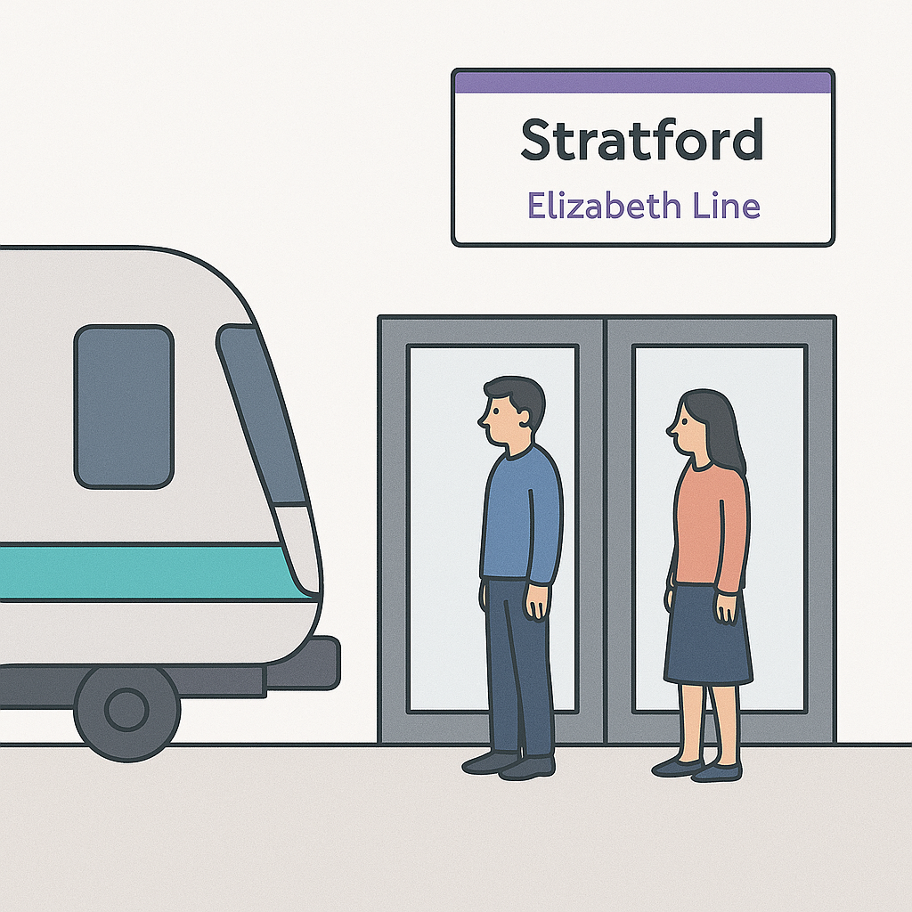
Case Study: Platform Screen Door Control System
Automated metro platforms use screen doors to protect passengers and synchronize with train operations.
* The figure is guided AI-generated

Slide 14
Case Study: Platform Screen Door Control System
System Elements
Trains: approach, stop, and depart from platforms.
Platforms: each has multiple screen doors.
Controller: monitors train position and door states.
Emergency System: allows manual intervention in abnormal situations.
Intended Operation
Train arrives (detected by sensors).
Train stops at a designated platform position.
Platform doors open only when train doors are aligned.
Before departure, all platform doors must close.
During emergencies, system must remain in or move to a safe state.

Slide 15

Safety Requirement Identification
Let's think and reflect
Case Study: Platform Screen Door Control System
System Goal:
Ensure passenger safety at station platforms.
Notes:
Safety req prevents hazards
The doors shall open within 2 seconds to improve passenger throughput: performance req
The controller shall log all door events for later analysis: maintenance req
The system shall provide real-time data to the passenger: functional convinience

Slide 16
Safety Requirement Identification
SR-1: Doors shall open only when a train is stopped at the platform.
SR-2: Doors shall remain closed whenever no train is present.
SR-3: Doors shall close before train departure.
SR-4: In emergency mode, doors can be manually overridden.
SR-5: No unsafe or undefined state (e.g., open doors + moving train).
These become your safety invariants in Event-B.

Slide 17
Event-B Notation Basics
  CONTEXT ContextName
  SETS
  BasicTypes
  CONSTANTS
  constants
  AXIOMS
  properties_that_always_hold
  END
  MACHINE MachineName
  SEES
  ContextName
  VARIABLES
  state_variables
  INVARIANTS
  properties_that_always_hold
  INITIALISATION
  initial_state_definition
  EVENTS
  operation_definitions
  END

Slide 18
Context Definition (Event-B CONTEXT)
CONTEXT DoorContext
SETS DOOR_STATE TRAIN_STATE
CONSTANTS OPEN, CLOSED, PRESENT, ABSENT, MOVING
AXIOMS
partition(DOOR_STATE, {OPEN}, {CLOSED}) partition(TRAIN_STATE, {PRESENT}, {ABSENT}, {MOVING})
END
Defines the static types (sets) and constants
“partition” ensures states are mutually exclusive

Slide 19
Abstract Machine: Safety Logic
MACHINE DoorControl
SEES DoorContext
VARIABLES door train
INVARIANTS
door ∈ DOOR_STATE
train ∈ TRAIN_STATE
door = OPEN ⇒ train = PRESENT // SR-1, SR-2
train = MOVING ⇒ door = CLOSED // SR-5
INITIALISATION
door := CLOSED
train := ABSENT
EVENTS
OpenDoors ≙ when
train = PRESENT then
door := OPEN
end
CloseDoors ≙
any t where
door = OPEN
t ∈ TRAIN_STATE then
door := CLOSED
end
TrainArrives ≙ when
train = ABSENT then
train := PRESENT
end
TrainDeparts ≙ when
door = CLOSED then
train := MOVING
end
END

Slide 20
Event-B Structure
Context (Static, domain facts)
  SETS: Abstract types
  CONSTANTS: Named domain values
  AXIOMS: Properties over sets/constants (type definitions, constraints)
Machine (Dynamic, system behavior)
  SEES: Links to one or more Contexts
  VARIABLES (state): System state components
  INVARIANTS: Properties that must always hold for the variables, before and after every event
INITIALISATION: Assigns the initial state satisfying the invariants
EVENTS: Possible state transitions (How behavior is modelled)
  Guards: Conditions enabling the event (when it is allowed)
  Actions: State updates
  ANY / WHERE: (optional) Binds local parameters with constraints

Slide 21
Abstract Machine: Safety Logic
MACHINE DoorControl
SEES DoorContext
VARIABLES door train
INVARIANTS
door ∈ DOOR_STATE
train ∈ TRAIN_STATE
door = OPEN ⇒ train = PRESENT // SR-1, SR-2
train = MOVING ⇒ door = CLOSED // SR-5
INITIALISATION
door := CLOSED
train := ABSENT
EVENTS
OpenDoors ≙ when
train = PRESENT then
door := OPEN
end
CloseDoors ≙
any t where
t ∈ TRAIN_STATE then
door := CLOSED
end
TrainArrives ≙ when
train = ABSENT then
train := PRESENT
end
TrainDeparts ≙ when
door = CLOSED then
train := MOVING
end
END
Events model possible behaviors of the system
`OpenDoors` can only fire when `train = PRESENT`
The ‘then’ clauses change the state of door to ‘open’
SR-1 & SR-2: Ensures doors stay closed when no train
SR-5: Prevents the unsafe state of open doors + moving train

Slide 22
Refinement (Adding Implementation Detail)
MACHINE DoorControl_R1 REFINES DoorControl
VARIABLES door train sensor
INVARIANTS
sensor ∈ BOOL
sensor = TRUE ⇔ train ∈ {PRESENT}
EVENTS
OpenDoors refines OpenDoors ≙ when
sensor = TRUE
train = PRESENT then
door := OPEN end
CloseDoors refines CloseDoors ≙ any t where
door = OPEN
t ∈ TRAIN_STATE then
door := CLOSED end
TrainArrives refines TrainArrives ≙ when
train = ABSENT then
train := PRESENT end
TrainDeparts refines TrainDeparts ≙ when
door = CLOSED then
train := MOVING
sensor := FALSE end
DetectTrain ≙ when // new event
sensor = FALSE
train = PRESENT then
sensor := TRUE end
END
Introduces sensor variable representing physical train detection
Gluing invariant links abstract and concrete variables
Events refined to include sensor checks
New event “DetectTrain” models sensor activation
Rodin tool will generate proof obligations to verify safety is preserved (more on Lecture 4)

Slide 23
Summery
Overview of : Z, CPS, B, Event-B
Safety Requirement identification
Safety properties specification
First Event-B model construction
  Modeling in Event-B: System and Software Engineering
  by Jean-Raymond Abrial
  https://wiki.event-b.org/
  Systems Engineering Principles and Practice, Alexander Kossiakoff et. al., 2011
Let’s read and explore

