Slide 1

Infrastructure as Code
Foundations
Part 2 — From IaC design to automated delivery
SEAtS | 549471

Slide 2
Intended
By the end of this session you will be able to:
Learning
1. Decompose an IaC system into modules with clear, versioned
interfaces, and manage providers and third-party IP.
2. Relate the service delivery platform and framework to how IaC
Outcomes
artifacts are built and deployed.
3. Use formal speciﬁcation (schemas, typed variables, policy-as-code)
to make infrastructure enforceable.
4. Compare the three ways to write IaC (JSON, DSL, general-purpose
language) and explain Pulumi's hybrid model.
5. Trace the Pulumi project/stack workﬂow from
pulumi new
through
up
to
destroy
.
6. Plan a testing strategy and a CI/CD and GitOps pipeline for
infrastructure changes.
7. Distinguish provisioning, deployment, orchestration and
conﬁguration management.
8. Identify common IaC risks and anti-patterns and propose mitigations.
2
SEAtS | 549471
© University of Southampton

Slide 3
Agenda
1. Designing IaC systems: modules and
interfaces.
2. Service delivery and formal speciﬁcation.
3. Writing IaC: JSON, DSL, Vagrant examples.
4. Pulumi: hybrid model and workﬂow.
5. Testing, CI/CD and GitOps.
6. Provisioning, orchestration, CM.
7. Risks, anti-patterns, and summary.
3
SEAtS | 549471
© University of Southampton

Slide 4
Designing IaC Systems
Decomposing
Identifying
Designing
Integrating
Managing
into Blocks
Interfaces
APIs &
Providers & IP
Third-Party IP
Protocols
Example module
Interfaces via:
Cloud providers
Version pinning
folders:
Input variables.
IaC interacts with:
(AWS, Azure,
and lifecycle
/networking
Output
Cloud provider
GCP).
management.
/identity
variables.
APIs.
Third-party
Licensing and
/compute
Remote state
Terraform
providers
compliance
references.
provider
(Cloudﬂare,
considerations.
/database
Datadog).
Security
Interfaces must be
schemas.
/monitoring
Internal
scanning of
clear, versioned,
Kubernetes
documented, and
manifests/CRDs
libraries reused
modules/provid
stable.
.
across teams.
ers.
4
SEAtS | 549471
© University of Southampton

Slide 5
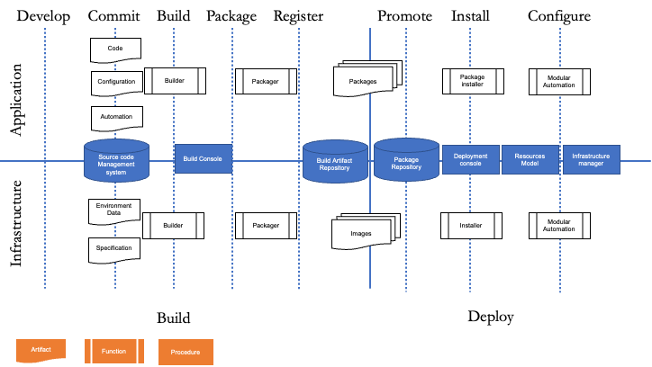
Service Delivery
Platform
Artifact: Versioned,
tested, deployed
units.
Procedures
(Imperative):
Commands to
produce desired state
(e.g., Bash).
Functions
(Declarative): Deﬁne
desired state; tooling
conforms system
(e.g., SQL, makeﬁles).
5
SEAtS | 549471
© University of Southampton

Slide 6
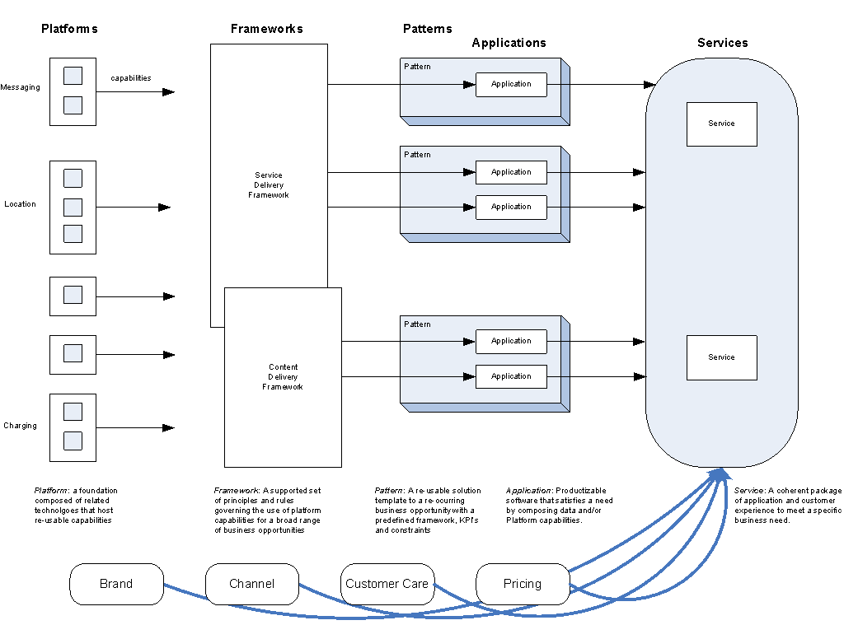
6
SEAtS | 549471
© University of Southampton

Slide 7
Formal Speciﬁcation in IaC
JSON/YAML schemas (CloudFormation, Kubernetes).
Terraform variable typing and module interfaces.
Policy-as-Code (OPA/Rego) for compliance.
Cloud policies (AWS Conﬁg, Azure Policy) to enforce encryption, logging, segmentation.
Formalisation supports reproducibility and enforcement.
7
SEAtS | 549471
© University of Southampton

Slide 8
Three Ways toWrite IaC
Method
Description
Resources (EC2 instance, security group, …) listed as structured data
JSON
for the provider to consume
Domain-speciﬁc language
A custom syntax built for one tool/provider — looks code-like, isn't a
(DSL)
general-purpose language
General-purpose
A real language (Pulumi supports TypeScript, JavaScript, Python, Go,
programming language
.NET) used to describe infrastructure
The general-purpose-language approach brings loops, conditionals, classes, and packages to infrastructure
deﬁnitions — e.g. a
for
loop that creates one instance per availability zone — plus normal IDEs, linters, and test
frameworks.
8
SEAtS | 549471
© University of Southampton

Slide 9
YAML Examples
Vagrant.configure("2") do |config|
servers = YAML.load_file('servers.yaml')
config.vm.box = "peru/ubuntu-18.04-desktop-amd64"
Vagrant.configure(VAGRANTFILE_API_VERSION) do |config|
config.vm.box_version = "2.3"
servers.each do |server|
config.vm.provider "virtualbox" do |vb|
config.vm.define server["name"] do |srv|
vb.gui = true
srv.vm.box = server["box"]
vb.memory = "1024"
srv.vm.network "private_network", ip: server["ip"]
vb.name = "ubuntudesktopscyther"
srv.vm.provider :virtualbox do |vb|
end
vb.name = server["name"]
end
vb.memory = server["ram"]
end
end
end
end
9
SEAtS | 549471
© University of Southampton

Slide 10
Pulumi : hybrid?
Pulumi is a hybrid, not a straightforward "imperative" tool: its
state model
is declarative — you describe desired
infrastructure and
pulumi up
diﬀs it against reality, exactly like Terraform — but its
authoring language
is a real
general-purpose language (Python), which is imperative. Two separate axes: what gets reconciled vs how you
express it.
Declarative state reconciliation scales better than hand-written procedural steps for large multi-component systems
— true whether you write that declaration in HCL (Terraform) or in Python (Pulumi).
10
SEAtS | 549471
© University of Southampton

Slide 11
From Theory to Pulumi: The
Workﬂow
A project is a single program that declares desired infrastructure; a stack is one deployed instance of that project
(e.g.
dev
vs
prod
) — same program, diﬀerent conﬁg (region, parameters), deployed independently. Neither term
appears in the theory chapters above — this is the vocabulary that was missing.
sequenceDiagram actor Dev participant CLI as Pulumi CLI participant Cloud as AWS Dev->>CLI: pulumi new
<template> CLI-->>Dev: scaﬀolds project + "dev" stack Dev->>CLI: pulumi conﬁg set aws:region ... Dev-
>>CLI: pulumi up CLI->>CLI: diﬀ desired state (code) vs actual state CLI-->>Dev: preview of resources to
create/update Dev->>CLI: conﬁrm (yes) CLI->>Cloud: create/update resources Cloud-->>CLI: resulting
resource state CLI-->>Dev: outputs (e.g. bucket name, URL) Dev->>CLI: pulumi stack output <name>
CLI-->>Dev: exported value Note over Dev,CLI: edit main.py, re-run "pulumi up" — only the minimal diﬀ is
applied Dev->>CLI: pulumi destroy CLI->>Cloud: tear down all stack resources Dev->>CLI: pulumi stack
rm <name>
11
SEAtS | 549471
© University of Southampton

Slide 12
Testing IaC Systems
Testing types:
1. Static testing (linting: tﬂint, checkov; policy-as-code).
2. Unit tests (Terratest, Molecule).
3. Integration tests (ephemeral deployments).
4. Acceptance tests (VPC routing, IAM permissions).
5. Security tests (CSPM, IaC scanning).
12
SEAtS | 549471
© University of Southampton

Slide 13
Build Systems & CI
Standard Pipeline
Continuous Deployment
Managing
(GitOps)
Development
1. Validate (
terraform validate
).
2. Lint (tﬂint, checkov).
ArgoCD / Flux for declarative
Methodologies: Agile, DevOps,
sync.
GitOps, infrastructure release
3. Plan (static analysis, diﬀs).
management.
4. Approvals (human-in-loop).
Atlantis, Spacelift, Terraform
5. Apply (automated, controlled).
Cloud for collaboration.
Multi-team decomposition,
6. Post-deploy tests (Terratest,
Automated rollbacks based on
module backlogs, environment
smoke tests).
policy drivers.
versioning.
Branch protection, review bots
(tfsec), semantic versioning.
Automated changelogs and
release notes.
13
SEAtS | 549471
© University of Southampton

Slide 14
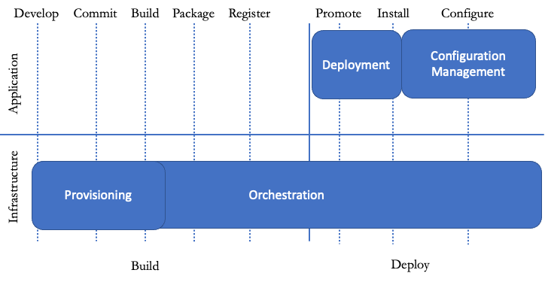
Deployment /
Orchestration
/ CM
Provisioning: Prepare server (hardware, OS,
services, network).
Deployment: Automated app deployment &
upgrades.
Orchestration: Coordinated operations
across systems.
Conﬁguration Management: Maintain app
dependencies.
14
SEAtS | 549471
© University of Southampton

Slide 15
Risks & Anti-Patterns
Conﬁguration drift.
Hard-coded secrets.
Unversioned remote state.
No testing or code reviews.
Monolithic Terraform ﬁles, parallel changes without locking.
Black-box modules with no documentation.
Mitigation: code reviews, state locking, policy-as-code, decomposition.
15
SEAtS | 549471
© University of Southampton

Slide 16
Summary
Decompose infrastructure into modules whose interfaces (inputs, outputs, remote state) are clear,
versioned and stable; pin, licence-check and scan third-party providers.
Formal speciﬁcation (schemas, typed variables, policy-as-code) makes infrastructure reproducible and
enforceable.
IaC can be written as JSON, a DSL, or a general-purpose language; Pulumi's
state model
is declarative
even though its
authoring language
is imperative Python.
pulumi new
→
up
→
destroy
is the same provisioning loop regardless of what you deploy; stacks run
the same code with diﬀerent conﬁg.
Test IaC at every level, and ship it through CI/CD (validate → lint → plan → approve → apply → test)
and GitOps.
Mitigate anti-patterns (drift, secrets, unlocked state, monoliths) through reviews, locking, policy-as-
code and decomposition.
16
SEAtS | 549471
© University of Southampton

