Slide 1
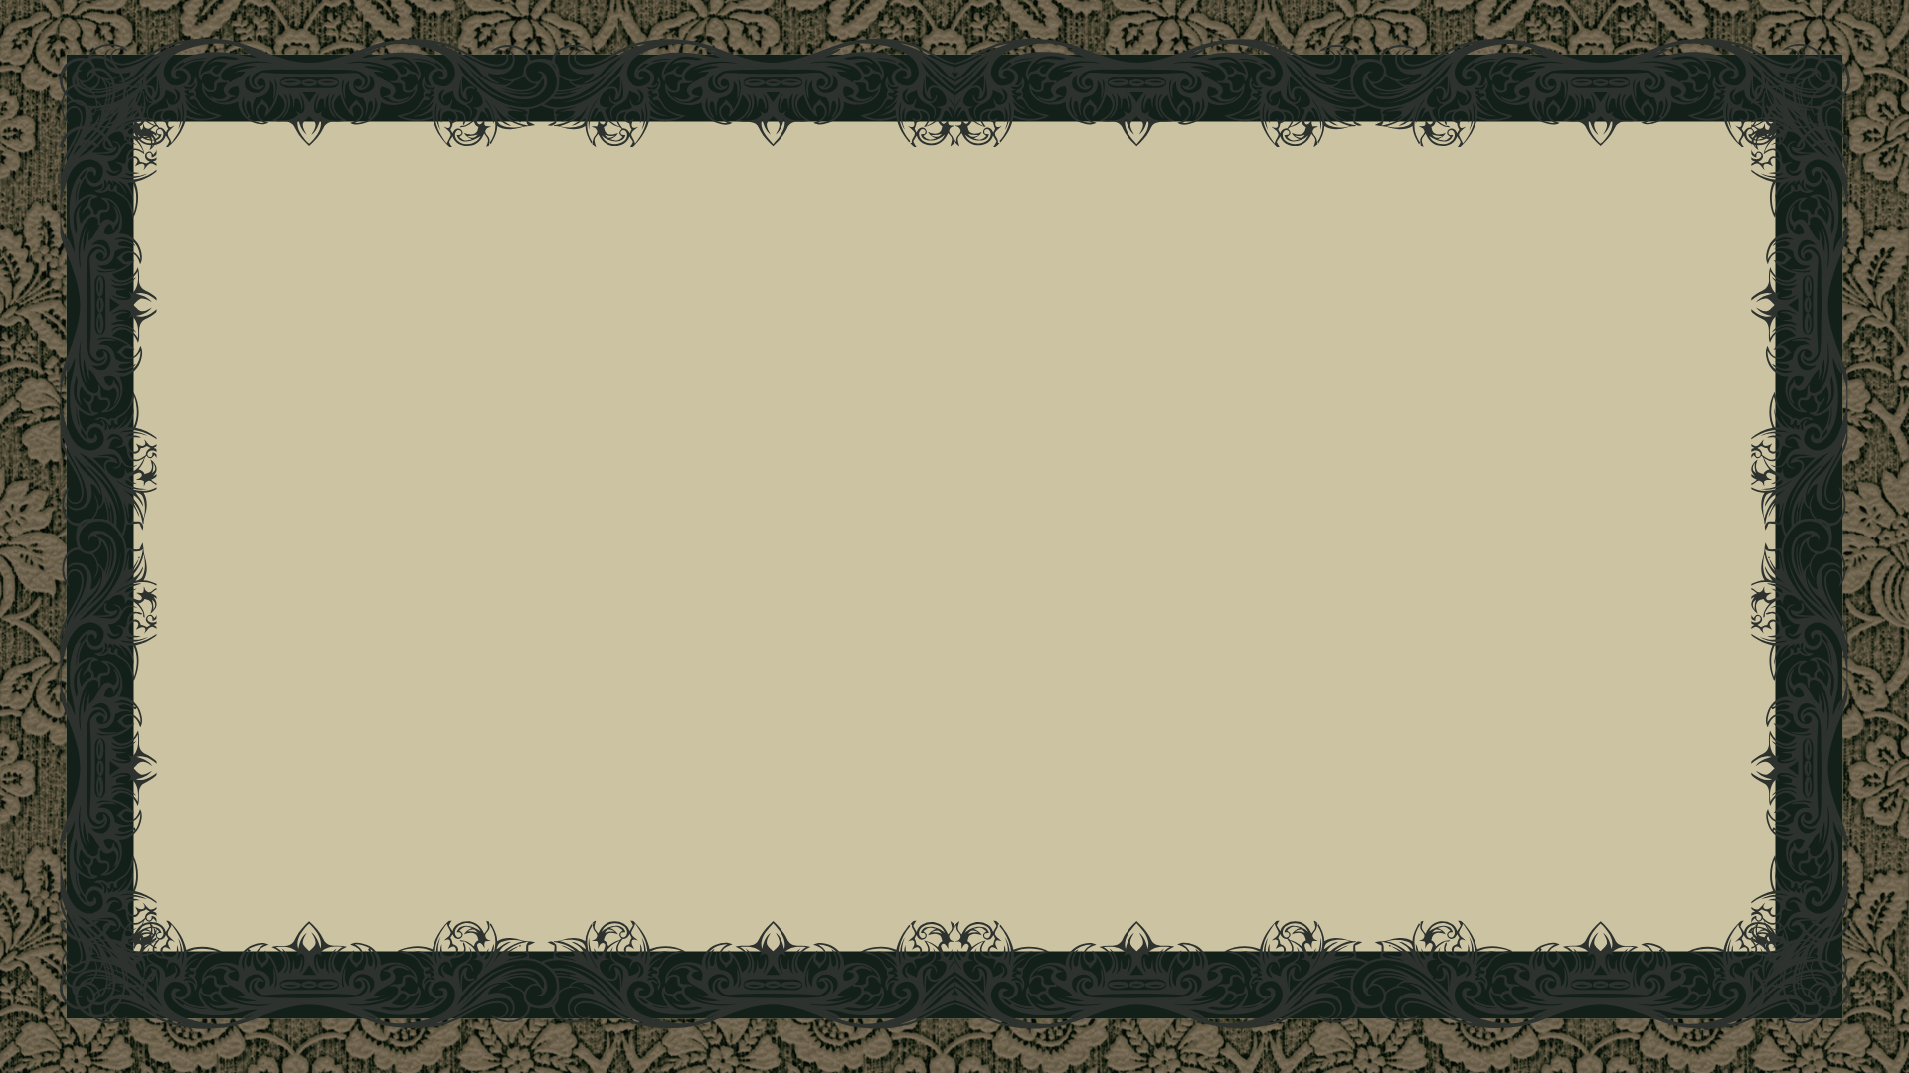
The Adventures of John Watson
Ardi Stringa 2021162

Slide 2
What is it about?
It is a Detective game, where you play as Dr John Watson, the famous character from the Sherlock Holmes stories. You play through multiple stories where they needed the Infamous Sleuth to solve a crime but the best they had is you, his partner.
The game is 2.5D and gives you the freedom to gather the evidence and talk to the npcs at your prefared pace. But do keep in mind that there is a finite amount of time for you to solve it.

Slide 3

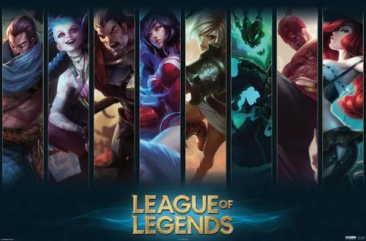
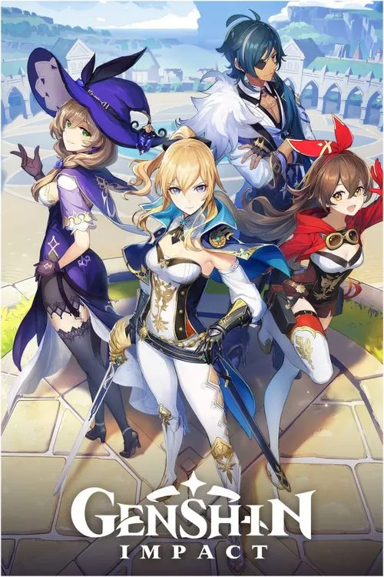
Inspirations
Basic Idea and Title: The Adventures of Sherlock Holmes, by Sir Arthur Conan Doyle
(Ideal) Art style: JRPG Games (e.g Genshin Impact)
Compatinility: Doom / League of Legends

Slide 4


Tools & Assists
Unity & C# for game making
Git & Github for version control
Free Assets from Asset Store
Multiple Youtube Tutorials

Slide 5
Mechanics
Camera Change

Slide 6

Future Improvements – Uni Project
Settings Customizability
Interactive Puzzles
Trust Level System
Saving
Npc interaction
Improve Character design
John Watson from Moriarty the Patriout -->

Slide 7
Future Improvements – Market
Rename and Private GH Repository
Make fully 3D
Automated Software Testing through Github Actions
Music and Dialog
Custom Made assets
Improve compatibility as much as possible

Slide 8
Thank You!

