Slide 1
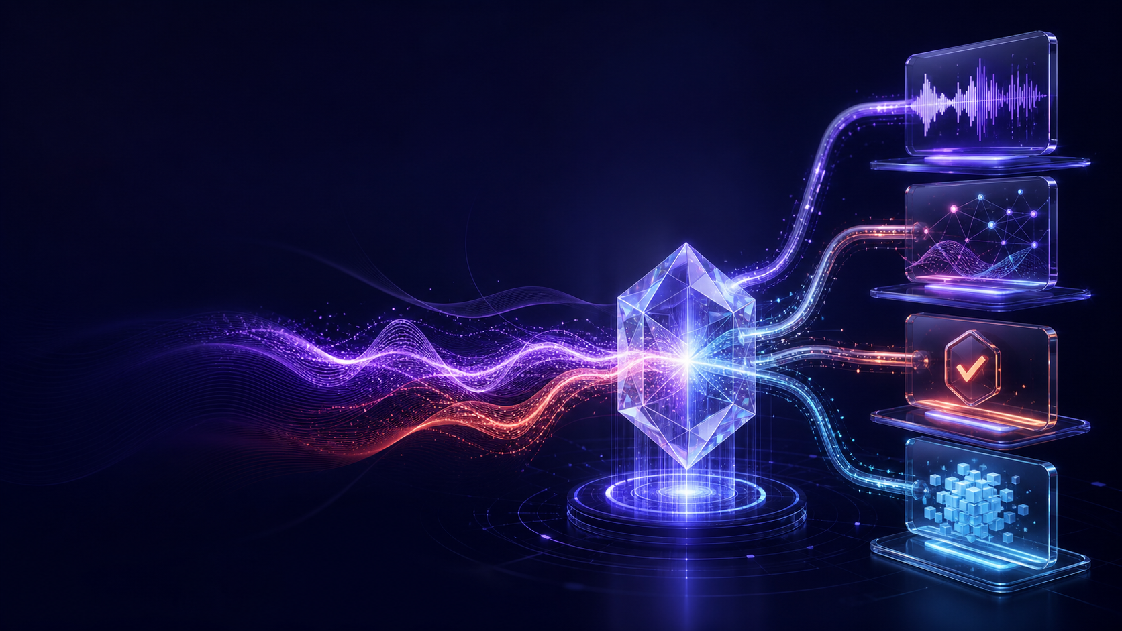
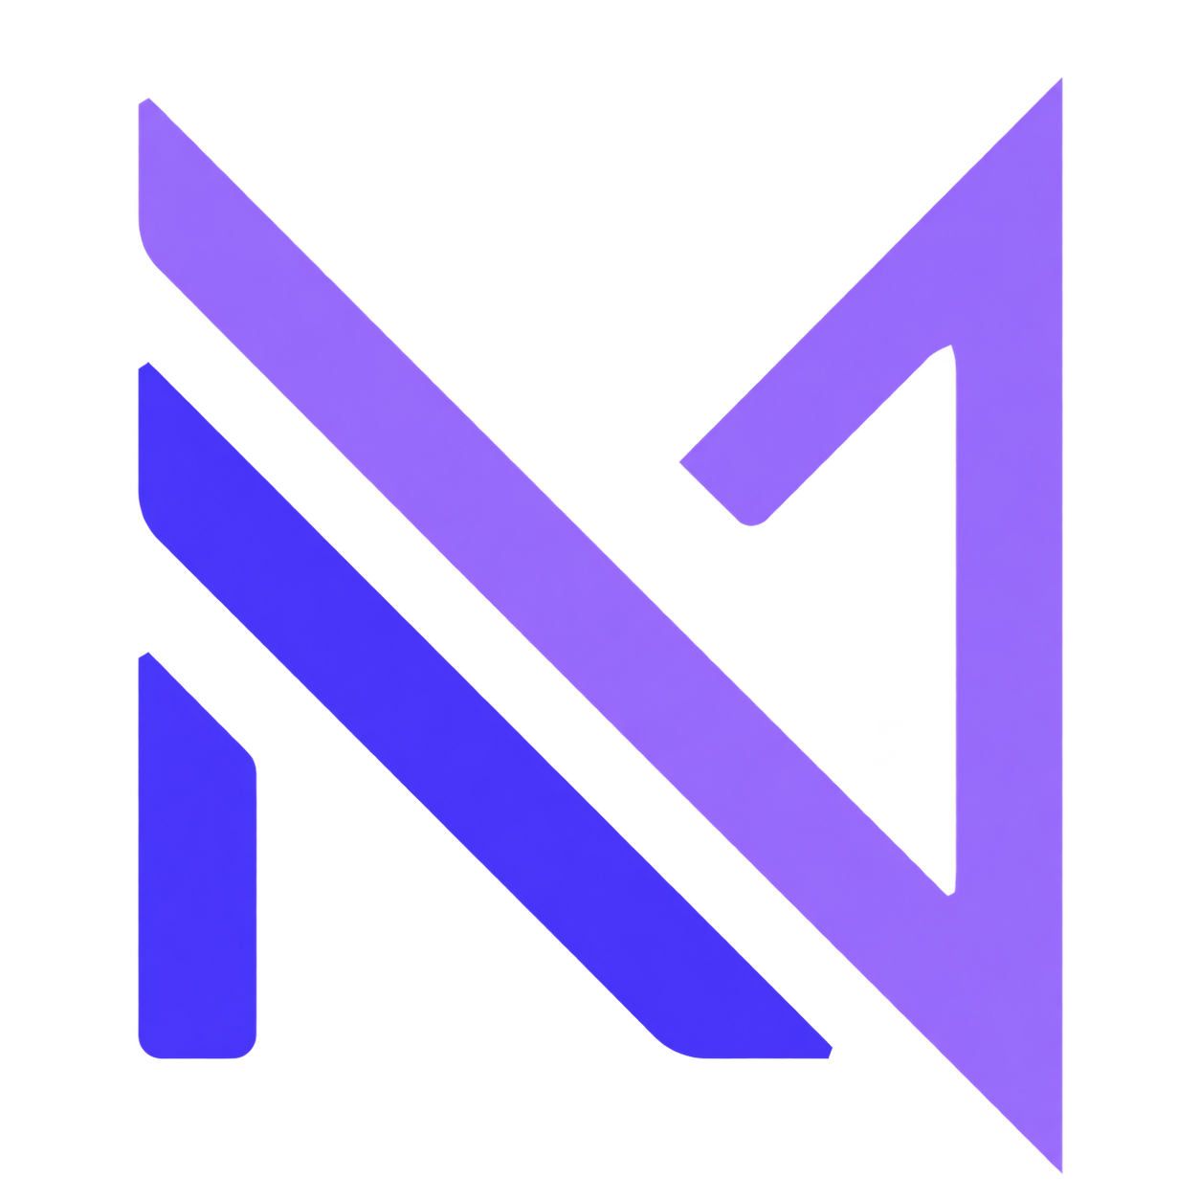
NEURAI PLATFORM
AI that is present
before it is prompted
The Persian-first operating surface for
organizational memory—beginning with Echo
PRESENT · EVIDENCE-BACKED · AUTHORITY-AWARE
Executive product & architecture demo · August 2026
Notes:
Open with the ambition: AI should be present where work happens, but it must remain evidence-backed and authority-aware. Echo is the first app, not a separate brand.
[Sources]
- C:/Users/amirreza/Desktop/mvp/docs/PLATFORM-BRIEF.md
- C:/Users/amirreza/Desktop/mvp/docs/AI-NATIVE-PLAN.md
- C:/Users/amirreza/Desktop/mvp/ARCHITECTURE.md (M22, M33–M36)

Slide 2
THE PROBLEM
Truth is created in conversation—and disappears into fragments
Organizations lose source, ownership, continuity, and follow-through.
01
Source
02
Ownership
03
Continuity
04
Follow-through
Notes drift away from the moment and the speaker who created them.
Generic AI sees copied context, not the caller’s real authority.
Each meeting restarts the story; past commitments stay buried.
Insights stop at a summary instead of entering governed action.
Meeting notes are a feature. Organizational memory is infrastructure.
NEURAI PLATFORM
02
Notes:
Frame the problem as organizational memory loss, not meeting inconvenience. The transcript must remain the source of truth and derived artifacts must carry provenance.
[Sources]
- C:/Users/amirreza/Desktop/mvp/docs/SPEC.md
- C:/Users/amirreza/Desktop/mvp/ARCHITECTURE.md (invariants 4–5)

Slide 3
WHY ECHO FIRST
The wedge is a conversation. The asset is memory.
One flow delivers immediate value and compounds into the platform.
CAPTURE
TRUTH
MEMORY
REASON
ACT
Browser + Echo Mobile
Transcript + timing
Versions + provenance
Cross-call agent
Tools + consent
Immediate product value
Compounding platform value
record · transcribe · summarize · search
memory · signals · workflows · more apps
A horizontal assistant without a truth source is generic. A meeting tool without a platform is bounded.
NEURAI PLATFORM
03
Notes:
Walk the audience from Capture to Act. Echo provides both the first customer outcome and the governed memory substrate future NeurAI Platform apps can reuse.
[Sources]
- C:/Users/amirreza/Desktop/mvp/docs/PLATFORM-BRIEF.md
- C:/Users/amirreza/Desktop/mvp/docs/SPEC.md
- C:/Users/amirreza/Desktop/mvp/ARCHITECTURE.md (M1, M4, M22)

Slide 4
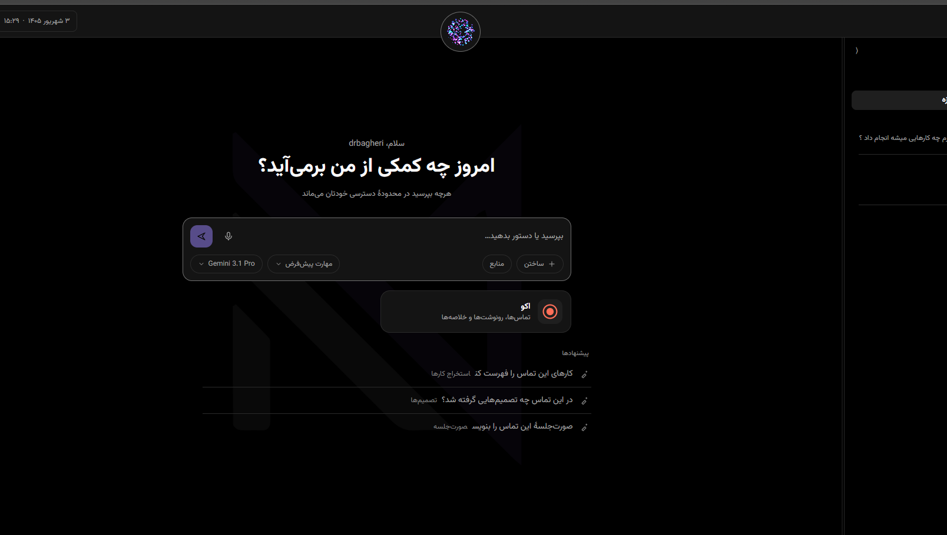
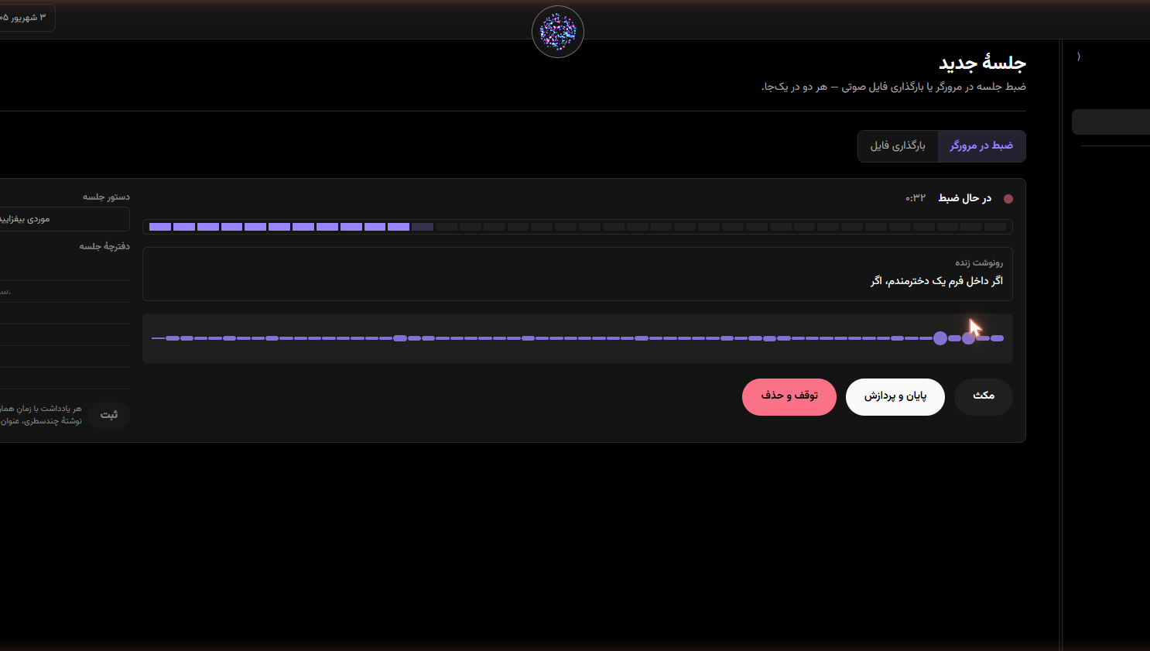
THE EXPERIENCE
One calm product surface—from question to captured truth
Actual current screens: Persian-first platform hub and Echo recording workspace.
PLATFORM HUB
ECHO CAPTURE
Ask across permitted memory. Attach sources. Choose agent, model, and web mode.
Waveform, live transcript, agenda, notes, and explicit recording controls.
NEURAI PLATFORM
04
Notes:
These are repository screenshots, not conceptual mockups. Show the hub as the shared NeurAI Platform surface and Echo capture as the first deep app experience.
[Sources]
- C:/Users/amirreza/Desktop/mvp/docs/screenshots/hub-fa.png
- C:/Users/amirreza/Desktop/mvp/docs/screenshots/new-meeting-recording.png
- C:/Users/amirreza/Desktop/mvp/web/src/app/[locale]/page.tsx

Slide 5
THE AI-NATIVE MODEL
Presence + hands + signals—governed by autonomy
The assistant becomes an operating layer, not an isolated chat box.
PRESENCE
Hub + contextual panes
where work already lives
AUTONOMY
Watch → Assist → Act
controls consequence
SIGNALS
Call events + rules +
timely briefs
HANDS
Memory tools + visible
product actions
WATCH
ASSIST
ACT
Autonomy changes exposed effects—not the model’s authority.
NEURAI PLATFORM
05
Notes:
Define the platform vocabulary. Presence is where the assistant appears; hands are typed tools; signals are proactive events; autonomy controls when write effects require consent.
[Sources]
- C:/Users/amirreza/Desktop/mvp/docs/AI-NATIVE-PLAN.md
- C:/Users/amirreza/Desktop/mvp/ARCHITECTURE.md (M33–M36)
- C:/Users/amirreza/Desktop/mvp/core/src/agent/client-tools.ts
- C:/Users/amirreza/Desktop/mvp/core/src/worker/signal-step.ts

Slide 6
THE ARCHITECTURE
Four parts. Three planes. Explicit authority at every seam.
A deliberately small topology with strong boundaries—not a maze of nominal services.
EXPERIENCE
Browser
BFF
Echo Mobile
Next.js UI
IndexedDB buffer
secure cookies · proxy
Android recorder
CONTROL
Core API
Worker
ML
Providers / Connectors
Fastify · identity · SSE
pgmq · lifecycle · retry
stateless speech facade
Soniox · OpenRouter · webhooks
short-lived signed media URL
DATA
Supabase
Postgres · Auth · Storage · RLS · grants · pgmq
NEURAI PLATFORM
06
Notes:
Explain the authority boundaries, not every route. Browser uses the BFF. Core owns identity and control. Worker handles durable jobs. ML is stateless and productless. Supabase is the final data wall.
[Sources]
- C:/Users/amirreza/Desktop/mvp/ARCHITECTURE.md (M1–M3, M7–M9, M12, M38)
- C:/Users/amirreza/Desktop/mvp/core/src/db/identity.ts
- C:/Users/amirreza/Desktop/mvp/core/src/worker/steps.ts
- C:/Users/amirreza/Desktop/mvp/ml/src/pipeline.ts

Slide 7
TRUST AS ARCHITECTURE
The agent borrows authority—never invents it
JWT, identity, RLS, grants, policy, consent, and audit form one wall.
1
JWT
Verify signature + subject
THE RESULT
2
Identity
Active user + org + role
A model can be wrong
without becoming
omnipotent.
3
RLS
Filter rows by actor
4
Grants
Hard ceiling; agent no DELETE
5
Policy
Tool list + roles + budgets
Prompts guide.
The wall enforces.
6
Consent & audit
Propose, confirm, record
NEURAI PLATFORM
07
Notes:
Describe the wall bottom-up. No database handle exists without an identity. RLS and database grants are the hard enforcement. Agent tools are centrally vetoed and consequential content writes are proposed first.
[Sources]
- C:/Users/amirreza/Desktop/mvp/ARCHITECTURE.md (M3, M4, M10, M11)
- C:/Users/amirreza/Desktop/mvp/core/src/db/identity.ts
- C:/Users/amirreza/Desktop/mvp/core/src/agent/runtime.ts
- C:/Users/amirreza/Desktop/mvp/core/src/agent/policy.ts

Slide 8
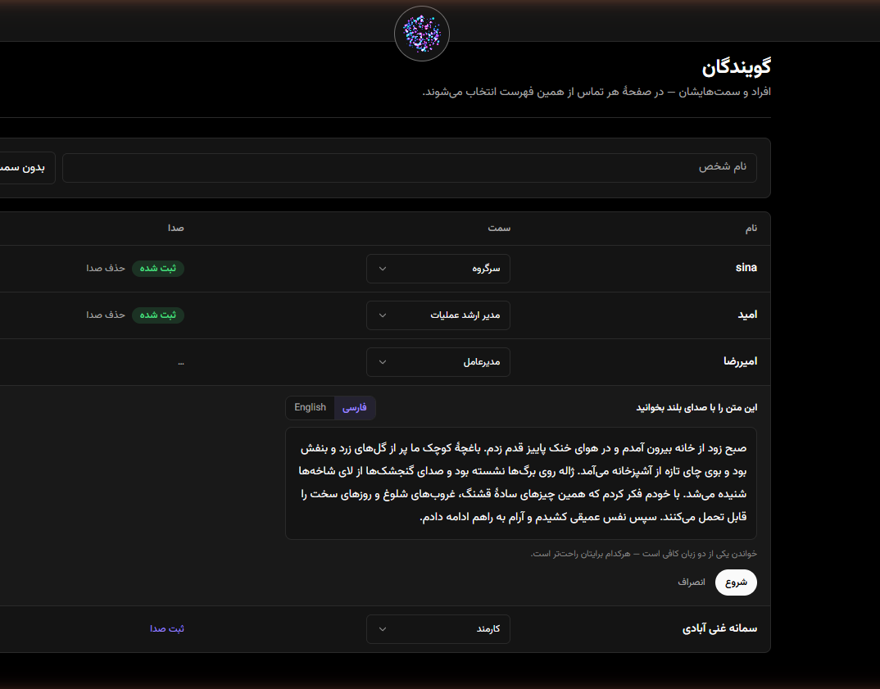
PERSIAN-FIRST SPEECH
Accuracy is a pipeline. Trust survives when fidelity changes.
RTL, names, mixed language, speakers, timing, and voice identity are one product system.
PROBE
VAD
STT
DIARIZE
VOICE
ffmpeg → local speech detection → Soniox / fallback → speaker structure → conservative directory match
THE TIMING LADDER
WORD
LINE
ANCHORED SPAN
click a word
click a segment
honest coarse seek
No timestamps never becomes ‘nothing’. It becomes a real speech span—with provenance.
NEURAI PLATFORM
08
Notes:
Use the timing ladder as the technical proof of honest degradation. Persian-first also includes RTL, normalization, glossary bias, mixed-language hints, voice enrollment, and Jalali-capable display.
[Sources]
- C:/Users/amirreza/Desktop/mvp/ARCHITECTURE.md (M6, M19, M20, M37–M40)
- C:/Users/amirreza/Desktop/mvp/ml/src/pipeline.ts
- C:/Users/amirreza/Desktop/mvp/core/src/worker/transcript-mapping.ts
- C:/Users/amirreza/Desktop/mvp/core/src/worker/voice-match.ts
- C:/Users/amirreza/Desktop/mvp/docs/screenshots/speakers-enrollment.png

Slide 9
COMPETITIVE POSITION
The category is proven. Our opening is still distinct.
Three excellent reference competitors—compared on strategy, not feature-count theatre.
PLATFORM
BEST-KNOWN STRENGTH
CLOSEST OVERLAP
NEURAI STRATEGIC CONTRAST
GONG
Revenue AI, deal signals, coaching, forecasting
Capture + cross-conversation intelligence + action
General AI-native platform; caller-bound authority; Persian-first wedge
OTTER.AI
General meeting capture, summaries, AI chat
Meeting knowledge + live transcription + assistant Q&A
Official May 2026 language list omits Persian; NeurAI is Persian-first end to end
FIREFLIES.AI
Meeting automation, AskFred, skills, integrations
Cross-meeting Q&A + custom insight + workflows
Identity/RLS/grants flow into product actions; visible Watch → Assist → Act
Win the underserved Persian-first trust surface—then compound Echo’s memory into more apps.
NEURAI PLATFORM
09
Notes:
Acknowledge competitor strengths. The comparison is public positioning, not an independent accuracy or security benchmark. The differentiators are Persian-first depth, authority-aware action, and the broader platform thesis.
[Sources]
- https://www.gong.io/conversation-intelligence
- https://otter.ai/
- https://help.otter.ai/hc/en-us/articles/26660468516631-Transcribe-conversations-in-English-Spanish-French-German-Japanese-or-Chinese-Simplified
- https://fireflies.ai/
- https://docs.fireflies.ai/askfred/overview
- C:/Users/amirreza/Desktop/mvp/docs/PLATFORM-BRIEF.md

Slide 10
THE EXPANSION THESIS
Echo is the beginning—not the boundary
One governed memory substrate can power an entire AI-native platform.
ECHO
SHARED AGENT
SIGNALS
MORE APPS
conversation truth
cross-memory reasoning
timely follow-through
projects · knowledge · service
New apps add a source of truth or a governed action surface—never a second identity, memory, or unbounded agent.
Capture what happened. Explain what it means.
Act only with authority. Learn across time.
PERSIAN-FIRST BY CONSTRUCTION
NEURAI PLATFORM
10
Notes:
Close on disciplined ambition. Echo proves the substrate. Future apps reuse identity, memory, tools, connectors, and audit instead of forking them.
[Sources]
- C:/Users/amirreza/Desktop/mvp/docs/PLATFORM-BRIEF.md
- C:/Users/amirreza/Desktop/mvp/docs/AI-NATIVE-PLAN.md
- C:/Users/amirreza/Desktop/mvp/ARCHITECTURE.md (M22, M30–M36)

