Slide 1
Staff Satisfaction Survey
2026
www.talentformula.co

Slide 2

SATISFACTION SCORES
At a Glance
2025
2026
Participation Rate
96%
99%
TF Overall Satisfaction Score
87%
85%
4% Above Industry
1% Above Industry
* Industry Benchmark refers to the Top 10% companies among Professional Services that employs 200-500 staff

Slide 3
SATISFACTION SCORES
Factor | TF Score 2025 | Industry Score 2025 | TF Score 2026 | Industry Score 2026
Engagement | 86% | 83% | 84% | 84%
Company Confidence | 87% | 85% | 85% | 85%
Alignment & Involvement | 84% | 84% | 81% | 84%
Collaboration & Communication | 84% | 82% | 83% | 83%
Enablement | 95% | 86% | 92% | 88%
Feedback & Recognition | 73% | 76% | 70% | 77%
Innovation | 88% | 83% | 82% | 85%
Leadership | 88% | 85% | 86% | 85%
Learning & Development | 82% | 82% | 85% | 84%
Management | 90% | 90% | 87% | 90%
Service & Quality Focus | 90% | 82% | 85% | 83%
Social Connection | 94% | 88% | 93% | 88%
Teamwork & Ownership | 95% | 84% | 91% | 85%
Work & Life Blend | 94% | 89% | 91% | 90%
Action | 71% | 74% | 73% | 74%
Overall Satisfaction Score | 87% | 84% | 85% | 84%

Slide 4
STRENGTHS & OPPORTUNITIES – TALENT FORMULA
Top Strengths
Workloads are divided fairly among people where I work
Most of the systems and processes here support us in getting our work done effectively
When it is clear that someone is not delivering in their role we do something about it
These are the key areas we are excelling in, and areas we scored best compared to Professional Services (200-500) Top 10%, 2026
Top Opportunities
My job performance is evaluated fairly
At Talent Formula there is open and honest two-way communication
Generally, the right people are rewarded and recognized at Talent Formula
These are our top opportunities compared to Professional Services (200-500) Top 10%, 2026

Slide 5
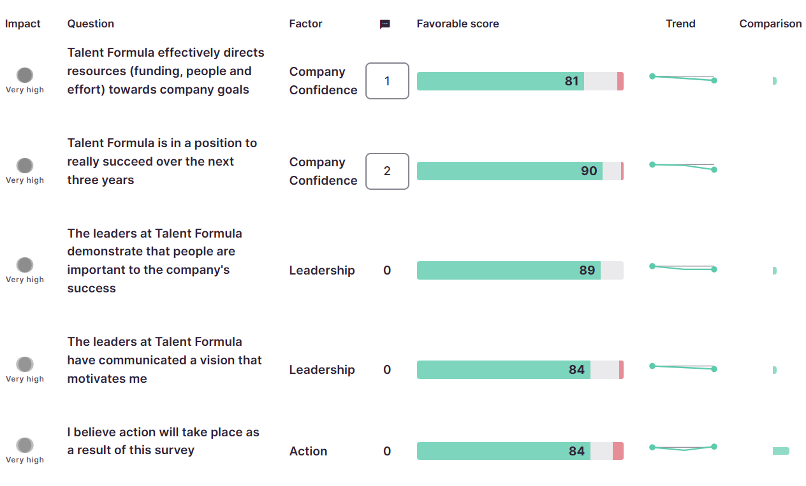
TOP 5 QUESTIONS IMPACTING ENGAGEMENT AT TALENT FORMULA
+2
16
9
0
+2
11
14
+2
+9
11

