Slide 1
RFLP in the (double) V-model
See the V-model explained and its evolution
Validation
Client Needs
ideally
Final Product
R
Verification
F
R
Virtual Test & Integration Phase
Design Phase
Physical Test & Integration Phase
L
F
R
L
F
P
L
P
P

Slide 2
What is the RFLP framework?
First, what does RFLP stand for?
RFLP = Requirements, Functional, Logical and Physical.
What is it?
Remember how the descending part of the V-model involves breaking your system down into subsystems and components? RFLP is a structured approach that helps manage the complexity of this decomposition, thanks to its four interconnected layers.
Validation
Client Needs
ideally
Final Product
R
Verification
F
Virtual Test & Integration Phase
Design Phase
Physical Test & Integration Phase
L
P

Slide 3
What is the RFLP framework?
Step by step
1. Refine the Client Needs into system Requirements.
2. Identify the Functions your system shall perform to meet the Requirements.
3. Define the system Logical architecture that shows the interactions between subsystem to achieve the Functions.
4. Design your Physical components to perform the interactions from the Logical architecture – hence, achieving the Functions identified and meeting the Requirements associated to the client Needs.
Validation
Client Needs
ideally
Final Product
R
Verification
F
Virtual Test & Integration Phase
Design Phase
Physical Test & Integration Phase
L
P

Slide 4
What is the RFLP framework?
How does the decomposition affect the RFLP?
As the decomposition in the V-model goes on, one value is to decouple the subsystems from each other for their design. This means that requirements are defined for the subsystem (and later for the components).
In practice, these lower-level requirements are derived from the R and F of the above level.
The small loop validation happens between the R of the lower level with the R of the higher level and eventually with the client needs.
Validation
Client Needs
ideally
Final Product
R
Verification
F
R
Virtual Test & Integration Phase
Design Phase
Physical Test & Integration Phase
L
F
R
L
F
P
L
P
P

Slide 5
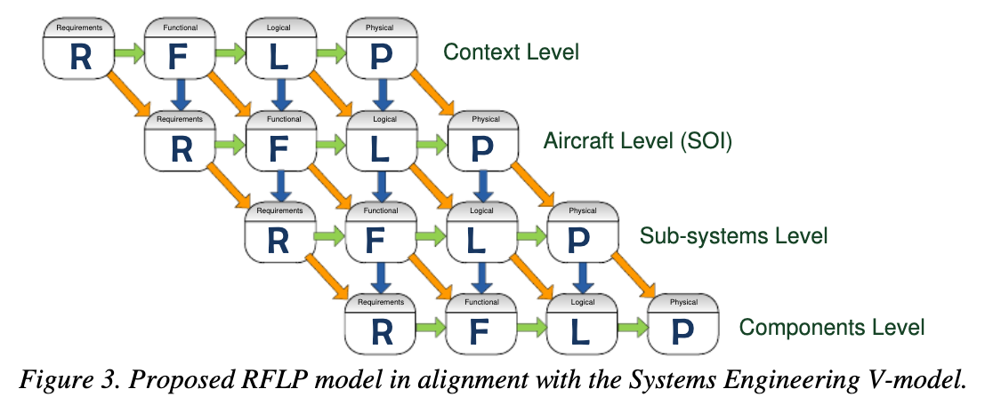
What is the RFLP framework?
Is that all?
For complex systems, there is more to it.
Esdras and Liscouët-Hanke identified that there might be back-propagation of requirements derived from higher system level F, L, or P.
(In the figure below, read the horizontal levels RFLP as the vertical levels from the image – aligned with the V-model.)
In practice, this means that design choices at system level have an impact on the requirements of the subsystems.

Slide 6
Is the RFLP evolving?
As the V-model is evolving, it is fair to try to understand if the RFLP is still actual.
And indeed, the rise in use of Behavioral modeling and simulation (also called 0D-1D simulation) is initiating a new layer (B) so that the RFLP is becoming RFLBP.
While the B could be seen as part of the P, the P is often seen as the 3D CAD and associated simulation rather and the importance of Behavioral modeling is forgotten.
…
Also, the poll we are running to understand which development cycle you are mainly using is finishing today. Please vote to let us know!
…
❓ Do you need a small example to better understand the RFLBP framework? Let me know.
Comment if you need any further clarifications or insights.
👇

