Slide 1
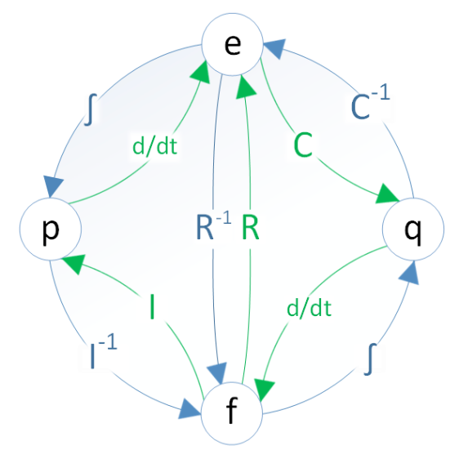
Leveraging analogies between physical domains

Slide 2
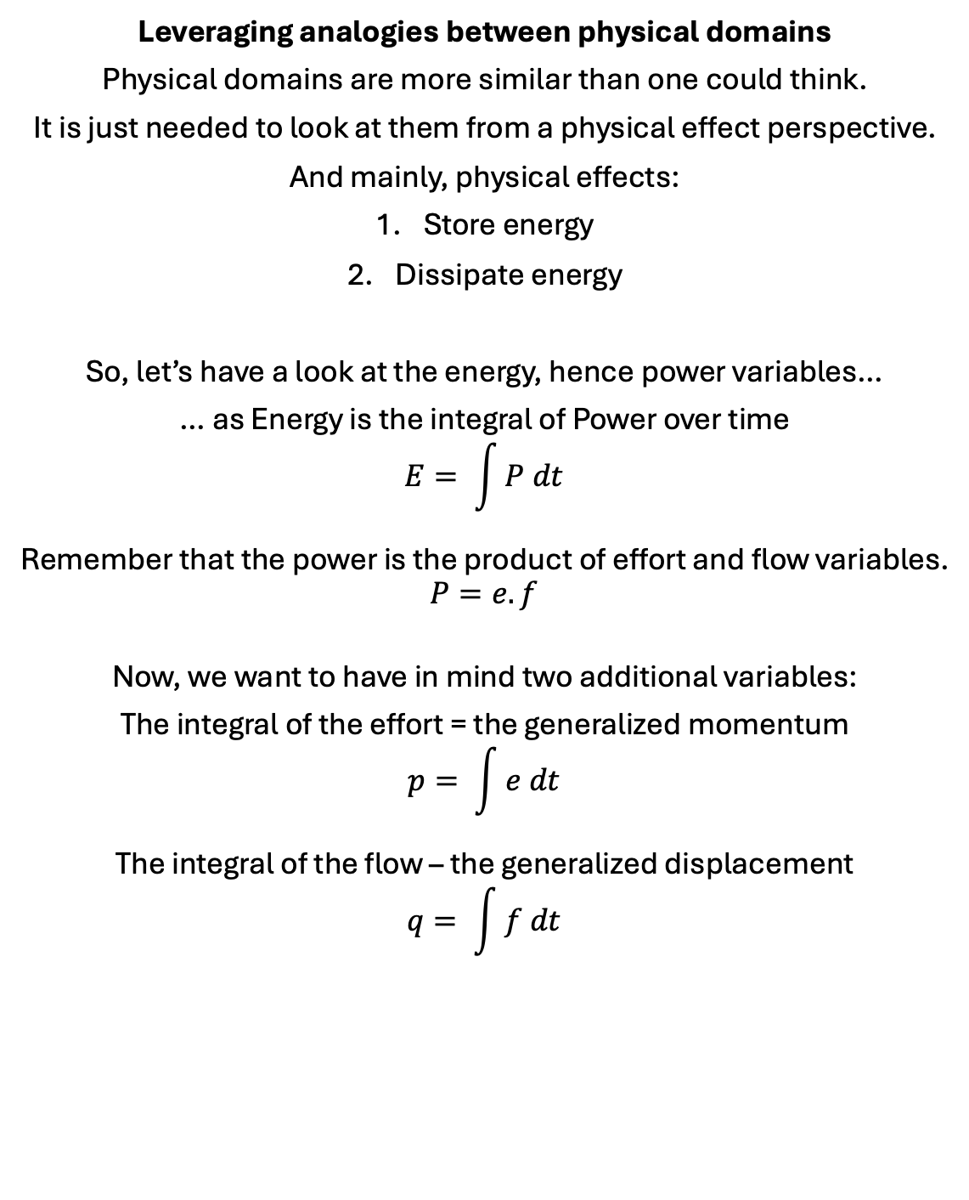
Leveraging analogies between physical domains
Physical domains are more similar than one could think.
It is just needed to look at them from a physical effect perspective.
And mainly, physical effects:
Store energy
Dissipate energy
So, let’s have a look at the energy, hence power variables…
… as Energy is the integral of Power over time
$$E= \int{P dt}$$
Remember that the power is the product of effort and flow variables.
$$P=e.f$$
Now, we want to have in mind two additional variables:
The integral of the effort = the generalized momentum
$$p= \int{e dt}$$
The integral of the flow – the generalized displacement
$$q= \int{f dt}$$

Slide 3
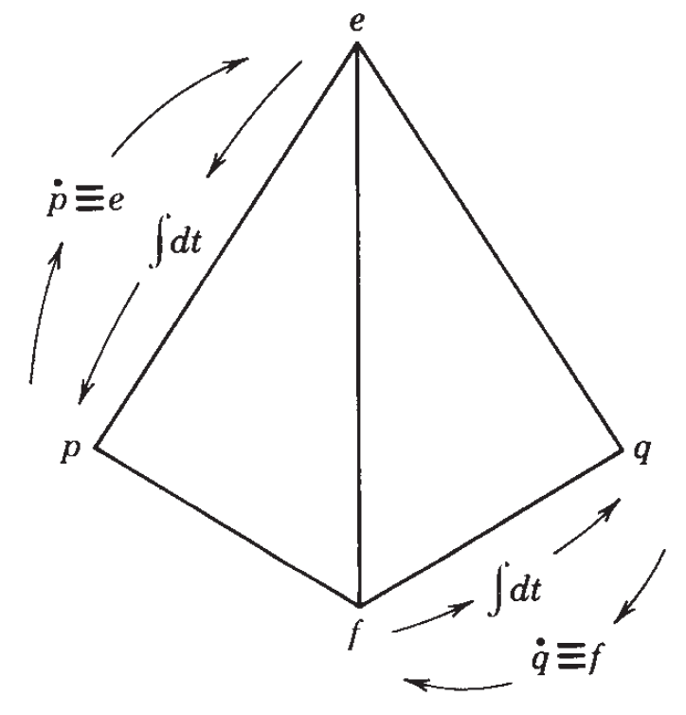
Leveraging analogies between physical domains
We obtain the following tetrahedron of variables:
This is known as Paynter’s tetrahedron. Henry Paynter invented the Bond Graphs, which is a modeling formalism based on physical effects.

Slide 4
Leveraging analogies between physical domains
We can look at the respective variables for each domain:
Who can complete the table for other domains like magnetism and chemistry❓ 🙂
Note that the integral of Temperature is not really used and hence not added to the table as temperature momentum.
Energy domain | Effort e | Flow f | Generalized Momentum p | Generalized Displacement q
Translational Mechanics | Linear force F [N] | Linear speed v [m/s] | Linear momentum p [N.s] | Displacement x [m]
Rotational Mechanics | Torque τ [N.m] | Angular speed ω [rad/s] | Angular momentum p_{ω} [N.m.s] | Angle θ [rad]
Electrical | Voltage u [V] | Current i [A] | Flux Φ [V.s] | Charge q [A.s]
Hydraulics | Pressure p [Pa] | Volume flow q [m³/s] | Pressure momentum p_{p} [Pa.s] | Volume V [m³]
Thermo- dynamics | Temperature T [K] | Entropy flow Ṡ [J/K/s] | - | Entropy S [J/K]

Slide 5
Leveraging analogies between physical domains
And here comes the beauty, what links these variables together are…
… the physical effects:
Store energy ( C and I )
Dissipate energy ( R )
Let’s detail the R, C and I 👉

Slide 6
Leveraging analogies between physical domains
There are two ways to store energy, by:
Capacitive effect ( C ) – relationship between the generalized displacement q with the effort variable.
Inertial effect ( I ) – relationship between the generalized momentum p with the flow variable.
The dissipative effect ( R ) creates a relationship between the effort and flow variables.

Slide 7
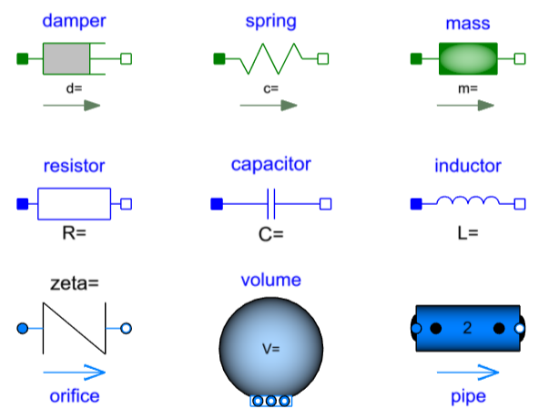
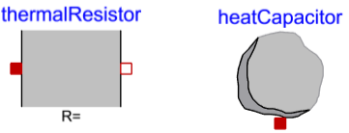
Leveraging analogies between physical domains
Examples of R, C and I per domain:
Can you provide more examples for each domain and physical effect❓
What would be examples for the chemistry and magnetism❓
🙂
Some Modelica components that could represent these effects:
 | Dissipative | Capacitive | Inertial
Mechanics | friction | spring | Inertia / mass
Electrical | resistor | capacitance | inductance
Fluidic | restriction | volume storage | inertance
Thermal | resistance | capacitance | (No thermal momentum)
 | Dissipative | Capacitive | Inertial
Mechanics
Electrical
Fluidic
Thermal

Slide 8
Leveraging analogies between physical domains
Is there more to it?
Yes, Bond Graphs also include Sources, junctions and Power Modulation (transformer and gyrator).
And this will be for another day.
There is already a lot of value in having a physical effects lens when looking at a system:
What are the physical effects involved?
Is there storage or dissipation of energy?
Capacitive or inertial storage?
And the beauty is that this vocabulary can be used for all domains. And the relationships between the different variables stand for all domains too – for a given physical effect.
This can be used to model entirely a multi-domain system! And you don’t need to learn each domain 😉
…
Let me know if you need any further clarifications or insights.
👇

