Slide 1
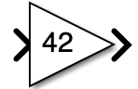
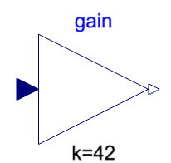
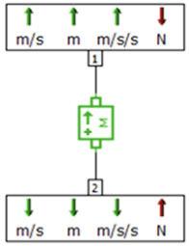
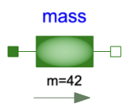
Don’t confuse: causal and block diagram acausal and component-based
👉
👉
Let’s first define the terms, and then explain the table below
Some examples | Causal | Acausal
Block diagram
Component-based

Slide 2
What does causal and acausal mean?
Generally, causality means that there is a relation from cause to effect.
For the scope of mathematical models, a causal model means that, for each equation (also referred to as “assignments” and uses “:=“ instead of “=”), it is defined which variables are the inputs and which are the outputs. Usually, causal models are also sequenced (the order of the equations matters).
At the contrary, an acausal model consists of a set of equations that can still be symbolically manipulated. The order of the equation does not matter. Acausal models shall be squared – contain as many equations as variables to solve.
This can be causal:
y := 2
z := y
z := 2*z
(Result: y = 2, z = 4)
This can be acausal:
y = 5 + x
x = -y - z
z = 3
(Result: x = -4 , y = 1, z = 3)

Slide 3
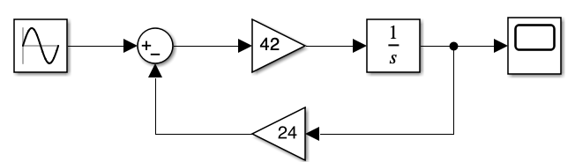
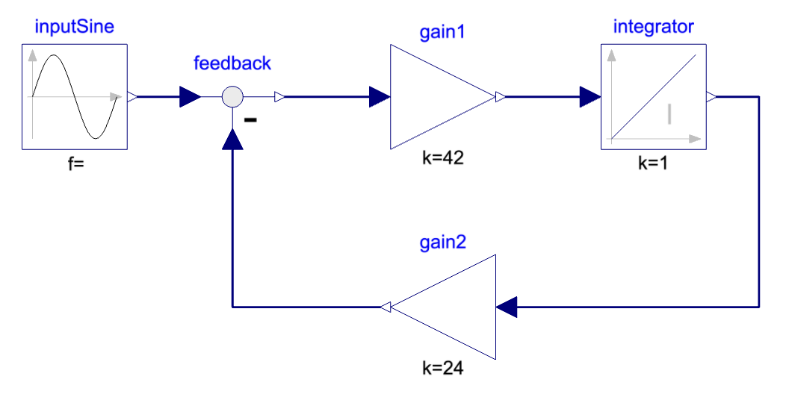
What are block diagrams?
Block diagrams are, as the name indicates… diagrams made of blocks.
For the scope of modeling physical systems, the blocks contain usually mathematical expressions – in pure algebraic form, in s-transform (Laplace) or z-transform.
Above is a block diagram from Simulink and below in Modelica.
Each line carries one variable, and the arrow indicates the flow of information for which the block is defined. This means that the output of the gain is equal to the input times the gain.

Slide 4
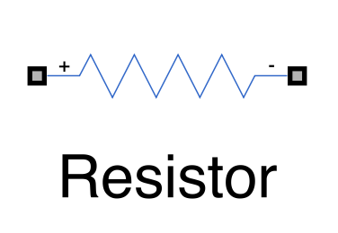
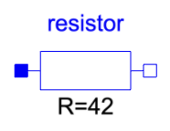
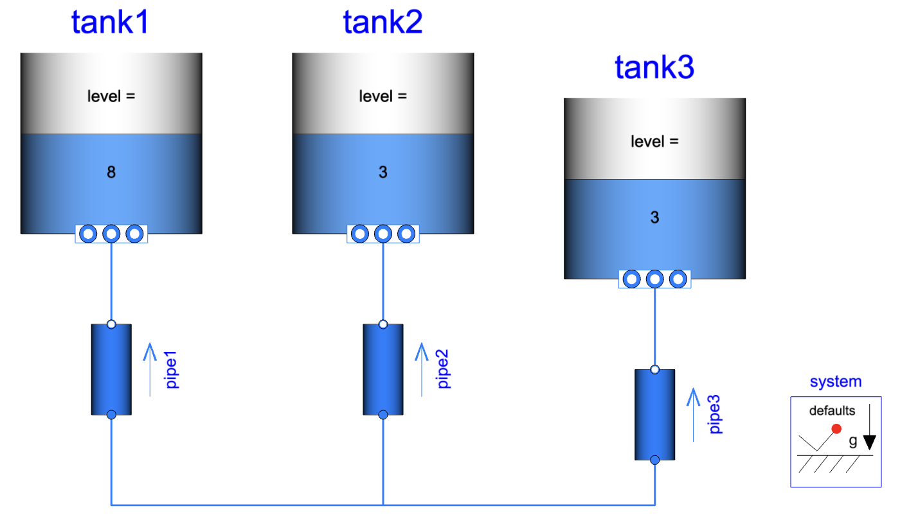
What is component-based modeling?
Component-based modeling refers to having models which interfaces are typically the physical interfaces of the physical component it represents.
Consider a Resistor: its interfaces would be electrical connectors from which current would flow through, and electrical potential would be measured.
From Simscape. From Modelica.
This way, a full system can resemble to its physical assembly of the components it is composed of. Below is a Modelica example of three tanks connected that will reach level equilibrium.

Slide 5
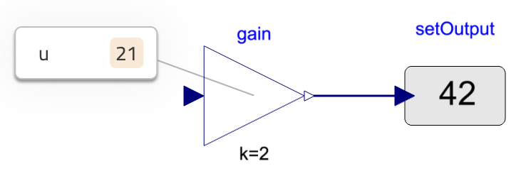
So, aren’t block diagrams always causal?
No. Block diagrams in Modelica are acausal and thus the equations of the blocks they represent can still be symbolically manipulated.
These are two separate concepts.
The example below shows a gain of 2, which output is set to be 42. The result of the simulation is finding the input of the gain for which the equality stands. Here, 21.
However, not all block diagrams are acausal. Simulink is causal and the above would not solve in this environment. There are other advantages though...
For example, fixing the causality ahead allow for a robust solving of the system and structural analysis of the equation system.

Slide 6
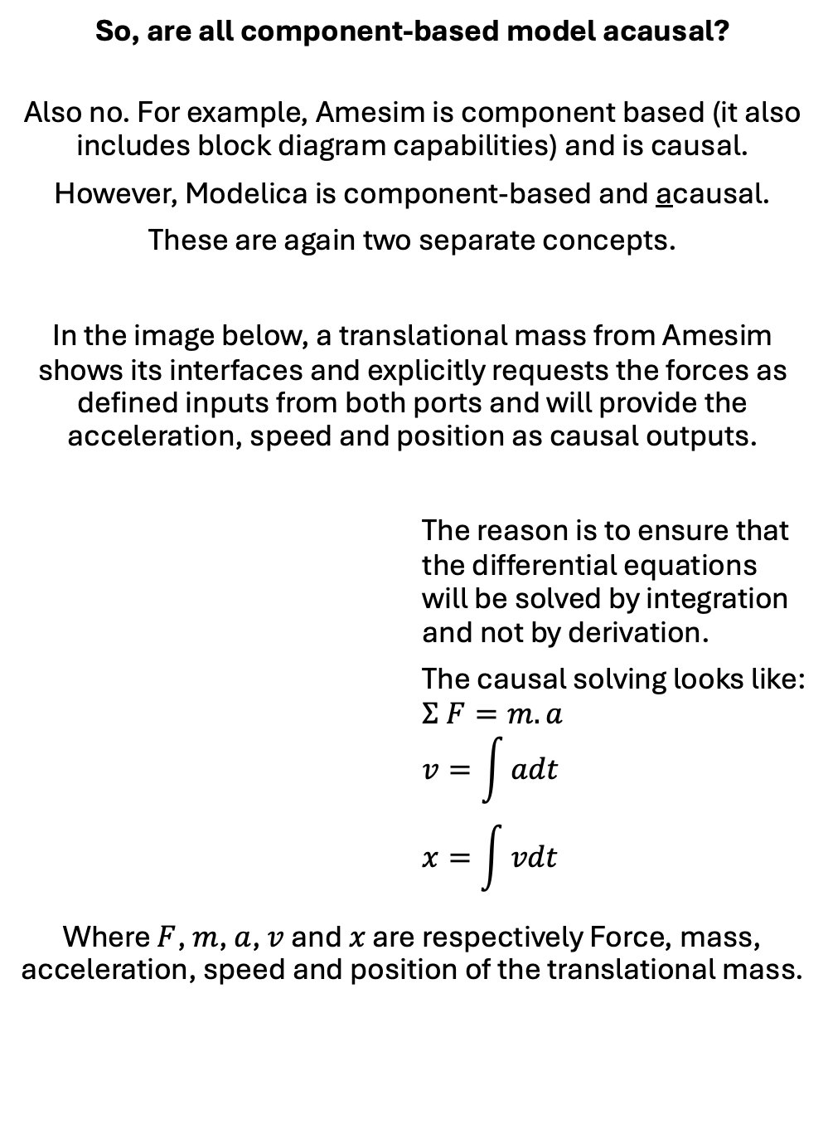
So, are all component-based model acausal?
Also no. For example, Amesim is component based (it also includes block diagram capabilities) and is causal.
However, Modelica is component-based and acausal.
These are again two separate concepts.
In the image below, a translational mass from Amesim shows its interfaces and explicitly requests the forces as defined inputs from both ports and will provide the acceleration, speed and position as causal outputs.
The reason is to ensure that the differential equations will be solved by integration and not by derivation.
The causal solving looks like:
$$Σ F=m.a$$
$$v=\int{adt}$$
$$x=\int{vdt}$$
Where $F$, $m$, $a$, $v$ and $x$ are respectively Force, mass, acceleration, speed and position of the translational mass.

Slide 7
Don’t confuse causal and block diagrams, acausal and component-based modeling.
Hopefully, this explains the initial table and how these terms differ and should not be mixed up.
❓Which of these combinations are you mostly using?
…
Comment if you need any further clarifications or insights.
👇
Some examples | Causal | Acausal
Block diagram
Component-based

